Slide 1

Linux On Azure Preparation Training The Linux File System
Mohd Mishal
Clouds Consultant | MCT

Slide 2
Linux Foundation Certified System Administrator
Essential Commands
User and Group Management
Operations of Running Systems
Networking
Service Configuration
Virtualization
Storage Management
Speaker Information:
https://training.linuxfoundation.org/certification/lfcs
Notes:
20533D
1: Introduction to Microsoft Azure

Slide 3


Session VI Agenda
fstab
Disk Partitioning
LVM
swap
mkfs
Mount Points
mount / umount Review

Slide 4
Linux File System Types
File systems in Linux are used to control how data is stored and retrieved
Common Linux file systems:
Ext4 – 4th Extended FS: Very Large FS sizes, Individual file can be 16TB + Perf
Ext3 – 3rd Extended FS: Large FS sizes, Individual file can be 2TB + Journaling
XFS – Developed by SGI: Individual file can be 8 EiB – Less performance
btrfs – Pronounced “ButterFS”: Many ideals of ext4 & ZFS + Duplication
ReiserFS – Very fast with small files & efficient – Not an active project
Also support for NTFS/FAT32/FAT16
File systems are often chosen depending on the data being stored & access requirements

Slide 5

Linux File System Types
Ext4 is standard for many enterprises
XFS is the default file system for RHEL 7 however can be changed
Both can be used in Logical Volume Management (LVM)
F2FS Created in 2012 – Flash Friendly FS
ext4 Created in 2006
ext3 Created in 1996
XFS Created in 1994

Slide 6
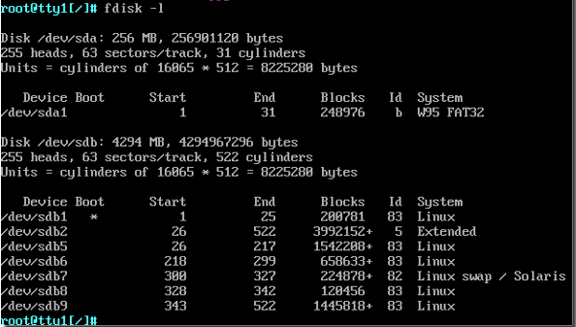
File System Views: fdisk -l
Block Devices
USB Stick ?
Partitions
FS Types

Slide 7
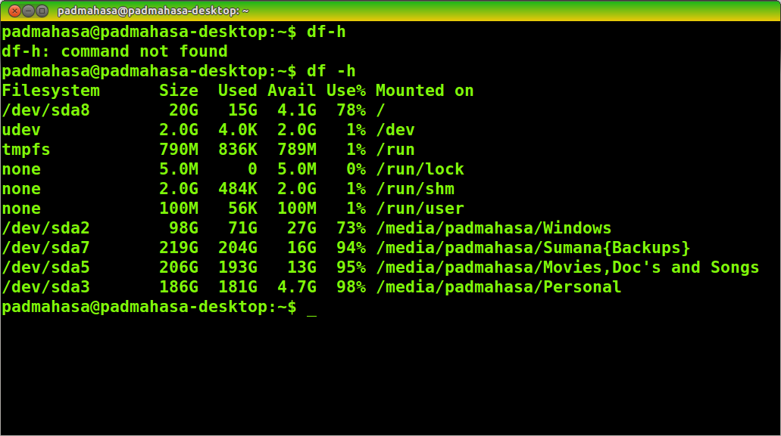
File System Views: df -h

Slide 8
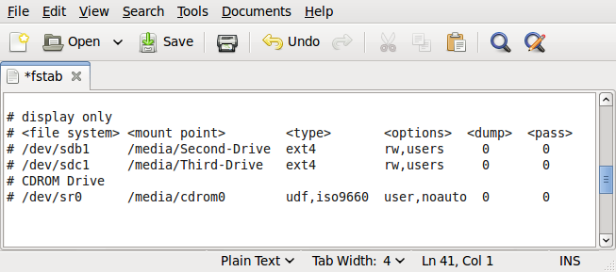
/etc/fstab – Raw Paths

Slide 9
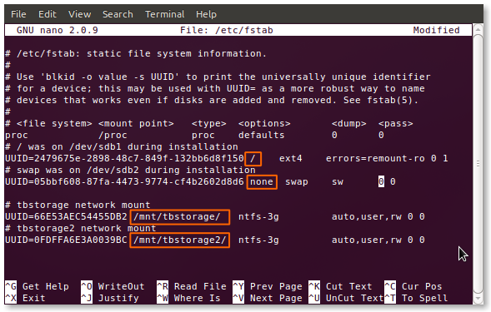
/etc/fstab – UUIDs

Slide 10
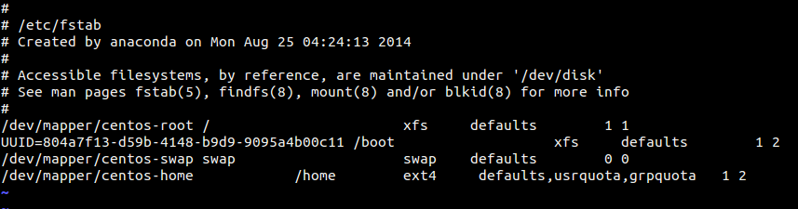
/etc/fstab – LVM Devices
Logical Volume (LV) name
Volume Group (VG) name

Slide 11
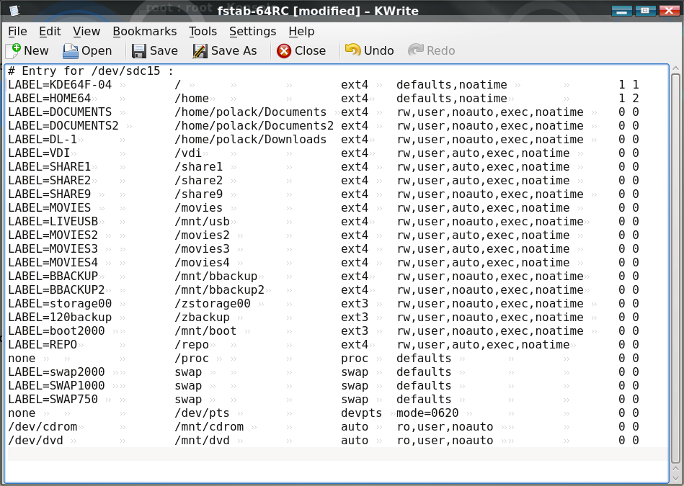
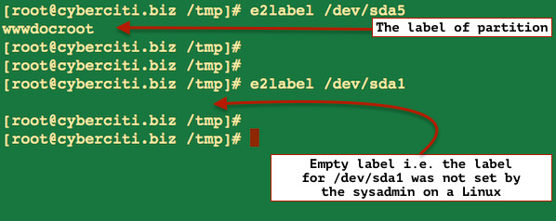
/etc/fstab – Labels

Slide 12
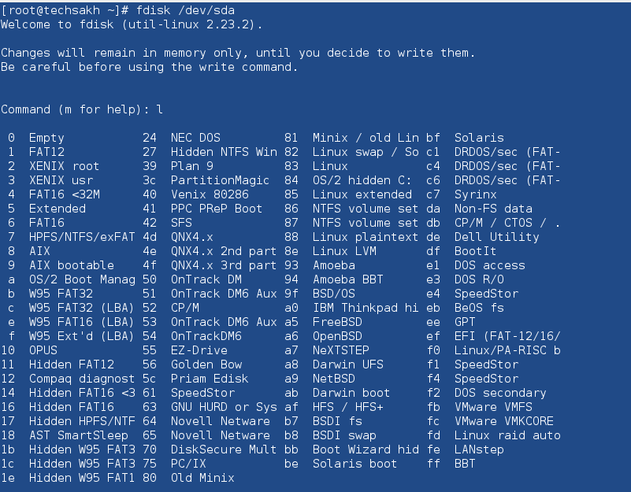
Partitioning Types

Slide 13
Creating Partitions
Use `fdisk` to invoke the partitioning manager; Select the correct raw disk!
Use `p` to print the existing partition table
Use `n` to create a new partition
Select the partition type `p` primary or `e` extended
Select the first sector for the partition – the default value is usually correct
Enter the size of the partition
Use `l` to view the available partition types
Use `t` to change the partitions system id if required (Swap, RAID, LVM)

Slide 14
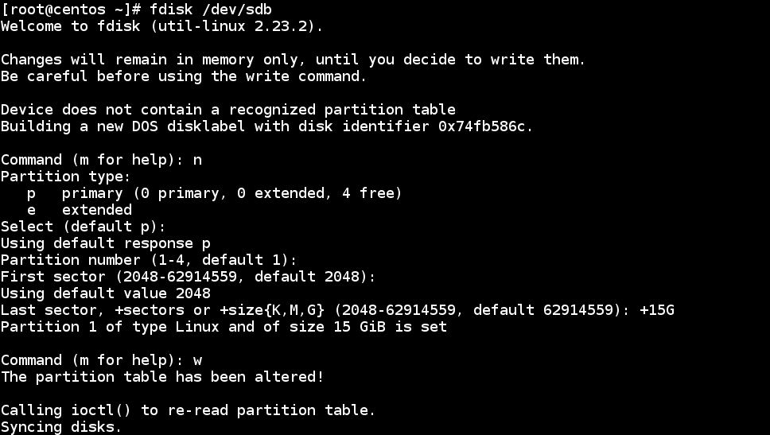
Creating partitions
Use `partprobe` to inform the OS of changes without rebooting!

Slide 15
Traditional Linux File System Layout
/ (root)
/home
/usr
/var/log
/dev/sdb1
/dev/sdb2
/dev/sdb3
/dev/sdb3
Free
0GB
10GB
80GB
10GB
40GB
20GB
40GB
30GB
100GB
/dev/sdb
100GB
How do we increase the size of /usr ?
Can we move space from /home to /usr ?
We forgot to create a /var/tmp partition which can lead to DoS. Now what?

Slide 16
LVM Layout
100GB
20GB
0 GB
100GB
20GB
0 GB
Available Space
In rootvg
File Systems
/ (root)
/home
/usr
/var/log
20GB
100GB
20GB
40GB
50GB
30GB
10GB
Logical
Volumes (LV)
rootlv
homelv
usrlv
varloglv
Volume
Groups (VG)
rootvg
rootvg
Physical
Volumes (PV)
/dev/sdb1
/dev/sdb2
/dev/sdc1
Partitions
/dev/sdb1
/dev/sdb2
/dev/sdc1
Physical Drives
/dev/sdb
100GB
/dev/sdc
100GB

Slide 17
Linux Swap – How much is too much?
Swap is used on a Linux host when the physical RAM is full
General Rules
Amount of RAM in the system Recommended swap space Recommended swap space
if allowing for hibernation
--------------------------- ---------------------------- ---------------------------
2GB of RAM or less 2 times the amount of RAM 3 times the amount of RAM
2GB to 8GB of RAM Equal to the amount of RAM 2 times the amount of RAM
8GB to 64GB of RAM 0.5 times the amount of RAM 1.5 times the amount of RAM
64GB of RAM or more 4GB of swap space No extra space needed
For a 4GB host, Swap should be 4GB
Swap may be dictated by an application vendor!
For a 32GB host, Swap should be 16GB
For a 128GB host, Swap should be 4GB

Slide 18
mount / umount
Allows additional block devices to be mounted to a Linux hosts
Block devices can be mounted natively or provisioned as LVM PVs
You must `mkfs` or “Make a file system” on a block device prior to `mount`
File systems are attached to “mount points” which are empty directories
There are many different types of file systems: ext4, xfs, btrfs, etc
All file systems to be mounted are defined in the file `/etc/fstab`
Can be defined by the path to the block device, label, or UUID
Assign a label to an ext4 FS to allow easy reference in fstab `e2label <device> <label>`
View a file system’s UUID using blkid `blkid` or `blkid -o list`

Slide 19

Live Demonstrations
Please standby as we switch to the live demonstrations which compliment the applications / concepts just taught

