Slide 1

LFCS Preparation Training Session I: The history of Linux & Why do we care: How OSS drives Azure consumption
Stuart R. Kirk, MCSA: Linux On Azure, RHCA
Technology Solutions Professional
Global Black Belt Team – Open Source Azure Incubation

Slide 2

Introduction
This is a new program designed by Linux experts for all Microsoft FTEs
Sessions will be one hour in length, recorded, and will be delivered in a slide + live demonstration format
Recordings will be posted at http://aka.ms/linuxlfcsprep
Instructors will be members of the Open Source GBB team and other Linux experts at Microsoft
The training material of the program will be focused on the areas tested in the LFCS exam
This training program will not guarantee that you pass the LFCS exam; Significant practice and comfort with the concepts taught is required prior to taking the examination

Slide 3
Session I Agenda
Much of the data in this first session will not be tested upon
This session aims to provide the following:
A brief history of Linux
An overview of the training program and LFCS examination
An understanding of core Linux terms which will be used in all sessions
Guidance to set up your personal test environment
Why Open Source is essential to increasing consumption on Azure
The test environment is essential to building upon the skills taught in subsequent sessions of this program
Week 2 and onwards will be highly technical and focus on the competencies which could be tested as part of the LFCS examination

Slide 4
Overview of LFCS Examination
Entirely performance based
Delivered “remotely” through a web browser; Privacy is required
Screen is divided into two columns:
Left Column provides the questions to be asked
Right Column provides the shell window to interact with your virtual machine
No breaks without permission from delivery proctor
No food, drink, other electronic devices present in viewing area which will be shown prior to exam being released
The proctor is unable to help with any technical questions; You’re on your own! You will be recorded! (A/V)

Slide 5


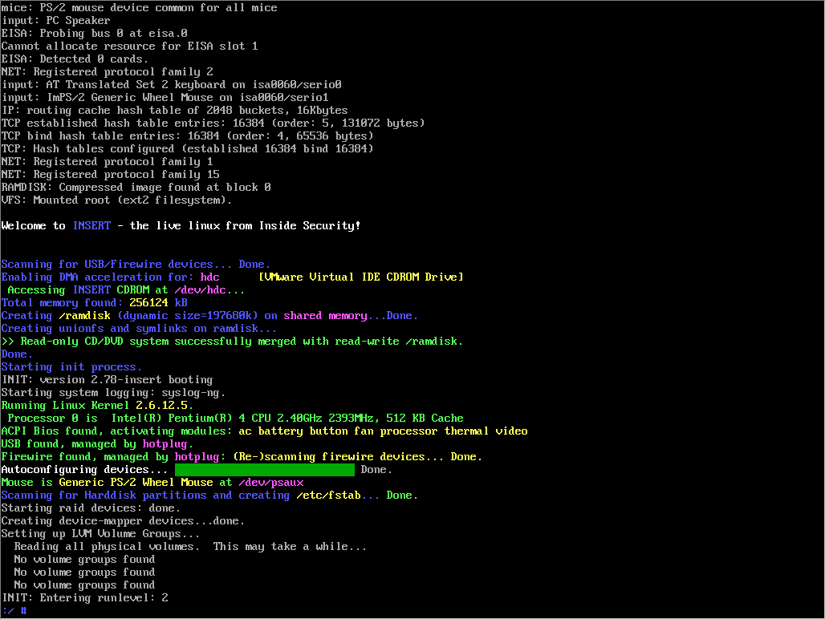
Overview of LFCS Examination
Question 1
Question 2
Question 3
Question 4
Question 5
…

Slide 6







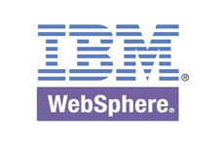
What this course is not…

Slide 7
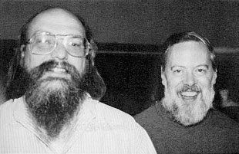

History of UNIX/Linux
UNIX was conceived by Ken Thompson and Dennis Ritchie from AT&T Bell Labs in 1969
Common UNIX derivatives include: SCO, IRIX, Solaris, AIX, HP/UX, BSD
Linux was created by Finnish software engineer Linus Torvalds in 1991
Made from a collection of open source software based on the Linux kernel which Torvalds developed
Linux is driven by community contributions which are merged into upstream “projects” and provided to users. Features are created based on need.

Slide 8
Common OSS/Linux Terms
Kernel – The core of the Linux operating system
Distribution (Distro) – A variant of the Linux operating system
Command-Line/Shell – The terminal window which commands are executed within
Daemon – A running service on a Linux server, httpd would be the web server
X-Windows (or X) – A graphical user interface to interact with & run applications
RPM – A package manager that provides for the install / removal / tracking of software
Fork – When a distribution is duplicated and changed to produce a new distribution
Package – An archive of software; Most apps on a host are installed via packages
GNU – Acronym for GNU’s Not Unix
GPL – The GNU GPL, or General Public License, is a free software license which guarantees end users the freedom to run, study, share and modify software
SSH – Secure Shell – Allows connections to other Linux servers via an encrypted tunnel

Slide 9

Distributions are a lot like Genealogy
Hundreds of distributions
https://en.wikipedia.org/wiki/List_of_Linux_distributions
Linux builds are based on a number of “Major” distributions
Debian (Knoppix, Ubuntu, Android, Linux Mint, Raspbian)
Gentoo (Chromium OS, CoreOS)
Pacman (Arch Linux)
RPM (Red Hat Linux, Red Hat Enterprise Linux, Fedora, Caldera, Oracle Linux)
Slackware (SuSE, Frugalware,
TUX the penguin got his name from “Torvalds’ UniX”

Slide 10
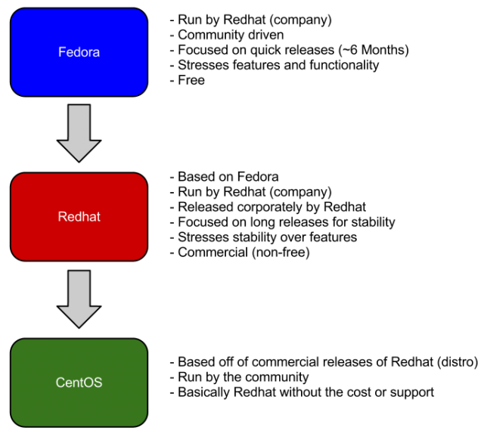
Commercial vs Community
Community projects have very quick release cycles
Typically bleeding edge technology and what will be seen in future commercial releases
Application vendors are unable to create software certified against a community project
Enterprise Linux products have much longer release cycle
Users pay for the support; Not the software

Slide 11
Red Hat Enterprise Linux forks from Fedora (Core)
Release | Codename | Release Date | Based on
Red Hat Linux 6.2E | Zoot | 2000-03-27 | Red Hat Linux 6.2
Red Hat Enterprise Linux 2.1 | Pensacola (AS)/ Panama (ES) | 2002-03-26 (AS) | Red Hat Linux 7.2
Red Hat Enterprise Linux 3 | Taroon | 2003-10-22 | Red Hat Linux 9
Red Hat Enterprise Linux 4 | Nahant | 2005-02-15 | Fedora Core 3
Red Hat Enterprise Linux 5 | Tikanga | 2007-03-14 | Fedora Core 6
Red Hat Enterprise Linux 6 | Santiago | 2010-11-10 | Mix of Fedora 12 Fedora 13 and several modifications
Red Hat Enterprise Linux 7 | Maipo | 2014-06-10 | Primarily Fedora 19 with several changes from 20 and later

Slide 12
What is / isn’t Open Source ?
Open Source
Source code freely available
Contributions can be made to the source code and submitted “upstream”
Distributed under licenses such as LGPL, GNU, MIT, etc.
Many licenses exist with varying degrees of restrictions.
Typically more secure due to community contributions
Closed Source
Source code not available
Software development is at the discretion of the application vendor
Software is copyrighted and licenses prohibit distribution
Software patches typically longer to distribute
Typically more profitable for vendors
https://opensource.org/licenses

Slide 13

What is ‘root’ ?
The ‘root’ user on any Linux system is used for administering the system
Equal to Windows “Administrator” account
Has complete access to the system, user home directories, service control, priorities, software managers, mail, etc.
Due to the “power” present in the “root” account, most Linux system administrators only use it to make necessary changes to a system that require elevated privileges
Administrators will typically create a login for themselves, for example, “bob” and when they require elevated permissions will “substitute user” or “su” to the root account, perform necessary actions, and then resume their original login shell

Slide 14
Pre-Requisites for Training Sessions
An RPM-based Linux virtual machine hosted locally or on Azure
Windows 10
Login to your Azure Account
Install the Azure CLI on RHEL
Install Windows 10 Subsystem for Linux
Create a RHEL VM using the Azure CLI
Login to your Azure Account
Install the Azure CLI in Windows 10 Bash
Login to the RHEL VM using SSH
Shut Down your RHEL VM when finished

Slide 15
Installing the Windows 10 Subsystem for Linux
In Windows 10 enable developer mode
“Cortana” => “developer” => “For Developers Settings” => “Developer Mode”
Enable the Windows Subsystem for Linux
“Control Panel” => “Programs and Features” => “Windows System for Linux”
Reboot host and allow updates to be installed
Run “bash” and type “y” to continue with the installation
Create a Linux Username
Create a Linux Password
Requires Windows 10 Anniversary Edition

Slide 16
Installing the Azure CLI on Windows 10 Bash for Windows
Log in to the Windows Bash Shell
Execute-as-root (or ‘sudo’) to the root account
For new VM installs on Azure, root access is obtained by typing “sudo su - root”
Run the following commands as root:
curl -sL https://deb.nodesource.com/setup_6.x | bash -
apt-get install -y nodejs
npm install -g azure-cli
Verify your configuration:
azure help

Slide 17
Creating a RHEL 7.2 VM using the Azure CLI on Windows 10
azure login
<Perform web authentication>
azure config mode arm
azure account list
If you have an INTERNAL CONSUMPTION subscription, ensure it is being used:
azure account set `azure account list |grep Internal |awk '{print $6}'`
Create and Start the Virtual Machine
azure group create LinuxLFCSPrep eastus
azure vm quick-create LinuxLFCSPrep RHELDemo eastus Linux RedHat:RHEL:7.2:latest USERNAME

Slide 18
Output from Red Hat Enterprise Linux VM Creation
data: Id :/subscriptions/xxx/resourceGroups/LinuxLFCSPrep/providers/Microsoft.Compute/virtualMachines/RHELDemo
data: ProvisioningState :Succeeded
data: Name :RHELDemo
data: Location :eastus
data: Type :Microsoft.Compute/virtualMachines
data:
data: Hardware Profile:
data: Size :Standard_DS1
data:
data: Storage Profile:
data: Image reference:
data: Publisher :RedHat
data: Offer :RHEL
data: Sku :7.2
data: Version :latest
data:
data: OS Disk:
data: OSType :Linux
data: Name :cli6b3eb77479b8e220-os-1475607484221
data: Caching :ReadWrite
data: CreateOption :FromImage
data: Vhd:
data: Uri :https://cli477491758479540136.blob.core.windows.net/vhds/cli6b3eb77479b8e220-os-1475607484221.vhd
data:
data: OS Profile:
data: Computer Name :RHELDemo
data: User Name :stuart
data: Linux Configuration:

Slide 19
Output from Red Hat Enterprise Linux VM Creation
data: Disable Password Auth :false
data:
data: Network Profile:
data: Network Interfaces:
data: Network Interface #1:
data: Primary :true
data: MAC Address :00-0D-3A-14-83-01
data: Provisioning State :Succeeded
data: Name :rheld-eastu-477491758-nic
data: Location :eastus
data: Public IP address :40.76.7.188
data: FQDN :rheld-eastu-477491758-pip.eastus.cloudapp.azure.com
data:
data: Diagnostics Profile:
data: BootDiagnostics Enabled :true
data: BootDiagnostics StorageUri :https://clisto2186702910rheldemo.blob.core.windows.net/
data:
data: Diagnostics Instance View:
info: vm quick-create command OK

Slide 20
Installing the Azure CLI on Red Hat Enterprise Linux
SSH connect to your RHEL VM from the Windows 10 bash shell
ssh USERNAME@publicIP
Accept the initial SSH key exchange warning
Enter the password you used when you created the VM
Substitute user (or ‘su’) to the root account
For new VM installs on Azure, root access is obtained by typing “sudo su - root” & entering the password you used when you created the VM
Run the following commands as root:
yum install -y gcc-c++ make
curl --silent --location https://rpm.nodesource.com/setup_4.x | bash -
yum install -y nodejs
npm install -g azure-cli
Verify your configuration:
azure help

Slide 21
Shut down your RHEL VM when it isn’t in use!
The RHEL virtual machine created makes use of the RHEL Pay-As-You-Go VM image in the Azure Marketplace. In order to avoid large consumption charges, shut it down when it is not in use.
To stop the Azure RHEL VM from the Windows 10 bash shell:
azure vm stop LinuxLFCSPrep RHELDemo
azure vm deallocate LinuxLFCSPrep RHELDemo (You will lose your public IP address!)
To start the Azure RHEL VM from the Windows 10 bash shell:
azure vm start LinuxLFCSPrep RHELDemo
azure vm list-ip-address (Because deallocating the VM removed the public IP, this will determine the new IP)
To delete the Azure RHEL VM from the Windows 10 bash shell:
azure vm delete LinuxLFCSPrep RHELDemo
azure group delete LinuxLFCSPrep

Slide 22
Final Thoughts
There are many ways to perform tasks in Linux
The LFCS exam, and most performance based exams, measure the ability to configure the Linux host as required
The exam does not measure *how* to get to your end result
Very binary – Is the task completed / Does the service work, or not?
Never hard code; Variables are your friend

Slide 23
Homework Assignment
Install the Windows 10 Subsystem for Linux
Install the Azure CLI tools in the “bash” shell
Verify access to your Azure account
Create a Red Hat / Fedora / CentOS Virtual machine in Azure
Install the Azure CLI tools on the Azure VM
Review topics to be covered next week

