Slide 1
CS 542 – Computer Networks – I Final Project
Submitted by:
Guru Prasad Natarajan
A20344932
Section -03

Slide 2
Overview
Link State Routing – An Introduction
Screenshots of workflow
Alternate flow screenshots
Enhancements for Extra Credit
Conclusion

Slide 3
Link State routing – An introduction
Link state routing is a complex routing technique in which each router shares information with other routers about the reachability of other networks and the metric to reach the other networks in order to determine the best path.
The metric is based on number of hops, link speeds, traffic congestion and other factors as determined by the network designers. A hop is the trip that a packet takes from one router to another as it traverses a network on the way to its destination.

Slide 4
LSR - Continued
In link state routing, every router on the network receives a map of the connectivity of the network in the form of a graph showing which nodes (i.e., routers, switches, computers and other network devices) are connected to which other nodes.
Each router then independently calculates the best next hop for every possible destination in the network using only its local copy of the map and without communicating with any other node. The collection of best next hops forms the routing table for the router.
Link state routers use Dijkstra's algorithm to calculate the lowest cost paths, and normally update other routers with which they are connected only when their own routing tables change.

Slide 5
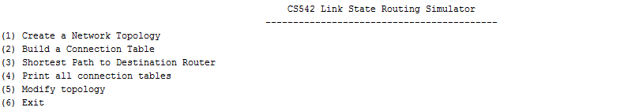
Screenshots of workflow
-Main Menu Displaying all the available options to the user.
Executing Instructions:
Use the following command to run the program.
python LSRSimulator.py

Slide 6
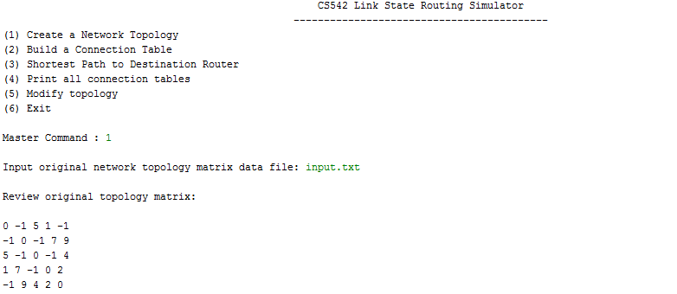
Input File to print topology data
When the user selects ‘1’ as the option. The program would prompt the user to supply the input file.
If the file is valid, topology data is displays as above and displays the menu to the user to make his/her next option.

Slide 7
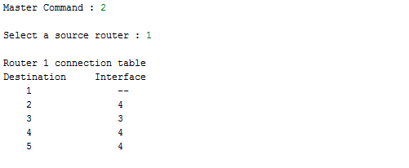
Build connection table
When the user selects option ‘2’, program would prompt the user to supply source router.
Connection table is built if the router is valid and displays the menu items to the user.

Slide 8
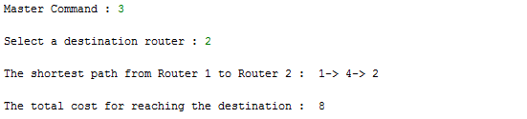
Shortest distance calculation
Option ‘3’ prompts the user for the destination router. If the destination router is valid, it provides the shortest distance between the supplied source and the destination and the path to reach it.
Menu is automatically shown to the user to proceed with the next steps.

Slide 9
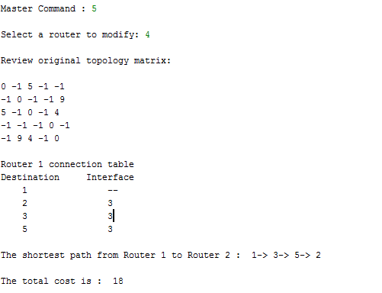
Modify topology
-This option is used to remove a node from the network.
-A new connection table and shortest path is established skipping the removed node.

Slide 10

Exiting the program
- When the user selects option ‘4’, the program is terminated.

Slide 11

Alternate workflow - screenshots
-Error Handling: If the user does not provide or provides invalid input file to create topology, error message will be prompted.

Slide 12
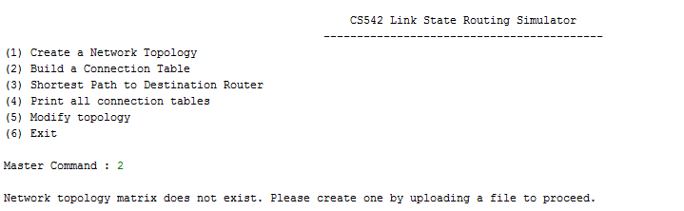
Alternate workflow - continued
-If the user selects option ‘2’ before option ‘1’ (i.e.,) even before the topology matrix could be created

Slide 13
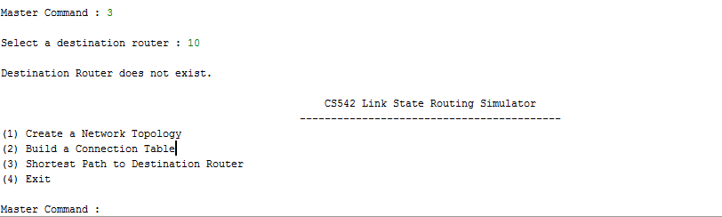
Alternate workflow - continued
-If the user enters a number more than the number of existing routers, an error message is thrown back.

Slide 14
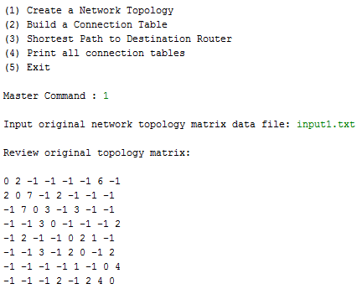
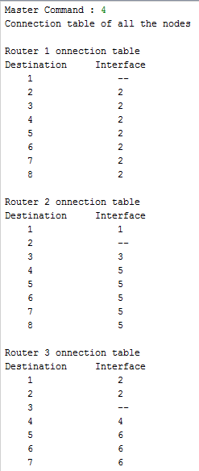
Enhancements for extra credit
-Enhancement 2 : Minimum initial number of nodes = 8.
-Enhancement 3: Create a connection table of each node as default and display all.

Slide 15
Conclusion
From the experiments, the implemented Link State Routing Simulator worked well with the supplied input, finding the shortest distance between the given source and the destination.
The simulator would work well with any number of routers in an [n x n] matrix form.
All the error scenarios are handled properly with appropriate error messages to guide the user.

