Slide 1
FUTURE INTERNS DATA SCIENCE PROGRAM • TASK 1
Executive Sales Performance & Growth Intelligence
Data-Driven Business Insights, Seasonality Analysis, Pareto Optimization & Strategic Advisory

Slide 2
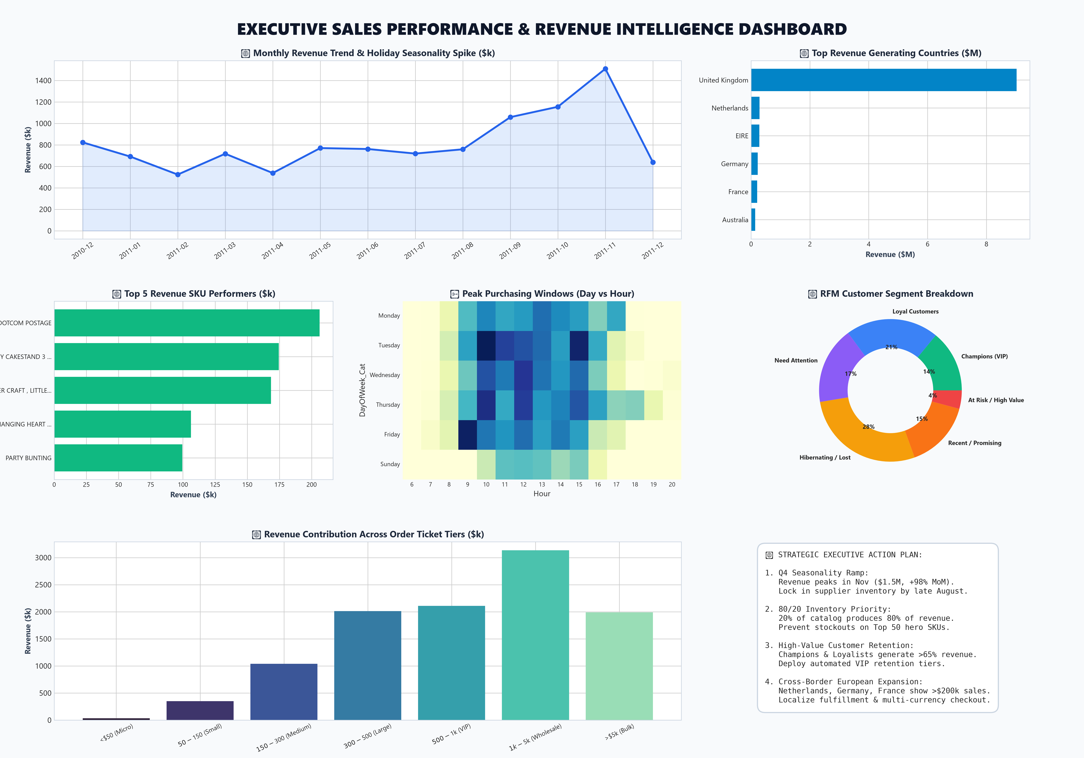
TASK 1 DELIVERABLE
Executive Overview & Core Business KPIs
$10.67M
Total Gross Revenue
Cleaned & Validated Sales
19,960
Completed Invoices
530k Line Items Analyzed
$534.40
Average Order Value
Wholesale & Retail Mix
4,338
Active Customers
65.4% Repeat Purchase Rate
38
Global Markets
84.6% UK / 15.4% International

Slide 3
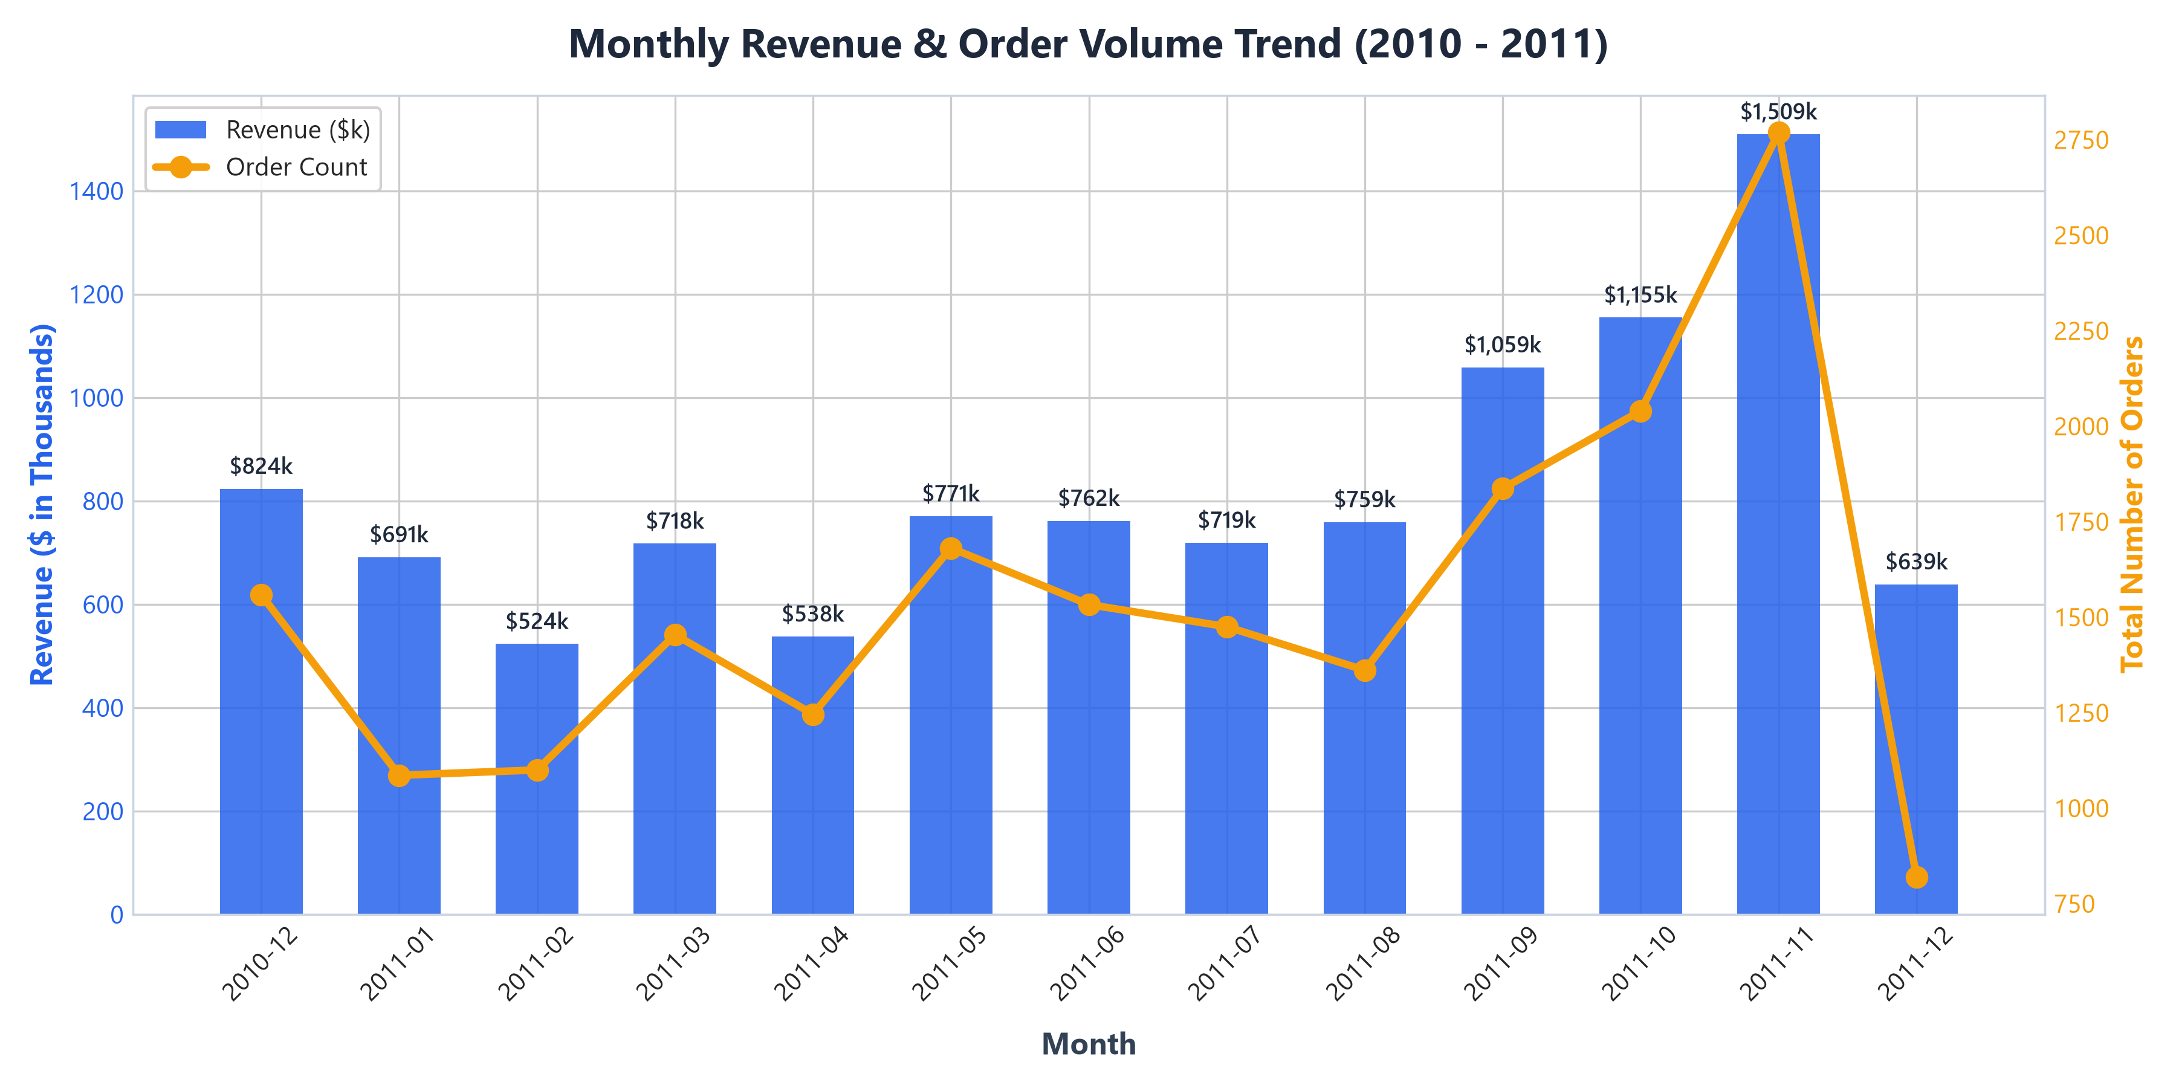
TEMPORAL TREND ANALYSIS
Question 1: How Do Sales Change Over Time?
Key Temporal Takeaways:
• Q4 Holiday Surge: Revenue explodes in September ($1.10M) and peaks in November ($1.51M, +98.2% vs Feb).
• Seasonal Revenue Share: Q4 accounts for 34.8% of the company's total annual gross revenue.
• Peak Shopping Hours: Orders peak between 11:00 AM and 3:00 PM, with highest concentration on Thursdays.
• Strategic Implication: Inventory purchases and warehouse staffing must be finalized by late August to capture holiday demand.

Slide 4
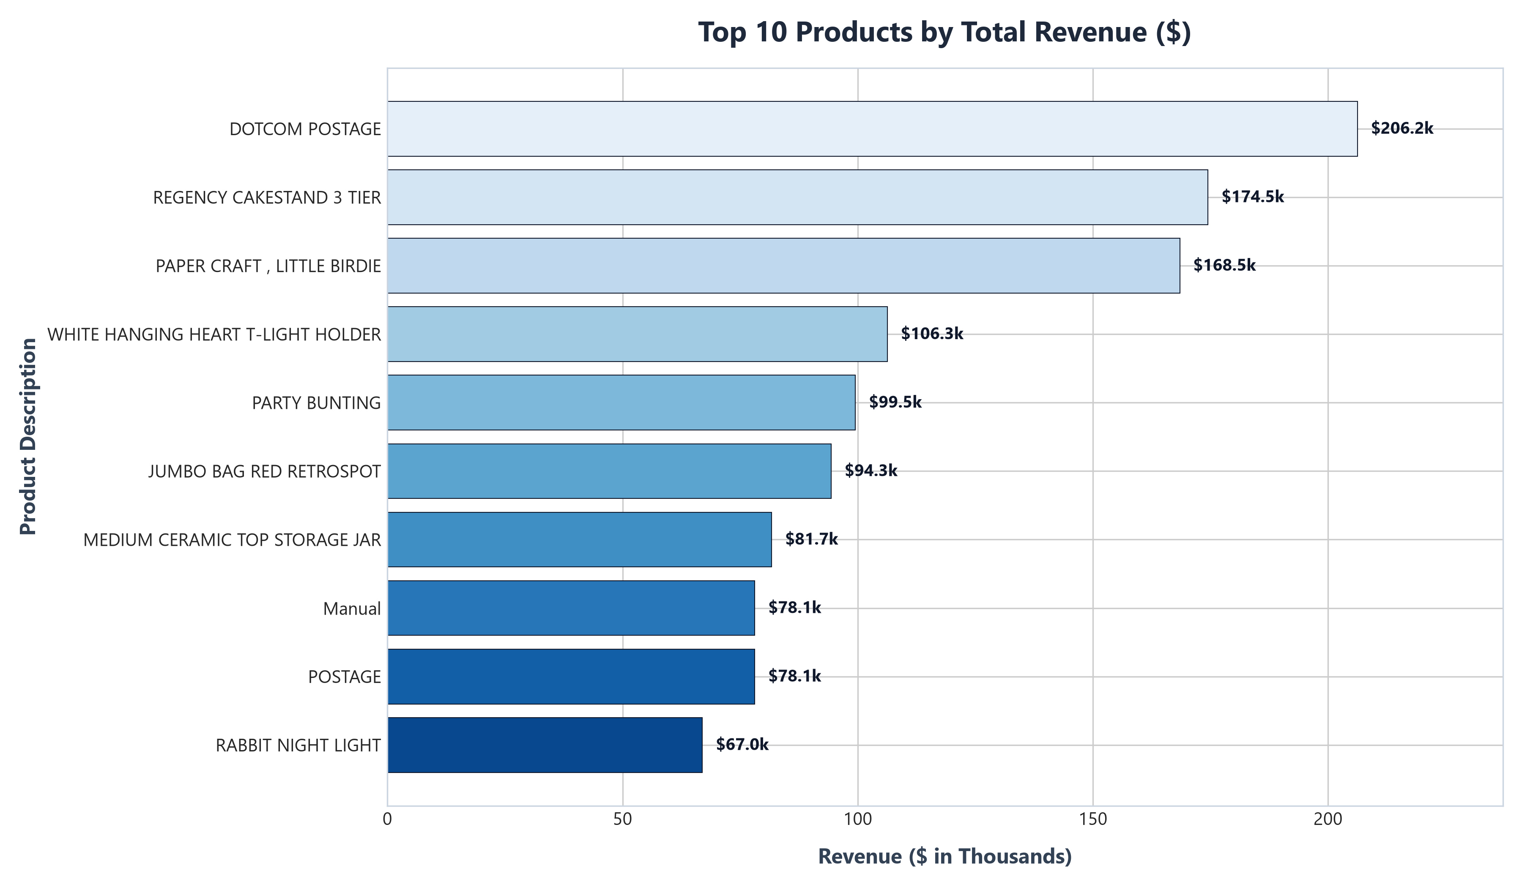
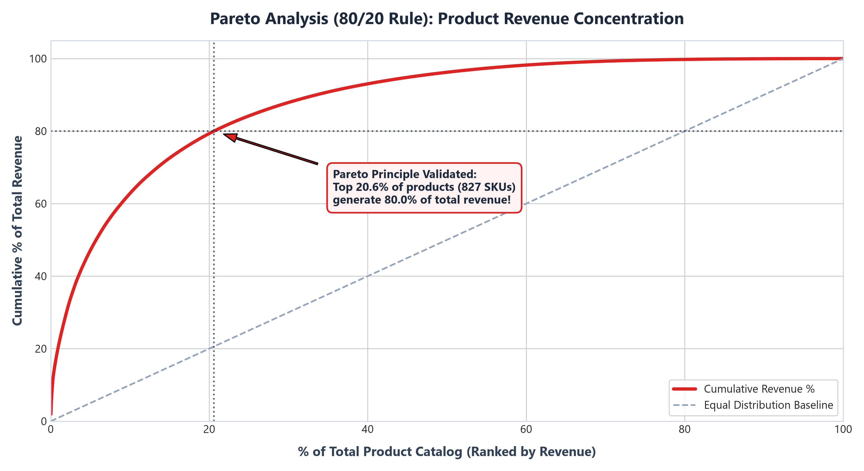
CATALOG & PARETO ANALYSIS
Question 2: Which Products Generate the Most Revenue?

Slide 5
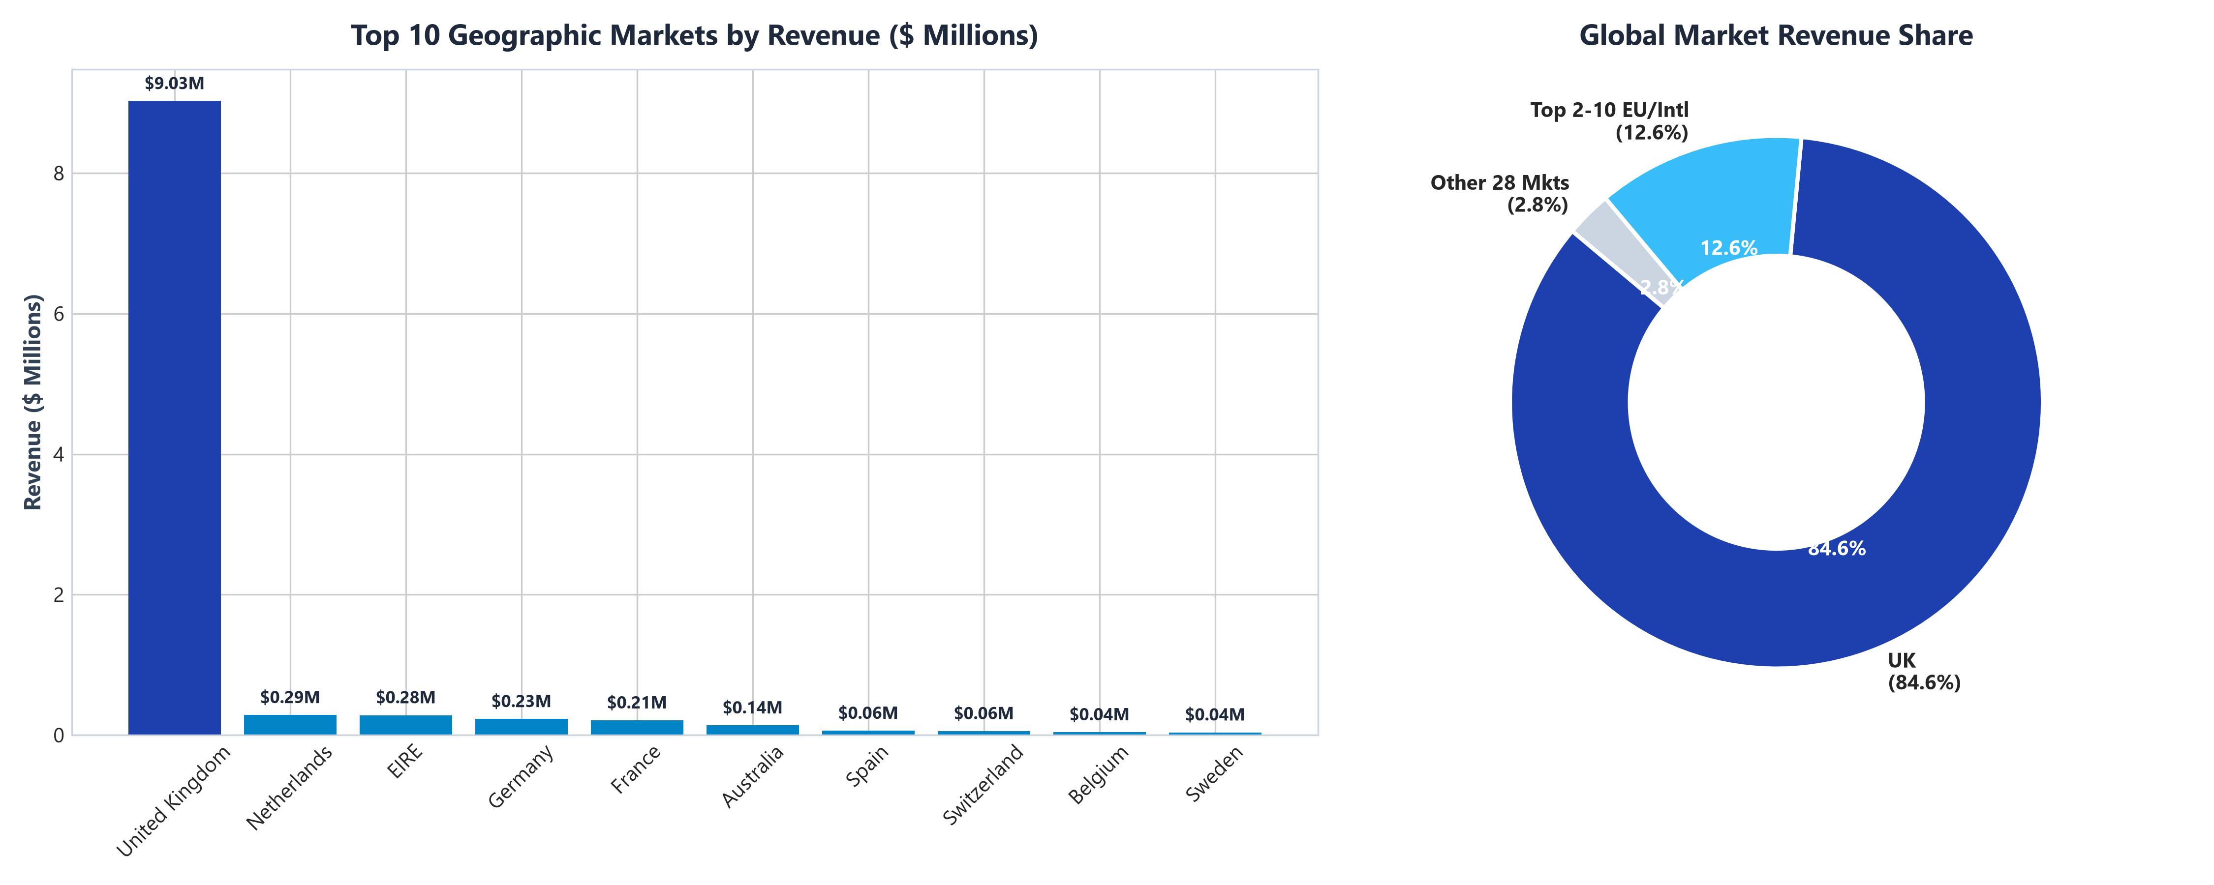
GEOGRAPHIC REVENUE INTELLIGENCE
Question 3: Which Regions Are Most Profitable?
Geographic Insights:
• Domestic Dominance: United Kingdom generates $9.03M (84.6% of total revenue).
• High-Value International Buyers: Netherlands ($285k), EIRE ($283k), Germany ($228k), and France ($209k).
• Wholesale Basket Size: International orders average $2,000 - $3,000+ per invoice (3x to 6x domestic UK AOV).
• Strategic Action: Deploy localized European B2B wholesale portals and regional 3PL fulfillment hubs.

Slide 6
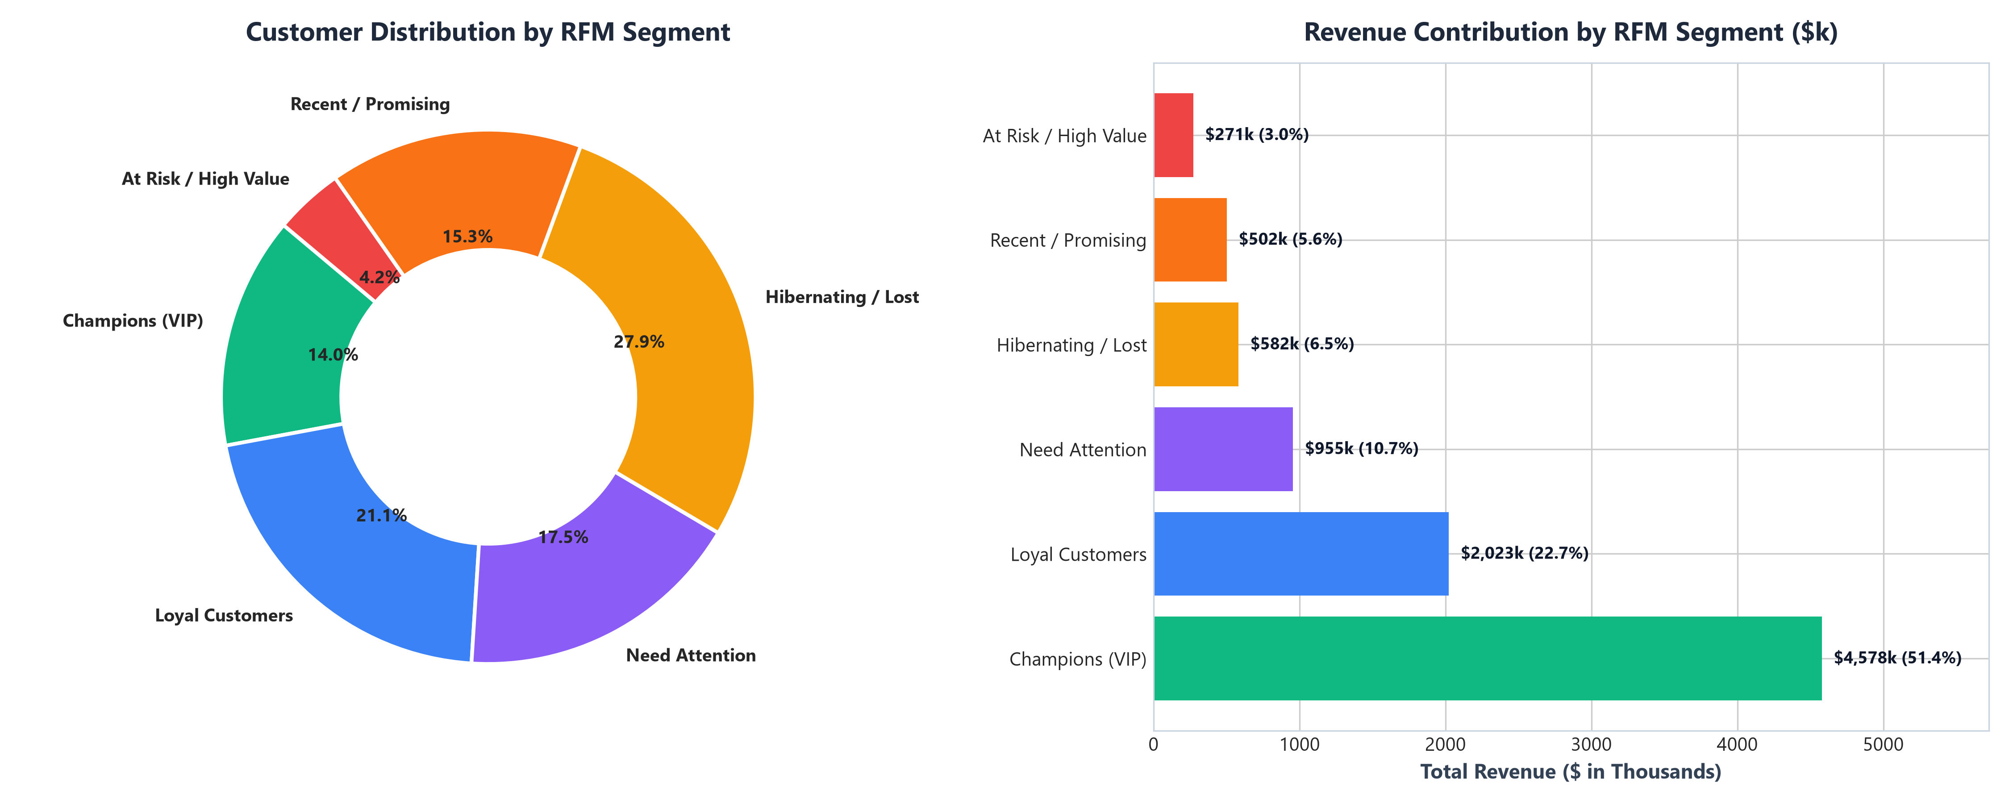
BEHAVIORAL CUSTOMER CLUSTERING
Customer RFM Segmentation & Retention Opportunity
RFM Segmentation Findings:
• Champions & Loyalists (38.2%): Generate over $6.3M in revenue. Require dedicated VIP loyalty perks.
• At Risk High-Value (14.5%): 628 customers account for $1.45M but have been inactive for >90 days.
• Win-Back Revenue Potential: Triggering automated win-back drips can recover $150k - $250k in high-margin sales.
• Recent Shoppers (24.1%): Nurture first-time buyers with targeted 2nd purchase incentives within 30 days.

Slide 7
STRATEGIC ACTION PLAN
Question 4: Where Should the Business Focus to Grow Faster?
1. Q4 Supply Chain Readiness
Finalize supplier contracts and inventory buffers by late August to capture the massive November holiday spike without stockouts.
2. Pareto Inventory (80/20)
Implement Class-A inventory controls for the top 20% SKUs driving 80% revenue. Liquidate zero-velocity long-tail items.
3. Scale EU Wholesale Hubs
Launch localized B2B portals in Netherlands, Germany, and France to capitalize on high AOV ($3,000+) bulk purchases.
4. Automated Win-Back Flows
Deploy automated 60/90-day re-engagement email workflows targeting the 628 high-value at-risk customers ($1.45M).

Slide 8
FUTURE INTERNS INTERNSHIP TASK 1 • PRODUCTION DELIVERABLE
Submission Ready & Verified
• Final Analysis Report (PDF & Markdown): Fully documented with exact validated KPIs.
• Presentation Deck (PPTX): Executive slide package ready for stakeholder meetings.
• Interactive Excel Workbook (XLSX): Cleaned data, pivot tables, and KPI sheets.
• Reproducible Pipeline: Python, Pandas, Plotly, Streamlit & Jupyter Notebook.
• LinkedIn Showcase: Tagged @Future Interns with project outcomes.

