Slide 1



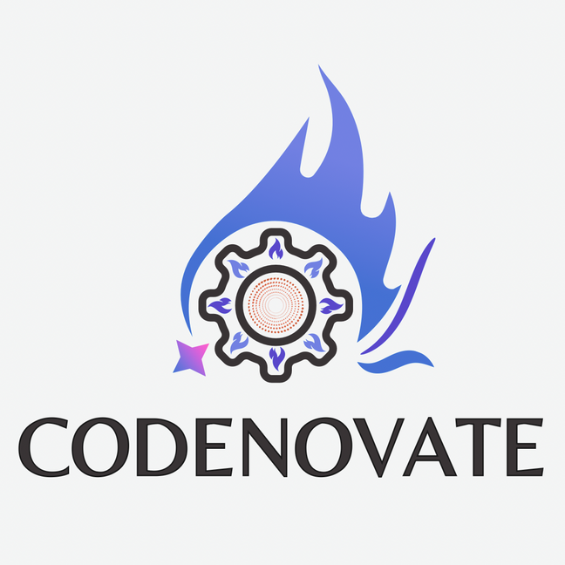

Document Chat System for DGFT
Prometheans
Smart Priority-based Document RAG system

Slide 2
Idea & Approach Details
Our system offers a document chat application that:
Extracts and processes mixed-content PDFs using OCR and text extraction tools
Uses LlamaIndex with Gemini embeddings for semantic indexing
Stores vectorized document data in a Neo4j vector database for fast and accurate retrieval
Provides an interactive chat interface using Streamlit for querying and exploring document content

Slide 3
Tech Stack & Flow Chart
Tech Stack
Python (PyPDF2, PyMuPDF, Tesseract, Streamlit)
LlamaIndex for document indexing and querying
Gemini for embeddings and LLM
Neo4j for vector storage
Input PDFs (uploaded or linked)
Extract text and images (OCR)
Query using a chatbot interface!
Generate embeddings and index data

Slide 4
Innovation / Market Feasibility
Innovation
Combines text and OCR-based image processing for comprehensive document analysis
Leverages state-of-the-art embeddings for precise document understanding
Market Feasibility
Useful for industries handling compliance documents, legal cases, research papers, and more
Enhances productivity by reducing manual document review time

Slide 5
Future Scope
Support for additional file formats (e.g., Excel, Word)
Integration with cloud storage platforms for seamless document access
Advanced query understanding using generative AI models
Real-time collaboration features for multi-user access

Slide 6
THANK YOU

