Slide 1



SHRI GURU GOBIND SINGHJI INSTITUTE OF ENGINEERING AND TECHNOLOGY,VISHNUPURI, NANDED-431606, [M.S], INDIA.
INDUCTION PROGRAM:2026-27
Role of Dean IL & TPO
By
Dr. S. B. Mundhe

Slide 2



HISTORY
  Established in 1981 by Government of Maharashtra
  An autonomous institute affiliated to Swami Ramanand Teerth Marathwada University (SRTMU), Nanded
  Approved by AICTE and recognized by UGC
  Offers UG, PG, and Ph.D. programs in Engineering, Technology, and Sciences
  Known for its focus on quality education, research, and innovation
  Campus spread over 46 acres with modern infrastructure and facilities
  Motto: (Service to society through education, research, and development)

Slide 3

About SGGS
Shri Guru Gobind Singhji Institute of Engineering and Technology (SGGSIET), established in 1981 in Nanded, is recognized as a prominent institution in technical education, research, and technology transfer. From the beginning, the institute has focused on student-cantered learning and is dedicated to achieving academic excellence. The campus covers 46 acres and is characterized by its cleanliness and greenery. It receives 100% grant-in-aid from the Government of Maharashtra.

Slide 4
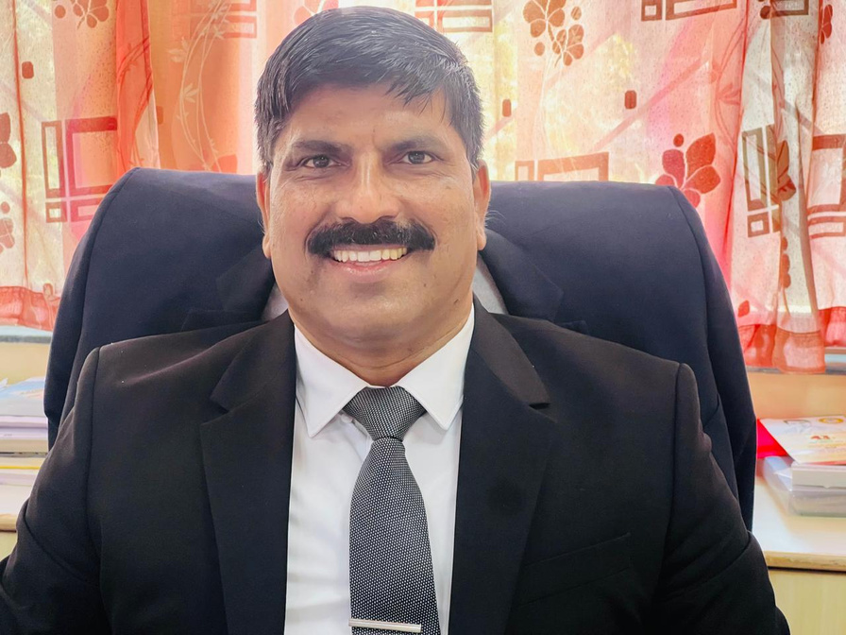
Director
At our SGGSIE&T, we strive to provide an exceptional experience that nurtures your intellectual growth, hones your technical skills, and fosters your personal development. Our accomplished many faculty members, who earned Ph.D. from IITs. All faculty members are renowned experts in their respective fields, and they are committed to imparting their knowledge and expertise to guide you toward excellence.

Slide 5
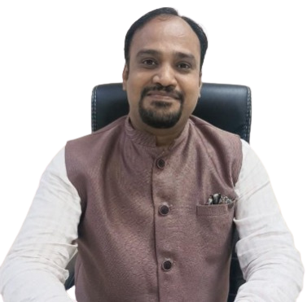
Dean(Industry Liaison & In-Charge, TPO)
The Training and Placement Cell at SGGSIE&T serves as a bridge between industry and academia, facilitating meaningful interactions between recruiters and students.
We focus on enhancing employability through technical training, aptitude development, communication skill enhancement, coding practice, industry interactions, internships, and career guidance initiatives. Our students are encouraged to participate in projects, research activities, hackathons, technical competitions, and innovation-driven programs.

Slide 6
Overview
Starting your engineering journey can feel overwhelming, with new subjects, professors, and expectations. But maintaining professionalism from the very first year sets the foundation for long-term success. Being punctual, disciplined, and respectful in every interaction—whether with faculty, peers, or industry professionals—builds a reputation that stays with you throughout your career. Professionalism isn’t just about formal behavior; it’s about commitment, responsibility, and consistency in your actions. By cultivating these habits early, you not only gain the trust and respect of others but also prepare yourself to confidently face opportunities, internships, and placements in the future. Remember, the seeds of discipline and professionalism you plant today will grow into the confidence and credibility that define your professional journey.

Slide 7


DEPARTMENTS
INFORMATION TECHNOLOGY
01
PRODUCTION ENGINEERING
COMPUTER SCIENCE ENGINEERING
MECHANICAL ENGINEERING
INSTRUMENTATION ENGINEERING
ELECTRONICS & TELECOMMUNICATION
TEXTILE ENGINEERING
CHEMICAL ENGINEERING
06
CIVIL ENGINEERING
ELECTRICAL ENGINEERING

Slide 8
TRAINING & PLACEMENT CELL
Role & Importance of Training & Placement (T&P) Cell:
Bridge between College & Industry
  Connects students with top companies for placements & internships.
Career Development Support
  Organizes aptitude, technical, and communication skill training.
  Conducts mock interviews and group discussions.
Opportunities & Exposure
  Arranges workshops, industrial visits, expert lectures.
  Provides internship and job opportunities.
Overall Mission
  Make students industry-ready, confident, and employable from the start of their journey.

Slide 9
TRAINING & PLACEMENT CELL
Our Placement Achievements (2021–2025)
2500+ Job Offers in the last 5 years
Average Package Growth:
  2021 → ₹4.0 LPA
  2025 → ₹5.0 LPA
  2026 → ₹5.12 LPA
Highest Package Achieved: ₹61 LPA (2026)
Companies Visiting: 100+ every year
Students Placed: Consistently 350+ every year (568+ offers in 2026)
Top Recruiters:
  Emerson, TATA Motors,, TCS, Wipro, Thyssenkrupp, Mahindra & Mahindra, L&T, IBM, Reliance, Algoquant, Zoho and many more leading MNCs.
Placement Trend: Strong and consistent upward growth
“Our students are excelling in top global companies with excellent packages, proving the strength of our academic and placement ecosystem.”

Slide 10
TRAINING & PLACEMENT CELL
Placement Policy
Every student is allowed one placement opportunity.
Once placed, a student may participate in another company’s recruitment process only if the new company offers a package at least twice the package of the previous placement.
Internship + PPO: PPO will be considered as placement.
Internship + Placement: Students may avail one internship and one placement opportunity.

Slide 11
TRAINING & PLACEMENT CELL
Placement Preparation Roadmap (Year-wise)
First Year:
  Focus on strong fundamentals (C, Python, Mathematics, Core Subjects).
  Improve English & communication skills.
  Develop discipline, consistency, and good academic habits.
Second Year:
  Build technical skills through projects & coding practice.
  Participate in hackathons, workshops, and online courses.
  Explore domains like Web, AI, Data Science, or Cloud.
Third Year:
  Resume building & LinkedIn/GitHub profiles.
  Apply for internships & participate in mock interviews.
  Strengthen aptitude and core technical subjects.
Fourth Year:
  Company-specific training & interview preparation.
  Placement drives & final internships.
  Confidence, time management, and adaptability.

Slide 12
TRAINING & PLACEMENT CELL
Dos, Don’ts & Final Message
Dos (From First Year):
Maintain good CGPA (companies set eligibility criteria).
Start coding and logical problem-solving early.
Improve communication & presentation skills.
Join clubs, societies, and competitions to gain exposure.
Build your digital presence (LinkedIn, GitHub).
Be punctual, disciplined, and professional in attitude.
Don’ts:
Don’t neglect academics thinking “placements are far away.”
Don’t copy assignments—learn concepts instead.
Don’t waste excessive time on social media/gaming.
Don’t postpone preparation until the final year.
Don’t fear failure—learn, adapt, and grow.

Slide 14
Student Technical Clubs Boosting Placement Readiness

Slide 15
Placement Value of Clubs
Technical Skills: Coding, robotics, cybersecurity → directly useful in aptitude & technical rounds.
Soft Skills: Teamwork, communication, leadership from seminars & projects.
Industry Exposure: Real-world problem solving & hackathon experience.
Recruiter Preference: Students with club involvement stand out due to practical learning & initiative.

Slide 16
RNxG
Provides hands-on experience in robotics, electronics, design & programming.
Encourages interdisciplinary collaboration, similar to real industry projects.
Builds problem-solving ability by applying technology to real-world challenges.
Helps students gain project experience valued by recruiters.

Slide 17
HACKIT
Strengthens programming & software development skills.
Exposure to hackathons, coding competitions & seminars → improves logical thinking & coding speed (key in placement tests).
Enhances team collaboration & working on live projects.
Provides networking with other programmers → peer learning & interview preparation.

Slide 18
ANNTRIX
Analytical Skills – Problem-solving, logical reasoning, and data analysis.
Teamwork – Collaboration and communication through projects & outreach.
Innovation – Curiosity-driven, creative thinking for new ideas.
Communication – Ability to present complex concepts clearly.
Industry Relevance – Links to aerospace, data science, R&D, and tech fields

Slide 19
THANK
YOU

