Slide 1
Linear Regression

Slide 2
CONTENTS
Introduction to Linear Regression | What is Linear Regression, examples, kinds of LR
Loss function | basic mathematical background of LR
Lab | Ndarray, reshape, dot product, concatenate, split, useful methods
For more info: SLIDESGO | SLIDESGO SCHOOL | FAQs
You can visit our sister projects: FREEPIK | FLATICON | STORYSET | WEPIK | VIDEVO

Slide 3
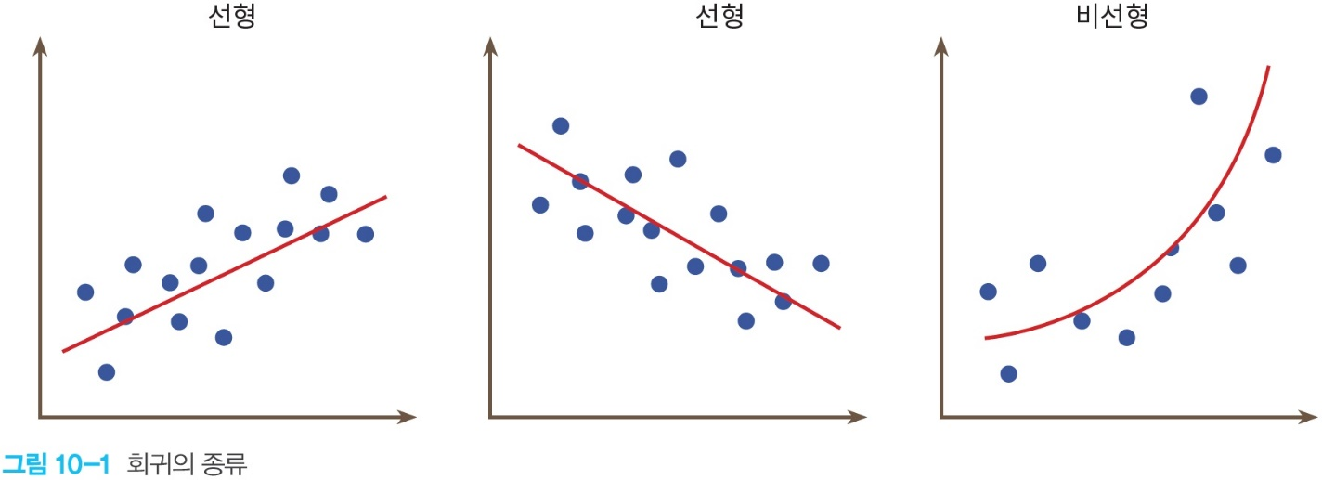
Introduction to Linear Regression
What is Linear Regression?
Regression is finding a linear or a curve which represent the tendency of data.
Therefore, Linear Regression(LR) is finding a linear which represents the tendency of data.
 | sleep hours | score
A | 7 | 84
B | 6 | 80
C | 8 | 82
…………

Slide 4
Introduction to Linear Regression
Examples where Linear Regression can be used:
relationship between height and weight.
relationship among age, sex, bmi, and diabetes.
relationship among building class, street, type of alley access, and house prices.

Slide 5
Introduction to Linear Regression
Kinds of Linear Regression; simple Linear Regression and multiple Linear Regression
1. simple Linear Regression: 1 variable, w is weight and b is bias
f(x)=wx + b
2. multiple Linear Regression: more than 1 variable, wn is weight and b is bias
f(x0, x1, x2, …) = w0x0 + w1x1 + w2x2 + … + b

Slide 6
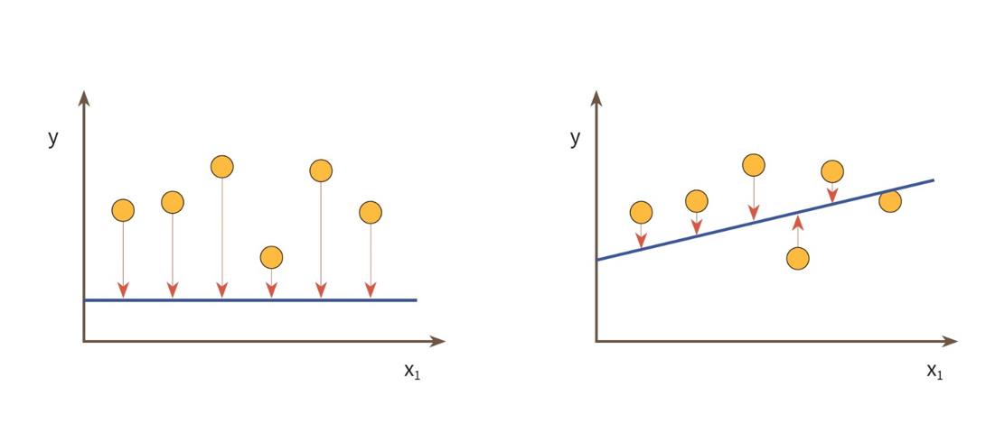
Loss function
To find an appropriate linear, we need to minimize gaps between the linear and each data.

Slide 7



Loss function
We can calculate the gaps like this: But, It can be negative….
0 | 2 | -2
-1 | 3 | -4
-2 | 4 | -6
-3 | 5 | -8
-100 | 2 | -102
-101 | 3 | -104
-102 | 4 | -106
-103 | 5 | -108

Slide 8

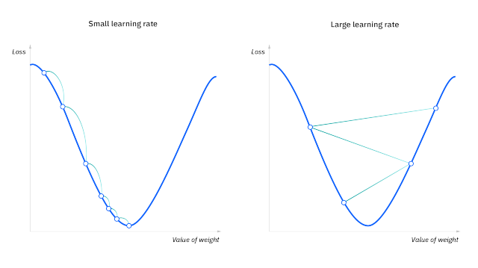
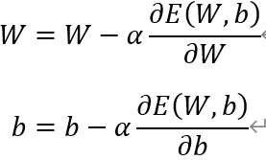
Loss function
Therefore, we square it
This is called "gradient descent method"

Slide 9
Together1
Relationship between sleep hours, study hours, and score. -> 내가 데이터셋과 정답 코드를 만들어야 함.

Slide 10
Together1
Relationship between sleep hours, study hours, and score. -> 내가 데이터셋과 정답 코드를 만들어야 함.

Slide 11
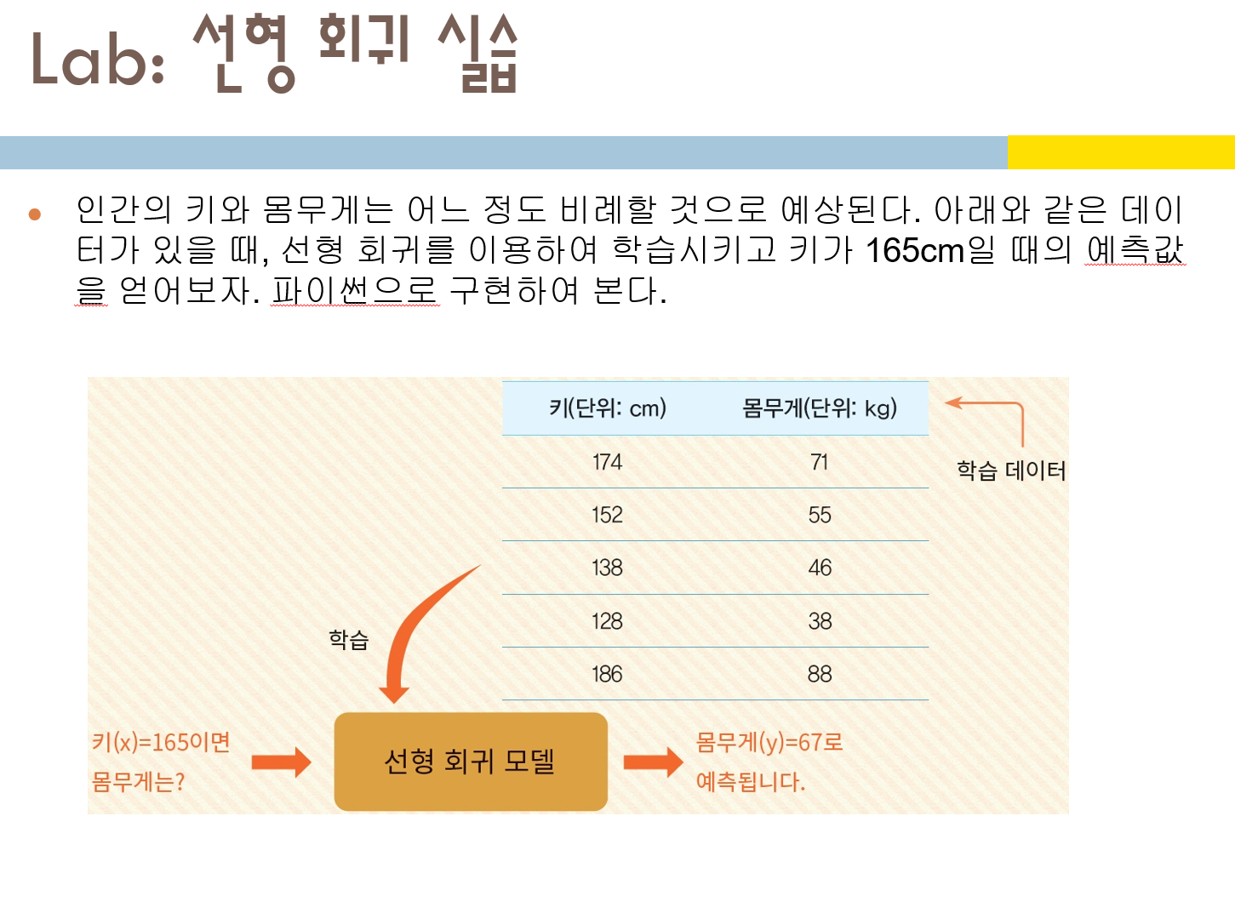
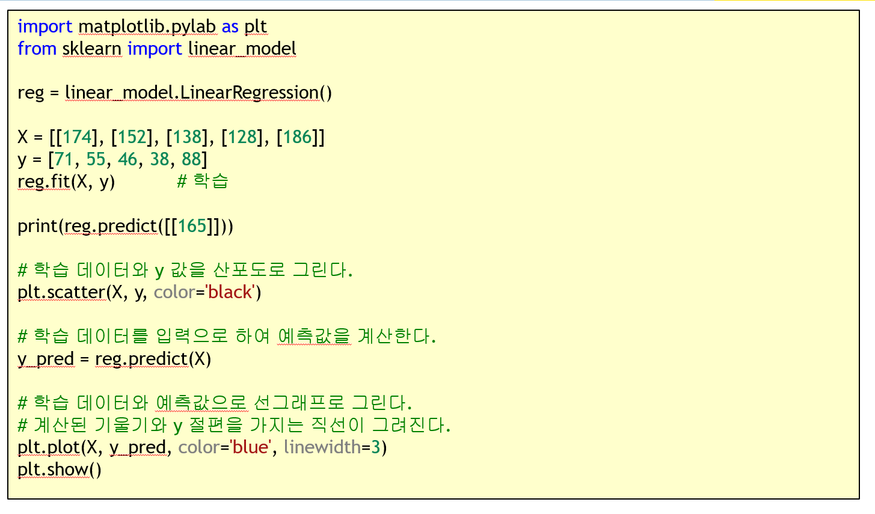
Lab1
Relationship between height and weight.

Slide 12
Lab2
Relationship between sleep hours, study hours, and score. -> 내가 데이터셋과 정답 코드를 만들어야 함.

Slide 13
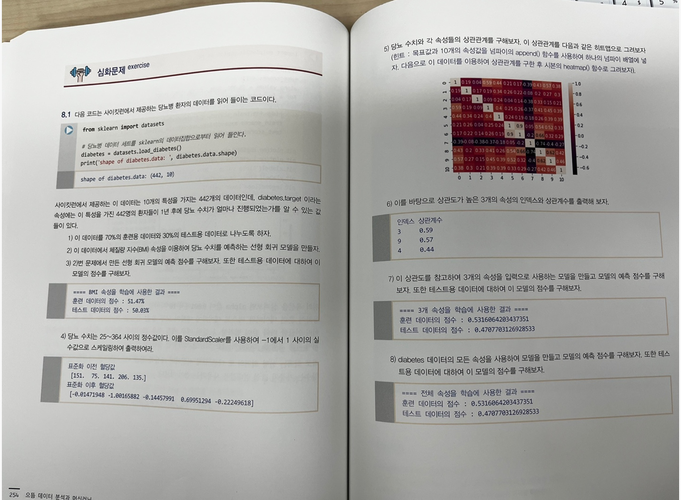
Lab3
Diabetes prediction using Linear Regression(LR) – 책

Slide 14
Lab4
Life expentancy using Linear Regression(LR)-책

Slide 15
Lab5
house prices prediction-https://www.kaggle.com/code/rbyron/simple-linear-regression-models

Slide 16
Lab6
medical cost personal datasets-https://www.kaggle.com/datasets/mirichoi0218/insurance

Slide 17
excercise(challenging)
Now, make number baseball game!!

Slide 18
THANKS
Do you have any questions?
youremail@freepik.com
+91 620 421 838
yourwebsite.com
Please keep this slide for attribution

