Slide 1
Linear Regression

Slide 2
CONTENTS
Introduction to Linear Regression | What is Linear Regression, examples, kinds of LR
Loss function | basic mathematical background of LR
Lab
For more info: SLIDESGO | SLIDESGO SCHOOL | FAQs
You can visit our sister projects: FREEPIK | FLATICON | STORYSET | WEPIK | VIDEVO

Slide 3
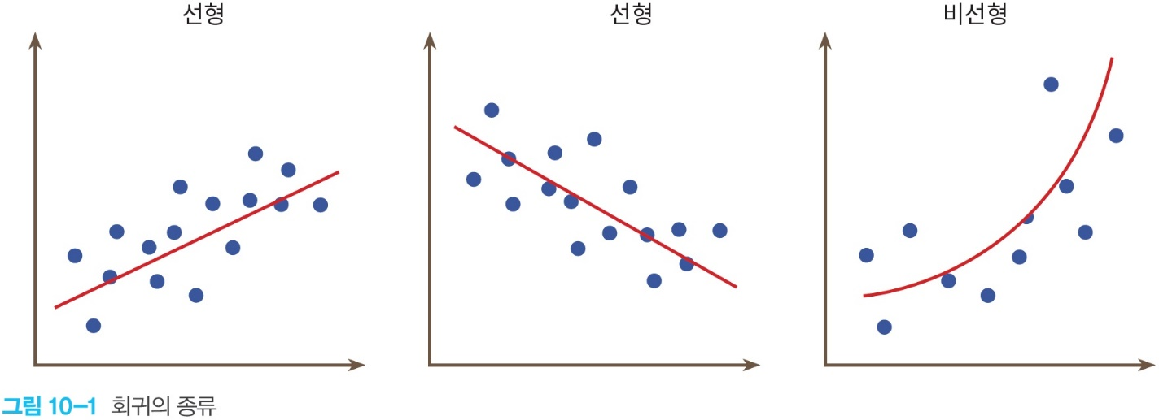
Introduction to Linear Regression
What is Linear Regression?
Regression is finding a linear or a curve which represent the tendency of data.
Therefore, Linear Regression(LR) is finding a linear which represents the tendency of data.
 | sleep hours | score
A | 7 | 84
B | 6 | 80
C | 8 | 82
…………

Slide 4
Introduction to Linear Regression
Examples where Linear Regression can be used:
relationship between height and weight.
relationship among age, sex, bmi, and diabetes.
relationship among building class, street, type of alley access, and house prices.

Slide 5
Introduction to Linear Regression
Kinds of Linear Regression; simple Linear Regression and multiple Linear Regression
1. simple Linear Regression: 1 variable, w is weight and b is bias
f(x)=wx + b
2. multiple Linear Regression: more than 1 variable, wn is weight and b is bias
f(x0, x1, x2, …) = w0x0 + w1x1 + w2x2 + … + b

Slide 6
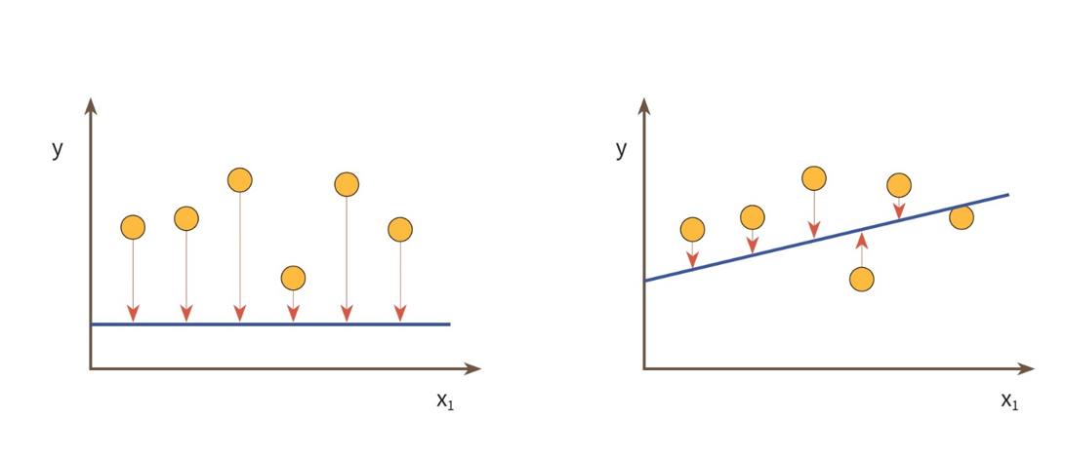
Loss function
To find an appropriate linear, we need to minimize gaps between the linear and each data.

Slide 7



Loss function
We can calculate the gaps like this: But, It can be negative….
0 | 2 | -2
-1 | 3 | -4
-2 | 4 | -6
-3 | 5 | -8
-100 | 2 | -102
-101 | 3 | -104
-102 | 4 | -106
-103 | 5 | -108

Slide 8

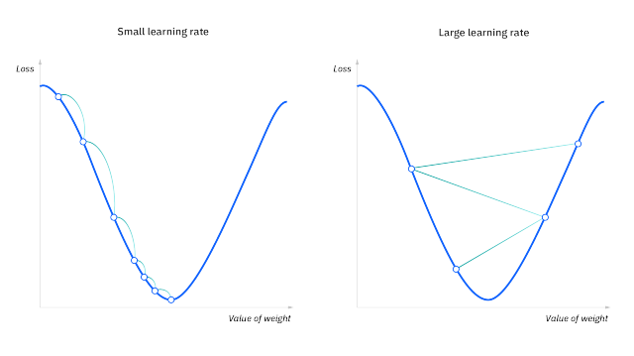
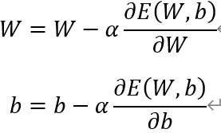
Loss function
Therefore, we square it
This is called "gradient descent method"

Slide 9
Together1
Relationship between sleep hours, study hours, and score.
sleep hours | study hours | score
8 | 3 | 56
7 | 7 | 78
4 | 13 | 92
8 | 7 | 98
10 | 5 | 66
9 | 10 | 97

Slide 10
Together2
Titanic Survival Prediction

Slide 11
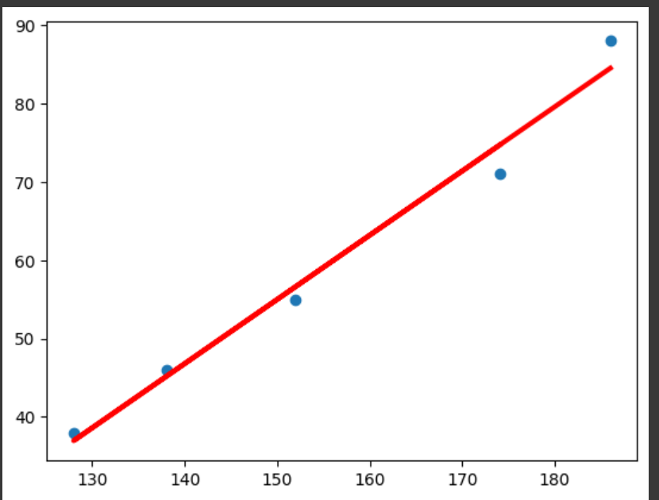
Lab1
Relationship between height and weight.
make datasets based on this table.
plot scatter height vs. weight
Do Linear Regression
print weight W and bias b
plot scatter and predicted line, height vs. weight
Height (cm) | Weight (kg)
174 | 71
152 | 55
138 | 46
128 | 38
186 | 88

Slide 12
Lab2
Relationship between sleep hours, study hours, and score. -> 내가 데이터셋과 정답 코드를 만들어야 함.

Slide 13

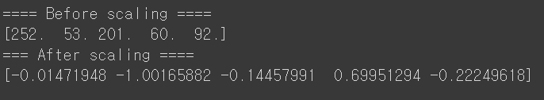
Lab3
Diabetes prediction using Linear Regression(LR)
1. seperate this data into 70% traning data and 30% test data.
2. make a Linear Regression model that predicts diabetes using BMI info.
3. Get prediction scores of the Linear Regression of problem (2). Also, get score of the Linear Regression about the test data.
4. diabetes values are integers from 25 to 346. Print these values as floats between -1 and 1 by scaling using StandardScaler.

Slide 14
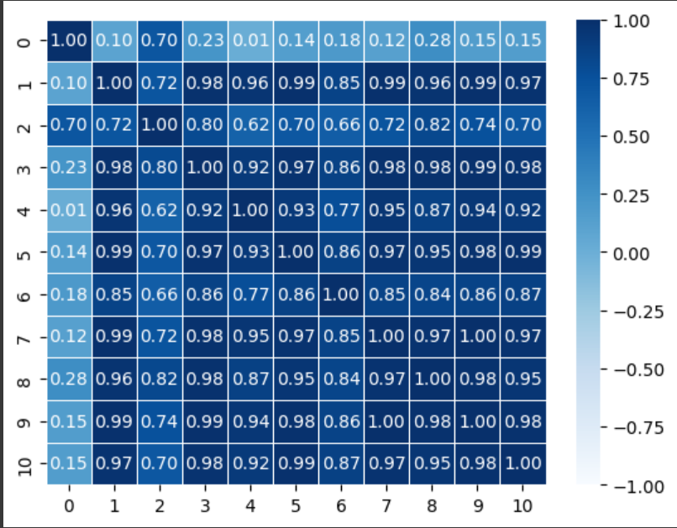
Lab3
5. Get relationship between diabetes and each property and Draw it as a form of heatmap below.

Slide 15
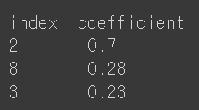


Lab3
6. Based on the above, print indexes and coefficients of 3 high-corr properties.
7. Make a Linear Regression model which uses the 3 properties as inputs and do the same work with problem (3).
8. make a Linear Regression model which uses all properties as inputs and do the same work with problem (3).

Slide 16
Lab4-life expentancy using LR
Life expentancy using Linear Regression(LR)-책

Slide 17
Lab5
house prices prediction-https://www.kaggle.com/code/rbyron/simple-linear-regression-models

Slide 18
Lab6
medical cost personal datasets-https://www.kaggle.com/datasets/mirichoi0218/insurance

Slide 19
THANKS
Do you have any questions?
youremail@freepik.com
+91 620 421 838
yourwebsite.com
Please keep this slide for attribution

