Slide 1
Linear Regression

Slide 2
CONTENTS
Introduction to Linear Regression | What is Linear Regression, examples, kinds of LR
Loss function | basic mathematical background of LR
Lab
For more info: SLIDESGO | SLIDESGO SCHOOL | FAQs
You can visit our sister projects: FREEPIK | FLATICON | STORYSET | WEPIK | VIDEVO

Slide 3
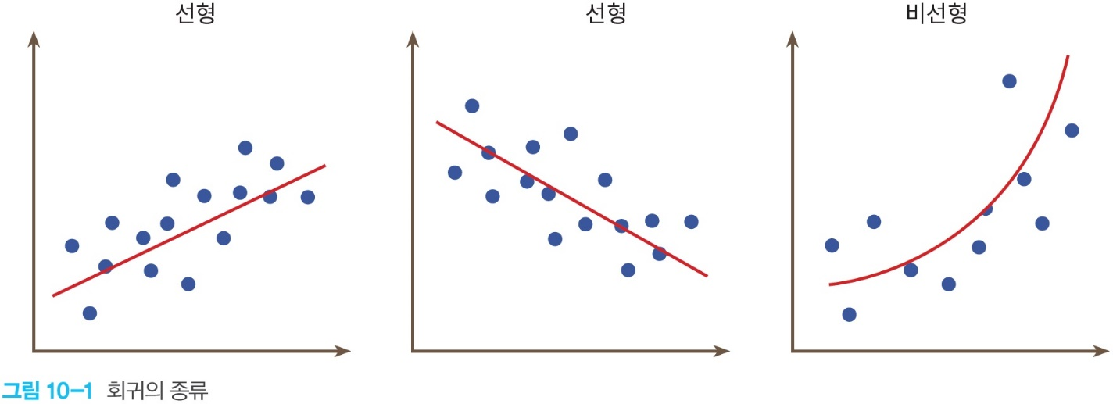
Introduction to Linear Regression
What is Linear Regression?
Regression is finding a linear or a curve which represent the tendency of data.
Therefore, Linear Regression(LR) is finding a linear which represents the tendency of data.
 | sleep hours | score
A | 7 | 84
B | 6 | 80
C | 8 | 82
…………

Slide 4
Introduction to Linear Regression
Examples where Linear Regression can be used:
relationship between height and weight.
relationship among age, sex, bmi, and diabetes.
relationship among building class, street, type of alley access, and house prices.

Slide 5
Introduction to Linear Regression
Kinds of Linear Regression; simple Linear Regression and multiple Linear Regression
1. simple Linear Regression: 1 variable, w is weight and b is bias
f(x)=wx + b
2. multiple Linear Regression: more than 1 variable, wn is weight and b is bias
f(x0, x1, x2, …) = w0x0 + w1x1 + w2x2 + … + b

Slide 6
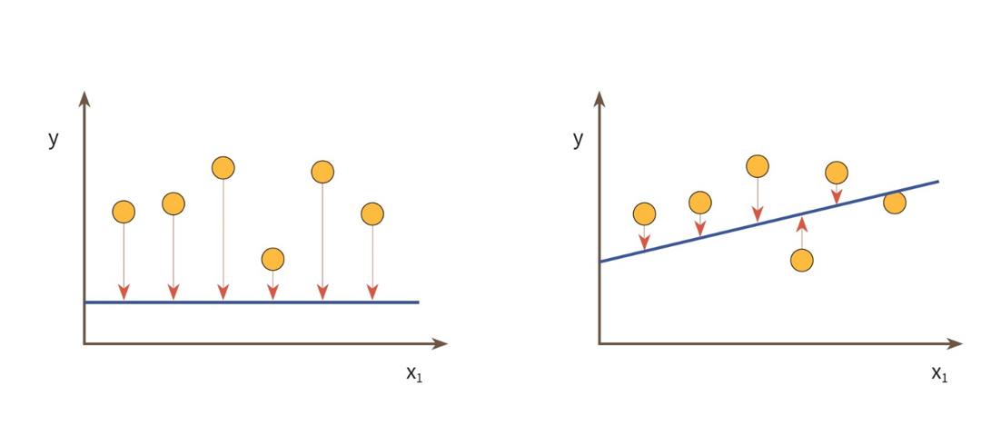
Loss function
To find an appropriate linear, we need to minimize gaps between the linear and each data.

Slide 7



Loss function
We can calculate the gaps like this: But they can be negative….
0 | 2 | -2
-1 | 3 | -4
-2 | 4 | -6
-3 | 5 | -8
-100 | 2 | -102
-101 | 3 | -104
-102 | 4 | -106
-103 | 5 | -108

Slide 8

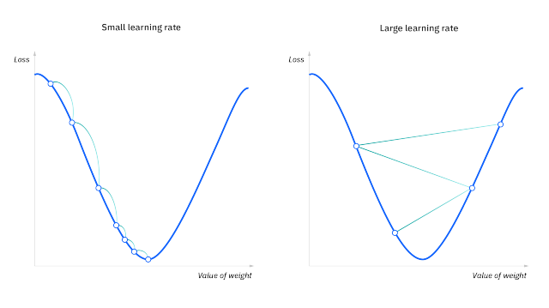
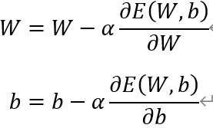
Loss function
Therefore, we square it
This is called "gradient descent method"

Slide 9
Lab
Relationship between sleep hours, study hours, and score.
sleep hours | study hours | score
8 | 3 | 56
7 | 7 | 78
4 | 13 | 92
8 | 7 | 98
10 | 5 | 66
9 | 10 | 97

Slide 10
Lab-your own dataset
Make your own dataset and a Linear Regression model

Slide 11
Lab
1.Make train data and test data using numpy.random.rand()
2.Draw a scatter
3.Make a Linear Regression model
4.Print score of the Linear Regression about the train data

Slide 12
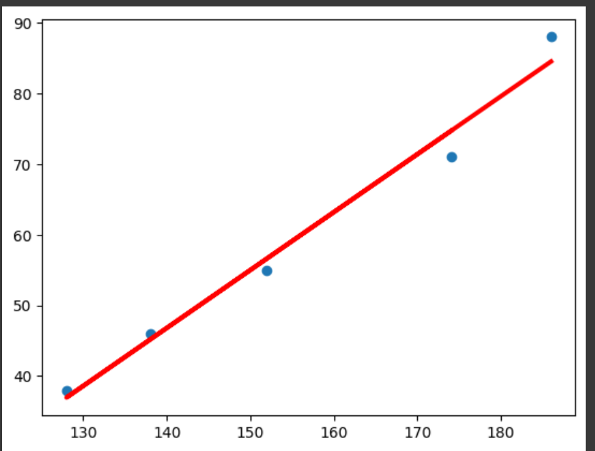
Lab-Relationship between height and weight
make datasets based on this table.
plot scatter height vs. weight
Do Linear Regression
print weight W and bias b
plot scatter and predicted line, height vs. weight
Height (cm) | Weight (kg)
174 | 71
152 | 55
138 | 46
128 | 38
186 | 88

Slide 13
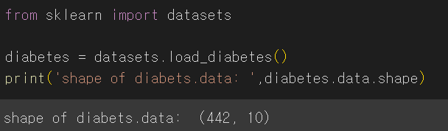

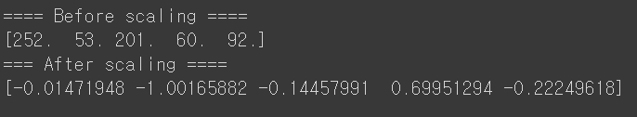
Lab-Diabetes prediction using LR
0.load diabetes dataset from sklearn.
1. seperate this data into 70% traning data and 30% test data.
2. make a Linear Regression model that predicts diabetes using BMI info.
3. Get prediction scores of the Linear Regression of problem (2). Also, get score of the Linear Regression about the test data.
4. diabetes values are integers from 25 to 346. Print these values as floats between -1 and 1 by scaling using StandardScaler.

Slide 14
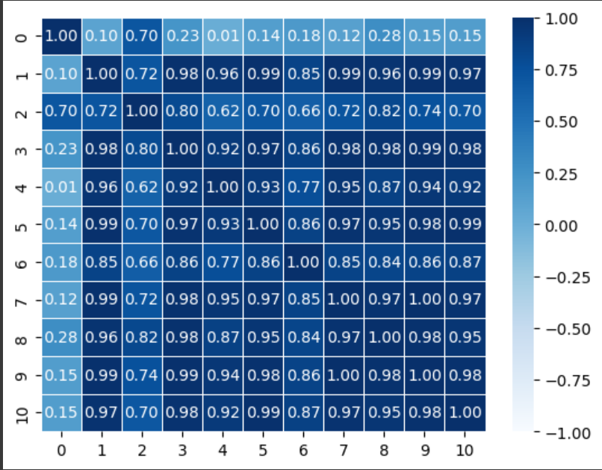
Lab-Diabetes prediction using LR
5. Get relationship between diabetes and each property and Draw it as a form of heatmap below.

Slide 15
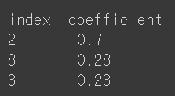


Lab-Diabetes prediction using LR
6. Based on the above, print indexes and coefficients of 3 high-corr properties.
7. Make a Linear Regression model which uses the 3 properties as inputs and do the same work with problem (3).
8. make a Linear Regression model which uses all properties as inputs and do the same work with problem (3).

Slide 16
Lab-life expentancy using LR
Here are explanations about data:
year: years from 2000 to 2015
Status: info. like Developing and Developed…
Adult mortality: deaths per 1000 adults between 15 years old to 60 years old
Infant deaths: deaths per 1000 infants
Alcohol: Alcohol spend per one person
Percentage expenditure: GDP vs. medical percentage expenditure
Hepatitis B:
BMI:
Under-five deaths
Polio:
Total expenditure:
Diphtheria:
HIV/AIDS:
GDP
Population:
Thinness 1-19 years:
Thinness 5-9 years:
Income composition of resources:
Schooling

Slide 17
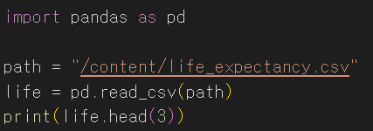
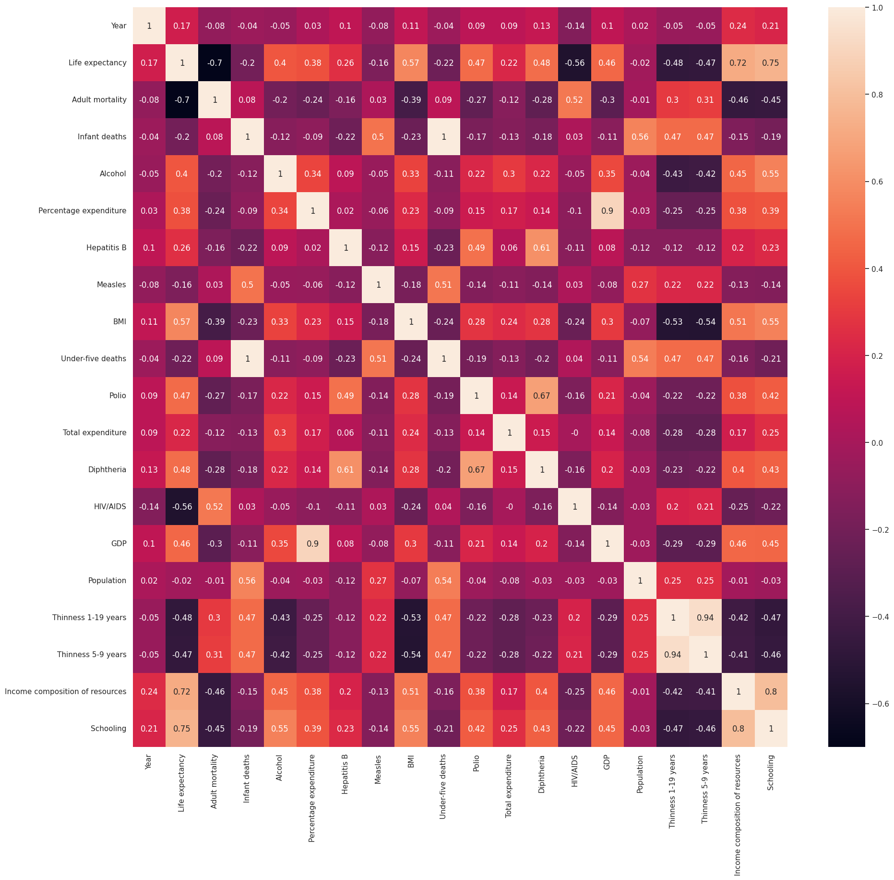
Lab-life expentancy using LR
1.load csv file (cf. path can be different)
2.get correlation between life expectancy and each data. And Draw a heatmap like below.

Slide 18
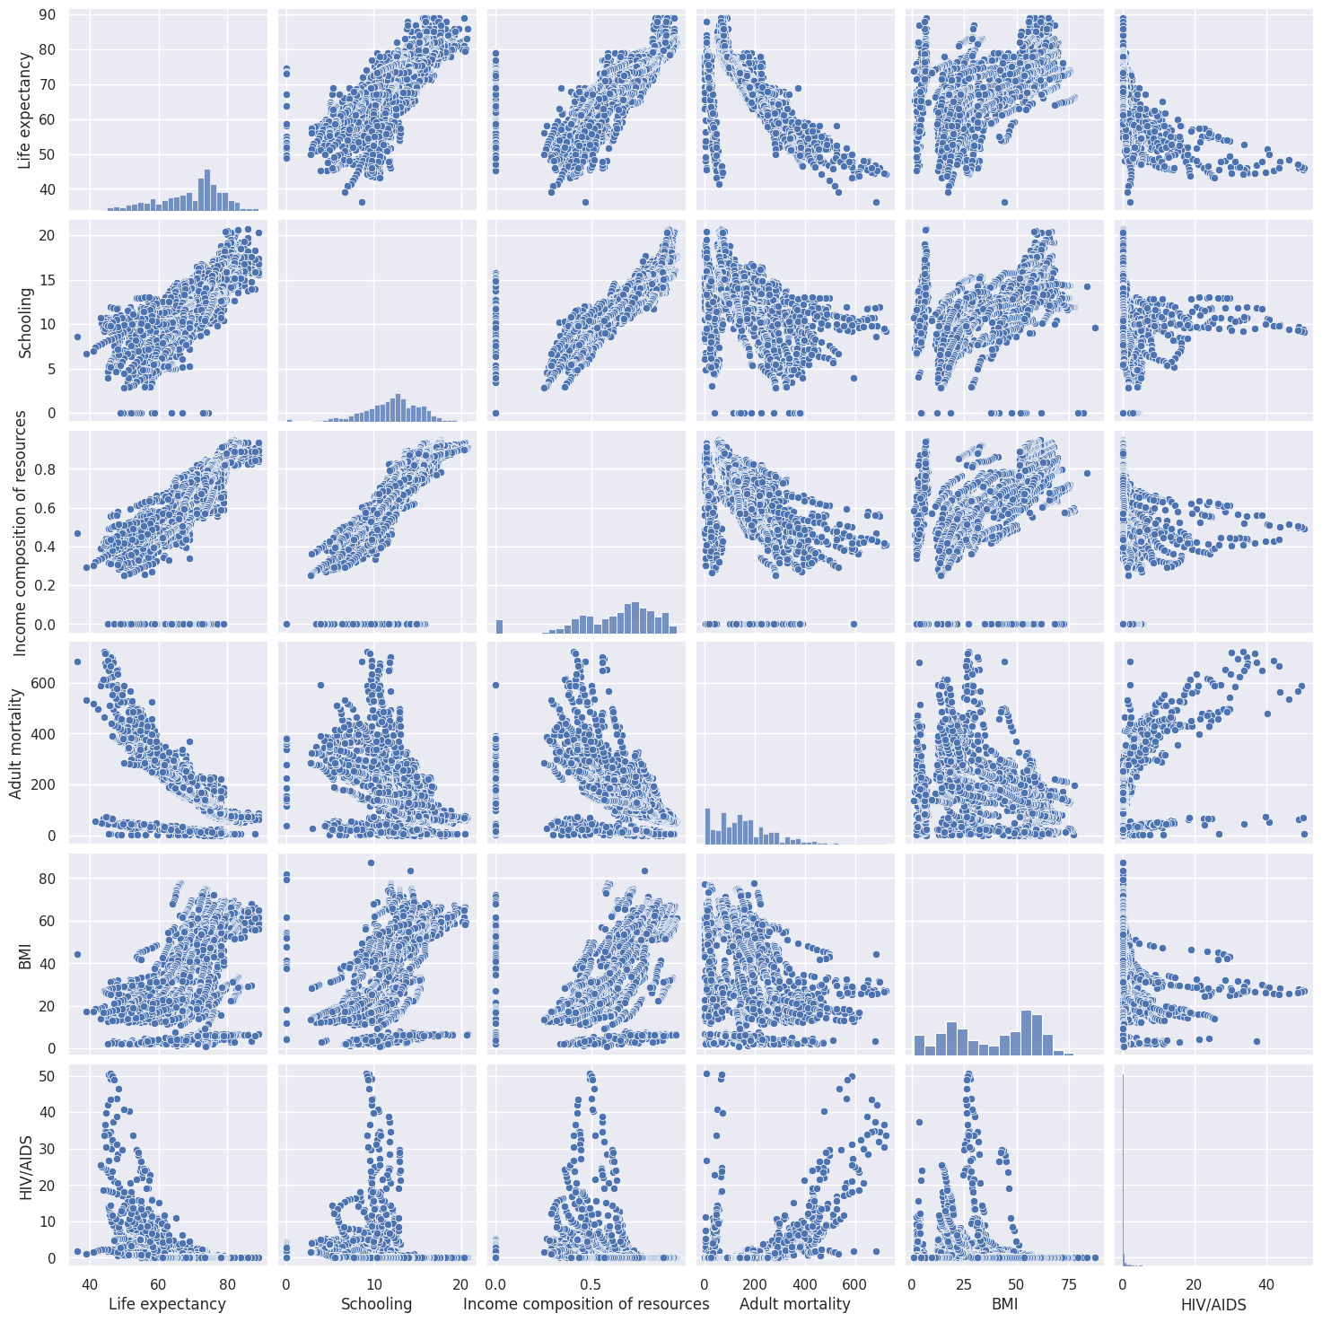
Lab-life expentancy using LR
3.print corr data in order of ascending. ( the form of ouput is: feature_name corr )
4.print 5 high-corr data ( the form of ouput is: feature_name corr )
5.Draw pairplots using seaborn of the 5 high-corr data like below.

Slide 19

Lab-life expentancy using LR
6.check sum of non data and drop them.
7.make a Linear Regression using the 5 high-corr data as inputs. And Print score about test data.

Slide 20
Lab-California Housing dataset
Here are explanations about data:
MedInc median income in block group
HouseAge median house age in block group
AveRooms average number of rooms per household
AveBedrms average number of bedrooms per household
Population block group population
AveOccup average number of household members
Latitude block group latitude
Longitude block group longitude

Slide 21
Lab-medical cost personal datasets
reference-https://www.kaggle.com/datasets/mirichoi0218/insurance

Slide 22
THANKS
Do you have any questions?
youremail@freepik.com
+91 620 421 838
yourwebsite.com
Please keep this slide for attribution

