Slide 1
Support Vector Machine

Slide 2
CONTENTS
Linear SVM | Learn svm, basic terms, linearly separable case
non-liner SVM | Learn non-linearly separable case and kernel trick
Lab
For more info: SLIDESGO | SLIDESGO SCHOOL | FAQs
You can visit our sister projects: FREEPIK | FLATICON | STORYSET | WEPIK | VIDEVO

Slide 3
Linear SVM
SVM is a method that classifies two groups by selecting max-distance hyperplane
hyperplane: a linear
support vector: the closest data from hyperplane( , )
margin: distance between support vector and hyperplane
bad classified
well classified

Slide 4
Linear SVM
SVM only uses support vector for prediction -> high speed, less computation

Slide 5
non-Linear SVM
Think about a 1D space. These are not linearly separable

Slide 6
non-Linear SVM
Move them to 2D space. Now, we can separate them by a linear. But moving data to higher dimension requires high computation.

Slide 7
non-Linear SVM
Kernel trick solves non-linearly separable data problem without moving data to higher dimension. And kernel is

Slide 8
sklearn SVM Parameter
There are something to know before using sklearn SVM.
Kernel | type of function to classify data; linear, polynomial, sigmoid, rbf …
C | classifying accuracy; the bigger C is, the more hyperplane be a curve.
gamma | defining how far the influence of a single training point reaches

Slide 9
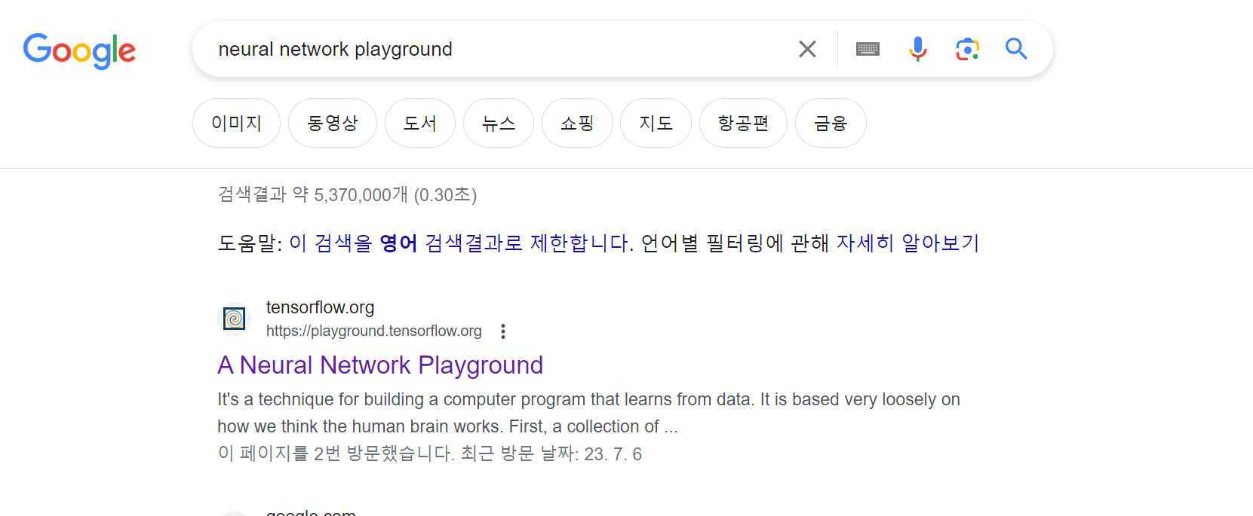
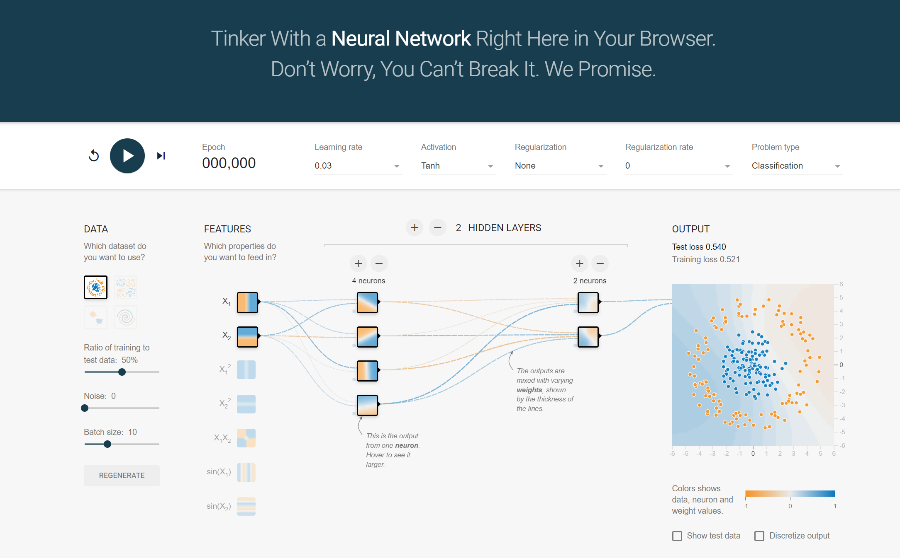
Lab
Let's go to A Neural Network Playground

Slide 10
Lab
Learning start button
learning count
input dataset
Output Layer
Hidden Layer
Input Layer

Slide 11
Lab-Titanic Survival Prediction

Slide 12
Lab-breast cancer dataset
reference: https://inuplace.tistory.com/600

Slide 13
Lab-credit card dataset
reference: https://www.kaggle.com/code/pierra/credit-card-dataset-svm-classification

Slide 14
Lab-multiclass classification
reference: https://www.kaggle.com/code/pranathichunduru/svm-for-multiclass-classification

Slide 15
excercise(challenging)
Now, make number baseball game!!

Slide 16
THANKS
Do you have any questions?
youremail@freepik.com
+91 620 421 838
yourwebsite.com
Please keep this slide for attribution

