Slide 1
Run AlphaFold3 on BioHPC

Slide 2
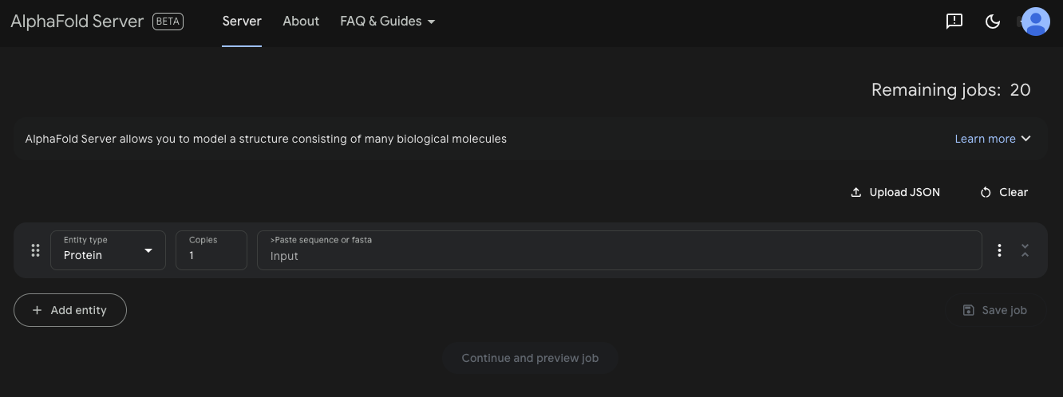
THE AlphaFold Server
https://alphafoldserver.com/

Slide 3
Brief introduction - AlphaFold3 pipeline
Protein sequence, ligand, ion, DNA, RNA
Structure prediction
GPU intensive, run on GPU servers
Suggest to use A100, H100, A6000 might work but less optimized
MSA with Jackhmmer
CPU intensive
Run on machines with more CPU cores
Structure predictions

Slide 4
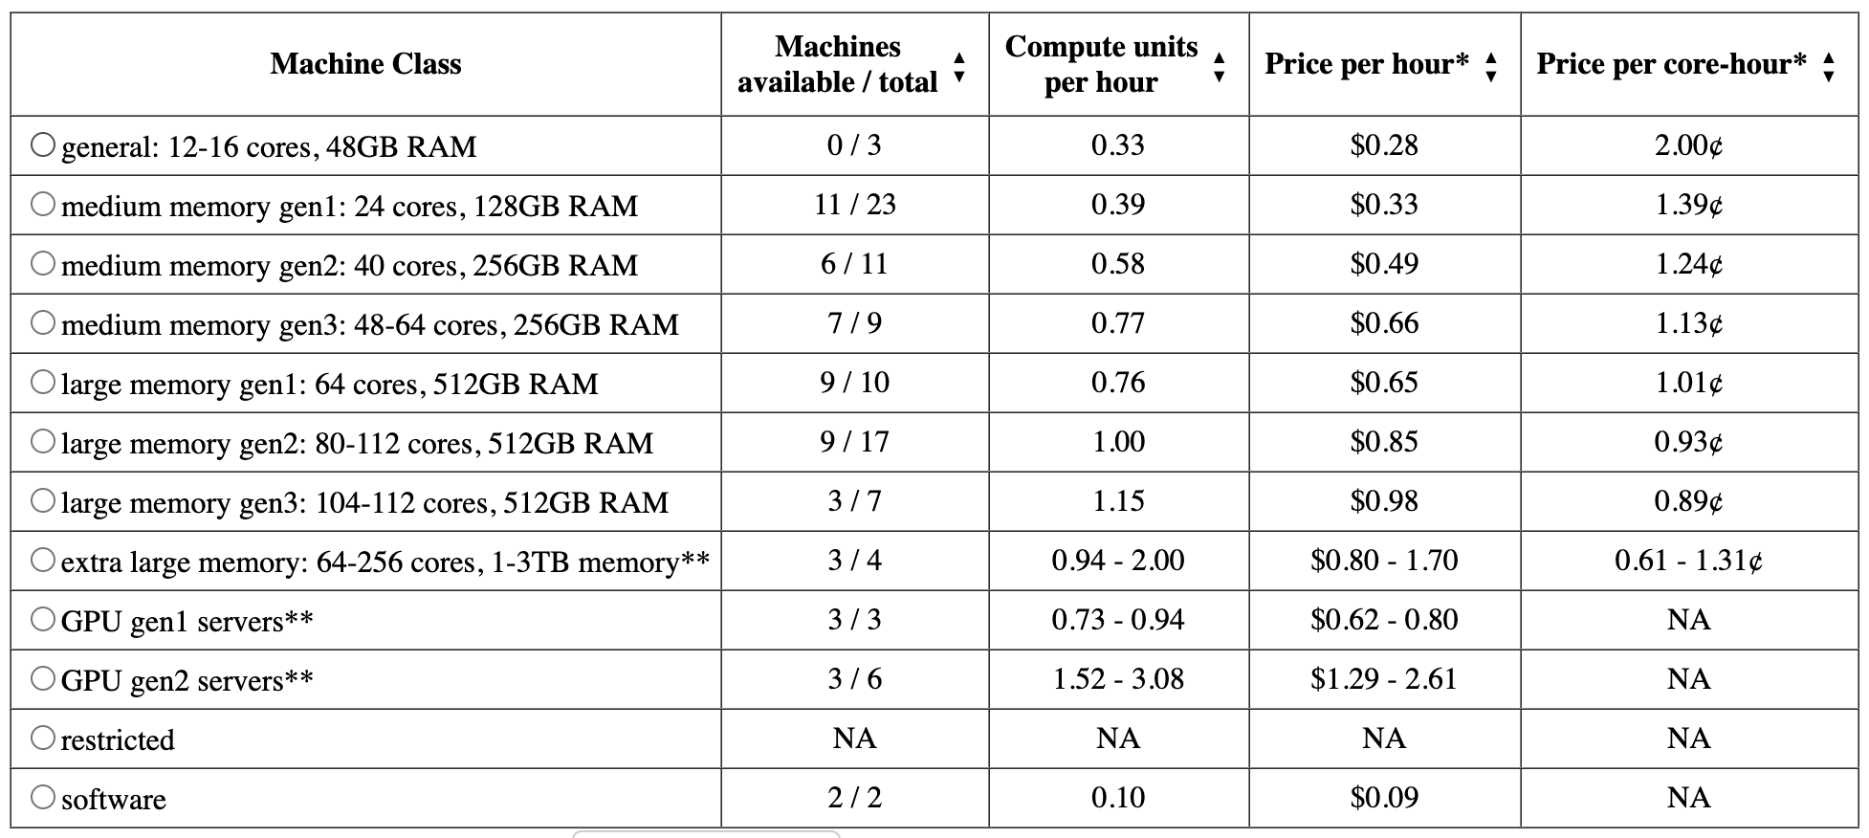
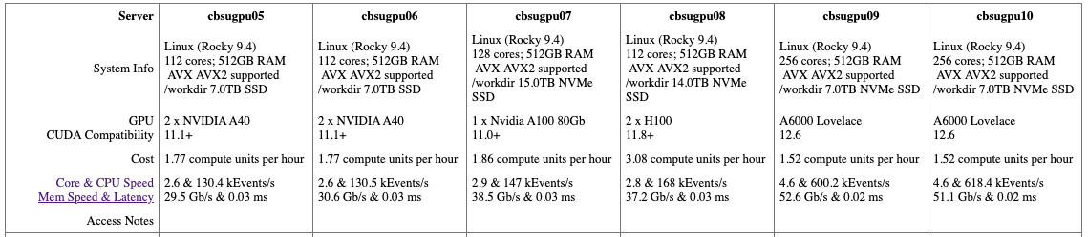
CPU and GPU servers on BioHPC

Slide 5
Run AlphaFold3 with a Docker image
# run one prediction
docker1 run -it \
--volume $INPUT:/root/af_input \
--volume $OUTDIR:/root/af_output \
--volume $WEIGHTS:/root/models \
--volume $DATABASE:/root/public_databases \
--gpus all \
biohpc_netid/alphafold3 \
python run_alphafold.py \
--json_path=/root/af_input/fold_input.json \
--model_dir=/root/models \
--db_dir=/root/public_databases \
--output_dir=/root/af_output
Binds the path on server to the docker image.
Example:
/home/users/username/input_folder:/root/af_input
/home/users/username/input_folder/my_input.json
/root/af_input/my_input.json
Only do this when you do not have too many predictions and you can afford running the whole process on a GPU server.

Slide 6

[optional] Create AF3 Singularity images for HPC
g3.xl with a A100 GPU
Ubuntu 24.04
Commit: 2b8e912
sudo apt install singularity-container
docker build -t alphafold3 -f docker/Dockerfile .
docker run -d -p 5000:5000 --restart=always --name registry registry:2
docker tag alphafold3 localhost:5000/alphafold3
docker push localhost:5000/alphafold3
SINGULARITY_NOHTTPS=1 singularity build alphafold3.sif docker://localhost:5000/alphafold3:latest
# test the singularity file
singularity exec --nv alphafold3.sif sh -c 'nvidia-smi'
[source]

Slide 7
Setup AlphaFold3
AlphaFold3 codebase
Model weights
Public databases
* This setup section assumes you do not have a lab server and are doing this on your laptop/desktop.

Slide 8
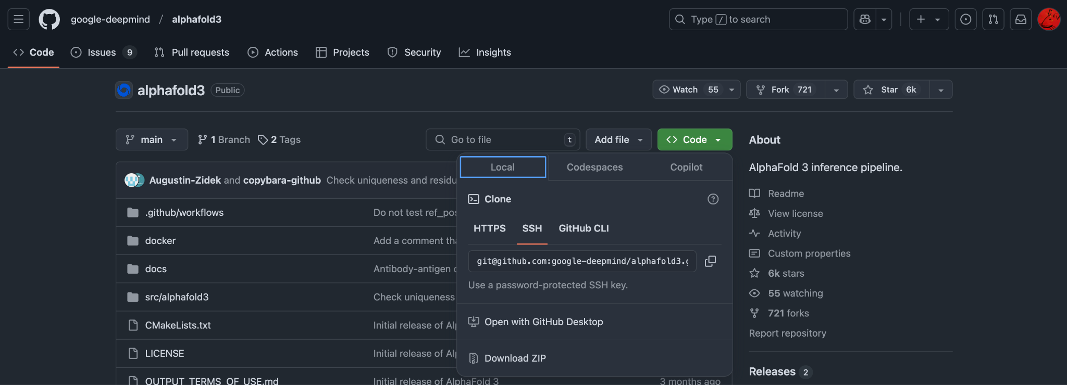
Clone the repository from GitHub
local
Go to https://github.com/google-deepmind/alphafold3?tab=readme-ov-file
Download or git clone the repo if you have the sshkey set. Upload the folder to the server.

Slide 9
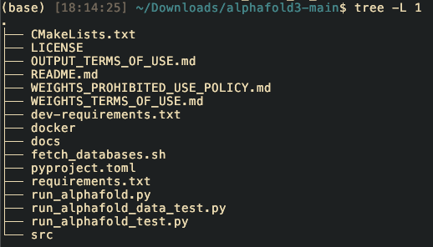
Obtain model parameters and download databases
local
AlphaFold 3 GitHub
This repository contains all necessary code for AlphaFold 3 inference. To request access to the AlphaFold 3 model parameters, please complete this form. Access will be granted at Google DeepMind’s sole discretion. We will aim to respond to requests within 2–3 business days. You may only use AlphaFold 3 model parameters if received directly from Google. Use is subject to these terms of use.
626GB data will be downloaded. With fetch_databases.sh
Recommend to have a copy on your local machine, use wired network while transferring to BioHPC.

Slide 10
Create Docker image and transfer data
# build docker image, this step takes a while
cd your_alphafold3_folder/
mv docker/dockerfile .
docker1 build -t alphafold3 $PWD
server
# move public_databases and weight to server
# I suggest tar your mmcif_files/ for faster transfer
tar -cf mmcif_files.tar mmcif_files/
rsync -av path_to_public_databases netid@server_name.biohpc.corenll.edu:/workdir/alphafold3
rsync -av path_to_af3.bin.zst netid@server_name.biohpc.corenll.edu:/workdir/alphafold3/model
local

Slide 11
Setup ssh-key on BioHPC
# on your local machine
> ssh-keygen
# and press enter until the end
> less $HOME/.ssh/id_rsa.pub # copy the string in the file
# on remote machine, paste your key in
> $HOME/.ssh/authorized_keys

Slide 12
Prepare MSA input

Slide 13
Input data format
{
"name": "Job name goes here",
"modelSeeds": [1, 2],
"sequences": [
{"protein": {...}},
{"rna": {...}},
{"dna": {...}},
{"ligand": {...}}
],
"bondedAtomPairs": [...], # Optional
"userCCD": "...", # Optional
"dialect": "alphafold3", # Required
"version": 2 # Required
}
{
"protein": {
"id": "A",
"sequence": "PVLSCGEWQL",
"modifications": [
{"ptmType": "HY3", "ptmPosition": 1},
{"ptmType": "P1L", "ptmPosition": 5}
],
"unpairedMsa": ..., # Mutually exclusive with unpairedMsaPath.
"unpairedMsaPath": ..., # Mutually exclusive with unpairedMsa.
"pairedMsa": ..., # Mutually exclusive with pairedMsaPath.
"pairedMsaPath": ..., # Mutually exclusive with pairedMsa.
"templates": [...]
}
}

Slide 14
MSA step
Prepare a fasta file for all of the sequences.
Prepare a pair file.
Make sure your fasta file has the same header as the ones in pair.txt. Ideally, use only UniProtKB id.
Run the prepare_json.py
Upload the output folder to the server
Run run_MSA_LM.sh
If failed meaning the htop not showing CPU usage but not getting all results. Kill the process and run fix_unfinished_jobs.sh
Then run run_MSA_LM.sh again, until all jobs are done.
On your local computer, run get_results.sh periodically. Expecting large data so prepare the space befor running.

Slide 15
Explain prepare_json.py
from Bio import SeqIO
import os
prot2seqs = {}
for record in SeqIO.parse(“path_to_your_fasta”, "fasta"):
prot2seqs[record.id.strip().replace(“>”, “”)] = str(record.seq)
# make json for msa
outdir = “path_to_output_folder”
if not os.path.exists(outdir):
os.makedirs(outdir)
for prot, seq in prot2seqs.items():
with open(f"{outdir}/single_{prot}.json", "w") as file:
json.dump(
{
"name": f"{prot}",
"modelSeeds": [
1,
], #
"sequences": [
{
"protein": {
"id": "A",
"sequence": f"{seq}",
}
}
],
"dialect": "alphafold3", # Required
"version": 1, # Required
},
file,
indent=4,
)
Make sure your fasta file has the same header as the ones in pair.txt. Ideally, use only UniProtKB id.
This script takes your fasta file and generate json files for MSA step.

Slide 16
Explain the run_MSA_LM.sh [part 1]
# assume you transfer alphafold3/ with model/ and public_databases/ to /workdir on remote server
# untar the mmcif_files.tar
cd /local/workdir/alphafold3/public_databases
if [ -d "mmcif_files" ]; then
echo "[date] mmcif_files already extracted!"
else
tar -xf mmcif_files.tar
echo "[date] mmcif_files extracted!"
fi
# build the docker image
cd /local/workdir/alphafold3/ && docker1 build -t alphafold3 -f dockerfile && echo "[date] Docker image built!"
# transfer your json_dir/ to /workdir
rsync -av your_json_dir netid@server.biohpc.cornell.edu:/workdir
# split json files into multiple jobs
ncpu=$(nproc --all) && njob=$(( ncpu/ 8 ))
INPUT="/local/workdir/"$(basename $json_dir_name)
ninput=$(ls $INPUT | wc -l) && ninput=$(( ninput/$njob )) && ninput=$(( ninput+1 ))
echo "[date] ncpu: $ncpu, njob: $njob"
for i in $(seq 1 $njob); do
mkdir input_${i};
export i=$i;
export INPUT=$INPUT;
ls $INPUT | head -n $ninput | xargs -I @@ bash -c 'mv $INPUT/@@ input_${i}';
done && echo "[date] Data copied and split!"
Extraction takes around 1 hour
Build docker image on server, this takes around 1 hour. If this command complain docker file not found, remember to move the dockerfile from docker/

Slide 17
Explain the run_MSA_LM.sh [part 2]
MDIR="/local/workdir/alphafold3"
DATABASE="${MDIR}/public_databases"
WEIGHTS="${MDIR}/model"
OUTDIR=$(date +'%y%m%d%H'_$(hostname | awk -F '.' '{print $1}'))
OUTDIR="/local/workdir/output_${OUTDIR}"
mkdir -p $OUTDIR
INPUT_PREF="/local/workdir/input_"
NPROC=$njob
cd /workdir/alphafold3
for i in $(seq 1 $NPROC); do
INPUT="${INPUT_PREF}${i}"
docker1 run \
--volume $INPUT:/root/af_input \
--volume $OUTDIR:/root/af_output \
--volume $WEIGHTS:/root/models \
--volume $DATABASE:/root/public_databases \
--cpus 8 \
biohpc_netid/alphafold3 \
python run_alphafold.py \
--input_dir=/root/af_input \
--model_dir=/root/models \
--db_dir=/root/public_databases \
--output_dir=/root/af_output \
--norun_inference &
done
wait
MDIR: where you clone the alphafold3 GitHub repo
DATABASE: the public_databases location
WEIGHTS: the model location
8 is the most optimal number for cost and compute efficiency
Update this with your Docker image, check with docker1 images
MSA only, & (background)

Slide 18
Email notification
# Email notification
if [ $? -eq 0 ]; then
echo "[`date`] Completed successfully." | mutt -s "${hostname} Finished" netid@cornell.edu
else
echo "[`date`] Encountered an error."| mutt -s "${hostname} Error" netid@cornell.edu
fi

Slide 19
Explain fix_unfinished_jobs.sh
# get data list
for file in $(find input*/*json -maxdepth 1); do jq '.name' $file | tr '[:upper:]' '[:lower:]' | sed 's/"//g' >> uniprotkb.txt; done
data=() # list
while IFS= read -r line; do
data+=("$line")
done < "uniprotkb.txt"
# Define an array of output directories
outdirs=("output_dir1" “output_dir2”)
# Initialize an array to store finished jobs
finished=()
# Iterate over each output directory
for outdir in "${outdirs[@]}"; do
# Check if the directory exists
if [ -d "$outdir" ]; then
# Read the contents of the directory and add to finished array
while read -r folder; do
finished+=("$folder")
done < <(ls "$outdir")
else
echo "Directory $outdir does not exist."
fi
done
for i in "${data[@]}"; do echo $i; done | sort > tmp_data.txt
for i in "${finished[@]}"; do echo $i; done | sort > tmp_finished.txt
for i in "${finished[@]}"; do echo $i; done | sort > tmp_finished.txt
comm -23 tmp_data.txt tmp_finished.txt > unfinished.txt
# load the unfinished.txt into a hash table
unset hash_table
declare -A hash_table
while IFS= read -r line; do
hash_table["$line"]=1
done < "unfinished.txt"
mkdir -p /workdir/unfinished_data
find input*/*json -maxdepth 1 | while read file; do
name=$(jq '.name' $file | tr '[:upper:]' '[:lower:]' | sed 's/"//g' )
if [[ -v hash_table[$name] ]]; then
cp $file /workdir/unfinished_data
fi
done
Get all UniProtKB ids in input
Get finished jobs
Get unfinished jobs

Slide 20
Explain fix_unfinished_jobs.sh
cd /workdir
mkdir archive_finished_jobs
mv input* archive_finished_jobs/
ncpu=$(nproc --all) && njob=$(( ncpu/ 8 ))
INPUT="unfinished_data"
ninput=$(ls $INPUT | wc -l) && ninput=$(( ninput/$njob )) && ninput=$(( ninput+1 ))
echo "[date] ncpu: $ncpu, njob: $njob"
for i in $(seq 1 $njob); do
mkdir input_${i};
export i=$i;
export INPUT=$INPUT;
ls $INPUT | head -n $ninput | xargs -I @@ bash -c 'mv $INPUT/@@ input_${i}';
done && echo "[date] Data copied and split!"
# run MSA
echo "[date] Running MSA..."
OUTDIR=$(date +'%y%m%d%H'_$(hostname | awk -F '.' '{print $1}'))
OUTDIR="/local/workdir/output_${OUTDIR}"
mkdir -p $OUTDIR
MDIR="/local/workdir/alphafold3"
DATABASE="${MDIR}/public_databases"
WEIGHTS="${MDIR}/model"
INPUT_PREF="/local/workdir/input_"
NPROC=$njob
cd /workdir/alphafold3
for i in $(seq 1 $NPROC); do
INPUT="${INPUT_PREF}${i}"
docker1 run \
--volume $INPUT:/root/af_input \
--volume $OUTDIR:/root/af_output \
--volume $WEIGHTS:/root/models \
--volume $DATABASE:/root/public_databases \
--cpus 8 \
biohpc_netid/alphafold3 \
python run_alphafold.py \
--input_dir=/root/af_input \
--model_dir=/root/models \
--db_dir=/root/public_databases \
--output_dir=/root/af_output \
--norun_inference &
done
wait
Run MSA again with json files in unfinised_data
If you need to do this multiple times, remember to remove the temporary files generated in this process to avoid file conflicts

Slide 21
Explain get_results.sh
# run this periodically on your local machine
rsync -av netid@server.biohpc.cornell.edu:/workdir/output* .

Slide 22
Prepare structure inference input

Slide 23
Prepare structure inference input
Prepare the output from the previous step with prepare_structure_inference_input_json.py
Then you will have a folder with a msas_templates/ and a list of json files.
Run structure_inference.sh to do prediction
If the machine you rent have multiple GPUs, I will need to try on your machine to use both of them for prediction.

Slide 24
Prepare structure inference input
# create comb msa
def prep_msa(
hp,
bp,
hp_paired_msa_file,
hp_unpaired_msa_file,
bp_paired_msa_file,
bp_unpaired_msa_file,
):
"""
Prepares and writes paired and unpaired multiple sequence alignments (MSA) to specified files for both hp and bp.
Parameters:
hp (dict): Dictionary containing the hp sequences and their associated MSA data.
bp (dict): Dictionary containing the bp sequences and their associated MSA data.
hp_paired_msa_file (str): File path to write the hp paired MSA.
hp_unpaired_msa_file (str): File path to write the hp unpaired MSA.
bp_paired_msa_file (str): File path to write the bp paired MSA.
bp_unpaired_msa_file (str): File path to write the bp unpaired MSA.
Notes:
- If any of the specified files already exist, they will not be overwritten.
- The MSA data is expected to be in the "sequences" key of the hp and bp dictionaries, under the "protein" key.
"""
# if any of the files does not exist, then create the files
# get the pairedMsa and unpairedMsa from loaded json
if not os.path.exists(hp_paired_msa_file):
hp_paired_msa = hp["sequences"][0]["protein"]["pairedMsa"]
hp_unpaired_msa = hp["sequences"][0]["protein"]["unpairedMsa"]
# write to a a3m file
with open(hp_paired_msa_file, "w") as f:
f.write(hp_paired_msa)
with open(hp_unpaired_msa_file, "w") as f:
f.write(hp_unpaired_msa)
if not os.path.exists(bp_paired_msa_file):
bp_paired_msa = bp["sequences"][0]["protein"]["pairedMsa"]
bp_unpaired_msa = bp["sequences"][0]["protein"]["unpairedMsa"]
# write to a a3m file
with open(bp_paired_msa_file, "w") as f:
f.write(bp_paired_msa)
with open(bp_unpaired_msa_file, "w") as f:
f.write(bp_unpaired_msa)
def prep_mmccif(
hp,
bp,
hp_mmcif_file,
bp_mmcif_file,
):
if len(glob(f"{hp_mmcif_file}*cif")) == 0:
for idx, template in enumerate(hp["sequences"][0]["protein"]["templates"]):
hp_mmcif = template["mmcif"]
with open(f"{hp_mmcif_file}_{idx}.cif", "w") as f:
f.write(hp_mmcif)
if len(glob(f"{bp_mmcif_file}*cif")) == 0:
for idx, template in enumerate(bp["sequences"][0]["protein"]["templates"]):
bp_mmcif = template["mmcif"]
with open(f"{bp_mmcif_file}_{idx}.cif", "w") as f:
f.write(bp_mmcif)

Slide 25
Prepare structure inference input
def update_path(hp, bp, hp_paired_msa_file, bp_paired_msa_file, hp_unpaired_msa_file, bp_unpaired_msa_file, hp_mmcif_file, bp_mmcif_file):
del hp["sequences"][0]["protein"]["pairedMsa"]
del hp["sequences"][0]["protein"]["unpairedMsa"]
del bp["sequences"][0]["protein"]["pairedMsa"]
del bp["sequences"][0]["protein"]["unpairedMsa"]
hp["sequences"][0]["protein"]["pairedMsaPath"] = hp_paired_msa_file.replace(
comb_msa_ref, msa_ref_ncsa
)
hp["sequences"][0]["protein"]["unpairedMsaPath"] = hp_unpaired_msa_file.replace(
comb_msa_ref, msa_ref_ncsa
)
bp["sequences"][0]["protein"]["pairedMsaPath"] = bp_paired_msa_file.replace(
comb_msa_ref, msa_ref_ncsa
)
bp["sequences"][0]["protein"]["unpairedMsaPath"] = bp_unpaired_msa_file.replace(
comb_msa_ref, msa_ref_ncsa
)
for idx in range(len(hp["sequences"][0]["protein"]["templates"])):
del hp["sequences"][0]["protein"]["templates"][idx]["mmcif"]
hp["sequences"][0]["protein"]["templates"][idx]["mmcifPath"] = hp_mmcif_file.replace(
comb_msa_ref, msa_ref_ncsa
) + "_" + str(idx) + ".cif"
for idx in range(len(bp["sequences"][0]["protein"]["templates"])):
del bp["sequences"][0]["protein"]["templates"][idx]["mmcif"]
bp["sequences"][0]["protein"]["templates"][idx]["mmcifPath"] = bp_mmcif_file.replace(
comb_msa_ref, msa_ref_ncsa
) + "_" + str(idx) + ".cif"
return hp, bp
def is_standard_aa(sequence):
# Define the set of standard amino acids
standard_amino_acids = set("ARNDCEQGHILKMFPSTWYV")
# Convert the sequence to uppercase to ensure case insensitivity
sequence = sequence.upper()
# Check for non-standard amino acids
for aa in sequence:
if aa not in standard_amino_acids:
return True
return False

Slide 26
Prepare structure inference input
def create_comb_msa(
hprot_msa,
bprot_msa,
outname,
token_thres=4352,
random_seed=[1],
comb_msa_ref=None,
msa_ref_ncsa=None,
logfile=None,
):
"""
Creates a combined MSA (Multiple Sequence Alignment) from two input MSAs and saves the result to a specified output file.
Args:
hprot_msa (str): Path to the JSON file containing the MSA for the first protein.
bprot_msa (str): Path to the JSON file containing the MSA for the second protein.
outname (str): Output filename for the combined MSA.
token_thres (int, optional): Threshold for the total number of tokens (sequence length). Defaults to 4352.
random_seed (list, optional): List of random seeds for the model. Defaults to [1].
comb_msa_ref (str, optional): Reference path for combined MSA files. Defaults to None.
msa_ref_ncsa (str, optional): Reference path for NCSA MSA files. Defaults to None.
logfile (str, optional): Path to a logfile for logging. Defaults to None.
Returns:
None
"""
hp = json.load(open(hprot_msa))
bp = json.load(open(bprot_msa))
hp_paired_msa_file = f"{comb_msa_ref}/{hp['name']}_paired.a3m"
hp_unpaired_msa_file = f"{comb_msa_ref}/{hp['name']}_unpaired.a3m"
bp_paired_msa_file = f"{comb_msa_ref}/{bp['name']}_paired.a3m"
bp_unpaired_msa_file = f"{comb_msa_ref}/{bp['name']}_unpaired.a3m"
prep_msa(
hp,
bp,
hp_paired_msa_file,
hp_unpaired_msa_file,
bp_paired_msa_file,
bp_unpaired_msa_file,
)
hp_mmcif_file = f"{comb_msa_ref}/{hp['name']}"
bp_mmcif_file = f"{comb_msa_ref}/{bp['name']}"
prep_mmccif(
hp,
bp,
hp_mmcif_file,
bp_mmcif_file,
)
hp["sequences"][0]["protein"]["id"] = "A"
bp["sequences"][0]["protein"]["id"] = "B"
# check the size of sequences. I think we have to try the limits, this time I have unified memory enabled but not sure how many tokens are allowed
if (
len(hp["sequences"][0]["protein"]["sequence"])
+ len(bp["sequences"][0]["protein"]["sequence"])
> token_thres
):
print(
f"Skipping {outname} because the total tokens exceed the limit {token_thres}",
file=open(logfile, "a"),
)
if not is_standard_aa(hp["sequences"][0]["protein"]["sequence"]) or not is_standard_aa(bp["sequences"][0]["protein"]["sequence"]):
print(
f"Skipping {outname} because of non standard aa.",
file=open(logfile, "a"),
)
return
hp, bp = update_path(hp, bp, hp_paired_msa_file, bp_paired_msa_file, hp_unpaired_msa_file, bp_unpaired_msa_file, hp_mmcif_file, bp_mmcif_file)
json.dump(
{
"dialect": hp["dialect"],
"version": 2,
"name": hp["name"] + "_" + bp["name"],
"sequences": [hp["sequences"][0], bp["sequences"][0]],
"modelSeeds": random_seed,
},
open(f"{outname}", "w"),
)

Slide 27
Prepare structure inference input
import random
"""
This script processes multiple sequence alignments (MSA) for human and bacterial proteins associated with diseases. It combines MSAs for pairs of human and bacterial proteins and saves the results to specified output files.
Functions:
prep_msa(hp, bp, hp_paired_msa_file, hp_unpaired_msa_file, bp_paired_msa_file, bp_unpaired_msa_file):
Prepares and writes paired and unpaired MSAs to specified files for both human and bacterial proteins.
create_comb_msa(hprot_msa, bprot_msa, outname, token_thres=4352, random_seed=[1], comb_msa_ref=None, msa_ref_ncsa=None, logfile=None):
Creates a combined MSA from two input MSAs and saves the result to a specified output file.
Variables:
msa_ref_ncsa (str): Path to the reference directory for NCSA MSA files.
hprot_msadir (str): Directory path containing MSA files for human proteins.
bprot_msadir (str): Directory path containing MSA files for bacterial proteins.
comb_msa_outdir (str): Output directory for combined MSA files.
comb_msa_ref (str): Reference directory for combined MSA files.
logfile (str): Path to the logfile for logging.
Processing:
Iterates over disease-associated human and bacterial proteins, combines their MSAs, and saves the results to output files. Logs progress and errors to a specified logfile.
"""
msa_ref_ncsa = "/root/af_input/msa_ref"
# get uniprotkb map to msa.json file path
hprot_msadir = "path_to_your_hp/msa_outputs/"
bprot_msadir = "path_to_your_bp_msa_outputs/"
comb_msa_outdir = "path_to_where_you_want_to_save_the_combined_msa/"
comb_msa_ref = f"{comb_msa_outdir}/msa_ref"
logfile = (
f"{comb_msa_outdir}/comb_msa.log"
)
# load the pair file
with open(“path_to_pair_file”, “r”) as file:
for line in file:
line = line.strip().split(‘ ’)
hprot, bprot = line[0], line[1]
outname = f"{comb_msa_outdir}/{hprot}_{bprot}.json"
hprot_msa = f"{hprot_msadir}/{hprot.lower()}/{hprot.lower()}_data.json"
bprot_msa = f"{bprot_msadir}/{bprot.lower()}/{bprot.lower()}_data.json"
# print error message if the file does not exist, but continue running
if not os.path.exists(hprot_msa) or not os.path.exists(bprot_msa):
print(f"Missing {hprot_msa} or {bprot_msa}", file=open(logfile, "a"))
continue
k = 2 # number of predictions
random_seeds = [random.randint(1, 1000) for _ in range(k)]
create_comb_msa(
hprot_msa,
bprot_msa,
outname,
token_thres=4352,
random_seed=random_seeds,
comb_msa_ref=comb_msa_ref,
msa_ref_ncsa=msa_ref_ncsa,
logfile=logfile,
)

Slide 28
Explain structure_inference.sh
MDIR="/local/workdir/alphafold3"
DATABASE="${MDIR}/public_databases"
WEIGHTS="${MDIR}/model"
OUTDIR=$(date +'%y%m%d%H'_$(hostname | awk -F '.' '{print $1}'))
OUTDIR="/local/workdir/output_${OUTDIR}"
mkdir -p $OUTDIR
INPUT_PREF="path_to_your_json_dir"
NPROC=$njob
cd /workdir/alphafold3
for i in $(seq 1 $NPROC); do
INPUT="${INPUT_PREF}${i}"
docker1 run \
--volume $INPUT:/root/af_input \
--volume $OUTDIR:/root/af_output \
--volume $WEIGHTS:/root/models \
--volume $DATABASE:/root/public_databases \
--gpus all \
biohpc_netid/alphafold3 \
python run_alphafold.py \
--input_dir=/root/af_input \
--model_dir=/root/models \
--db_dir=/root/public_databases \
--output_dir=/root/af_output \
--norun_data_pipeline &
done
wait

Slide 29

ACCESS
ACCESS
Estimate 10 seconds per pair for structural prediction.

Slide 30
Adjustment for A100 40G
Adjusting pair_transition_shard_spec in model_config.py:
pair_transition_shard_spec: Sequence[_Shape2DType] = (
(2048, None),
(3072, 1024),
(None, 512),
)

