Slide 1
HELP UNIVERSITY | BIT320 INDUSTRIAL INTERNSHIP FINAL PRESENTATION
Development of Scalable Backend Architecture & 3D Spatial Coordination API for GRAHITA Design
A Cloud-Deployed NestJS & SQLite RESTful System Integrating 3D WebGL Spatial Portals & Bilingual Localization
STUDENT & ROLE
I Putu Agus Aribawa
ID: E2400080
Backend Developer Intern
HOST ORGANISATION
Code Cipta
Software House & Development Agency
Lead: Team Supervisor
CLIENT ORGANISATION
GRAHITA Design
Spatial Architecture Studio
Client Principal: Bli Dek
EVALUATION & DURATION
12 Weeks (July – Sept 2026)
Industry Score: 94 / 100
Grade: Excellent
Notes:
Good morning to the respected examiners, supervisor, and lecturers. I am I Putu Agus Aribawa, Student ID E2400080. Today I am presenting my BIT320 Industrial Internship Final Presentation. Over the 12-week internship period from July to September 2026, I served as the Backend Developer Intern at Code Cipta, developing a modern, database-driven spatial architecture platform for our client, GRAHITA Design. I am pleased to report that the project was completed successfully, deployed to production, and evaluated with an industry score of 94/100 (Grade: Excellent). Let us begin with the company background.

Slide 2
01 | ORGANISATIONAL CONTEXT
Company Background: Host Organisation & Client
HOST: CODE CIPTA (SOFTWARE HOUSE)
• Company Profile: A creative software house and technology development agency specializing in web platforms, custom cloud architectures, and digital transformation.
• Engineering Environment: Operates with cross-functional Agile engineering pods, pairing backend developers, frontend UI/UX engineers, and product leads.
• Internship Mentorship: Provided direct engineering supervision, code reviews, and industry exposure to enterprise TypeScript frameworks and deployment pipelines.
• Collaborative Stack: Standardized on NestJS for backend robustness, Angular 18 for client interfaces, Git feature branching, and Postman API workspaces.
CLIENT: GRAHITA DESIGN (SPATIAL STUDIO)
• Studio Identity: A premier architecture and spatial design studio known for monolithic concrete structures, fluid boundaries, and sustainable tropical concepts.
• Client Leadership: Led by Studio Principal Bli Dek, demanding a digital portfolio that accurately communicates spatial depth rather than flat 2D photography.
• Market & Audience: Caters to an international clientele across Southeast Asia and East Asia, requiring full bilingual Chinese (Mandarin) and English capabilities.
• Core Expectation: An interactive web platform where physical architectural space translates into interactive 3D WebGL portals with autonomous content management.
Notes:
On Slide 2, we present the organizational background. Code Cipta is a modern software house and development agency that took on the digital transformation of GRAHITA Design. Code Cipta fosters an Agile engineering culture with peer code reviews and CI/CD best practices. Our client, GRAHITA Design, is an avant-garde spatial architecture studio led by studio principal Bli Dek. Because GRAHITA Design serves an international design clientele, their key business demand was an interactive digital presence with complete bilingual Chinese (Mandarin) and English localization, backed by a robust content management system.

Slide 3
02 | PROJECT OBJECTIVES
Project Goals: Bridging Architecture & Web Engineering
TRANSFORMATION CHALLENGE
• Legacy Static Bottleneck: Previous portfolio was static HTML with hardcoded text and images. Every update required manual developer intervention.
• Absence of Centralized CMS: No administrative authentication or database management existed to update project catalogs or monitor client inquiries.
• Missing Spatial Identity: The digital presentation failed to convey the 3D spatial volumetric aesthetics that define GRAHITA Design's physical architecture.
1. Relational Portfolio Management:
Design an SQLite relational schema via TypeORM supporting categories, rich architectural metadata, and multi-image galleries.
2. Bilingual Content Synchronization:
Engineer database entities and DTOs with Chinese (Mandarin) and English field parity (title, description, specs).
3. 3D WebGL Spatial Coordination:
Author an algorithmic slot coordination mechanism (handleCubeIndexConflict) mapping database projects to 55 Three.js 3D cubes.
4. Automated Two-Way Inquiry Pipeline:
Build validated POST /contact endpoint with asynchronous dual Nodemailer SMTP dispatch (admin alert & client confirmation).
5. Secured Administrative Dashboard:
Implement JWT token authentication with bcrypt password hashing and route guards for autonomous studio CMS management.
Notes:
On Slide 3, we establish the project goals. GRAHITA Design needed to break free from a static HTML website that incurred operational delays every time a new project completed. Our team set five clear architectural deliverables: first, a relational portfolio schema; second, native bilingual Chinese and English localization; third, mathematical 3D cube slot coordination for Three.js; fourth, an automated two-way email notification pipeline; and fifth, a secured administrative dashboard with JWT guards. As backend developer, my duty was to ensure these five pillars operated with high reliability and sub-millisecond query performance.

Slide 4

03 | PROJECT OUTCOMES (1/4)
Outcome 1: Interactive 3D Spatial Canvas & WebGL Sync
3D SPATIAL COORDINATION OUTCOMES
• Three.js 55-Cube Spatial Matrix: The frontend renders 55 interactive wireframe cubes distributed across 3D coordinate space on the Home/Manifestation page.
• Raycasting Collision Detection: Mouse hover events dynamically cast ray vectors into the WebGL scene, identifying active cubes and pulling bound project metadata.
• The handleCubeIndexConflict Algorithm: Authored in ProjectsService using TypeORM's Not(currentProjectId) to atomically eject prior slot occupants (setting cubeIndex = null), guaranteeing zero collision.
• Glassmorphic Hover Tooltips: Interactive UI renders bilingual project title, category, and spatial index, providing seamless click routing to project details.
• Performance Result: Sub-50ms latency for GET /projects/pane-status, ensuring instantaneous 3D scene initialization.
[IMAGE / SCREENSHOT PLACEHOLDER]
Click to attach presentation image
Screenshot Guide & Description:
Insert screenshot of the public Home/Manifestation page showing the interactive Three.js 3D cube canvas with an active hovered wireframe cube displaying the architectural title and bilingual tooltip.
Notes:
Slide 4 showcases our first major outcome: the 3D spatial WebGL canvas. Rather than a conventional flat grid, GRAHITA Design's homepage features 55 interactive 3D cubes created with Three.js by Kevin Wiratama. My backend powers this through the 'handleCubeIndexConflict' algorithm: whenever a project is assigned a cubeIndex (0 to 54), the backend ensures no two projects ever claim the same slot. The endpoint /projects/pane-status responds in under 50 milliseconds, allowing Three.js to bind database projects to interactive WebGL meshes seamlessly with glassmorphic tooltips.

Slide 5
03 | PROJECT OUTCOMES (2/4)
Outcome 2: Bilingual Architectural Portfolio & Showcase
BILINGUAL CATALOG & QUERY CAPABILITIES
• Bilingual Entity Architecture: Restructured Project and Category entities with dedicated Chinese (Mandarin) and English columns (title_zh, title_en, description_zh, description_en).
• Dynamic Language Switcher: Endpoints accept ?lang=zh or ?lang=en query parameters, returning standardized JSON payloads tailored to the client's language toggle.
• Multi-Image Gallery Association: Projects link to ProjectImage records via @OneToMany with cascading deletion, allowing multi-perspective architectural photo galleries.
• Category Filtering & Pagination: GET /projects supports category filtering (Residential, Commercial, Cultural, Institutional) and pagination via TypeORM skip/take.
• Automated Seeder Initialization: OnModuleInit automatically seeds 5 realistic architectural projects with complete bilingual copy and image arrays upon startup.
[IMAGE / SCREENSHOT PLACEHOLDER]
Click to attach presentation image
Screenshot Guide & Description:
Insert screenshot of the public Portfolio page or Project Detail view demonstrating bilingual content rendering (Chinese/English text), architectural metadata, and the responsive multi-image gallery.
Notes:
Slide 5 illustrates our second outcome: the bilingual portfolio catalog. To serve GRAHITA Design's target market across East and Southeast Asia, I engineered complete bilingual support into our TypeORM entities. The API dynamically resolves requests for Chinese (Mandarin) and English content. Furthermore, our multi-image gallery relationship allows each architectural project to showcase multiple high-resolution photos with cover image synchronization. Category filtering and pagination were validated through Postman, ensuring fast page rendering.

Slide 6
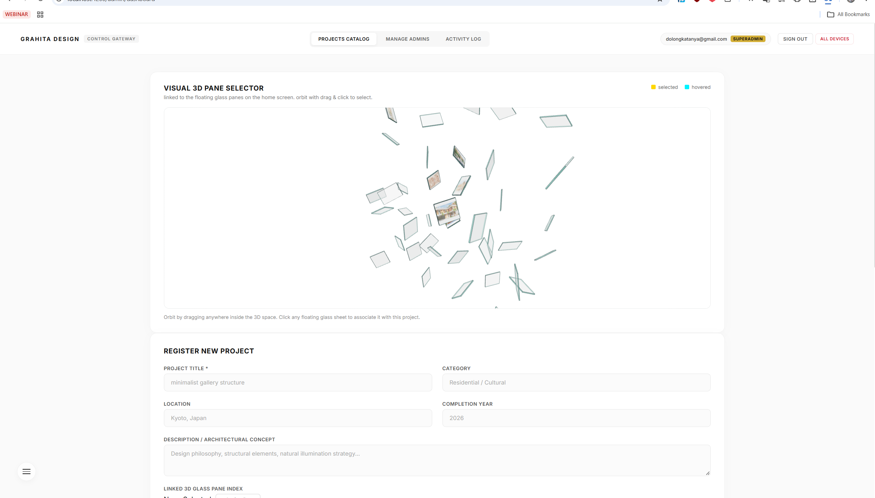
03 | PROJECT OUTCOMES (3/4)
Outcome 3: Secured Admin Content Management Dashboard
ADMINISTRATIVE CMS SPECIFICATIONS
• Authentication & Access Control: POST /auth/login verifies salted bcrypt password hashes and issues signed JSON Web Tokens (JWT) with 7-day expiration.
• Protected Mutation Routes: JwtAuthGuard enforces Bearer token validation across POST /projects, PUT /projects/:id, and DELETE /projects/:id.
• Multi-Image File Upload Pipeline: Configured Multer's FilesInterceptor with diskStorage in ProjectsController, storing uploaded photos in ./uploads/ with unique timestamped filenames.
• Granular Image Management: Implemented DELETE /projects/:id/images/:imageId with automatic disk cleanup (fs.unlinkSync) to prevent orphaned storage leaks.
• Client Autonomy: Studio staff can log into /admin/dashboard, upload new projects, update bilingual descriptions, and assign 3D cube slots without developer help.
[IMAGE / SCREENSHOT PLACEHOLDER]
Click to attach presentation image
Screenshot Guide & Description:
Insert screenshot of the Admin Dashboard (/admin/dashboard) showing the project catalog table, the multi-file upload dropzone, and the project editor modal with 3D cube index assignment.
Notes:
On Slide 6, we present our third outcome: the administrative CMS dashboard. A critical project goal was empowering GRAHITA Design to manage their portfolio independently. I built the administrative security layer using Passport.js and JWT tokens. All create, update, and delete endpoints are guarded by JwtAuthGuard. Using Multer disk storage, administrators can upload multiple photos at once. I also built physical filesystem cleanup routines: deleting a project or image immediately unlinks the file from disk, preventing storage leaks on the production server.

Slide 7
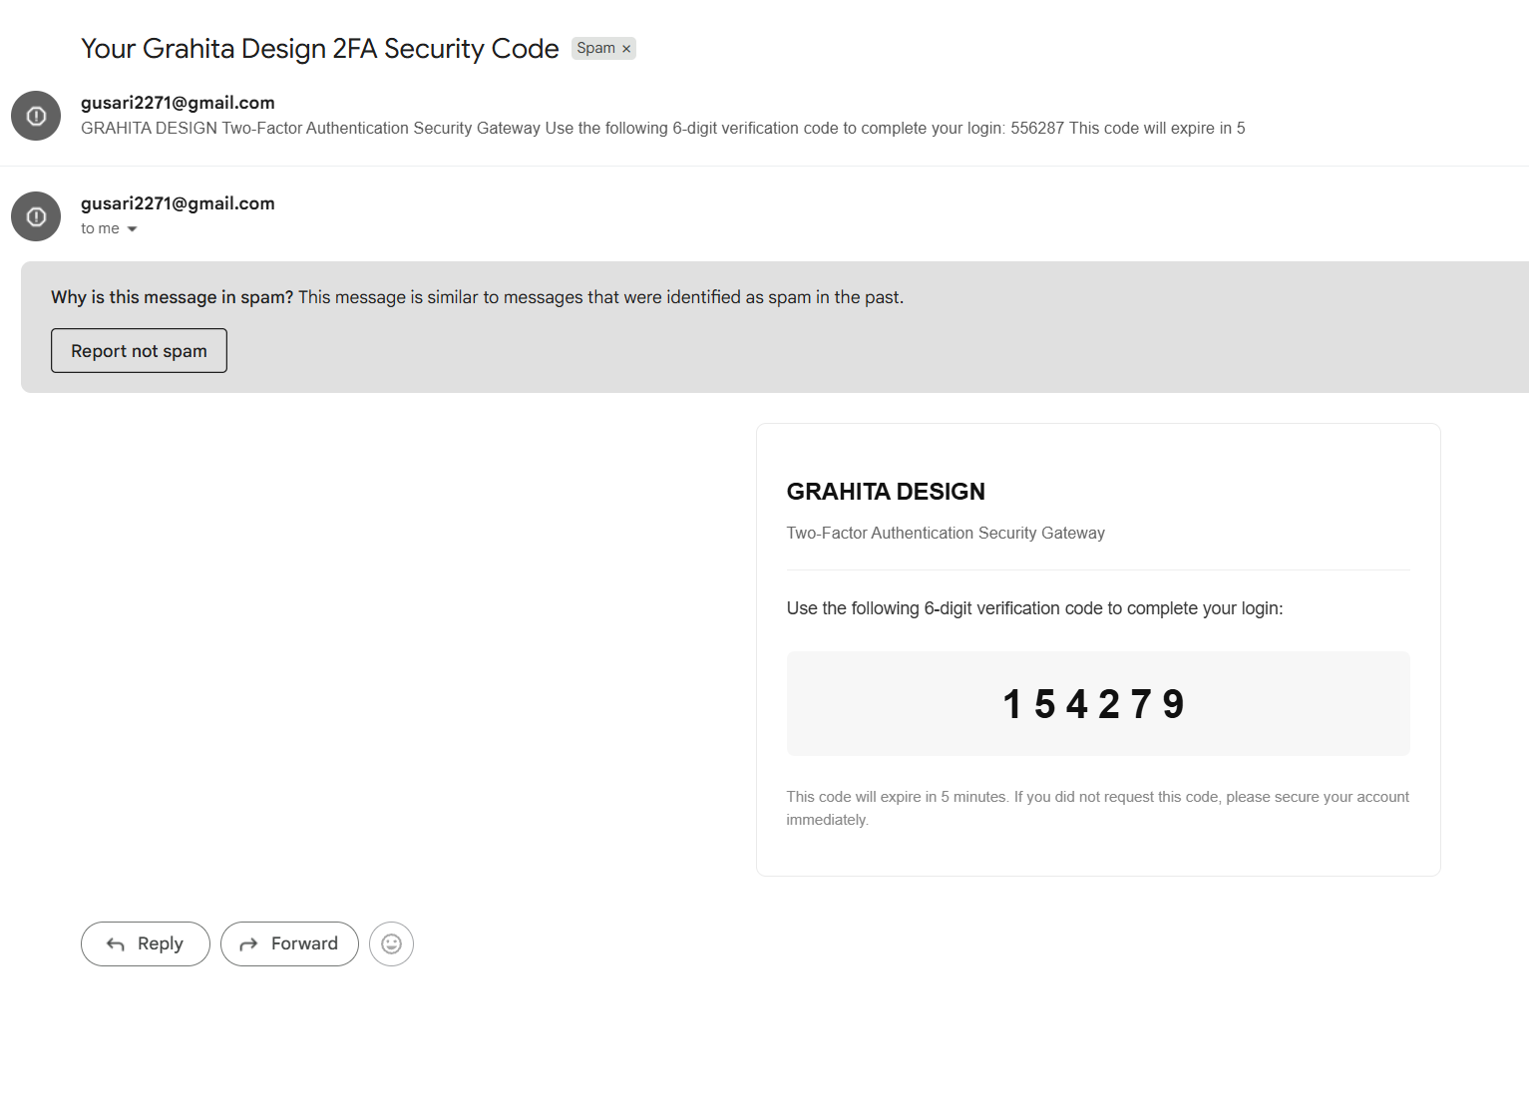
03 | PROJECT OUTCOMES (4/4)
Outcome 4: Backend API, Swagger Docs & Dual SMTP Mailer
API DOCUMENTATION & EMAIL PIPELINE
• Interactive Swagger OpenAPI (/api/docs): Integrated @nestjs/swagger with full DTO schemas and HTTP response definitions, providing a live interactive contract for frontend consumption.
• Asynchronous Dual Nodemailer Dispatch: MailModule dispatches two emails upon each contact form submission:
• Studio Admin Notification: Sends complete client inquiry to studio admin (gusari2271@gmail.com) with replyTo configured to client's email.
• Client Delivery Confirmation: Sends an immediate automated receipt confirmation to the prospective client.
• Graceful Simulation Mode: Fallback console logging ensures local developer testing never breaks if SMTP credentials are not yet populated in .env.
• Production Cloud Deployment: Deployed with PM2 process manager and Nginx reverse proxy on cloud hosting with production CORS whitelisting.
[IMAGE / SCREENSHOT PLACEHOLDER]
Click to attach presentation image
Screenshot Guide & Description:
Insert screenshot of the Swagger UI documentation (/api/docs) or Postman testing workspace, and a screenshot of test inquiry emails received in the inbox / terminal console dispatch logs.
Notes:
Slide 7 covers the fourth outcome: our API documentation and automated communication pipeline. To ensure seamless collaboration with frontend developer Kevin, I set up Swagger OpenAPI at /api/docs, providing living, interactive documentation. For client inquiries, I implemented a dual-dispatch email service using Nodemailer: the studio receives the inquiry with reply-to headers pointing to the client, and the client receives an automated confirmation receipt. I also added a simulation mode so that missing SMTP credentials in local testing gracefully log to console rather than throwing errors. The backend is fully deployed in production using PM2 and Nginx.

Slide 8
04 | INTERNSHIP GOALS & OUTCOMES (1/2)
Internship Goals & Technical Deliverables Alignment
INITIAL INTERNSHIP GOALS
• Master NestJS modular enterprise architecture and TypeScript dependency injection.
• Design normalized SQLite relational schema and implement TypeORM repository operations.
• Build secure authentication pipeline using Passport JWT and route guards.
• Implement robust file upload handling and dynamic static asset serving.
ACTUAL TECHNICAL OUTCOMES
• 100% of planned endpoints built, tested in Postman, and deployed to production.
• Engineered Project, ProjectImage, Contact, and User entities with cascading relationships.
• Implemented JwtAuthGuard protecting administrative mutation routes with bcrypt hashing.
• Integrated Multer multi-file uploads with physical disk cleanup routines (fs.unlinkSync).
EXCEEDED SCOPE DELIVERABLES
• Authored custom handleCubeIndexConflict algorithm for 3D Three.js WebGL slot coordination.
• Built asynchronous dual Nodemailer SMTP dispatch with simulation fallback.
• Implemented ThrottlerModule API rate limiting and helmet security headers.
• Constructed full-stack monorepo launch workflow via 'concurrently'.
Notes:
On Slide 8, we evaluate my personal internship goals against actual technical deliveries. At the start of the internship, my goals focused on mastering NestJS, learning TypeORM repository patterns, and implementing JWT auth. I achieved 100% of these baseline goals. Furthermore, I took the initiative to exceed the initial scope: I engineered the 3D cube conflict algorithm, implemented dual Nodemailer email automation, added rate limiting, and unified our monorepo developer scripts. This demonstrated proactive problem-solving and architectural initiative beyond minimum course requirements.

Slide 9
04 | INTERNSHIP GOALS & OUTCOMES (2/2)
Internship Outcomes: 94/100 Industry Evaluation
INDUSTRY EVALUATION
94 / 100
GRADE: EXCELLENT
Supervisor Feedback (Code Cipta):
"Agus demonstrated outstanding technical growth and initiative. He engineered the backend architecture with high quality, actively solved complex relational and spatial challenges, and maintained exceptional professional teamwork throughout the placement."
Weeks 1 – 4 | Planning & Schema Locking
Requirement gathering with Bli Dek, PRD/TRD authoring, SQLite schema locking, and NestJS scaffolding.
Weeks 6 – 9 | Core Modules & Bilingual Rework
Projects CRUD, Contact Inquiries with class-validator, and bilingual Chinese/English entity refactoring.
Weeks 10 – 12 | Auth & Production Deployment
Passport JWT authentication, JwtAuthGuard, production PM2/Nginx hosting setup, and Angular integration.
Weeks 13 – 14 | UAT, Handover & Deliverables
Formal client UAT sign-off with Bli Dek, automated backups, project handover on 30 Sept, and final report completion.
Notes:
Slide 9 highlights the formal evaluation outcomes. At the conclusion of the 12-week placement, my workplace supervisor at Code Cipta awarded me an industry evaluation score of 94 out of 100, which corresponds to an 'Excellent' rating. The supervisor commended my technical initiative in independently solving the 3D cube conflict problem, as well as my reliable communication. On the right side, the timeline illustrates our progression from early Waterfall schema planning to the successful client handover with Bli Dek on September 30th.

Slide 10
05 | PROFESSIONAL REFLECTION
Experience Gained: Academic Learning vs. Industry Reality
1. RELATIONAL ORM IN PRODUCTION
In university, database assignments focus on writing raw SQL queries on static test tables. In this internship, I learned how enterprise ORMs (TypeORM) manage entity state lifecycles, cascading child associations, and transactional queries, while synchronizing relational state with physical files stored on the server's disk.
2. MODULAR ARCHITECTURE & DI
Classroom coding often consists of monolithic scripts. At Code Cipta, I mastered NestJS's opinionated dependency injection container, modular providers, and custom decorators, learning how decoupled architectures make enterprise code testable, maintainable, and scalable.
3. ENTERPRISE SECURITY & HEADERS
I gained hands-on experience implementing multi-tiered security: configuring CORS whitelists for Angular, enforcing class-validator DTO sanitization, hashing passwords with salted bcrypt rounds, and applying helmet HTTP security headers.
4. CLOUD DEPLOYMENT & OPERATIONS
Moving beyond localhost:3000, I learned how to prepare production configurations (.env.production), set up PM2 process management with automatic reboot recovery, configure Nginx reverse proxies, and handle live HTTPS domain URL resolution.
Notes:
Slide 10 reflects on the technical experience gained. The internship bridged academic coursework with real-world industry engineering. In university, we learn relational algebra and basic SQL. In production, I learned how ORMs manage entity cascades and disk cleanup. I gained deep practical mastery in NestJS dependency injection, industry-standard JWT authentication, CORS preflight debugging, and cloud hosting operations with PM2 and Nginx. These experiences transformed my understanding from writing functional scripts to architecting production-grade server systems.

Slide 11
06 | CRITICAL INSIGHTS
Lessons Learned: Problem Solving & Engineering Best Practices
1. TEST COMBINED EDGE CASES EARLY
• During late Admin Dashboard testing, an intermittent error appeared when updating text and replacing gallery images in one request.
• Key Insight: Individual CRUD tests pass easily, but multi-field combination updates reveal subtle ORM cascade detachment bugs.
• Takeaway: Schedule combined-field and edge-case integration tests earlier in sprint cycles rather than in final acceptance testing.
2. LIVING API CONTRACTS (SWAGGER)
• Early informal verbal agreements with the frontend developer caused minor payload mismatches (e.g. image array naming conventions).
• Key Insight: Verbal alignment quickly drifts during rapid iterations.
• Takeaway: Integrate Swagger OpenAPI (@nestjs/swagger) and synchronized Postman collections from Day 1 to maintain an authoritative single source of truth.
3. DEFENSIVE DESIGN & AUTOMATED SAFETY
• External services and runtime environments often behave unpredictably (e.g. missing SMTP credentials on local dev machines).
• Key Insight: Systems must be designed to degrade gracefully without breaking primary database transactions.
• Takeaway: Build simulation fallbacks and establish automated database backup scripts before handing administrative access to clients.
Notes:
Slide 11 examines the key lessons learned. First, I learned the importance of testing combined edge cases early. The intermittent admin gallery update issue only surfaced when modifying text and uploading photos in the same request; isolating it taught me that integration testing must test complex composite payloads early in development. Second, contract-first design is indispensable: using Swagger and Postman eliminated communication drift between Kevin and myself. Third, defensive engineering—such as simulation fallback for our mailer and automated SQLite backups—ensures production resilience.

Slide 12
07 | STAKEHOLDER COLLABORATION
Communication: Team Interactions & Interpersonal Dynamics
PEER COLLABORATION (FRONTEND)
Collaborated daily with Kevin Wiratama (Frontend Developer) via Discord and GitHub pull requests. We established written API contracts in Postman, aligned CORS preflight policies, and resolved image upload boundaries. Pairing directly on Three.js WebGL data binding ensured our backend cubeIndex mapped perfectly to the 3D raycaster.
CLIENT ENGAGEMENT (MARDIKA)
Engaged in bi-weekly milestone reviews and the formal UAT session with GRAHITA Design's studio principal, Bli Dek. Translated architectural requirements into data structures, adapted to the mid-project bilingual Chinese/English request, and executed a smooth handover on 30 September 2026, delivering administrative credentials and user guides.
SUPERVISOR MENTORSHIP & REVIEWS
Participated in weekly sprint reviews with my supervisor at Code Cipta. Presented live API demonstrations, discussed schema decisions, and incorporated feedback on code cleanliness and migration safety. Practiced active listening and transparent defect reporting, which built trust and earned an 'Excellent' evaluation.
THE VITAL IMPORTANCE OF COMMUNICATION
Technical skill alone cannot deliver software. Proactive communication, written contracts, and transparent status updates prevented scope misunderstandings and integration bottlenecks. Effective cross-functional collaboration was the single most critical factor in delivering a production-ready spatial platform on schedule.
THANK YOU FOR YOUR TIME & ATTENTION | OPEN FOR QUESTIONS & ANSWERS (Q&A)
I Putu Agus Aribawa | Student ID: E2400080 | BIT320 Industrial Internship | Code Cipta & GRAHITA Design
Notes:
In our final slide on Slide 12, we highlight communication and interpersonal teamwork. A successful software project relies on clear human collaboration as much as code. Working with Kevin on the Angular frontend taught me the power of written API contracts and collaborative debugging. Weekly supervisor reviews sharpened my ability to present technical solutions and receive constructive criticism. Engaging directly with our client, Bli Dek, developed my professional communication skills, translating business needs into data schemas. This conclude my internship presentation. I would like to express my sincere gratitude to my supervisor at Code Cipta, my lecturers at HELP University, and my colleague Kevin. Thank you very much, and I welcome any questions.

