Slide 1
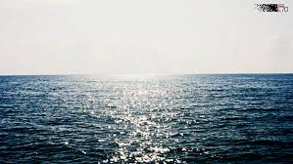
Gus is here!
This is the sea

