Slide 1
UNI92K
UFS SW개발 문서
개발본부 S/W2팀
조창희 주임

Slide 2
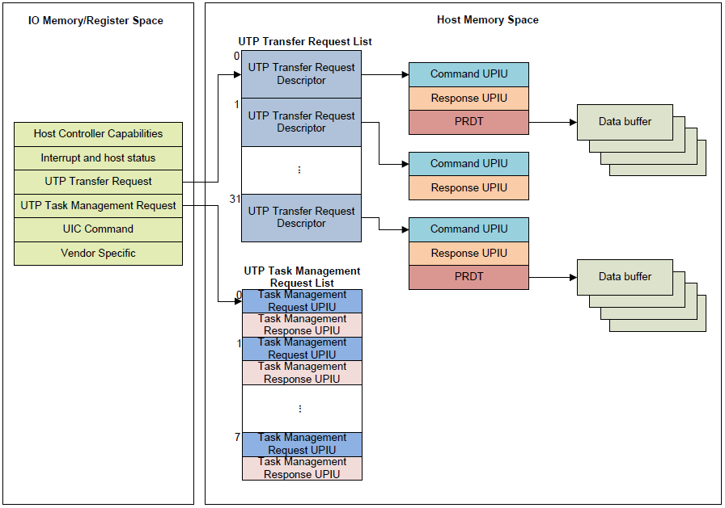
UFS Overview
General architecture of UFS Host Controller Interface
UFSHCI

Slide 3
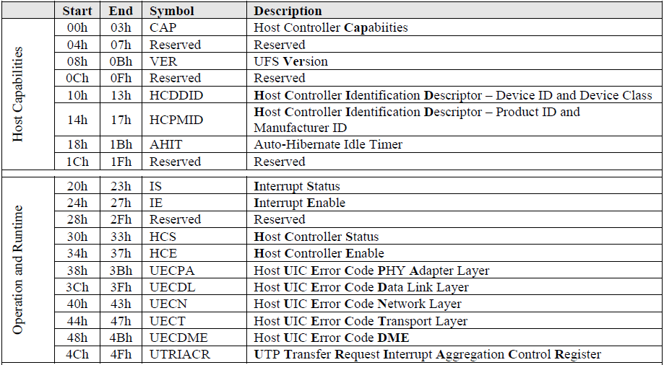
UFS Overview
UFSHCI Register Map
Standard register map for UFSHCI.

Slide 4
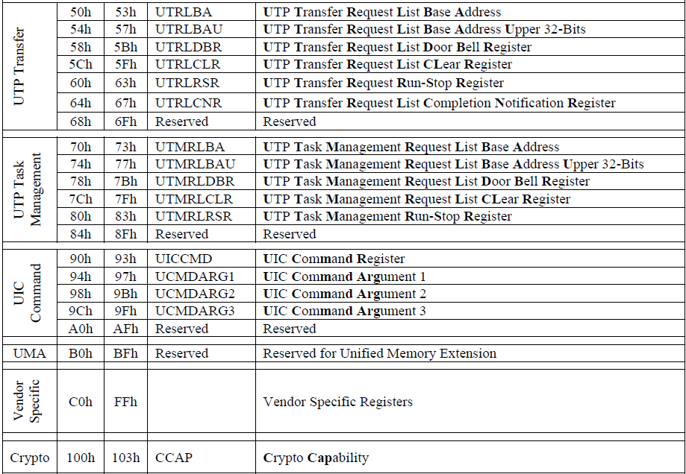
UFS Overview
UFSHCI Register Map
Standard register map for UFSHCI.

Slide 5
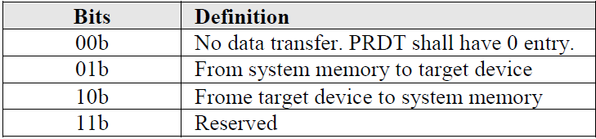
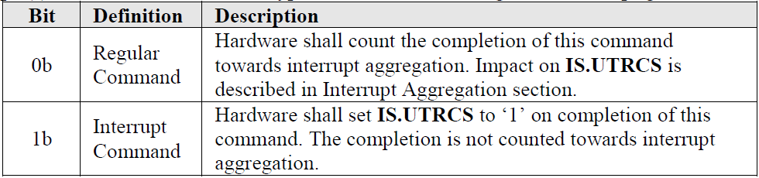
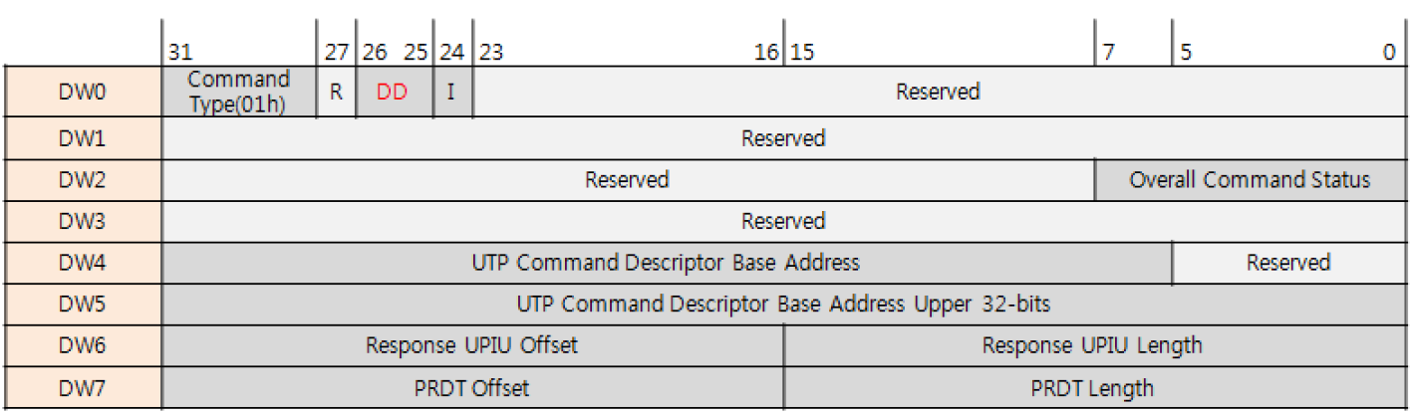
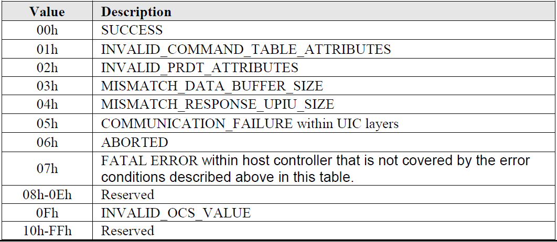
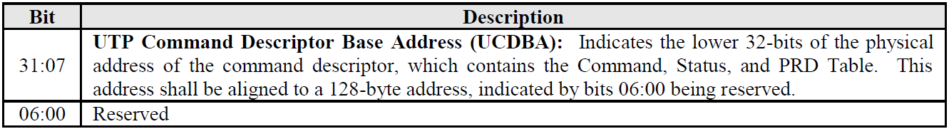
UFS Overview
UFS Transfer Request List
UTP transfer request descriptor
Data Direction
Interrupt
UFS Storage (01h)
Contains a pointer for a UTP Command Descriptor (UCD)

Slide 6
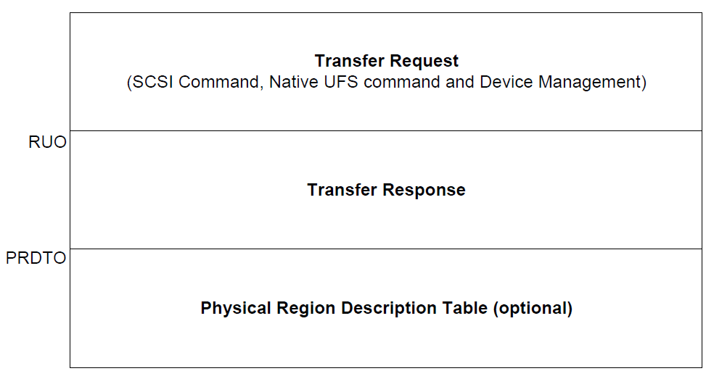
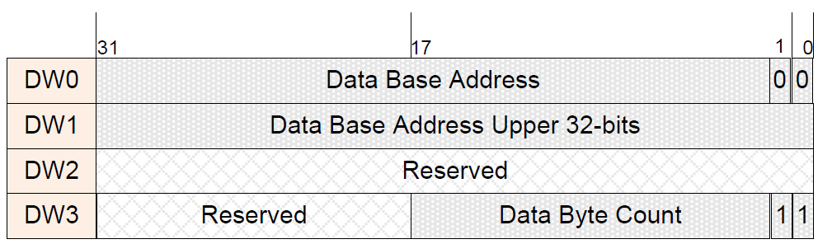
UFS Overview
UFS Transfer Request List
UTP command descriptor
Data structure for PRDT

Slide 7
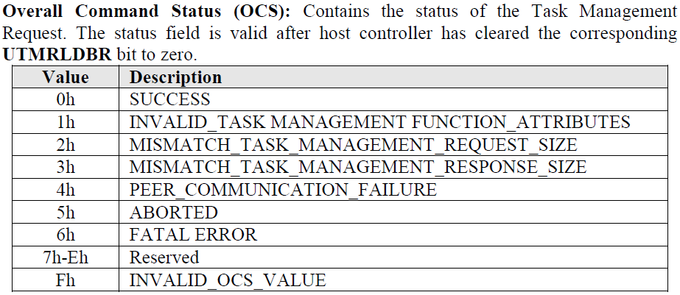
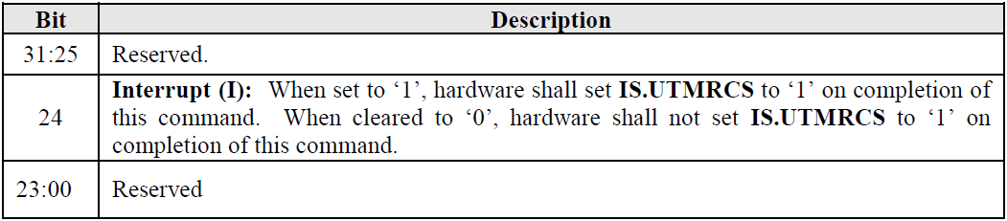
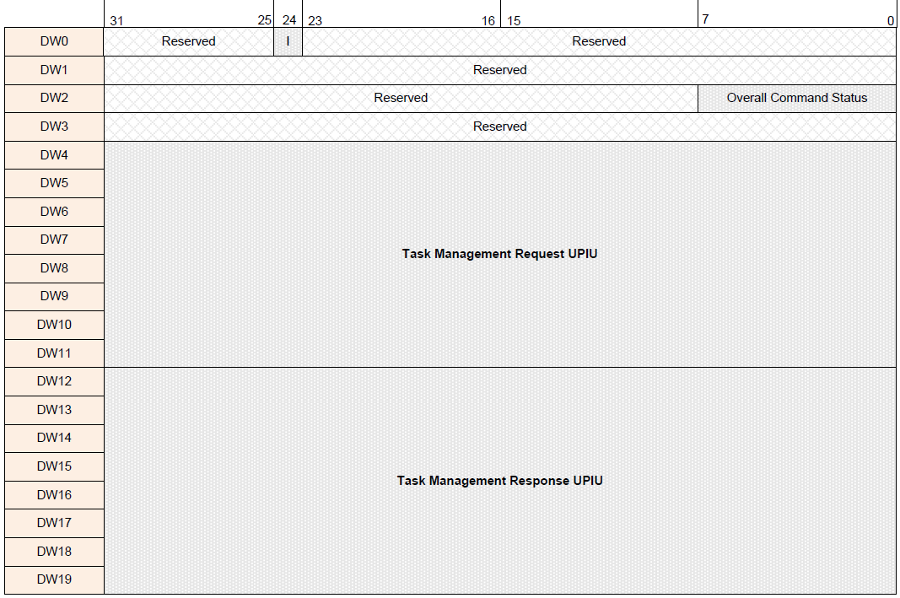
UFS Overview
UTP Task Management Request List
UTP task management request descriptor
Little endian format
Big endian format

Slide 8
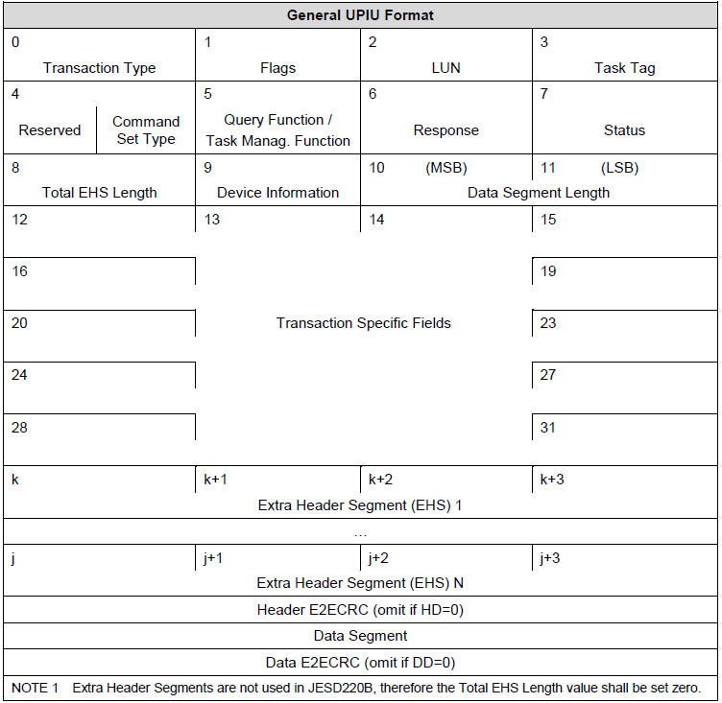
UFS Overview
UPIU (UFS Protocol Information Unit) format
UPIU total size
Integer Multiple of 32-bits
Smallest sized UPIU is 32 bytes
UPIU types
COMMAND UPIU
RESPONSE UPIU
DATA OUT UPIU
DATA IN UPIU
READY TO TRANSFER UPIU
TASK MANAGEMENT REQUEST UPIU
TASK MANAGEMENT RESPONSE UPIU
QUERY REQUEST UPIU
QUERY RESPONSE UPIU
REJECT UPIU
NOP OUT UPIU
NOP IN UPIU
Basic header format

Slide 9
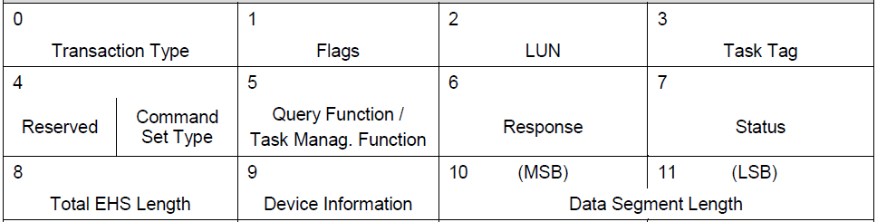
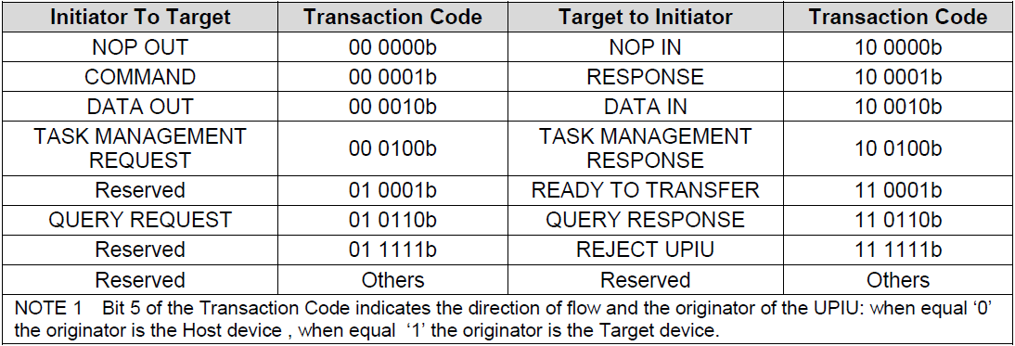
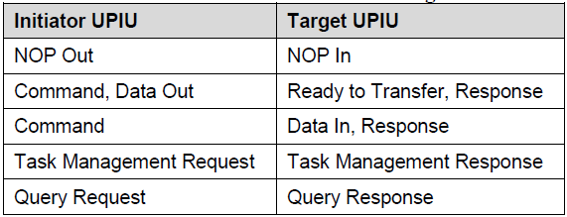
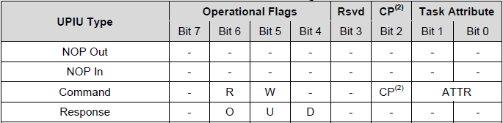
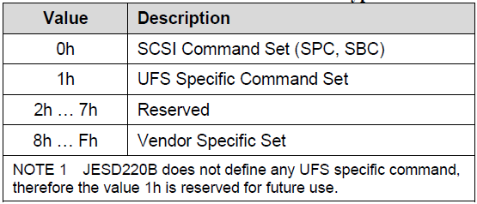
UFS Overview
UPIU (UFS Protocol Information Unit) format
Basic header format
0 - Transaction Type
2 - Logical Unit Number of target device
3 - Task Tag ( Queue )
1 - Flag: Vary with transaction type
4 - Command Set Type

Slide 10
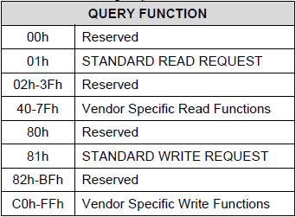
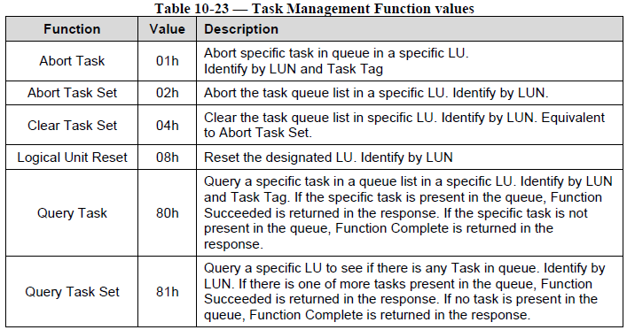
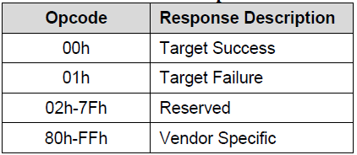
UFS Overview
UPIU (UFS Protocol Information Unit) format
Basic header format
5 - Be used in QUERY, TASK MAG. Function
6 - Response
7 - SCSI status (RESPONSE UPIU with CMD set type = 0x00)

Slide 11
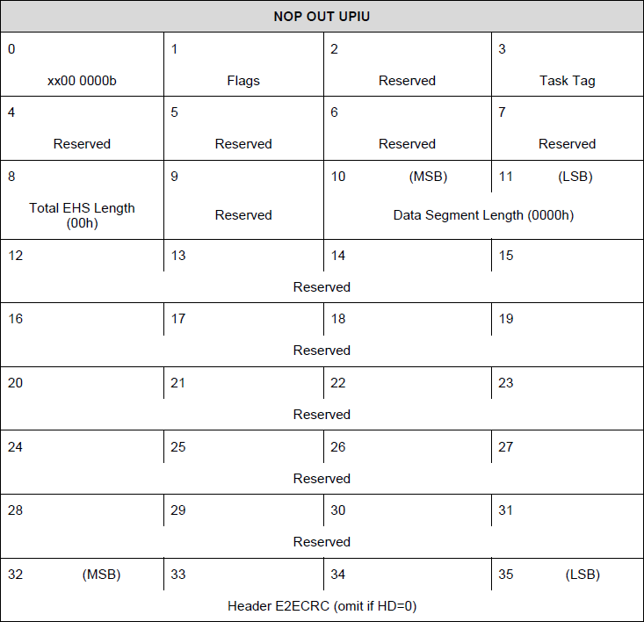
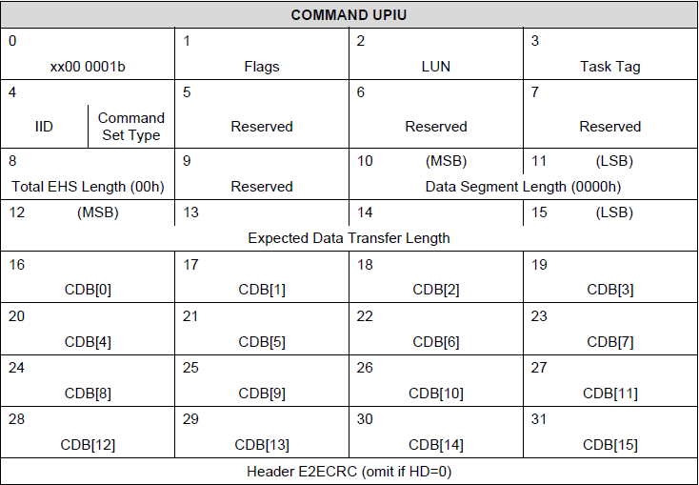
UFS Overview
UPIU (UFS Protocol Information Unit) format

Slide 12
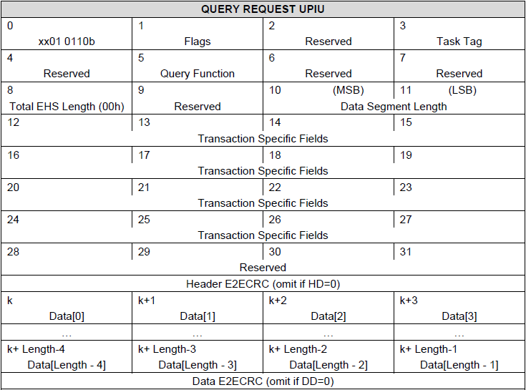
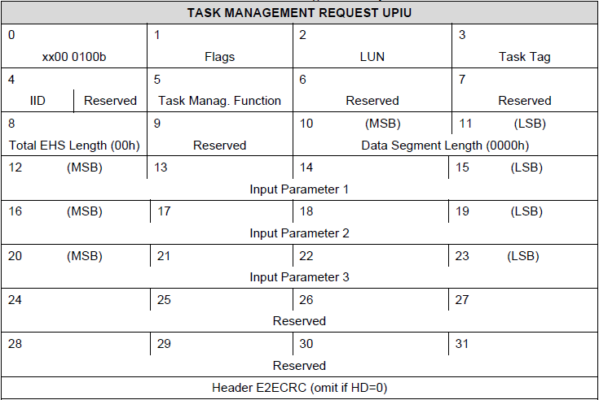
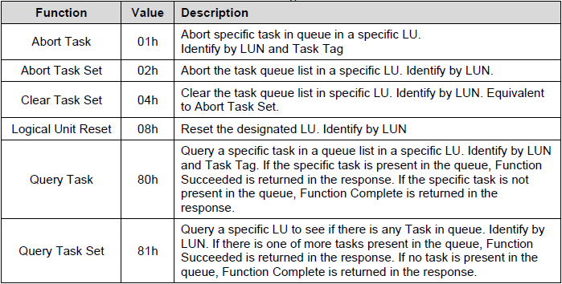
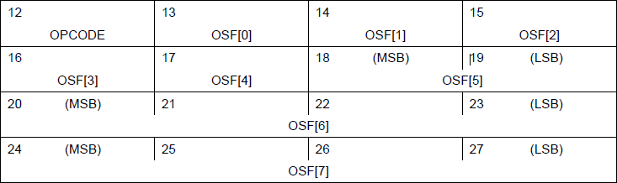
UFS Overview
UPIU (UFS Protocol Information Unit) format
LUN
Task Tag
IID

Slide 13
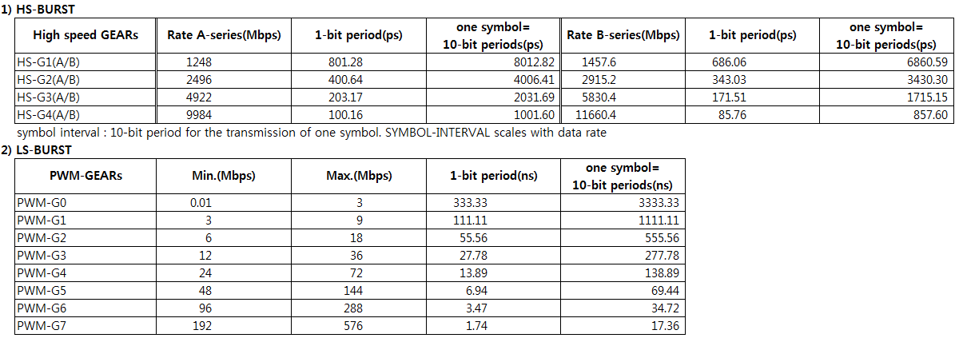
UFS Overview
RATE Series and GEARs

Slide 14
UFS Initialize Host
Set PA Layer
TX HS G1 Sync Length
TX HS G1 Prepare Length
TX HS G2 Sync Length
TX HS G2 Prepare Length
TX HS G3 Sync Length
TX HS G3 Prepare Length
TX HS G4 Sync Length ( UFS 3.0 )
TX HS G4 Prepare Length ( UFS 3.0 )
Peer RX HS Adapt Refresh ( UFS 3.0 )
Peer RX HS Adapt Initial ( UFS 3.0 )
TX HS Adapt Type ( UFS 3.0 )
Adapt After LRST InPA_INIT ( UFS 3.0 )
TX MK2 Extension
Peer Scrambling
TX Skip
TX Skip period
Local TX LCC Disable
Peer TX LCC Enable
Scrambling
MK2 Extension Guardband
TX Trailing locks
AFC0 Req Time out val
Initialize Host
START
Set HS GEAR
Set DRP
HCE Disable & Check
HCE Enable & Check
Interrupt Enable
Set DMA Addr (Transfer Req. List)
Set DMA Addr (Task Mang.)
Set Retry Timer
Set PA Layer
Set Symbol Clock
END

Slide 15
UFS Link Startup
Initialize Link Startup
START
Device Reset
UIC LinkStartup Cmd
NOP OUT UPIU
Query – Set Flag( fDeviceInit ) & Check
Query – Write Desc.( Config Desc. )
CMD UPIU ( Test Unit Ready ) & Check
END

Slide 16
UFS Set Power Mode
Set Power Mode
START
Set PA Layer
TX Gear
RX Gear
TX Termination
RX Termination
Active TX Data Lanes
Active RX Data Lanes
HS Series
TX HS Adapt Type ( UFS 3.0 )
Power Mode User Data 0
Power Mode User Data 1
Power Mode User Data 2
FC0 Protection Timeout Attribute
TC0 Replay Timeout Attribute
AFC0 Request Timeout Attribute
Power Mode
Set HS GEAR
Set RX CDR Config
GTX Reset
Set PA Layer
END

Slide 17
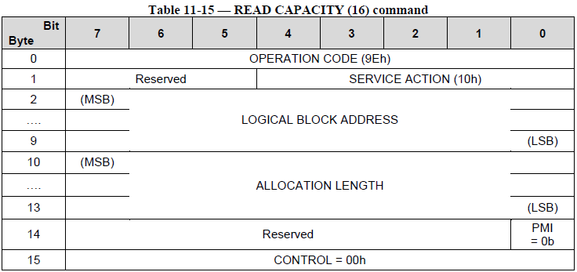
UFS Command UPIU Operation
Command UPIU Operation
Ex) Read Capacity16 CMD
START
Transfer Request List
CDB Setting
0x2
0x1
Command UPIU Setting
0x0
Transfer Request List Setting
0xC
0xD
Issue Door Bell & Interrupt Check
0x1C
0x1
Clear Completion Notification
CMD UPIU Start Address
OCS & Response Check
0x40
0x0
1 Queue
END
0x0
32

Slide 18
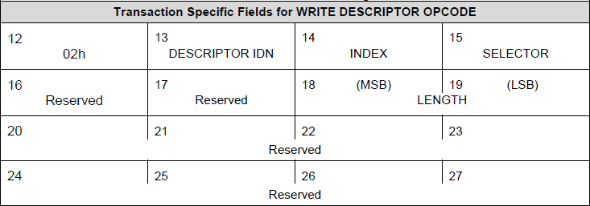
UFS Query UPIU Operation
Query UPIU Operation
Ex) Write Descriptor ( Configuration Descriptor )
START
Transfer Request List
Query UPIU Setting
Transfer Request List Setting
0x1
0x1
0x0
Issue Door Bell & Interrupt Check
Clear Completion Notification
0x48
0x48
0x0
0x0
OCS & Response Check
Query UPIU Start Address
END
0x0
1 Queue
0x81
0x0
0x0
0x0
Data Length
Data Length
Descriptor Format

Slide 19

UFS Task Management UPIU Operation
Task Management UPIU Operation
START
Ex) Abort Task Function
Task Manag. UPIU Setting
Task Management Request List
Task Manag. Request List Setting
0x1
Issue Door Bell & Interrupt Check
0xF
OCS & Response Check
END
0x0
0x0
Queue
0x0
0x1
0x0
Queue
0x0

Slide 20
UFS RPMB
PMB Resources
Authentication Key
Type : Write once, not erasable or readable
Size : 32 Bytes
Authentication key register는 MAC이 calculate되었을 때 authenticate access에 사용된다.
Write Counter
Type : Read only
Size : 4bytes
authenticated data write requests의 성공된 총 횟수
programming access가 성공적으로 끝날때마다 UFS device에 의해 '1'씩 자동으로 증가. ( Reset 불가능 )
Counter 값이 maximum value인 FFFF_FFFFh에 도달하면 더 이상 증가하지 않는다.(overflow prevention)
RPMB Data Area
Type : Readable and writable
Size : Multiples of 128Kbytes defined in RPMB Unit Descriptor
Data는 인증된 write/read access를 통해서만 read되거나 write될 수 있다. ( Overwrite 가능, Erase 불가능 )
Algorithm and Key for MAC Calculation
MAC(Message Authentication Code)는 [HMAC-SHA]에 정의되어 있는 HMAC SHA-256을 이용하여 만들어진다.
HMAC SHA-256은 input key와 message를 이용.
생성된 MAC은 256bits(32bytes)의 크기를 갖고 request나 response의 data frame에 삽입되어진다.

Slide 21
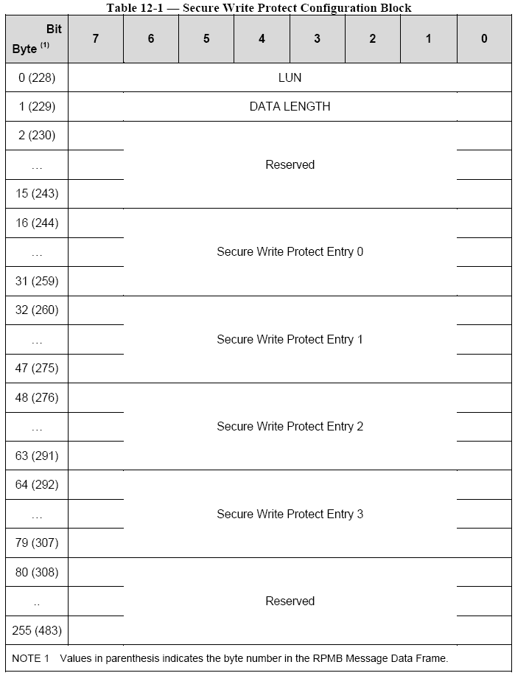
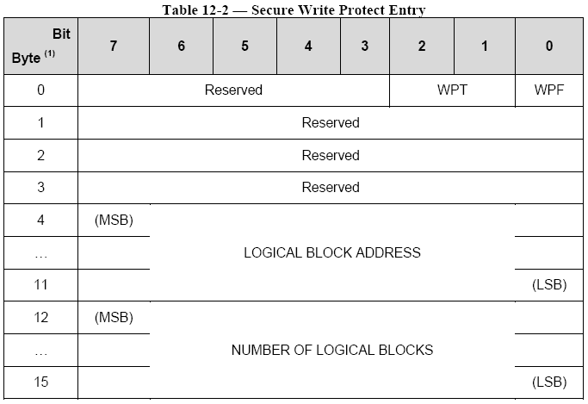
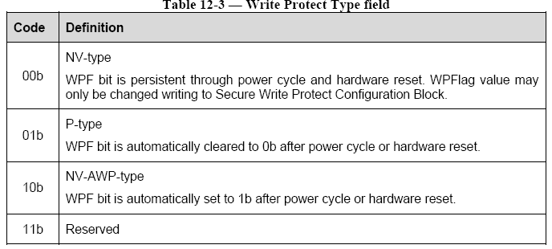
UFS RPMB
RPMB Resources
Secure Write Protect Configuration Block
Type : Readable and writable
Size : 256Bytes
logical unit에 secure write protect area를 설정하기 위해 사용
각각의 logical unit은 하나의 Secure Write Protect Configuration Block을 가지고 있음.
각각의 Secure Write Protect Configuration Block은 네 개의 Secure Write Protect Entries를 가지고 있다.
각각의 entry는 하나의 secure write protect area를 나타낸다.
WPF(Write Protect Flag)
0b : Secure Write Protection disabled
1b : Secure Write Protection enabled
0~bMaxNumberLU
16:one entry, 32:Two entries….
Write Protect configuration Block

Slide 22
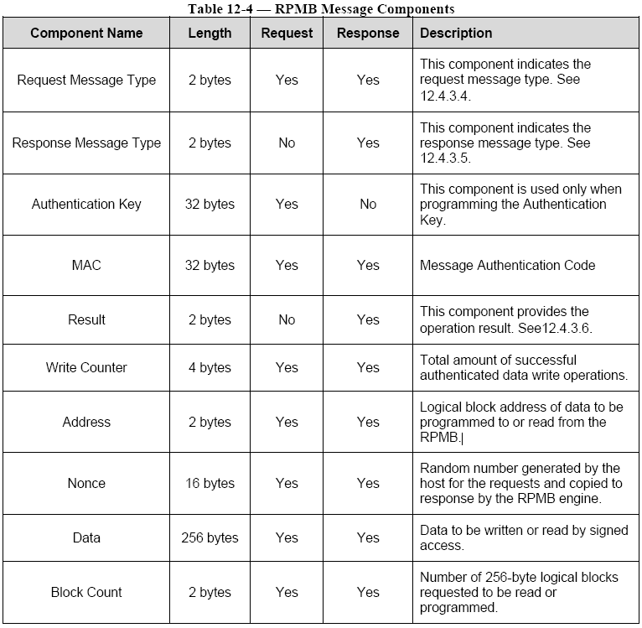
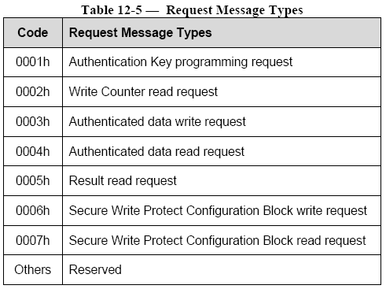
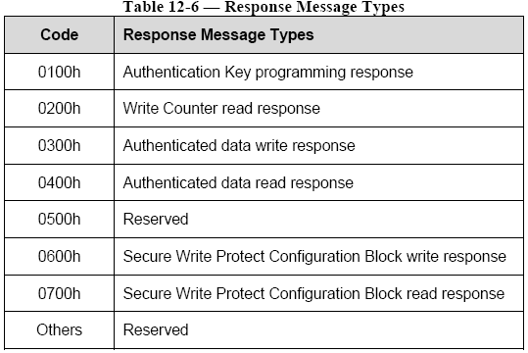
UFS RPMB
RPMB Resources
Algorithm and Key for MAC Calculation
MAC(Message Authentication Code)는 [HMAC-SHA]에 정의되어 있는 HMAC SHA-256을 이용하여 만들어진다.
HMAC SHA-256은 input key와 message를 이용한다.
생성된 MAC은 256bits(32bytes)의 크기를 갖고 request나 response의 data frame에 삽입되어진다.
MAC calculation을 위해 사용되는 256bit의 Authentication Key는 UFS device에 저장된다.
RPMB Message Components

Slide 23
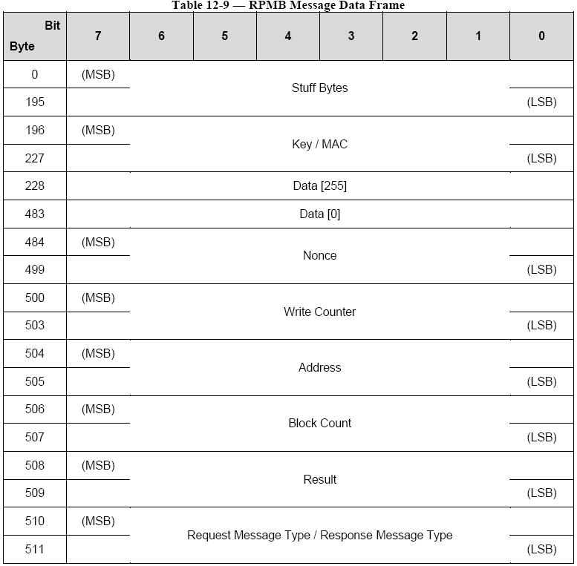
UFS RPMB
RPMB Message
RPMB Message Data Frame size는 512bytes이며 아래와 같이 구성된다.

Slide 24
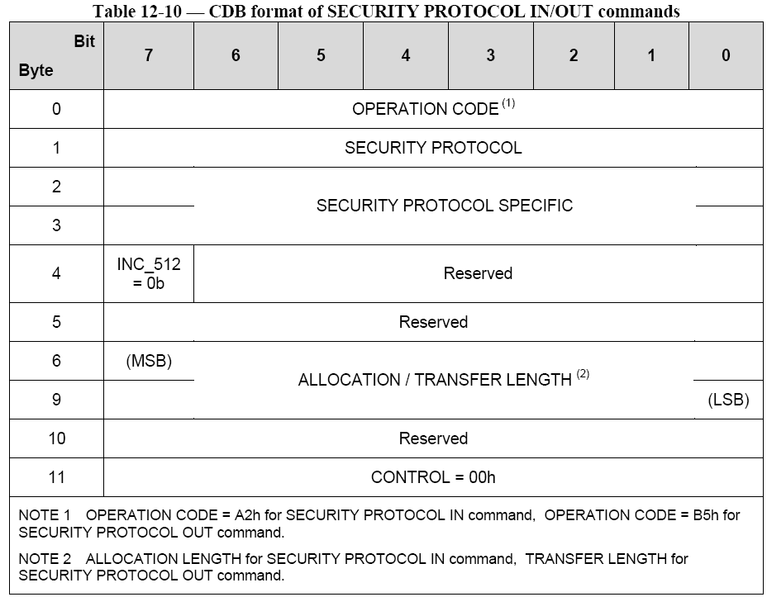
UFS RPMB
SECURITY PROTOCOL IN/OUT Commands
RPMB Security Data를 사용하기 위해서는 SECURITY PROTOCOL IN/OUT Commands를 사용한다.
00h : Security protocol information
Ech : JEDEC Universal Flash Storage
0000h : supported security protocol list
0001h : Certificate data
ALLOCATION LENGTH
SECURITY PROTOCOL IN command일 때 512의 배수가 아니면 해당 command는 CHECK CONDITION status와 함께 종료된다.
TRNASFER LENGTH
SECURITY PROTOCOL OUT command일 때 512의 배수가 아니면 해당 command는 CHECK CONDITION status와 함께 종료된다.

Slide 25
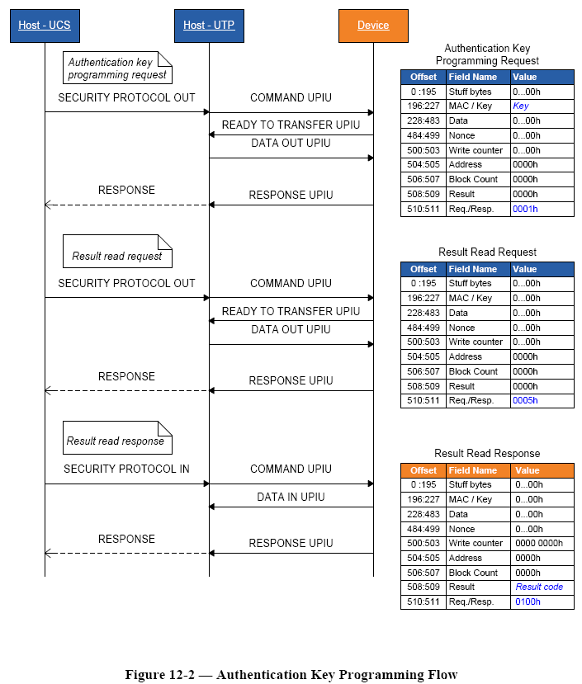
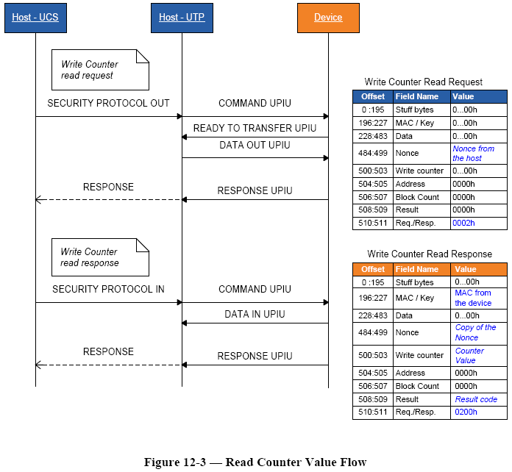
UFS RPMB
Authentication Key Programming
Read Counter Value

Slide 26
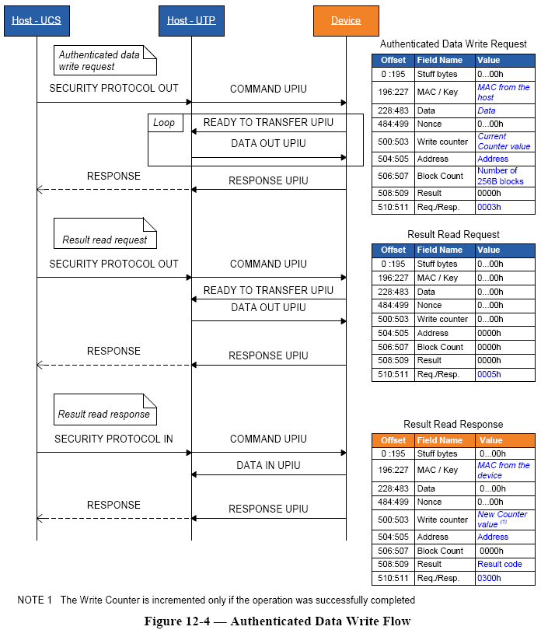
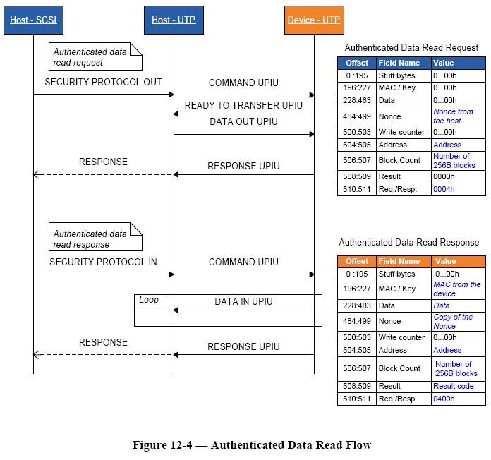
UFS RPMB
Authenticated Data Write
Authenticated Data Read

Slide 27
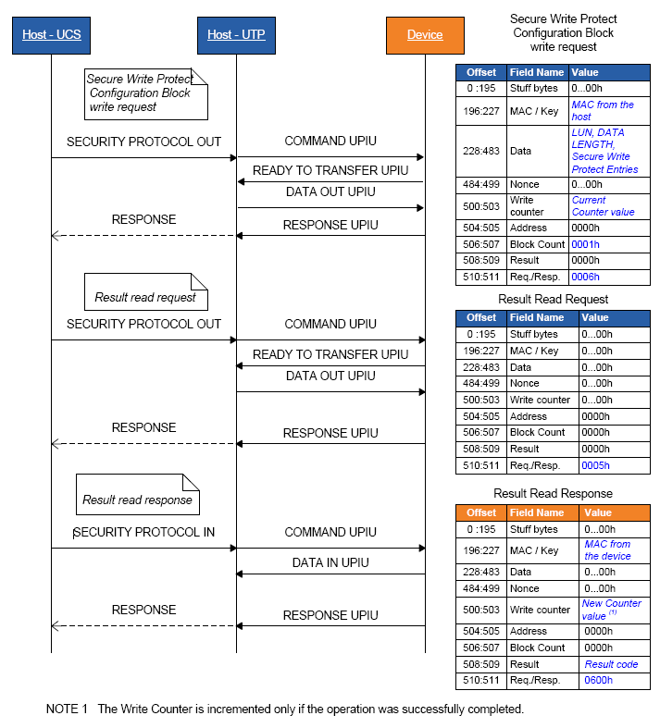
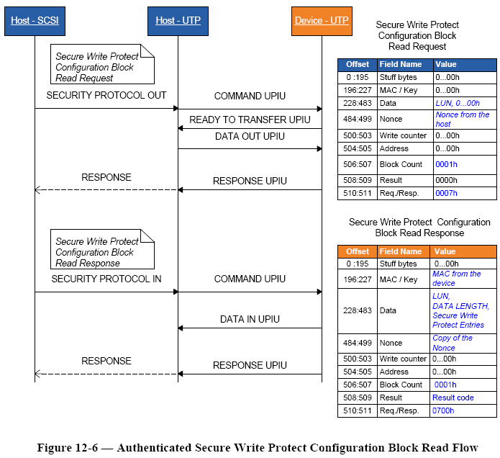
UFS RPMB
Authenticated Secure Write Protect Configuration Block Write
Authenticated Secure Write Protect Configuration Block Read

Slide 28
Thank You For Your Attention
감사합니다.

