Slide 1
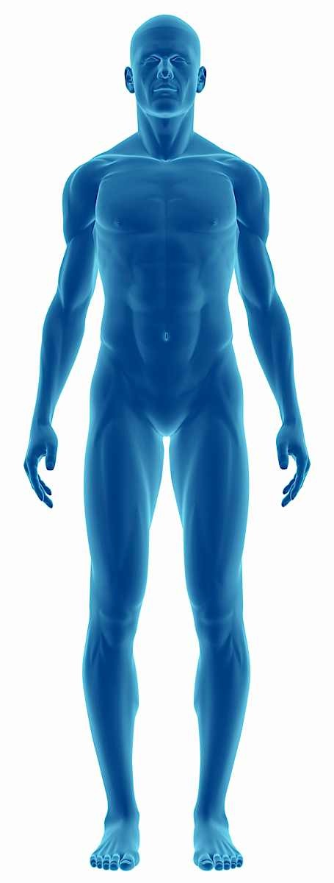
Fall Detection using wearable sensor data

Slide 2
Motivation
Falls are the second leading cause of accidental or unintentional injury deaths worldwide (behind only of road traffic injuries)
Almost 50% of older adults who fall experience a minor injury
25% will experience a more serious injury such as a fracture
Less then 50% who fell tell their doctor they have had a fall
Each year, 2.8 million are treated in emergency departments for fall injuries

Slide 3
Research
A comparison of accuracy of fall detection algorithms (threshold‑based vs. machine learning) using waist‑mounted tri‑axial accelerometer signals from a comprehensive set of falls and non‑fall trials (SFU, 2015)
Waist sensor
Tri-axial (X, Y and Z) Acceleration data
Collected data, but not used:
Six other sensors (head, sternum, left and right tights, left and right ankles)
Tri-axial measurements: Gyro and Magnetic Fields

Slide 4
Research
Sensitivity (Recall) = $\frac{True Positive}{True Positive+False Positive}$ Specificity = $\frac{True Negative}{True Negative+False Positive}$

Slide 5
Project Plan
Understand the problem
SFU Research
Exploratory Data Analysis
Other Sensors
Preprocessing
Mean and Variance
2.5s groups
Model
Primary Goal
Secondary Goals
Replicate Research (best Model)
Fall Detection (80% accuracy atm)
Fall Prediction
Improve Models
Quality Check
Real time data
Not Initialized
Initialized
Completed

Slide 6
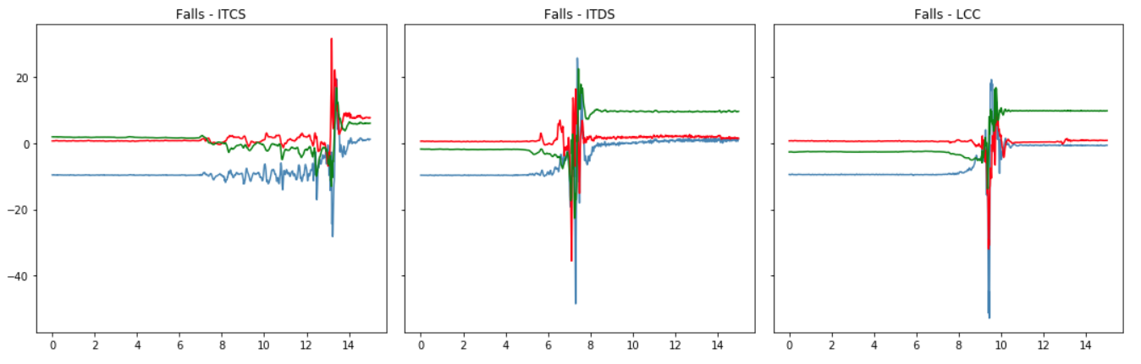
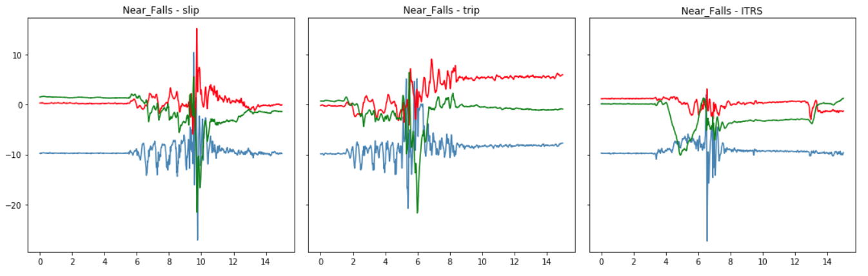
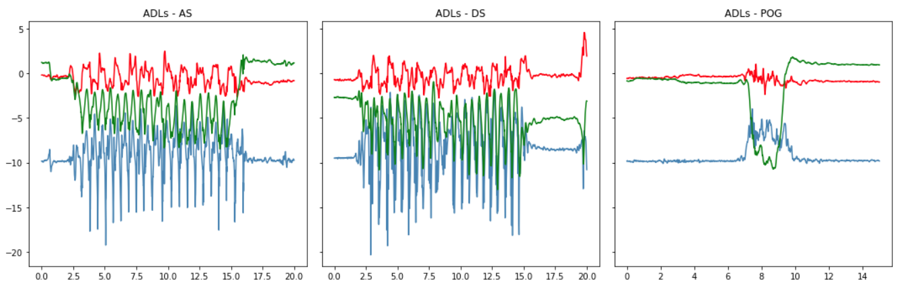

Exploratory Data Analysis
Falls
Near Falls
Activities of Daily Life

Slide 7
Thank You! Gustavo Felhberg Jorge Marcano Muhammad Muhaimin
Fall Detection using wearable sensor data

