Slide 1
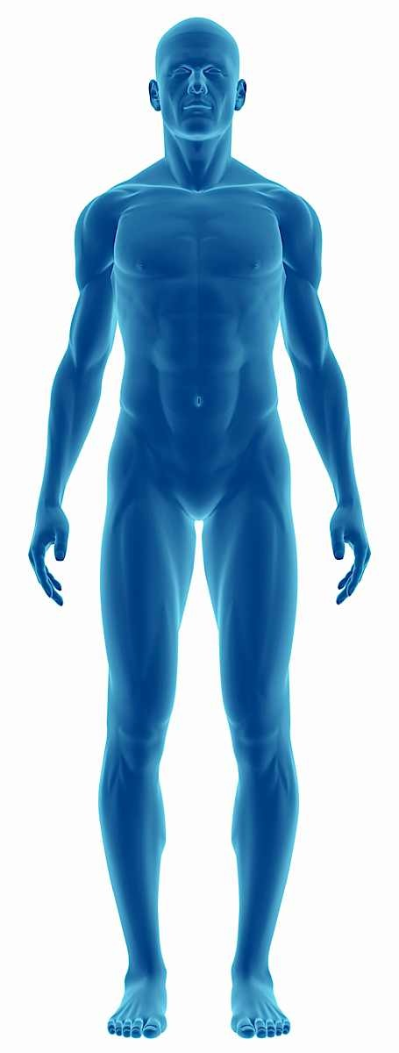
Fall Detection using wearable sensor data

Slide 2
Motivation
Falls are the leading cause of injury-related morbidity and mortality among older adults
Almost 50% of older adults who fall experience a minor injury
25 % will experience a more serious injury such as a fracture
A study shows that:
70 % of older adults who had fallen were unable to get up unaided
20 % of patients admitted to hospital as a result of a fall had been on the ground for an hour or more

Slide 3
Research
A comparison of accuracy of fall detection algorithms (threshold‑based vs. machine learning) using waist‑mounted tri‑axial accelerometer signals from a comprehensive set of falls and non‑fall trials (SFU, 2015)
Waist sensor
Tri-axial (X, Y and Z) Acceleration data
(include some more information)

Slide 4
Research
(change the graphic, leaving or Sensitivity or Specificity data)

Slide 5
Goals
Fall Detection
Improve the results of research
Use different Machine Learning algorithms
Fall Prediction
Identify a fall before it happens
Use data from other sensors
Collect and Analyze sensor data in real time
Streaming techniques

Slide 6
Current Situation
Exploratory Data Analysis
Preprocessing
Model
Streaming

Slide 7
Thank You! Gustavo Felhberg Jorge Marcano Muhammad Muhaimin
Fall Detection using wearable sensor data

