Slide 1
Real-Time Task Scheduler Simulator using Dual Indexed Min-Heaps (Binary and Fibonacci)
CS603 Advanced Data Structures and Algorithms
Second Review · 2 November 2026
Presented by
Submitted to
Name | Roll No.
Sriram Paranthaman | 206126034
Tejas Mishra | 206126035
Dr. (Ms.) Rajeswari Sridhar
Professor
Department of Computer Science and Engineering
NIT Tiruchirappalli
Notes:
[Sriram] Good morning, ma'am. This is our second review. As required, we will show the implementation status, the test cases and the evaluation metrics we will use. The focus of the project is the data structure behind the scheduler: an indexed binary heap and a Fibonacci heap.

Slide 2
Where We Are
A real-time scheduler keeps its tasks in two priority queues. We build both queues as an indexed binary heap and as a Fibonacci heap, and compare them.
10 / 12
24 / 24
0
planned work items shown today (requirement: 60%)
test cases pass
mismatches with theory in 132,000 simulations
Requirement for this review | Where | Slides
1. 60% implementation | Status, design of the two heaps, demo | 3 – 8
2. Test cases | 24 test cases, TC01 – TC24 | 9 – 11
3. Evaluation metrics to be used | Data-structure, correctness and scheduling metrics | 12 – 14
Notes:
[Sriram] In one line: a real-time scheduler keeps its tasks in two priority queues, and we build those queues as an indexed binary heap and as a Fibonacci heap. Today, ten of our twelve planned work items are done, which is above the sixty percent required. All twenty-four test cases pass, and in one hundred and thirty-two thousand simulations the scheduler never disagreed with real-time theory. The table shows where each requirement of this review is covered.

Slide 3
Implementation Status
# | Work item | Module | Status
1 | Task generator (UUniFast) | M1 | Done
2 | Indexed binary heap (Sleep and Ready queue) | M2, M3 | Done
3 | Fibonacci heap (Sleep and Ready queue) | M2, M3 | Done
4 | Sorted-list queue (FreeRTOS style), baseline | M2, M3 | Done
5 | Dispatcher and job completion (RM and EDF) | M4, M5 | Done
6 | Metrics and log | M6 | Done
7 | Theory tests (Liu-Layland, hyperbolic, RTA, EDF) | M7 | Done
8 | Verdict check (simulator vs theory) | M8 | Done
9 | Test suite (24 test cases) | all | Done
10 | Visualisation: terminal and browser viewer | all | Done
11 | Red-black tree queue (as in Linux), for comparison | M2, M3 | Final review
12 | Data-structure benchmark, graphs, analysis | all | Final review
83%
10 of 12 work items done (requirement: 60%)
34
C++17 source files, about 3,100 lines including comments and tests
0
external libraries: builds with CMake or one g++ command
Notes:
[Sriram] This is our plan of twelve work items. Ten are done and shown today: all eight modules, both heaps, the sorted-list baseline, the test suite, and the visualisation in the terminal and the browser. The last two items are planned for the final review: a red-black tree, which is what Linux uses, to compare with existing work, and the full data-structure benchmark with graphs and analysis. Everything is in C++17 with no external libraries, about three thousand one hundred lines including comments and tests.

Slide 4
One Scheduler, Interchangeable Queues
Module 5: job finished → back to sleep until release + period
Task generator
Module 1 (UUniFast)
Sleep queue
Module 2 · key = wake-up time
Ready queue
Module 3 · key = period / deadline
Dispatcher
Module 4 · runs the top job
On top
Module 6: metrics
Module 7: theory tests
Module 8: verdict check
TaskQueue interface
insert · peek · extractMin · remove · update · decreaseKey
Switch in one word
makeQueue("binary")
makeQueue("fibonacci")
makeQueue("sorted_list")
Indexed binary heap
Fibonacci heap
Sorted list (FreeRTOS)
Same scheduler code for every data structure, so the comparison is fair: identical schedules, only the cost differs.
Notes:
[Sriram] This is how the code is organised. Tasks move from the Sleep queue to the Ready queue when their wake-up time comes, the dispatcher runs the top job, and a finished job goes back to sleep. Both queues are used only through one small interface, TaskQueue, with operations like insert, peek and extract-min. Each data structure implements that interface, so switching from a binary heap to a Fibonacci heap is one word in the code. That is what makes the comparison fair: the scheduler is identical, only the data structure changes.

Slide 5
Data Structure 1: Indexed Binary Heap
T0
key 10
Array: parent of i at (i − 1) / 2, children at 2i + 1 and 2i + 2. The smallest key is at index 0.
Index: every task knows its array position, updated on every swap.
Result: any task can be removed or re-prioritised in O(log N), not O(N).
T1
key 20
T2
key 40
T3
key 25
T4
key 50
T5
key 45
T6
key 60
Operation | Cost
Insert, extract-min | O(log N)
Peek (top) | O(1)
Decrease-key, remove any task | O(log N)
Find a given task | O(1) via heap_pos
array:
T0
T1
T2
T3
T4
T5
T6
0
1
2
3
4
5
6
T3 stores heap_pos = 3, so the heap finds T3 without searching.
Notes:
[Sriram] The first data structure is the indexed binary heap. It is a complete binary tree stored in an array: the parent of position i is at i minus one over two, and its children at two i plus one and two i plus two. The smallest key is always at position zero. The "indexed" part is our addition: every task also remembers its own position in the array, and the heap updates it on every swap. With that, we can find any task in O(1) and remove or re-prioritise it in O(log N), which a normal heap cannot do.

Slide 6
Data Structure 2: Fibonacci Heap
min
Insert: add a one-node tree to the root list. One comparison.
Extract-min: remove the min, its children become roots, then link trees of equal degree.
Decrease-key: cut the node to the root list; a parent that loses a second child is cut too.
Catch: costs are amortized, so one extract-min can cost O(N).
root list
T0
key 10
T4
key 30
T6
key 40
T1
key 20
T3
key 25
T5
key 50
T2
key 45
Operation | Cost
Insert, peek | O(1)
Extract-min | O(log N) amortized
Decrease-key | O(1) amortized
One extract-min, worst case | O(N)
Three trees in the root list. Orange ring = min pointer; red dashed border = marked node.
Notes:
[Sriram] The second data structure is the Fibonacci heap. It is a list of small heap-ordered trees, the root list, with a pointer to the smallest root. Insert is lazy: it just adds a one-node tree, which costs one comparison. All the tidying is postponed to extract-min, which links trees of the same degree until every degree appears once. Decrease-key cuts the node out and moves it to the root list; if a parent loses a second child, it is cut too, which is called a cascading cut. These bounds are amortized, so a single extract-min after many inserts can cost O(N). That is exactly what we will measure for the final review.

Slide 7
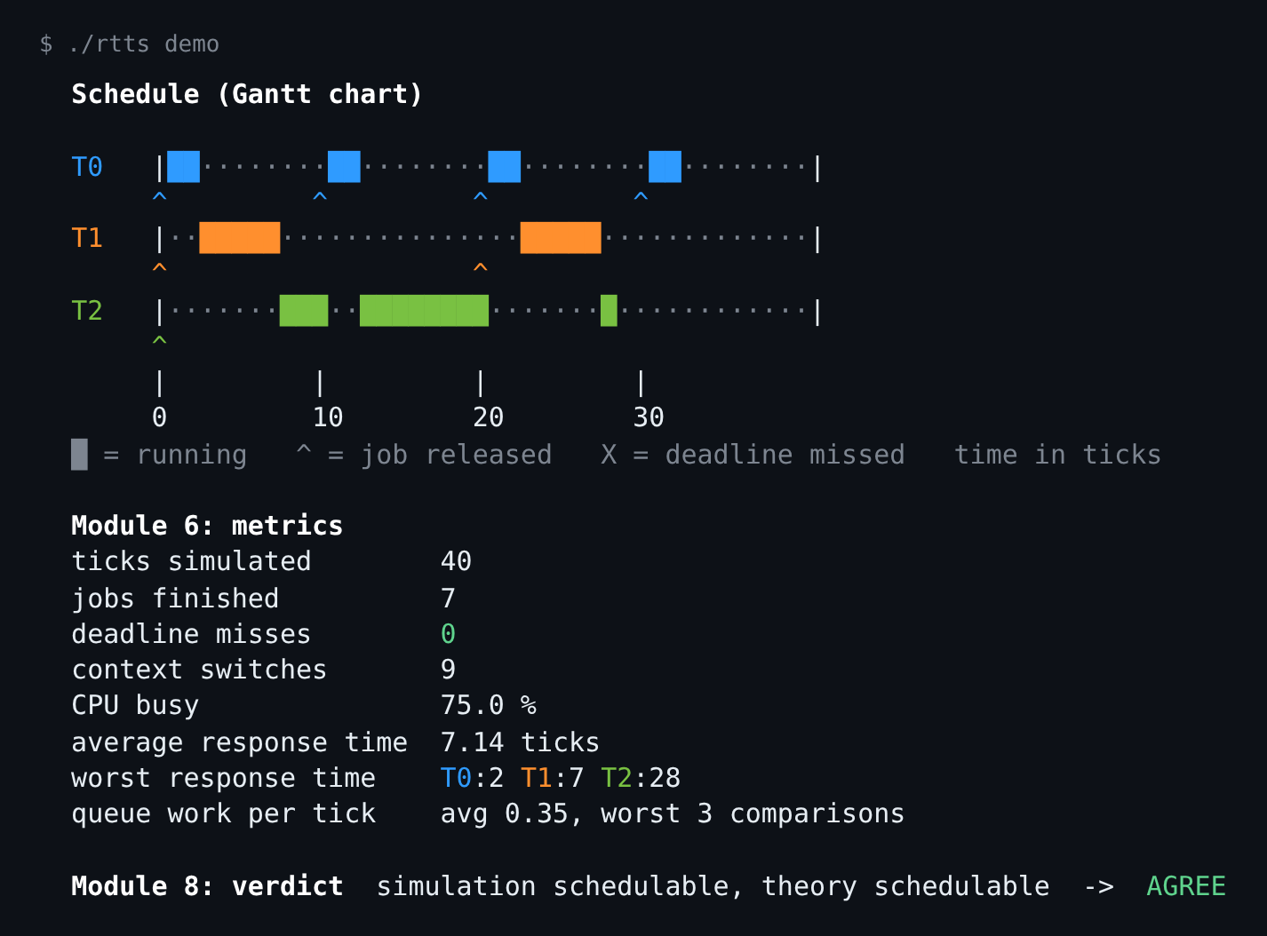
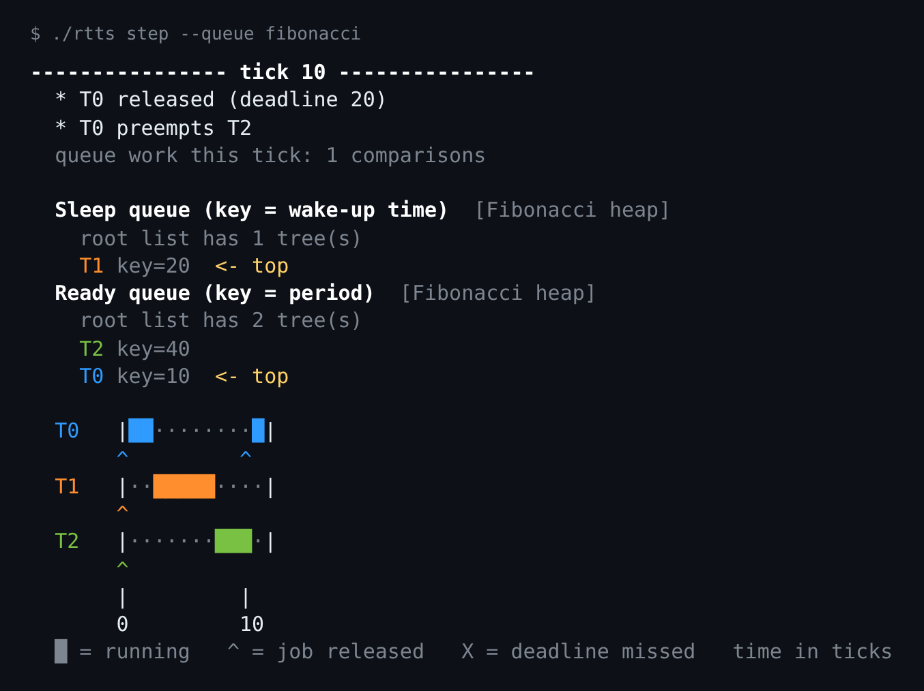
Demo 1: Terminal
./rtts demo: Gantt chart, metrics, verdict
./rtts step: tick 10, T0 preempts T2
Notes:
[Tejas] Thank you. This is the program running in the terminal. On the left, ./rtts demo runs the sample set from our first review: the Gantt chart shows Task 2 finishing at 28, the response time that RTA predicts, and the verdict line says the simulation and the theory agree. On the right, ./rtts step goes one tick at a time. At tick 10, Task 0 is released and preempts Task 2, and you can see both Fibonacci heaps: the Ready heap has two trees in its root list and T0 on top.

Slide 8
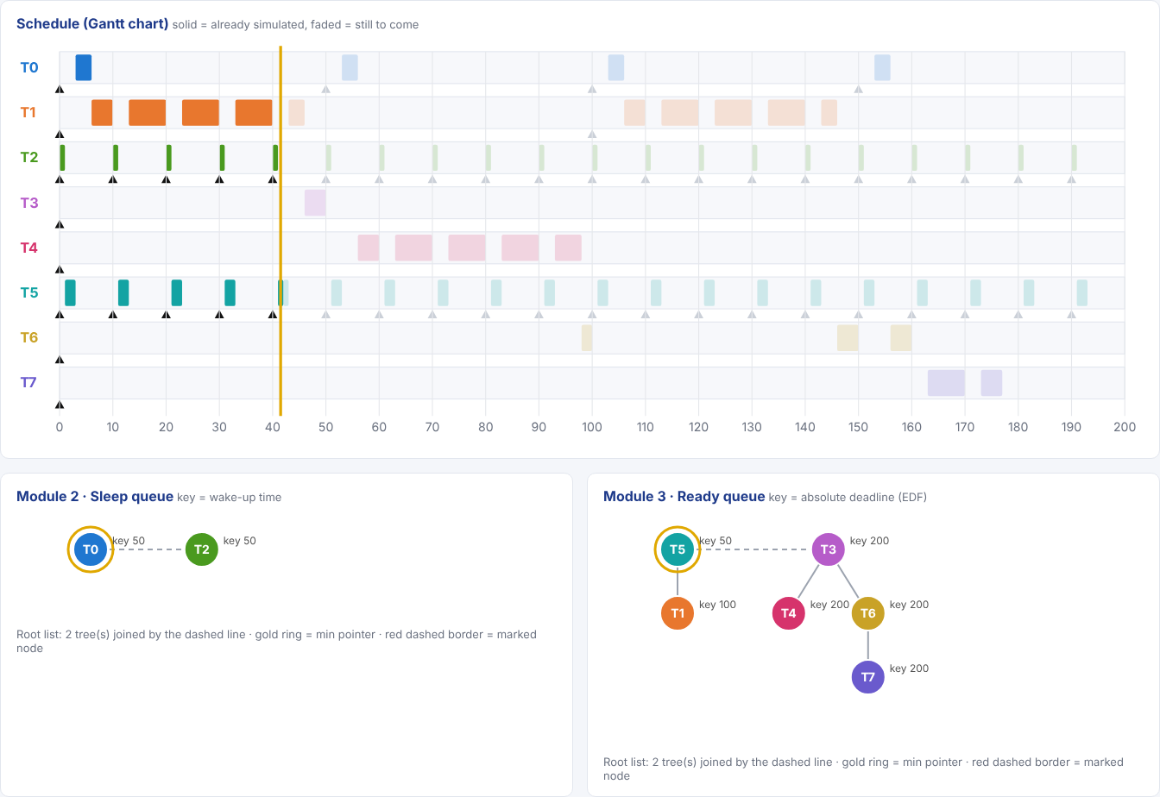
Demo 2: Browser Viewer
Open viewer/index.html: no install, no server
Play, pause or step tick by tick
Gantt chart fills in as time moves
Sleep and Ready queues drawn live: binary heap as tree + array, Fibonacci heap as root list
Switch policy (RM / EDF) and data structure at any tick
Notes:
[Tejas] The browser viewer needs no installation: you open one HTML file. You can play the schedule or step through it. The solid bars are already simulated and the faded ones are still to come. Below, the Sleep and Ready queues are drawn live; here both are Fibonacci heaps, and you can switch to the binary heap at the same tick to compare their shapes. Other tabs show the verdict check and the benchmark.

Slide 9
Test Cases (1/3): The Data Structures
ID | What is checked | Expected result | Result
TC01 | Priority order (200 tasks, many equal keys) | Sorted by key, ties by task id | Pass
TC02 | Remove any task, not just the top | Removed tasks gone, rest still sorted | Pass
TC03 | Keys change up and down | Still extracted in order | Pass
TC04 | Decrease-key | Task becomes the top at once | Pass
TC05 | Empty queue, single element | Nothing returned; one in, one out | Pass
TC06 | Binary heap after 2,000 random operations | Heap-ordered, index finds every task | Pass
TC07 | Fibonacci: 64 inserts, then 1 extract-min | 64 roots, then ≤ 6 with different degrees | Pass
TC08 | Fibonacci after 1,500 random operations | Heap order, no marked roots, min correct | Pass
TC09 | Fibonacci: a node loses two children | Marked after the 1st cut, cut after the 2nd | Pass
TC10 | 500 inserts, count comparisons | Sorted list > binary > Fibonacci (= 499) | Pass
TC01 – TC05 run on every data structure.
Notes:
[Tejas] We have twenty-four test cases, numbered TC01 to TC24, and the program prints each one when it runs. The first ten test the data structures. TC01 to TC05 run on every queue type: correct order with equal keys, removing any task, key changes, decrease-key, and the empty queue. TC06 to TC09 check the internal shape: the binary heap after two thousand random operations, and the Fibonacci heap's lazy insert, heap order and cascading cut. TC10 checks that the comparison counts match the theory.

Slide 10
Test Cases (2/3): Theory and Generator
ID | Input | Expected result | Result
TC11 | T = 10, 20, 40; C = 2, 5, 12 | U = 0.75, bound 0.780, product 1.95, R = 2, 7, 28 | Pass
TC12 | (T, C) = (4, 2), (10, 5) | RTA: R = 11 > D = 10, RM fails; EDF passes | Pass
TC13 | (10, 5), (20, 10), U = 1.0 | Liu-Layland fails, RTA passes (only sufficient) | Pass
TC14 | U = 1.0 and U = 1.02 | EDF test: pass, then fail | Pass
TC15 | UUniFast, n = 2, 5, 20, U = 0.8 | All u_i ≥ 0, sum = 0.8 | Pass
TC16 | Periods 10, 20, 40 and 25, 40 | Hyperperiod 40 and 200 | Pass
Notes:
[Tejas] TC11 to TC16 check the theory module and the task generator against numbers we can compute by hand. TC11 is the sample set from our first review: utilization 0.75, Liu-Layland bound 0.780, hyperbolic product 1.95 and response times 2, 7 and 28. TC12 and TC13 show that RTA finds a real miss and that Liu-Layland is only sufficient. TC14 checks the EDF test exactly at utilization one.

Slide 11
Test Cases (3/3): Simulator and Verdict Check
ID | What is checked | Expected result | Result
TC17 | Worked example, RM, every queue | Same Gantt chart as the slide; T2 ends at 28 | Pass
TC18 | (4, 2), (10, 5), U = 1.0 | RM misses a deadline, EDF does not | Pass
TC19 | (10, 6), (20, 10), U = 1.1 | Misses detected with every queue | Pass
TC20 | Heap snapshots, tick 0 | Ready heap: 3 one-node trees, T0 on top | Pass
TC21 | 50 random sets, RM and EDF | Identical schedules with every queue | Pass
TC22 | Verdict on the sample set | Simulator and theory agree | Pass
TC23 | Verdict on 330 random sets | 0 mismatches | Pass
TC24 | Write and read the dataset CSV | Same task sets | Pass
Do the tests catch bugs?
We broke the code on purpose:
• binary heap ignores the right child → TC06 and others fail
• Fibonacci heap never marks a node → TC09 fails
Then restored: 24 / 24 pass.
Notes:
[Tejas] TC17 to TC24 test the whole simulator. TC17 checks the full Gantt chart of the worked example tick by tick, with every queue type. TC18 and TC19 check a set that only EDF can schedule and an overloaded set. TC21 checks that all queues give the identical schedule on fifty random sets, and TC23 runs the verdict check on three hundred and thirty sets. We also checked that the tests really catch bugs: we broke the binary heap and the Fibonacci heap on purpose, and the matching tests failed.

Slide 12
Evaluation Metrics (1/2): The Data Structures
# | Metric | What it tells us | How we measure it
M1 | Key comparisons per operation (average) | Work per insert, extract-min, decrease-key | Each queue counts its comparisons: exact, machine-independent
M2 | Worst comparisons in one operation | Predictability: the slowest decision | Largest M1 value in a run
M3 | Time per operation (ns) | Real cost, incl. memory and pointers | steady_clock over many operations, median of 3 runs
M4 | Growth with N | O(1), O(log N) or O(N)? | M1 – M3 for N = 10 … 100,000
Operations measured
Insert
N inserts, random keys
Extract-min
until the queue is empty
Decrease-key
on a full queue
Hold
extract-min + insert later key = what the Sleep queue does
Notes:
[Tejas] These are the metrics we will use, and they focus on the data structure. M1 counts key comparisons per operation: it is exact and the same on every computer. M2 is the worst single operation, because a real-time scheduler is judged by its slowest decision. M3 is real time, which also shows memory and pointer costs that comparisons miss. M4 is how all of these grow with N, from ten to one hundred thousand elements. We measure four operations; hold means extract-min followed by insert, which is exactly what the Sleep queue does when a job finishes.

Slide 13
Evaluation Metrics (2/2): Correctness and Scheduling
# | Correctness metric | Target
M5 | Verdict agreement: simulation = exact test (RTA for RM, U ≤ 1 for EDF) | 100%
M6 | Schedule equality: every data structure gives the identical Gantt chart | 100%
# | Scheduling metric | Meaning
M7 | Deadline misses | Jobs that finished after their deadline
M8 | Acceptance ratio | Share of task sets called schedulable, per utilization
M9 | Response time (average, worst) | Release to finish; worst must equal RTA's R_i
M10 | Context switches, CPU busy % | How often the running task changes; CPU use
Why these metrics matter
Identical, correct schedules (M5, M6) mean that any difference in M1 – M4 is the cost of the data structure alone.
Notes:
[Tejas] The second group makes sure the comparison is fair. M5, verdict agreement, is the share of task sets where the simulation and the exact test agree; it must be one hundred percent. M6, schedule equality, means every data structure must give the identical Gantt chart, so only the cost differs. The scheduling metrics, M7 to M10, are reported for every run: deadline misses, acceptance ratio, response time, context switches and CPU use.

Slide 14
Early Results
132,000
simulations (33,000 task sets × RM/EDF × 2 heaps)
0
mismatches with theory (M5 = 100%)
100%
identical schedules, binary vs Fibonacci (M6)
Notes:
[Tejas] Some early results with these metrics. Correctness first: in one hundred and thirty-two thousand simulations, thirty-three thousand task sets under RM and EDF with both heaps, there were zero mismatches with theory, and both heaps gave identical schedules. On the right is metric M1 inside the scheduler: the average comparisons per tick. The sorted list grows linearly with the number of tasks, while both heaps stay small; the Fibonacci heap needs the fewest. For the final review we will add time and the worst case, where we expect the picture to change.

Slide 15
Plan for the Final Review (23 November 2026)
1
Red-black tree queue
The structure the Linux scheduler uses, as a 4th data structure (comparison with existing work)
2
Data-structure benchmark
Insert, extract-min, decrease-key, hold for N = 10 … 100,000: metrics M1 – M4
3
Performance graphs
Comparisons and time per operation and per tick, for all four structures
4
Analysis and comparison
What the numbers show, which structure fits a real-time scheduler, and our results vs published results
Notes:
[Tejas] For the final review we will complete the last two work items. First, a red-black tree queue, which is what the Linux scheduler uses, so we compare our heaps with both FreeRTOS and Linux. Second, a benchmark of the data structures on their own: insert, extract-min, decrease-key and hold, from ten to one hundred thousand elements. Then the graphs, the analysis, and a comparison of our results with the published ones.

Slide 16
Thank You
Questions?
Notes:
[Tejas] That is our second review: ten of twelve work items done, twenty-four test cases passing, and the metrics defined. Thank you, ma'am. We are happy to take questions.

