Slide 1
Unit III
Mission Decision Making : Obstacle detection and Avoidance – Mission Planning and Path Planning – Wireless Communication on UAV – Multi UAV Systems.

Slide 2
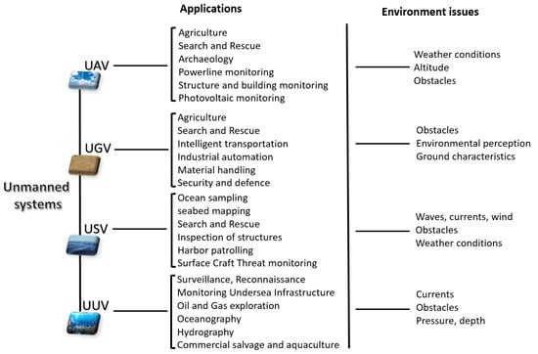
UAV (Unmanned Aerial Vehicle): An aircraft that flies without a human pilot on board, controlled either remotely or autonomously.
UGV (Unmanned Ground Vehicle): A robotic vehicle that operates on the ground without a human driver.
USV (Unmanned Surface Vehicle): A watercraft that operates on the surface of oceans, rivers, or lakes without an onboard crew.
UUV (Unmanned Underwater Vehicle): A vehicle that can operate underwater without a human occupant

Slide 3
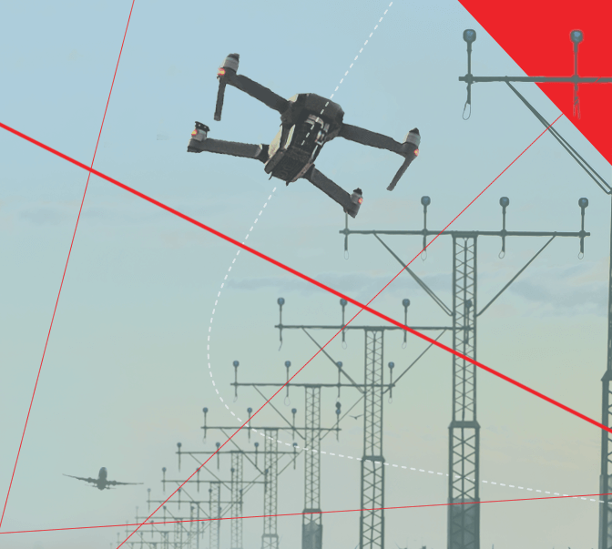
Drone obstacle detection and avoidance : Uses a combination of sensors (like ultrasonic, LiDAR, Radar and cameras) to perceive its environment and algorithms to plan a path that avoids collisions. The system can automatically slow down, stop, or navigate around obstacles to prevent collisions, making it crucial for autonomous flight.

Slide 4
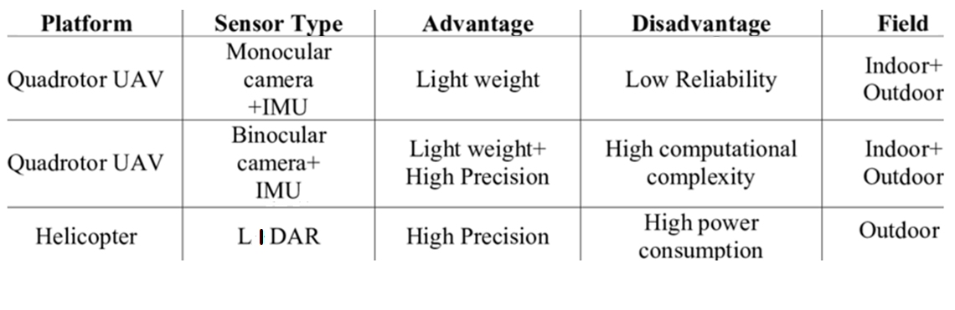

Slide 5

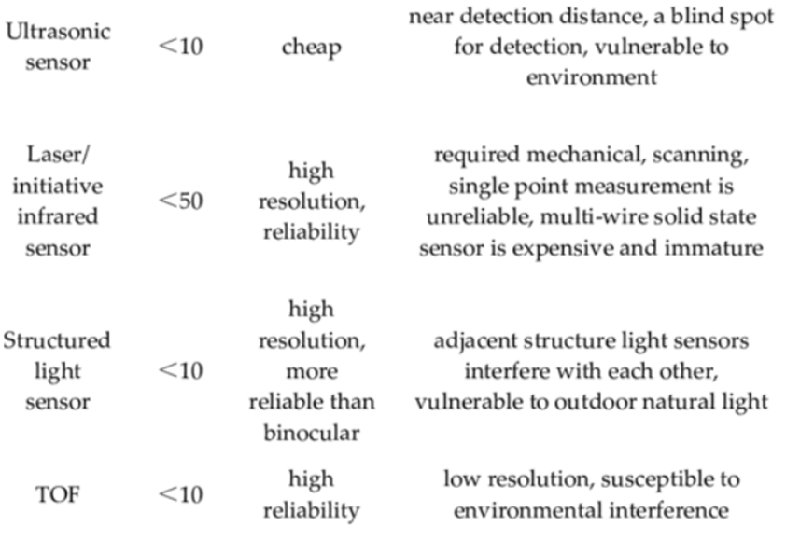

Slide 6
Obstacle detection and Avoidance
https://www.youtube.com/watch?v=CDajySfx1-8&t=61s

Slide 7
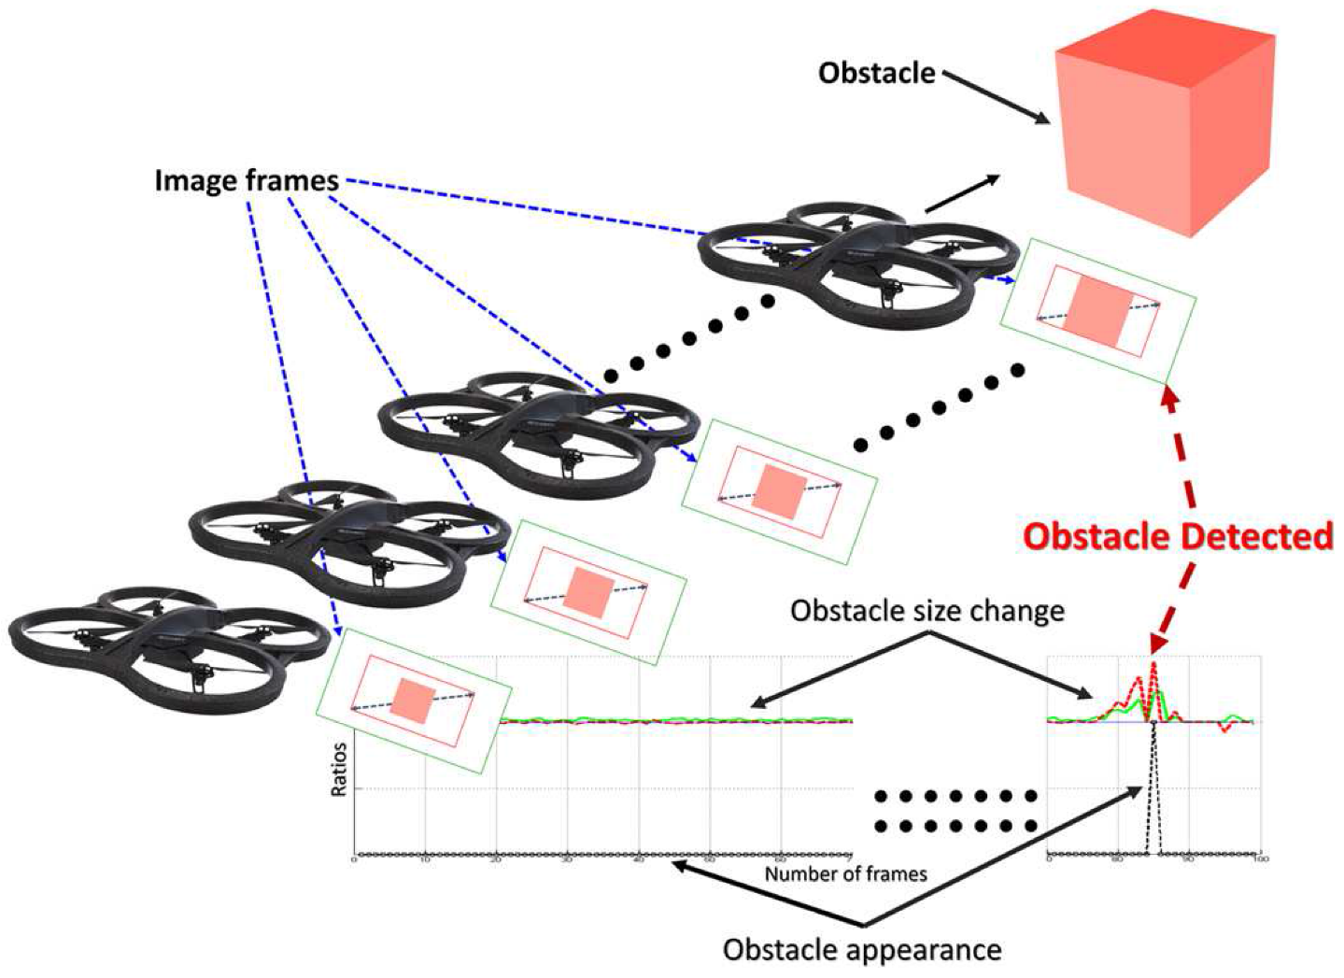
Sensor technology for obstacle detection

Slide 8
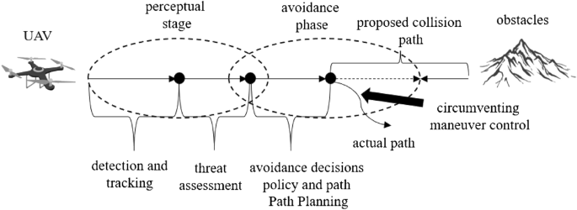
Path Planning based on Obstacle Detection

Slide 9
Sensor Techniques for obstacle detection
Sensor
Flight planning
Flight control
Collision detection
Collision avoidance

Slide 10
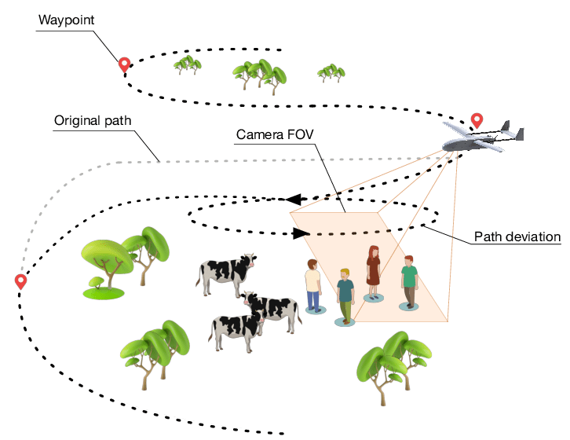
Mission Planning and Path Planning
UAV path planning : Involves the pre-flight formulation of an optimal reference trajectory that satisfies constraints based on environmental information and mission requirements.
During flight, in the presence of unknown or dynamic threat information, local trajectory optimization is performed dynamically.

Slide 11
Sensor Techniques for Mission planning
Sensors
Navigation
Motion/path planning
Controller
Actuators
Movement from A to B
- Inertial frame : Position, Velocity, Acceleration

Slide 12
Mission Planning and Path Planning
UAV path planning : Involves the pre-flight formulation of an optimal reference trajectory that satisfies constraints based on environmental information and mission requirements.
During flight, in the presence of unknown or dynamic threat information, local trajectory optimization is performed dynamically.

Slide 13
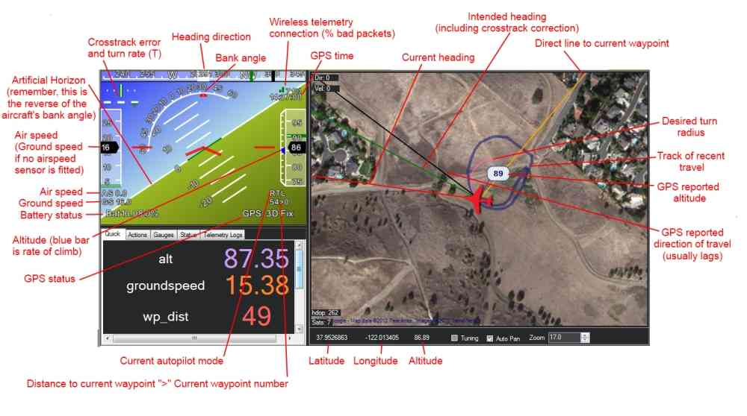
Mission Planner

Slide 14


