Slide 1
Wireless Communication on UAV

Slide 2
Methods of UAV Communication
RF signal
Bluetooth / Cellular / wireless
Satellite network
Choice depends on the type (Fixed / Rotary wings)

Slide 3
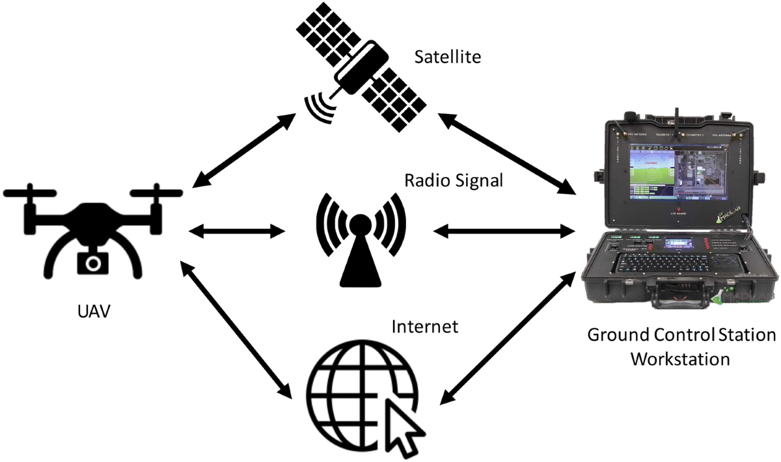
Ways of Communication

Slide 4
Less Wireless Connectivity – High & Low Altitude Platform (HAP & LAP)
Advantages of LAP:
Suitable for a limited duration
Short range line of sight – improves performance
Performance enhancement – dynamic adjustment of UAV
Adaptive communication for UAV mobility control – improve communication performance

Slide 5
Consideration
Support safety-critical functions such as real-time control, collision detection & avoidance, etc… (more effective resource management & security mechanism for UAV communication system)
High mobility environment of UAVs (high dynamic network topology )
Multi UAV coordination (ensure reliable network connectivity)
New communication protocol (sparse and intermittent network connectivity)
Limit communication, computation & Endurance (due to size, weight, power)
Effective interference management technique (UAV aided cellular coverage )

Slide 6
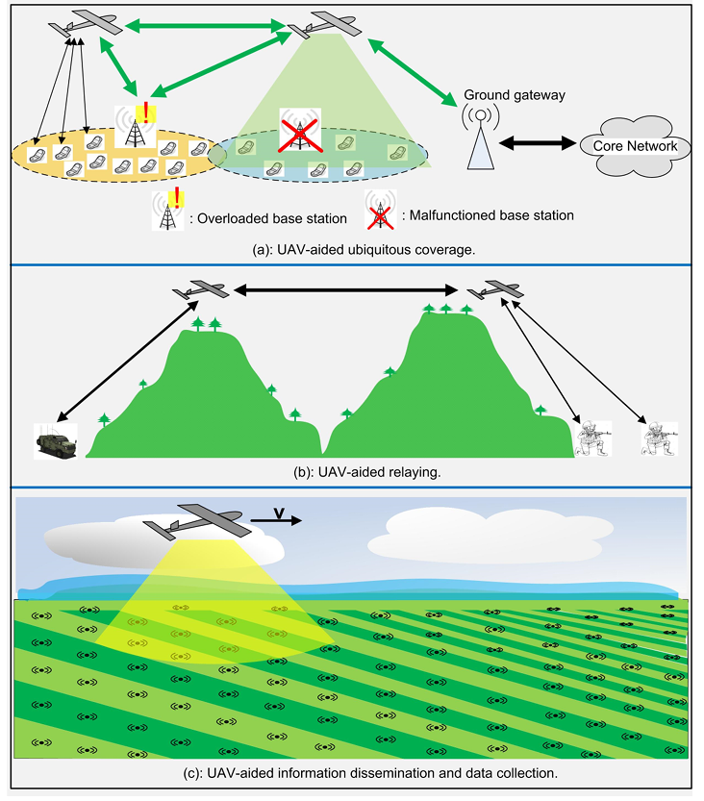
Typical use cases of UAV aided wireless communication

Slide 7
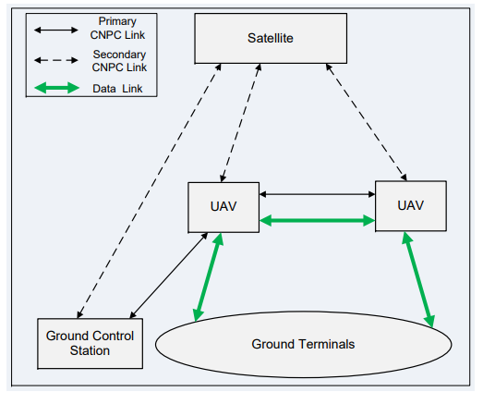
Basic networking architecture of UAV-aided wireless communications
CNPC – Control & Non Payload communication link

Slide 8
Control & Non Payload communication (CNPC) link
Information flow is categorized into
Command and control from GCS to UAV
Report the status from UAV to ground
Sense & information among UAVs.

Slide 9
Links:
CNPC link:
Operates in protected spectrum
2 bands (L : 960 – 977 MHZ & C- band : 5030 – 5091 MHZ)
Primary link: Direct link between GCS and UAV (Avoid delay)
Secondary link : (Backup to enhance reliability and robustness
Effective high-security mechanism employed to avoid ghost control scenario
Data link :
Support mission-related communication for the ground terminals (includes terrestrial Base Station (BS), mobile terminal, gateway nodes, wireless sensors)
Note: Air traffic control (ATC) link: necessary only when the UAVs are within controlled airspace ie near an airport

Slide 10
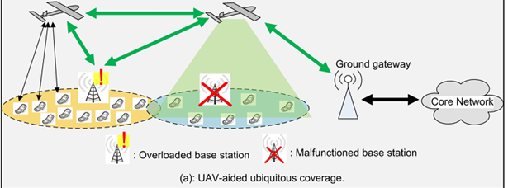
Data link supports following communication:
Direct mobile UAV communication for BS offloading / during complete BS malfunction
UAV – BS & UAV gateway wireless backhaul (Network that connects a core network to smaller subnetworks)
UAV – UAV wireless backhaul

Slide 11
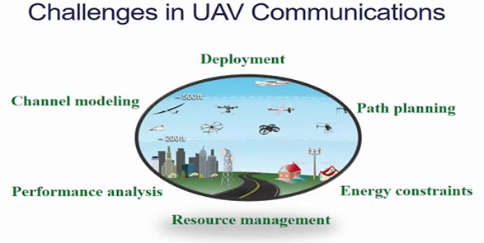

Slide 12
UAV deployment and path planning
Appropriate path planning significantly shortens the communication distance and thus is crucial for high capacity performance
In general, finding an optimal path in UAV is challenging
- Path optimization problem involves an infinite number of variables for the continuous UAV trajectory to be determined.
- Variety of practical constraints such as connectivity, fuel limitation, collision and terrain avoidance
- Time varying in nature

Slide 13
Energy aware deployment and operation
The performance and operational duration of a UAV are constrained by the limited onboard energy.
Although powerplant and energy-storage technologies have advanced dramatically over the past few decades, limited energy availability still severely hampers UAV endurance.
Approaches to address the issue:
- Effective energy-aware deployment mechanisms are needed for timely onboard energy replenishment, yet without noticeable interruption of the communication services supported.
- Energy-efficient operation through smart energy management is required, i.e., accomplishing the missions with minimum energy consumption

Slide 14
Case Study 1 (RF Communication)
Case Study 2 (Multi UAV System)

Slide 15
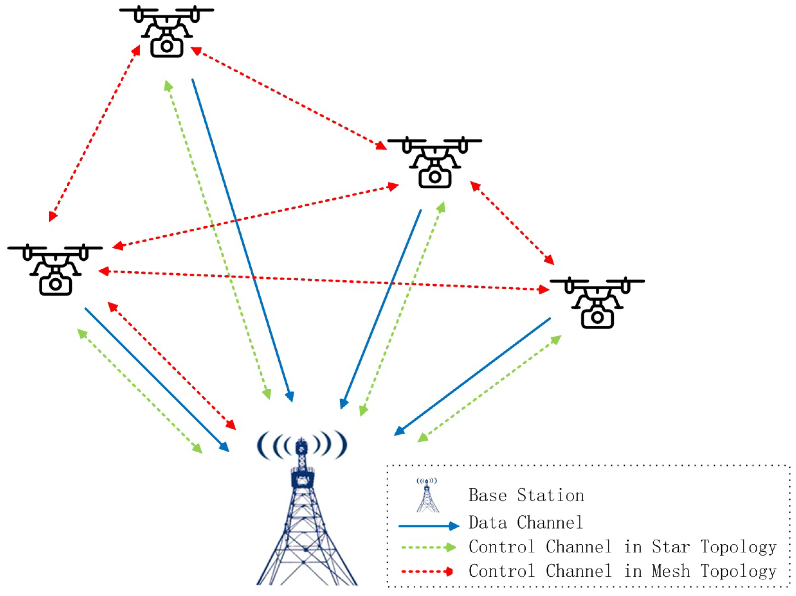
Multi UAV Systems
A set of UAVs works together to achieve a specific goal
Perform more complex tasks in a large area

Slide 16
Key characteristics of UAV swarms
Collaborative autonomy: Each drone acts independently but communicates with others to coordinate its actions and contribute to the overall mission.
Decentralized Control: Decision-making is distributed among the individual drones, rather than being dictated by a single, central computer.
Emergent behavior: Complex tasks are accomplished through the collective, self-organizing actions of the individual, simpler robots.
Robustness and redundancy: A swarm can continue to operate even if some individual drones are lost or fail.
Scalability: The system can be scaled by adding more drones to the swarm to handle larger or more complex tasks.

Slide 17
Applications
Surveillance: Performing wide-area surveillance or tracking targets over a large area.
Disaster response: Locating missing persons or assessing damage in a disaster zone.
Environmental monitoring: Monitoring crop health, tracking wildlife, or inspecting infrastructure.
Military operations: Providing intelligence, performing reconnaissance, or executing tactical strikes.
Logistics: Transporting payloads, especially in areas where traditional transport is difficult.
Challenges
Control algorithms:
Developing efficient algorithms for path planning, formation control, and task allocation remains an active area of research.
AI and machine learning:
Integrating artificial intelligence and machine learning is key to improving decision-making and adaptability.
Communication:
Ensuring reliable communication between drones, especially in challenging environments, is a critical hurdle.
Security:
Addressing security concerns, such as counter-swarming tactics is an important area for future development.

Slide 18
Swarm of UAV - Classification
Based on type: Homogeneous & Heterogeneous
Based Network : Centralized & Decentralized
Hybrid : Homogeneous Decentralized
Heterogeneous Decentralized
Centralized Heterogenous

Slide 19
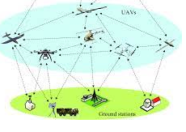
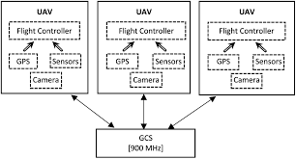
Type 1
Homogeneous Heterogeneous
- Limited to applications - Wide applications

Slide 20
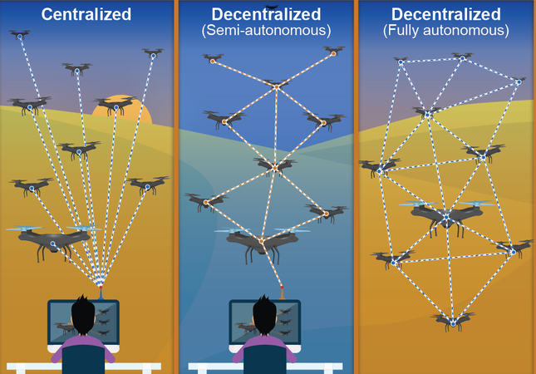
Type 2
Centralized:
Single point of contact
Centralized decision making
Disdv:
Single pt. failure : affects the entire system
Increased Communication load – GS overloaded with data
Decentralized:
Peer to peer data exchange
Distributed decision-making
Adaptive routing

Slide 21
Type 3
Hybrid

Slide 22
Challenges:
GPS signal interference
Weather condition
Complex environment
ML algorithm
Accuracy
Safety & Security
Privacy and cybersecurity
Communication between drones

Slide 23
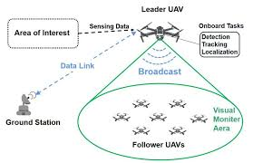
Working of Leader UAV
Leader is a designated drone that coordinates the actions of the other drones, often called "followers," through a hierarchical structure.
The leader receives commands, processes information, and relays instructions to the rest of the swarm, which then adjust their speed, direction, and position based on the leader's commands to maintain a formation and complete a mission.

Slide 24
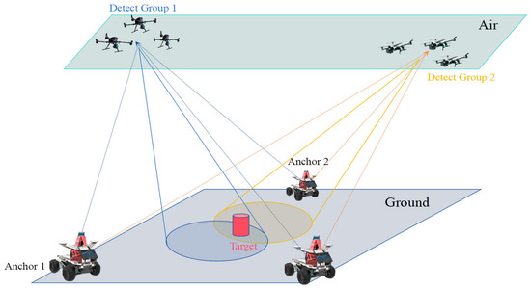
Communication architecture
UAV to UAV
UAV to GCS
Group to group (GTG)

