Slide 1
Unit 4
Simulators

Slide 2
Robot Operating System (ROS)
The Robot Operating System (ROS) is a set of software libraries and tools that help to build robot applications.
From drivers to state-of-the-art algorithms, and with powerful developer tools, ROS provides next robotics project.
How to Install ROS?
https://www.instructables.com/How-to-Install-ROS/

Slide 3
https://ros.org/
Introduction to ROS for Drone Development
https://www.youtube.com/watch?v=N4XvVldWlXk
Installing ROS for Drone Development
https://www.youtube.com/watch?v=EmIjedzHwzI
Installing Gazebo and ArduPilot Plugin
https://www.youtube.com/watch?v=m7hPyJJmWmU
https://gazebosim.org/docs/garden/ros_installation/
Basic OpenCV with ROS for Drones
https://www.youtube.com/watch?v=WtJtkg6NLmQ&list=PLy9nLDKxDN6-4GBOzi309QRAahbWrnUVV

Slide 4
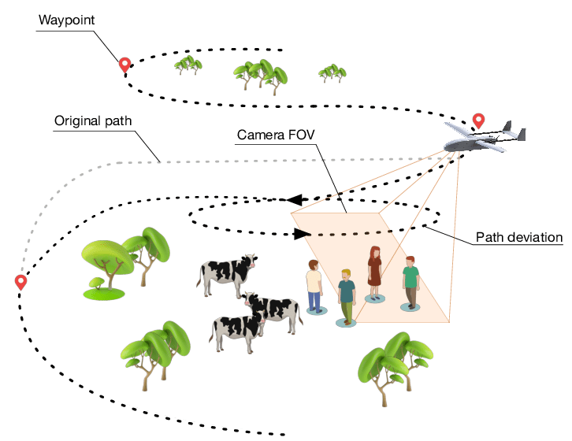
Mission Planning and Path Planning
UAV path planning : Involves the pre-flight formulation of an optimal reference trajectory that satisfies constraints based on environmental information and mission requirements.
During flight, in the presence of unknown or dynamic threat information, local trajectory optimization is performed dynamically.

Slide 5
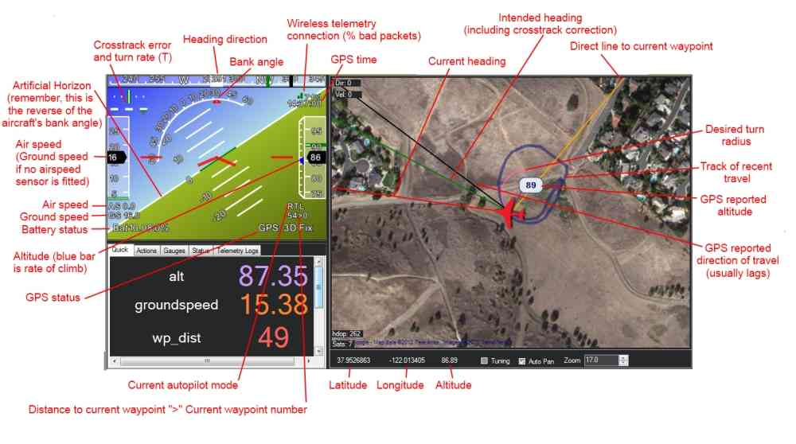
Mission Planner

Slide 6
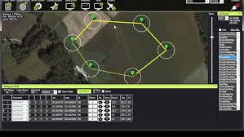

Slide 7
Steps to be followed in Mission Planner
Connect USB of drone to laptopo (get beep sound)
Open mission planner
- Choose values in the top left corner (Auto & 9600)
2. Setup
- Install firmware
- Copter v4.4.3. official
3. Configure (Tool box)
- 1. CAN (CAN_D1_Protocol, CAN_D2_Protocol, CAN_P1_Protocol, CAN_P2_Protocol)
- 2. GPS type
- 3. NTF_LED_Type (Yellow – not ready to fly; Green - ready to fly)
- 4. Standard parameter (Related to switch; all – barometer, compass, IMU)

Slide 8
- 5. Mandatory hardware: (Frame type – quad, etc.; acceleration calibration – Calibrate with drone [ Left – right; drone – noise; Bottom – Top])
- 6. Compass ( hold & rotate 360 degree, reverse, dround direction, all direction)
- 7. Radio calibration : (To bind receiver & transmitter; Trim the value in RC ; min:999 to mx: 2000)
- 8. ESC calibration ( Remove USB and battery & reconnect – turn on the transmitter)
- 9. Flight mode: (F1: position hold ; to F5 : RTL)
- 10. Acceleration calibration: (Check for the motor rotation)
- 11. Failsafe (For returning back )

Slide 9
Mission Planner - Simulation
https://www.youtube.com/watch?v=rui2Trps2yc

