Slide 1
Project 1 US FINANCIAL DATA
David, Tyler and Gustavo

Slide 2
Introduction
Data collected from the Federal Reserve and Zillow.
30 Year Fixed Rate Mortgage Average
https://api.stlouisfed.org/fred/series/observations?
Average Hourly Earnings of All Employees, Private Service-Providing
https://api.stlouisfed.org/fred/series/observations?
Unemployment rate using the Nasdaq library
https://api.stlouisfed.org/fred/series/observations?
Single Family Home value average (ZSFH) from Zillow
https://data.nasdaq.com/api/v3/datatables/ZILLOW/
Consumer Price Index for All Urban Consumers using the Nasdaq library
https://api.stlouisfed.org/fred/series/observations?
Gross domestic product using the Nasdaq library
https://api.stlouisfed.org/fred/series/observations?
U.S. Bureau of Labor Statistics
https://api.bls.gov/publicAPI/v2/timeseries/data/ 4-year data limit

Slide 3
The Nasdaq-Data-Link library
https://pypi.org/project/Nasdaq-Data-Link/
This library simplified the collection. The API key was still required and was configured in the imports per the documentation
API keys obtained from:
https://fred.stlouisfed.org/docs/api/fred/
https://www.bls.gov/developers/home.htm
https://data.nasdaq.com/api/v3/datatables/

Slide 4
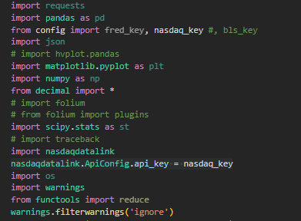
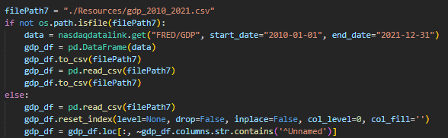
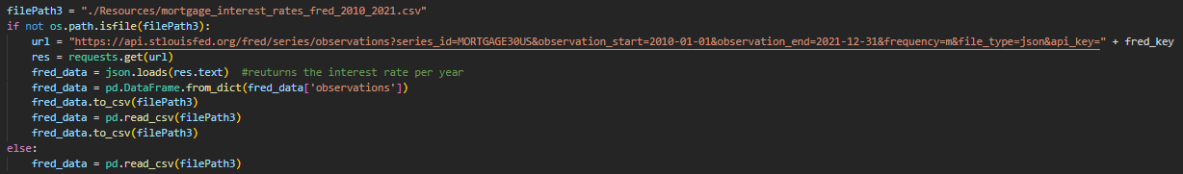
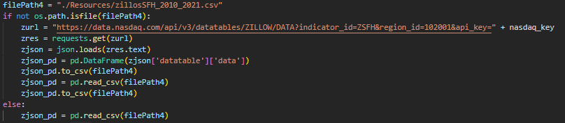

Slide 5
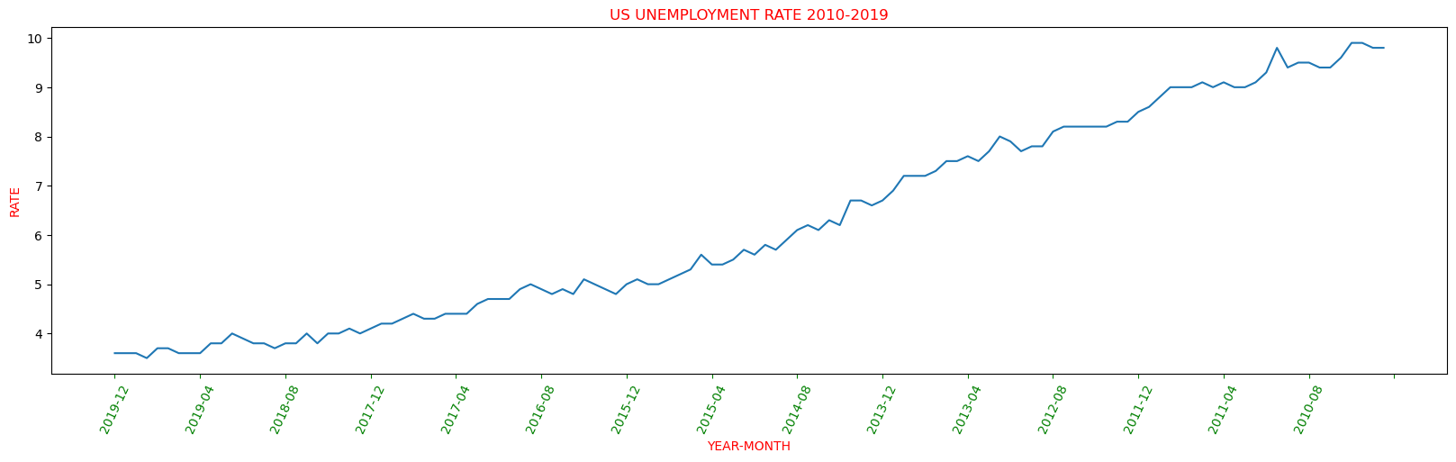
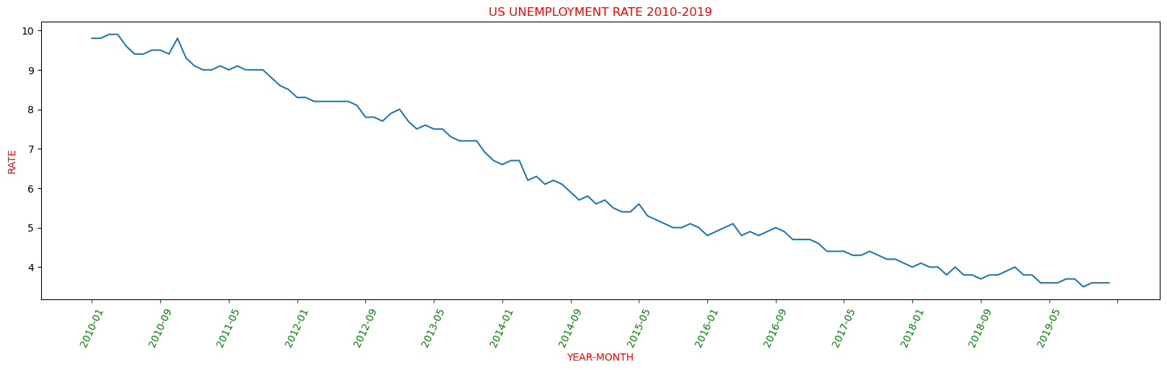

Slide 6
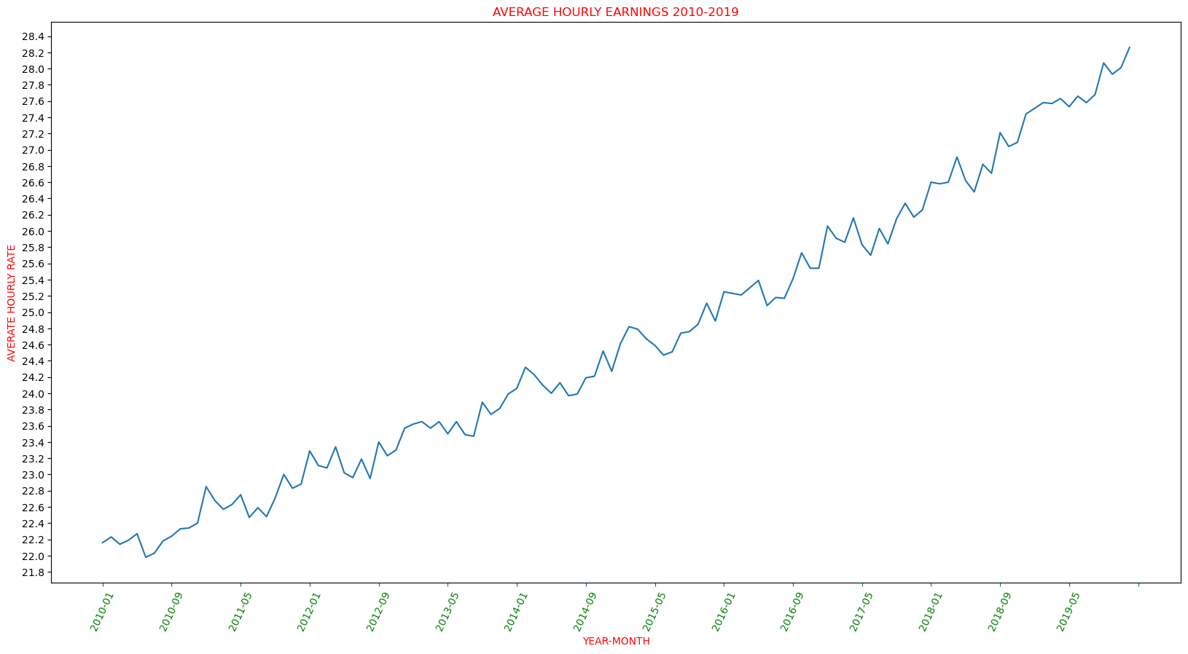

Slide 7
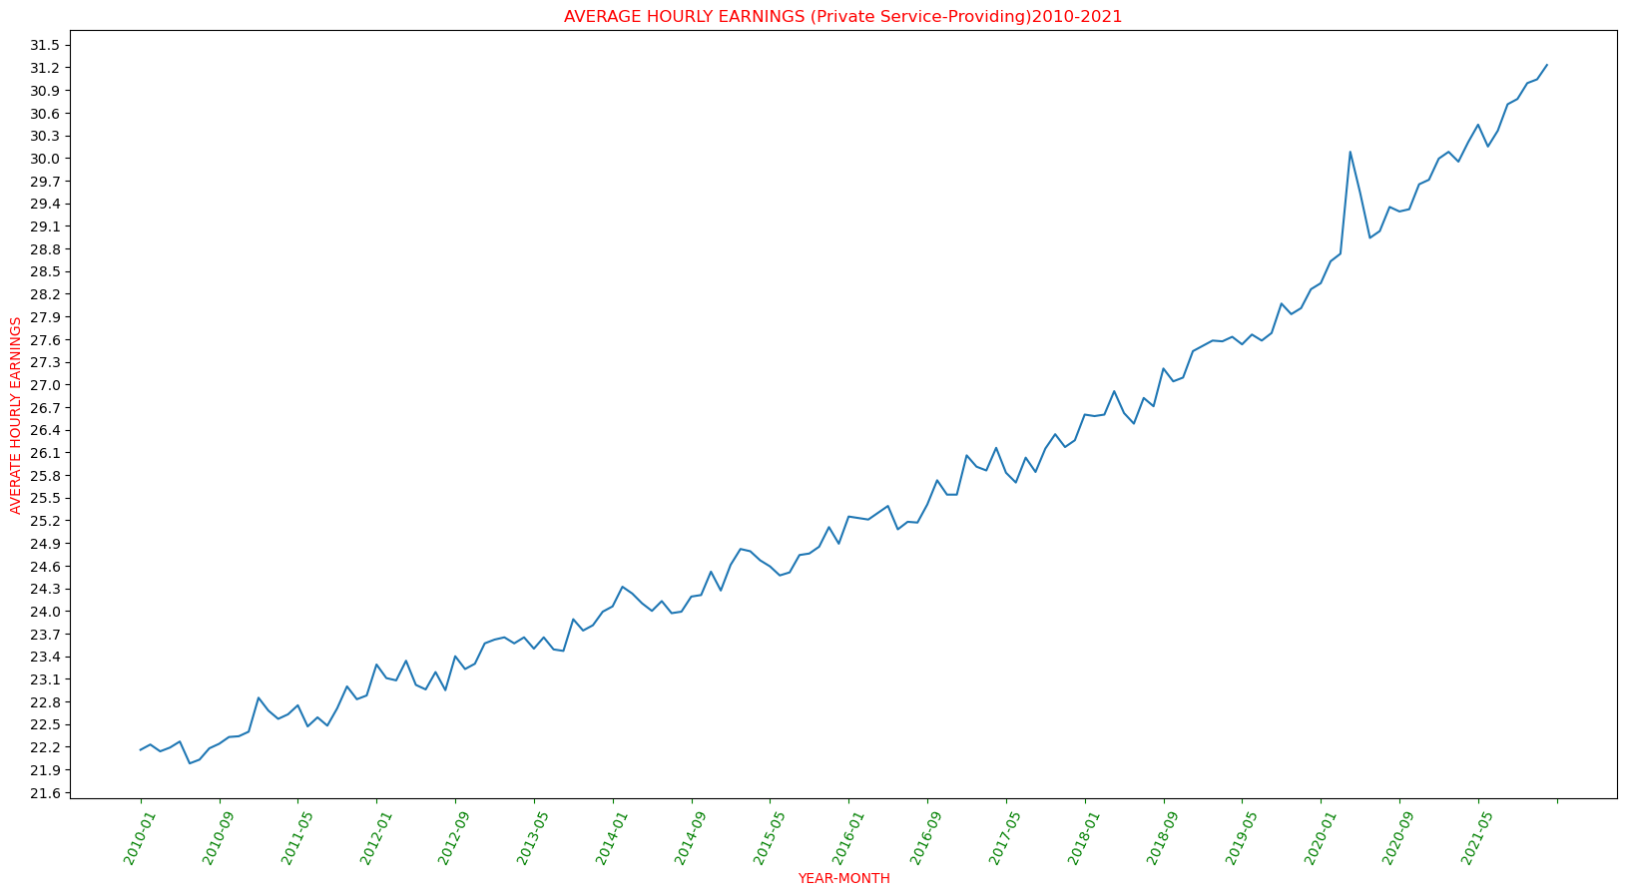

Slide 8
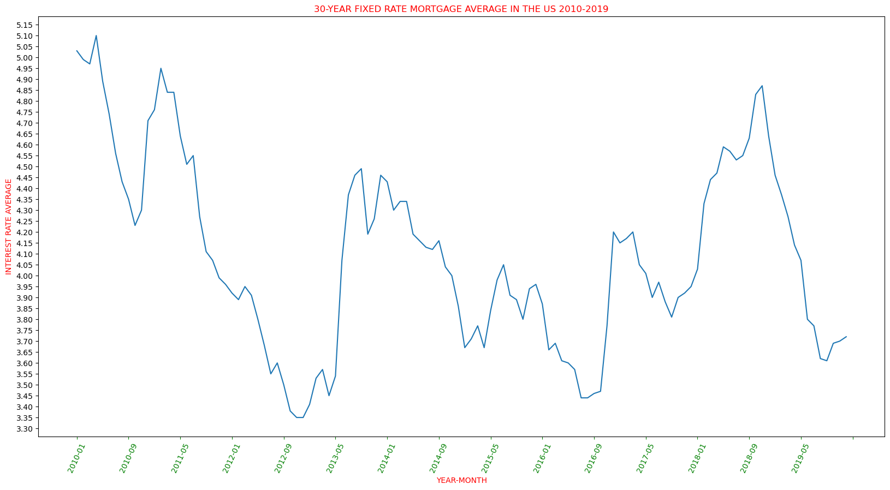

Slide 9
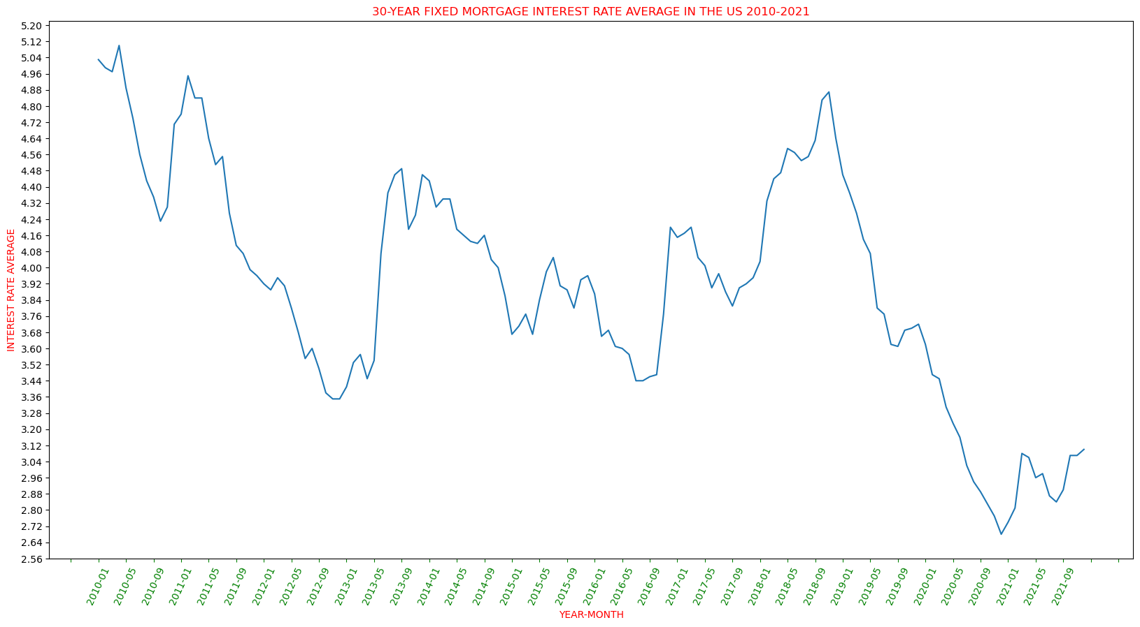

Slide 10
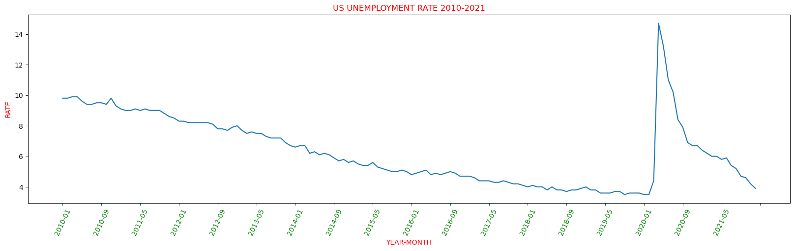

Slide 11
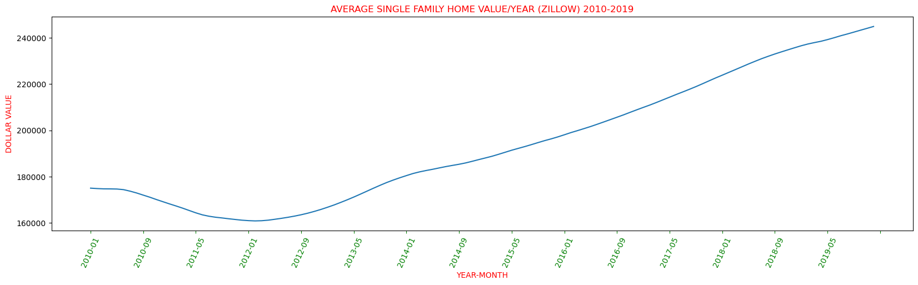
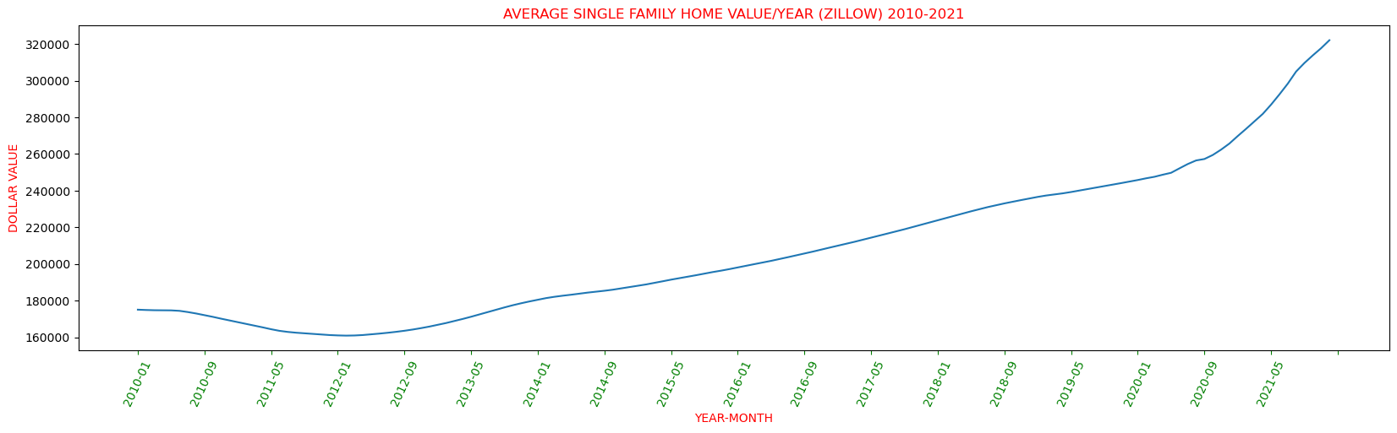

Slide 12
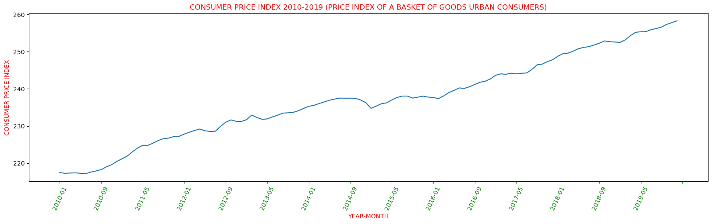
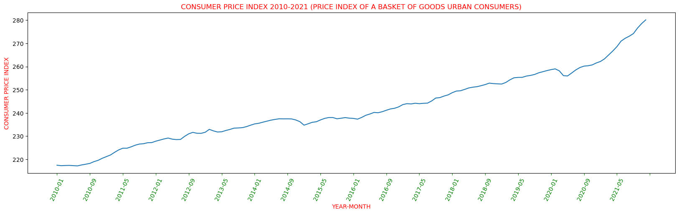

Slide 13
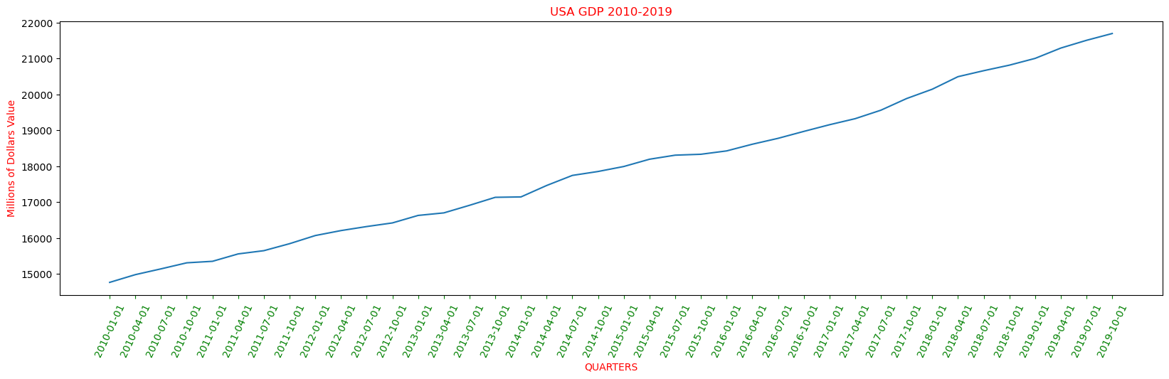
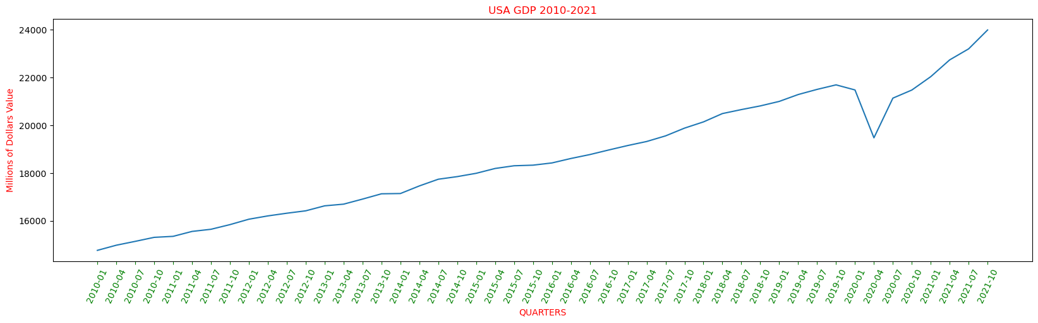

Slide 14
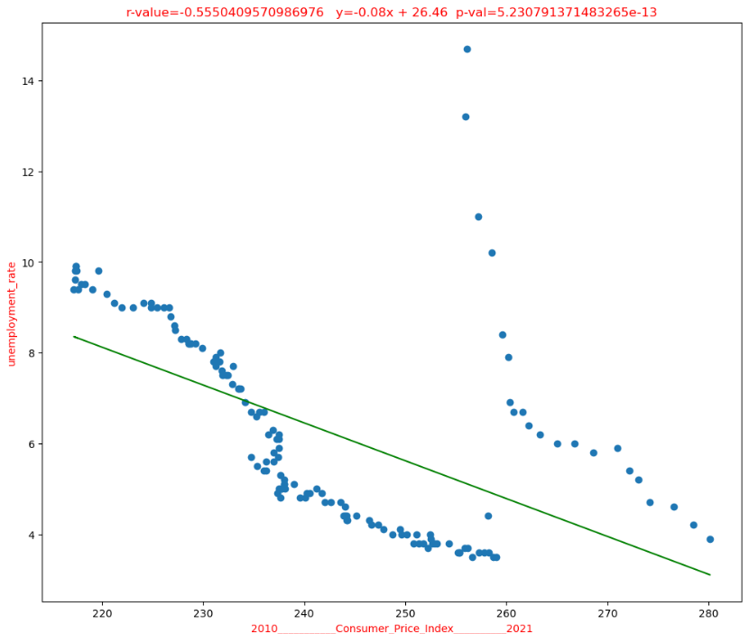
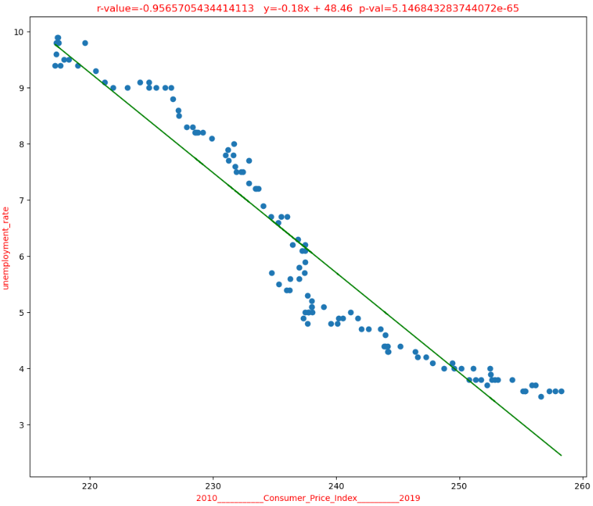
Does the price index of a basket of goods and services paid by urban consumers affect the unemployment rate?

Slide 15
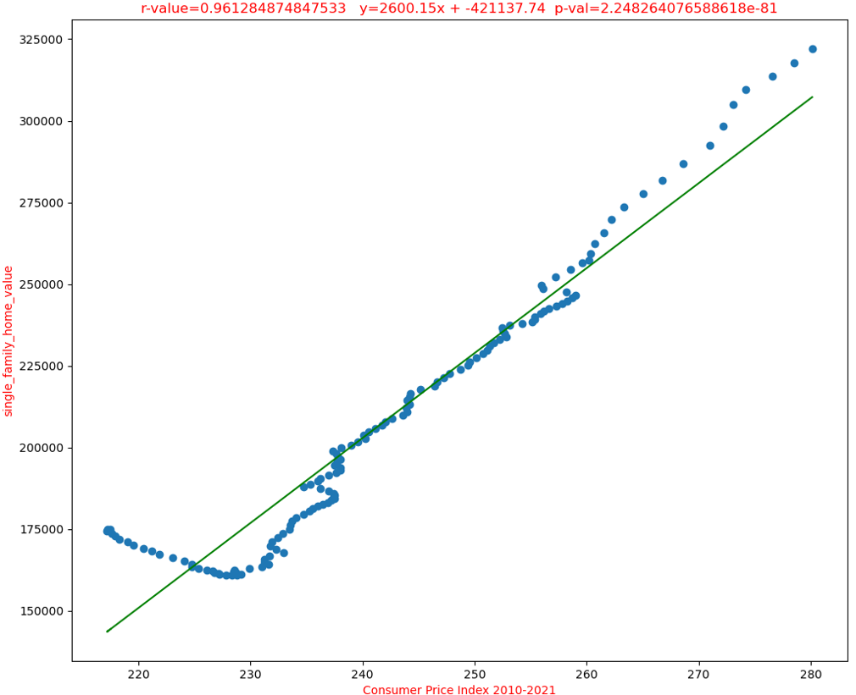
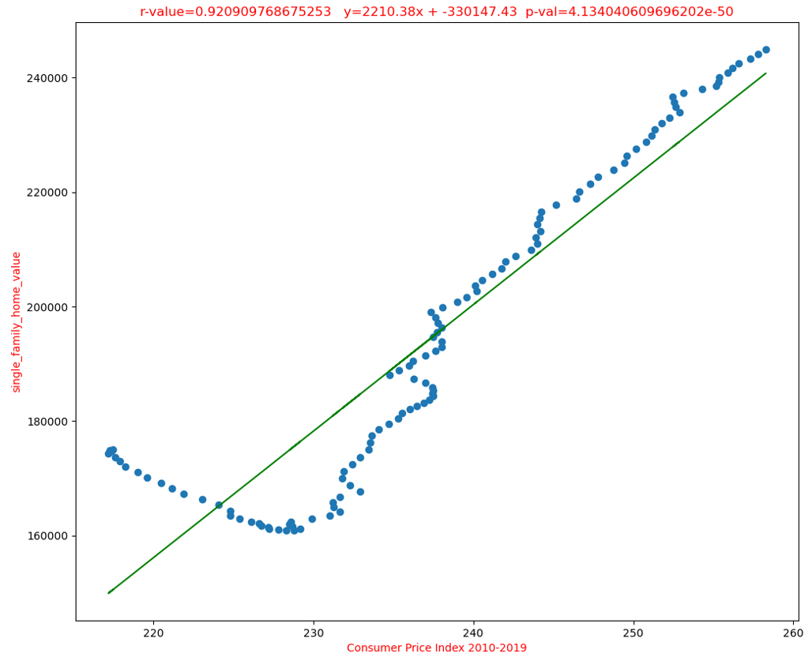
Does the price index of a basket of goods and services paid by urban consumers affect the single family home value ?

Slide 16
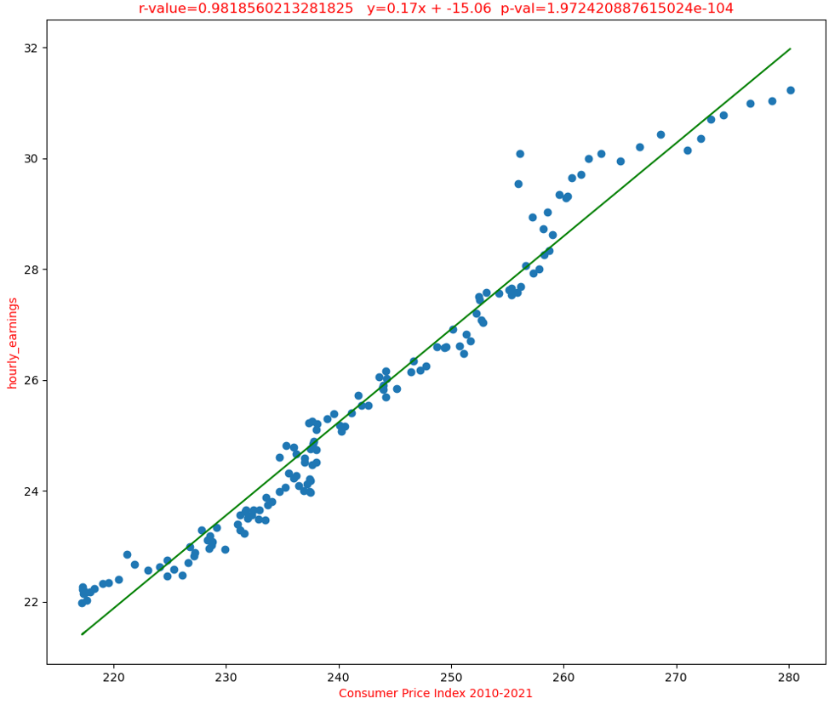
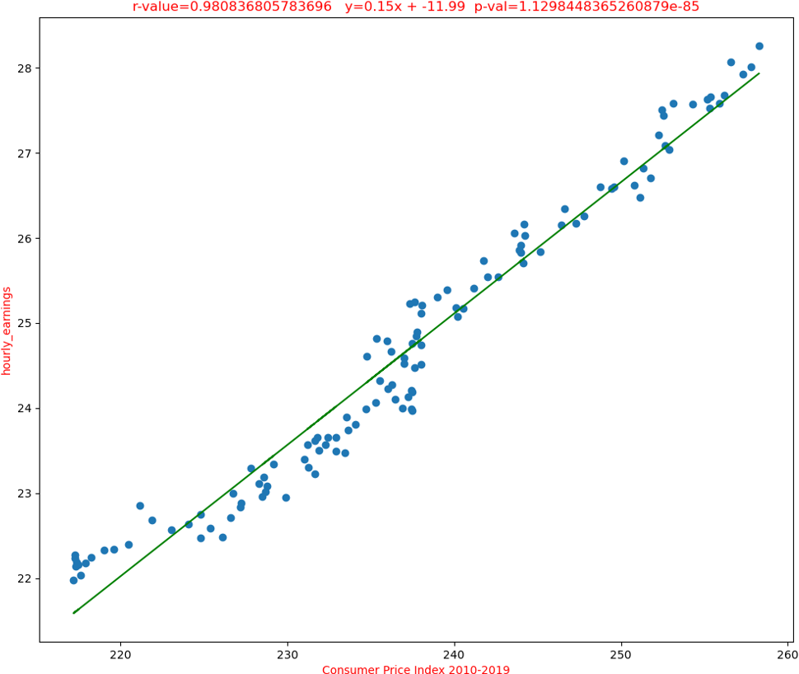
Does the price index of a basket of goods and services paid by urban consumers affect the hourly earnings of all employees?
Positive relationship, p-value is high, hypothesis is less statistically significant

Slide 17
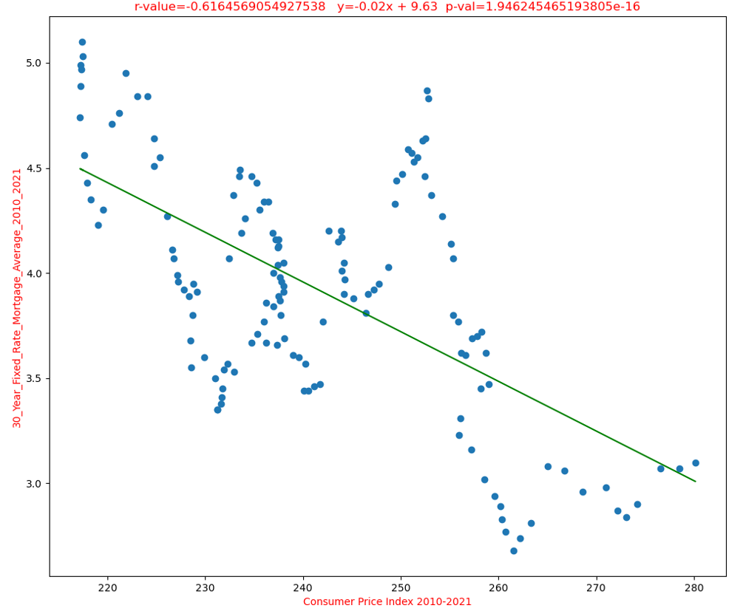
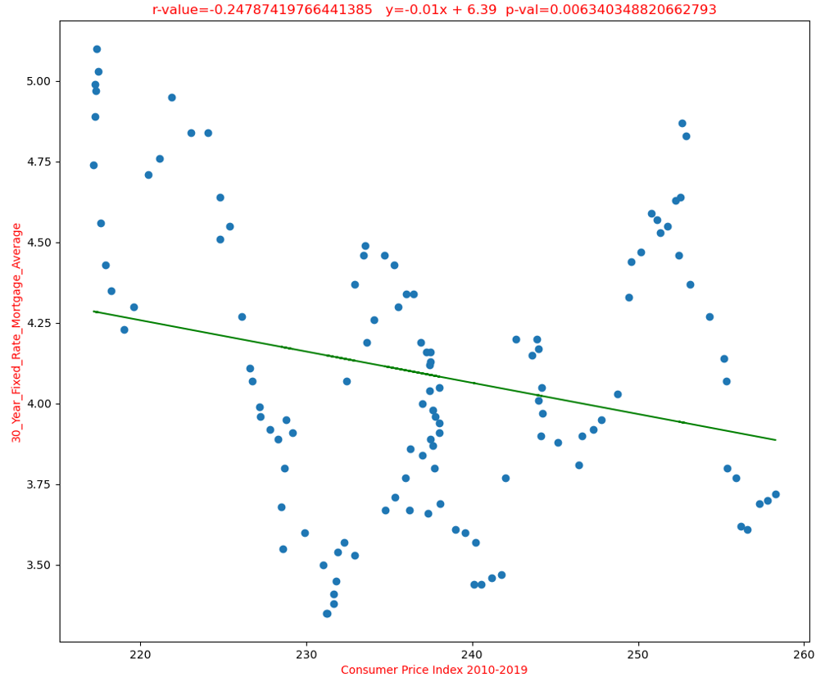
Does the price index of a basket of goods and services paid by urban consumers affect the 30 year fixed mortgage interest rate?

Slide 18
SUMMARY

Slide 19
THANK YOU

