Slide 1
Project 1 US FINANCIAL DATA
David, Tyler and Gustavo

Slide 2
Introduction
Data collection and analysis of
- 30 Year Fixed Rate Mortgage Average from https://api.stlouisfed.org/fred/series/observations?
- Average Hourly Earnings of All Employees from https://api.stlouisfed.org/fred/series/observations?
- Unemployment rate. Data obtained from https://fred.stlouisfed.org
- Single Family Home value average (ZSFH) from Zillow
- Consumer Price Index for All Urban Consumers. Data source https://fred.stlouisfed.org
Data set used independently in our analysis as a reference.
- Gross domestic product from https://fred.stlouisfed.org

Slide 3
Three of the datasets were obtained via API
The other 3 were obtained using the library
Nasdaq-Data-Link
That simplified the collection by eliminating the need of adding, headers or other parameters. The API key was still required.
API keys obtained from:
https://fred.stlouisfed.org/docs/api/fred/ https://www.bls.gov/developers/home.htm https://data.nasdaq.com/api/v3/datatables/

Slide 4
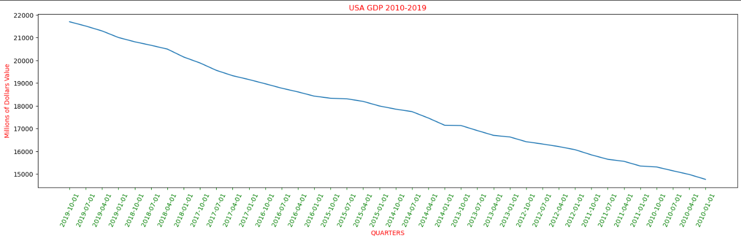

Slide 5
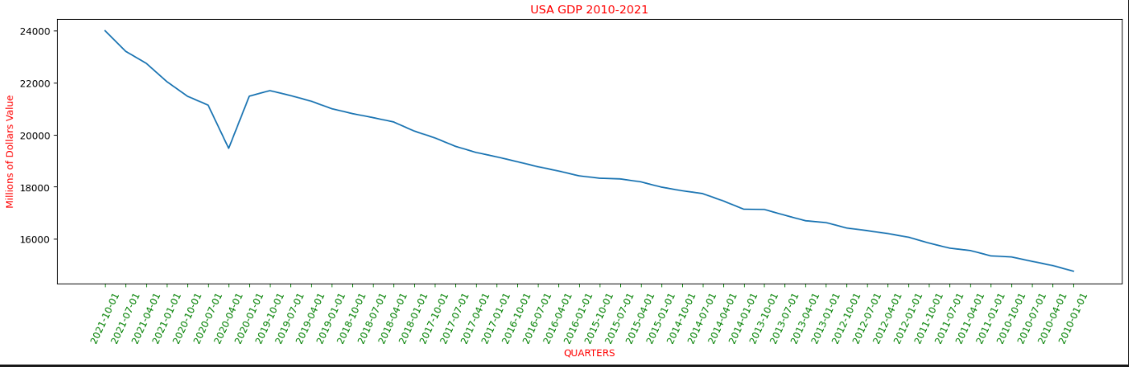

Slide 6
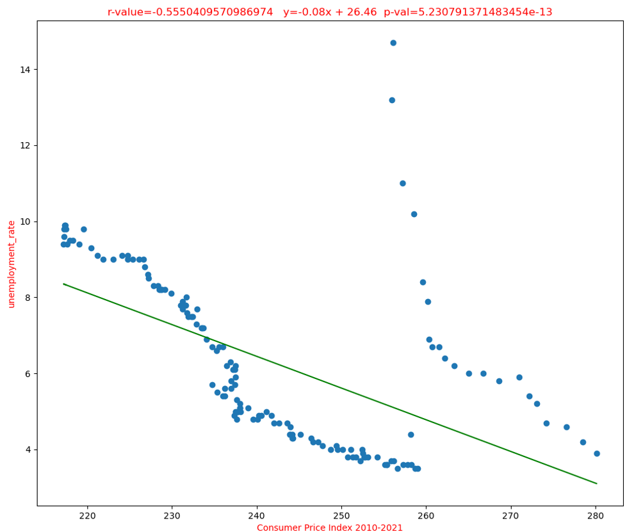
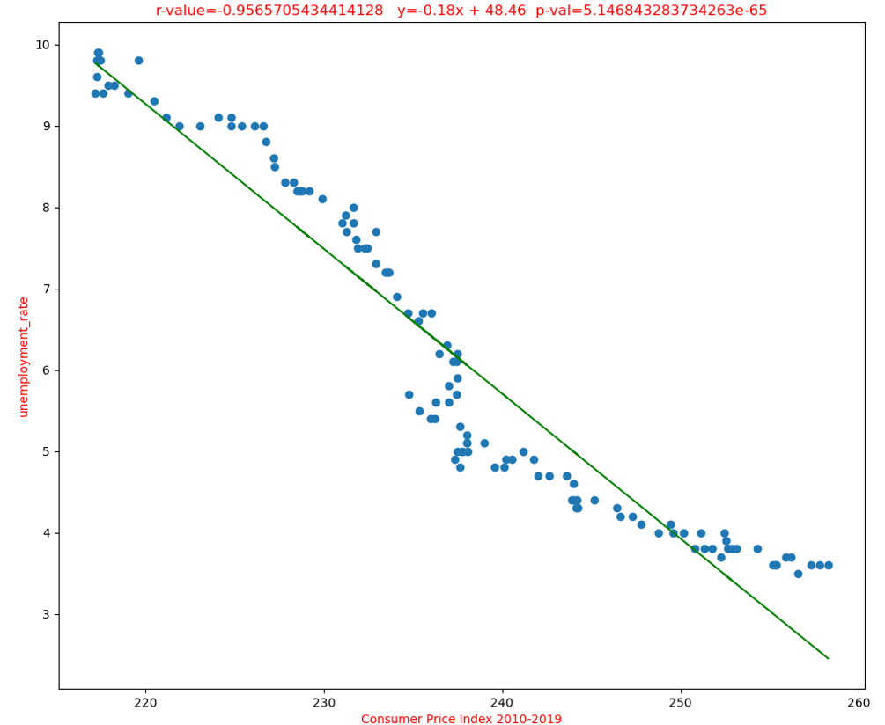
Does the price index of a basket of goods and services paid by urban consumers affect the unemployment rate?
Both have a negative relationship, p-value is high, hypothesis is not statistically significant

Slide 7
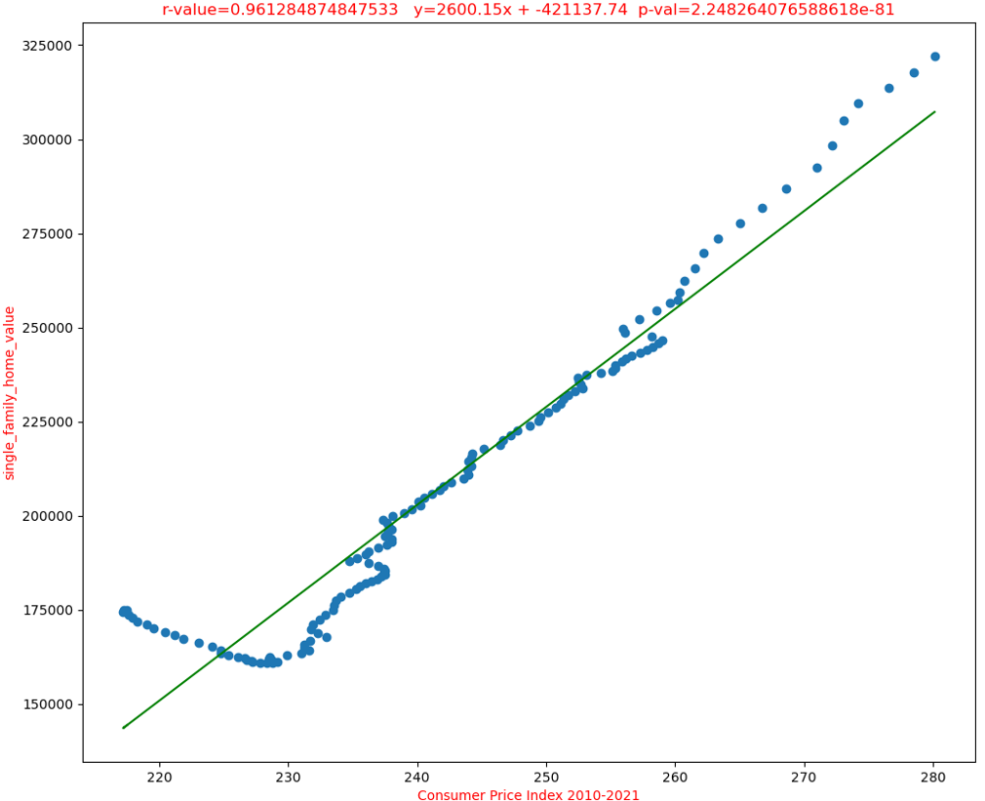
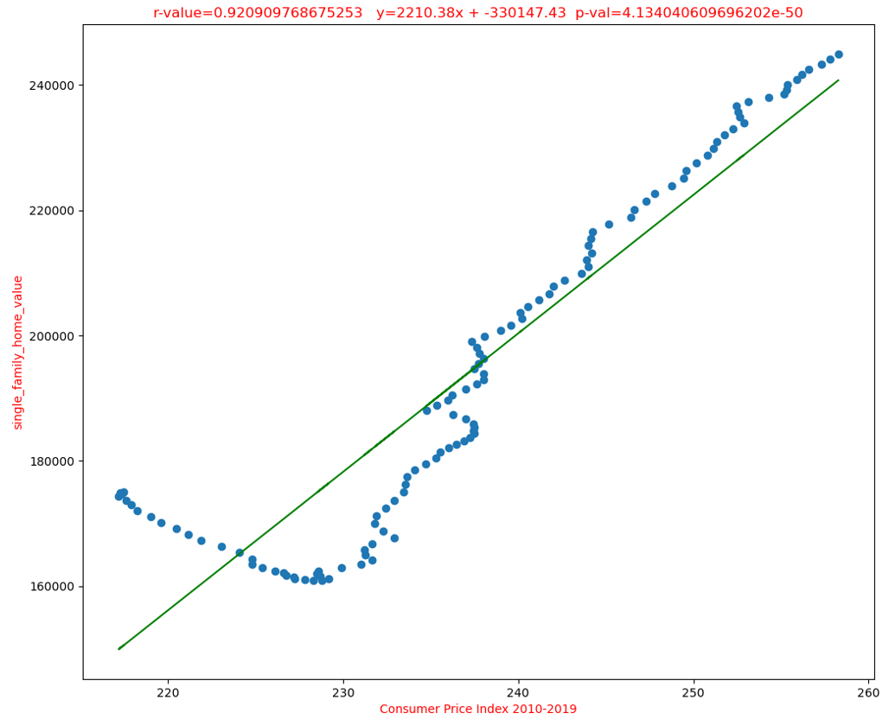
Does the price index of a basket of goods and services paid by urban consumers affect the single family home value ?
Both have a positive relationship, p-value is high, hypothesis is not statistically significant, we can accept the hypothesis as null, no evidence of consumer prices affecting single family home prices also increase?

Slide 8
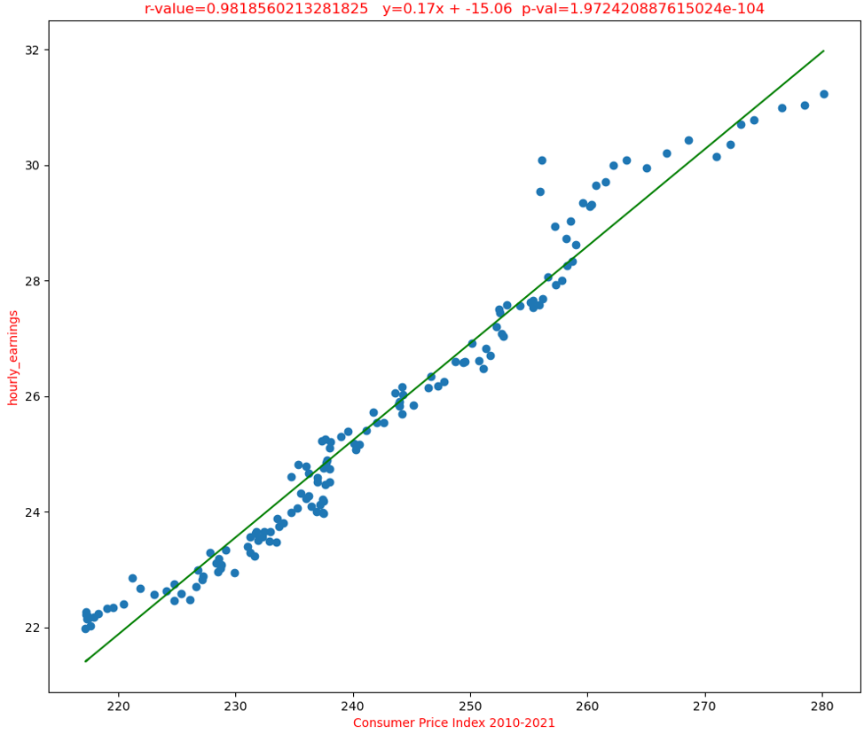
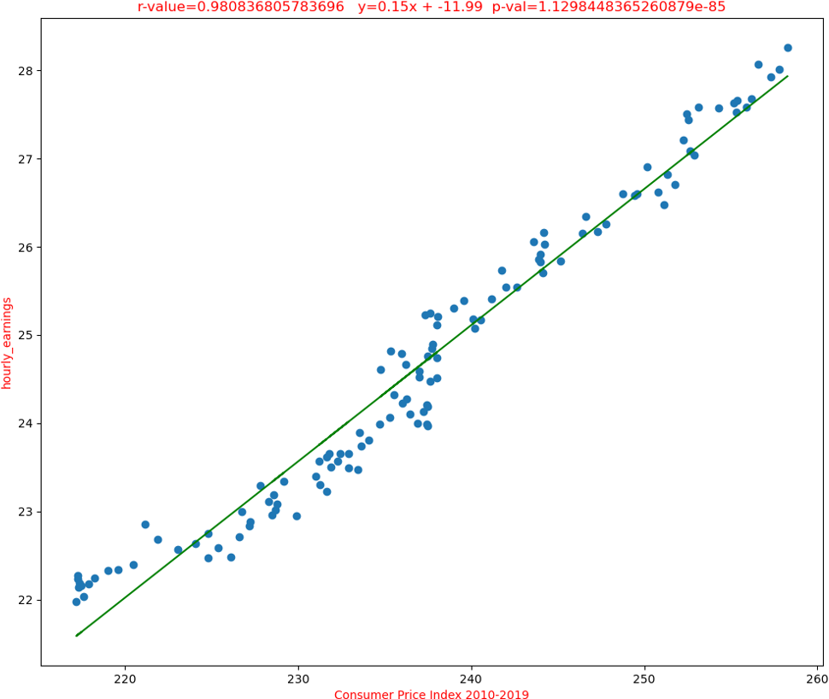
Does the price index of a basket of goods and services paid by urban consumers affect the hourly earnings of all employees?
Positive relationship, p-value is high, hypothesis is not statistically significant

Slide 9
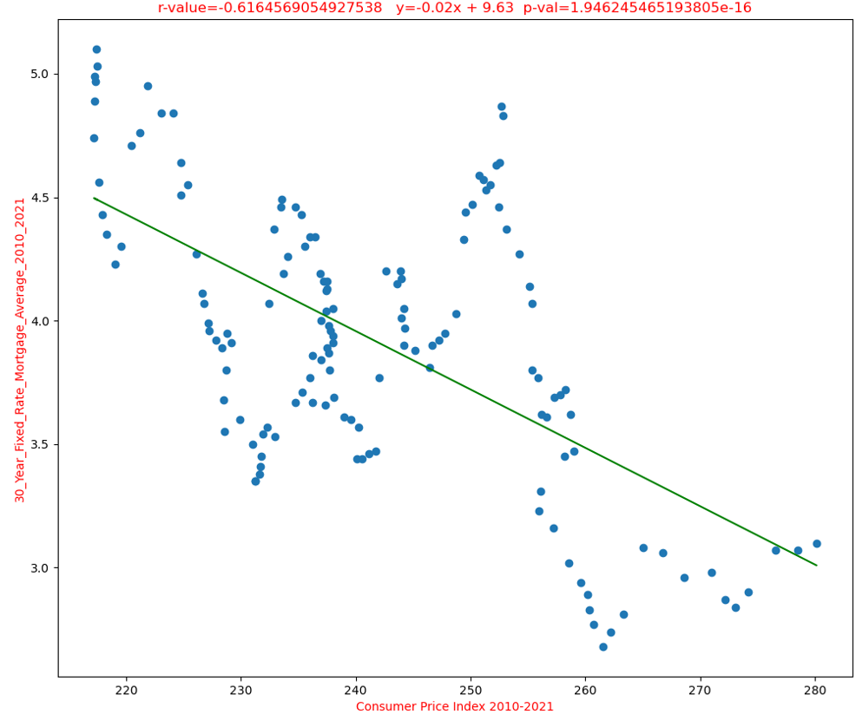
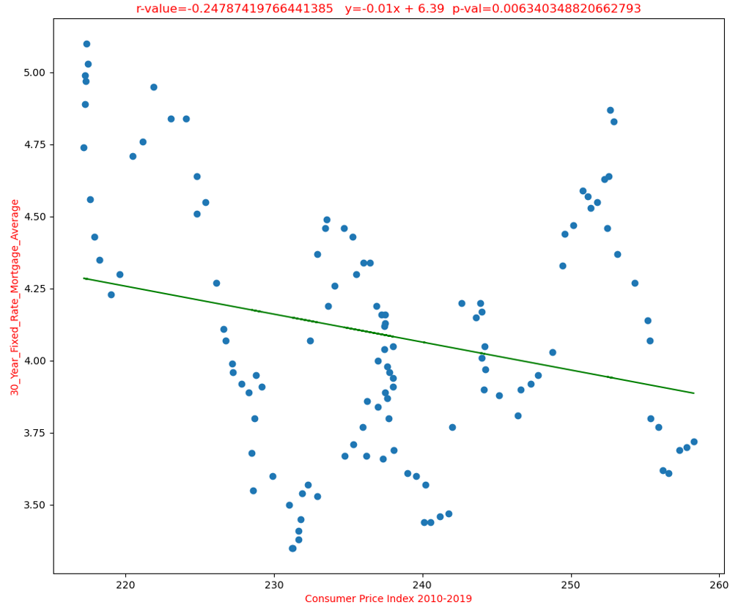
Does the price index of a basket of goods and services paid by urban consumers affect the 30 year fixed mortgage interest rate?
Negative relationship, p-value is high when we include Covid time frame. Until 2019 the p-value is very small which statistically is significant. We can reject a null hypothesis and say there is an effect by the consumer prices to the interest rate.

Slide 10
SUMMARY
At Contoso, we believe in giving 110%. By using our next-generation data architecture, we help organizations virtually manage agile workflows. We thrive because of our market knowledge and great team behind our product. As our CEO says, "Efficiencies will come from proactively transforming how we do business."

Slide 11
THANK YOU

