Slide 1
WSO2 Carbon
Clustering
WSO2 Training

Slide 2
What is a cluster?
A cluster
Should contain two or more instances (nodes) of a product that are configured to run within the same domain, thus acting as if they are a single instance.
The activities of the nodes are orchestrated by "clustering middleware", a software layer that sits atop the nodes and allows the users to treat the cluster as one cohesive computing unit.
Clustering relies on a centralized management approach which makes the nodes available as orchestrated shared servers.
2

Slide 3
Why use a cluster?
A cluster
Improves performance (requests are distributed among several servers instead of just one)
Ensures reliability (if one instance becomes unavailable, another instance will seamlessly handle the request)
Enables High Availability, Simplified Administration, Increased scalability, Failover and switchover
3

Slide 4
Carbon Clustering Capabilities
The WSO2 Carbon core supports distributed caching and clustering based on Hazelcast
Hazelcast combines distributed data structures, distributed caching capabilities, elasticity, memcache support, and integration with Spring and Hibernate
4

Slide 5
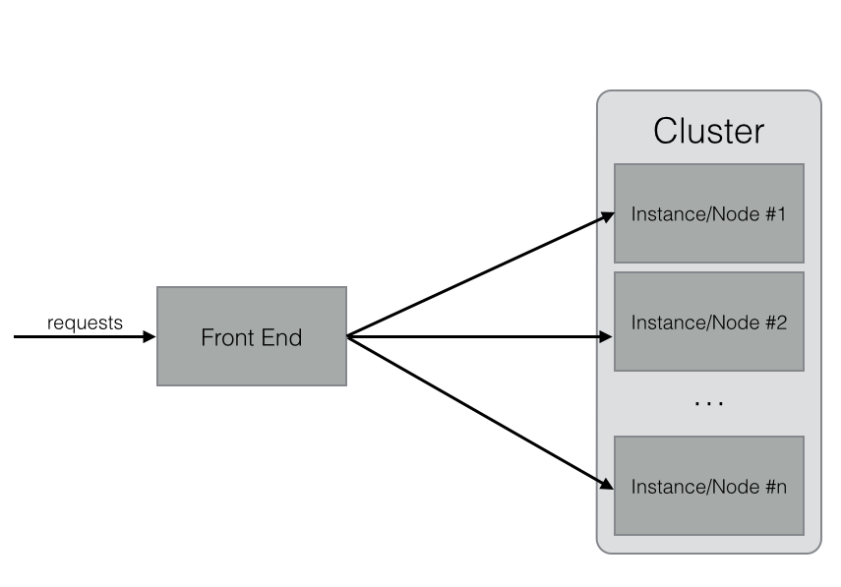
Cluster
Many possibilities for the front end : Apache Web Servers, Hardware, DNS-based algorithms…
5

Slide 6
Cluster Membership (1)
To make a Carbon-based product instance a member of a cluster, it must be configured using one of these schemes:
Well-Known Address (WKA) membership scheme
Multicast membership scheme
WKA is a mechanism that allows cluster members to discover and join a cluster using unicast instead of multicast
Start the cluster with few members known as WKA members
Other members join the cluster through these WKA members
The system should have at least 2 WKA members
6
Notes:
If the system has only 1 WKA member and this member goes down, the cluster breaks and the members will not be able to communicate with each other !

Slide 7
Cluster Membership (2)
Multicast | WKA
All nodes should be in the same subnet | Nodes can be in different networks
All nodes should be in the same multicast domain | No multicasting requirement
Multicasting should not be blocked | No multicasting requirement
No fixed IP addresses or hosts required | At least one well-known IP address or host required
Failure of any member does not affect membership discovery | New members can join with some WKA nodes down, but not if all WKA nodes are down
Does not work on IaaSs such as Amazon EC2 | IaaS-friendly
No WKA requirement | Requires keepalive, elastic IPs, or some other mechanism for re-mapping IP addresses of WK members in cases of failure
7

Slide 8
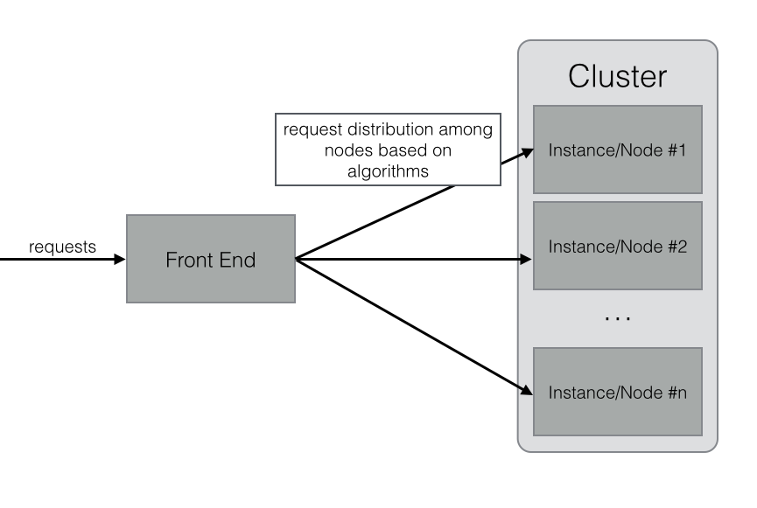
Clustering
For Load Balancing
The front end component distributes requests based on load distribution policies.
The front end is called Load Balancer.
8

Slide 9
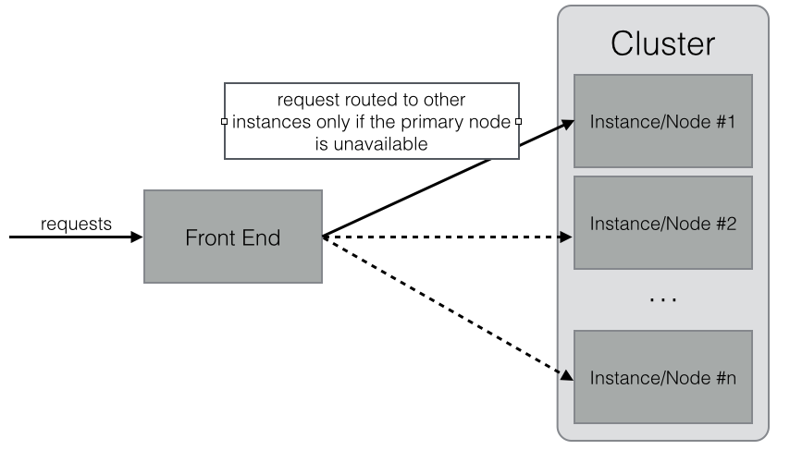
Clustering
For High Availability
User requests are redirected to a backup node if the primary node is unavailable
9

Slide 10
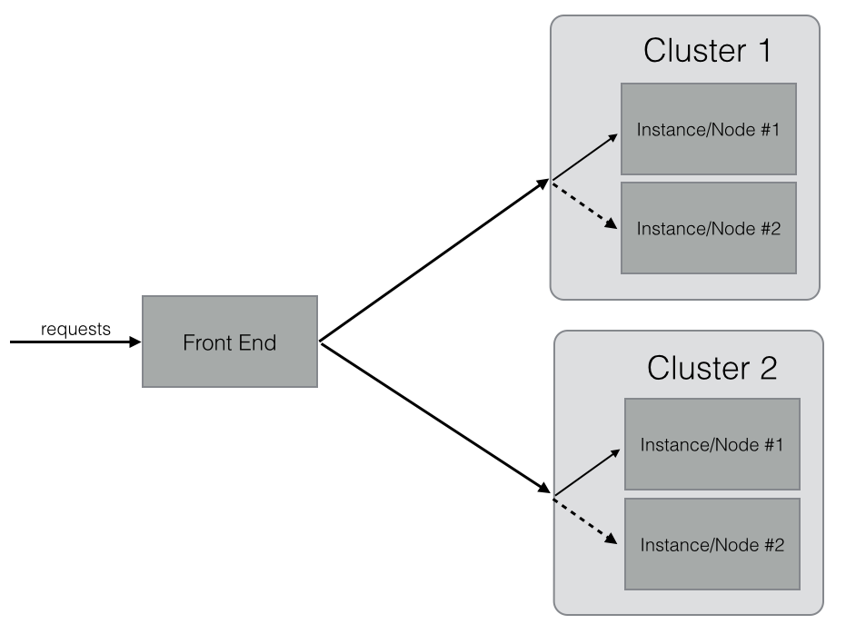
Clustering
For both HA and LB
Coupling the HA principle inside a cluster to a LB principle between clusters
10

Slide 11
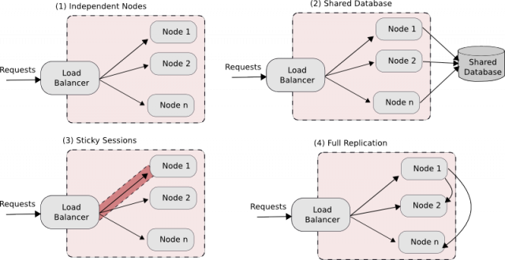
Clustering Patterns
11

Slide 12
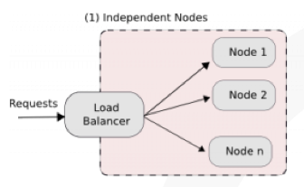
Clustering
(1) Independent nodes
No state is shared between the cluster nodes
A Load Balancer is needed in front of the nodes, dispatching requests following given LB policies
12

Slide 13
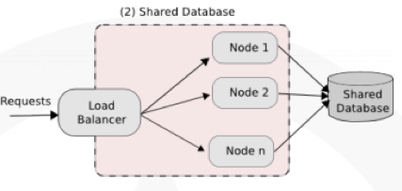
Clustering
(2) Shared Database
All the nodes of the cluster are connected to the same database
Services hosted in the nodes are stateless
The application state is stored in a database
System can scale up till the database is overwhelmed
13
Notes:
With enterprise class databases, this setup is known to scale to thousands on nodes, and this is one of the most common deployment setup. A common optimization is caching data from reads at the service level for performance, but unless nodes flush their caches immediately following a write, the reads may return old data from the cache. However, all the writes to the database must be transactional. Otherwise, concurrent writes might leave the database in a inconsistent state.

Slide 14
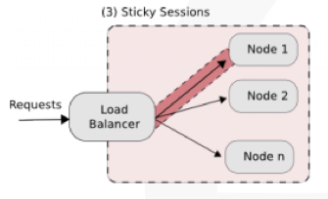
Clustering
(3) Sticky sessions
Requests from the same client are tied to a given session
This session is, in turn, tied to a given node, allowing requests to share the same state
14
Notes:
One downside of this approach is that if a node has failed, the sessions associated with that nodes are lost and need to be restarted. It is common to couple database based system described in scenario 2 with sticky sessions in practice, where session data is kept in memory, but persistent data are saved into a database.

Slide 15
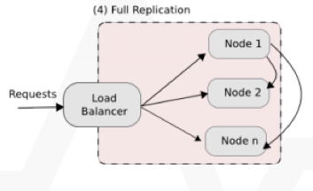
Clustering
(4) Full Replication
Changes done in a given node are replicated into the other nodes of the cluster
Implemented using a some kind of group communication methods.
Group Communication keeps track of the cluster members. When a message is sent using group communication, it guarantees that all nodes in the current group will receive the message.
15
Notes:
As seen in the previous slides, Hazelcast replaces Tribes as the distributed data management framework for WSO2 products based on Carbon 4.2.0

Slide 16
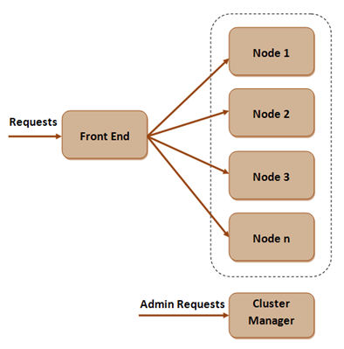
Manager/Worker Clustering Pattern
16
Notes:
Only management nodes are authorized to add new artifacts into the system or make configuration changes.

Slide 17
Manager/Worker Clustering Pattern
The manager node must be well-protected, separated from the other nodes (workers) of the cluster
Advantages of this separation:
Proper separation of concerns: Management nodes specialize in management of the setup while worker nodes specialize in serving requests to deployment artifacts.
Specific worker node tasks: Worker nodes can only deploy artifacts and read configuration.
Less memory requirements: There is a lower memory footprint in the worker nodes because the OSGi bundles related to the management console are not loaded.
Improved security: Management nodes can be behind the internal firewall and be exposed to clients running within the organization only, while worker nodes can be exposed to external clients.
17

Slide 18
Deployment Synchronizer
Deployment Synchronizer provides capability to synchronize deployment artifacts across cluster nodes
All Carbon-based products use Deployment Synchronizer (DepSync) to ensure the same status is maintained across all nodes in the cluster.
It maintains a central repository of deployment configurations (mirroring the <PRODUCT_HOME>/repository/deployment/server folder), and uses that repository to synchronize the nodes.
A product's repository typically contains user-uploaded service archives, modules, service metadata, scheduled tasks etc. These artifacts are typically shared across multiples nodes in a cluster.
18

Slide 19
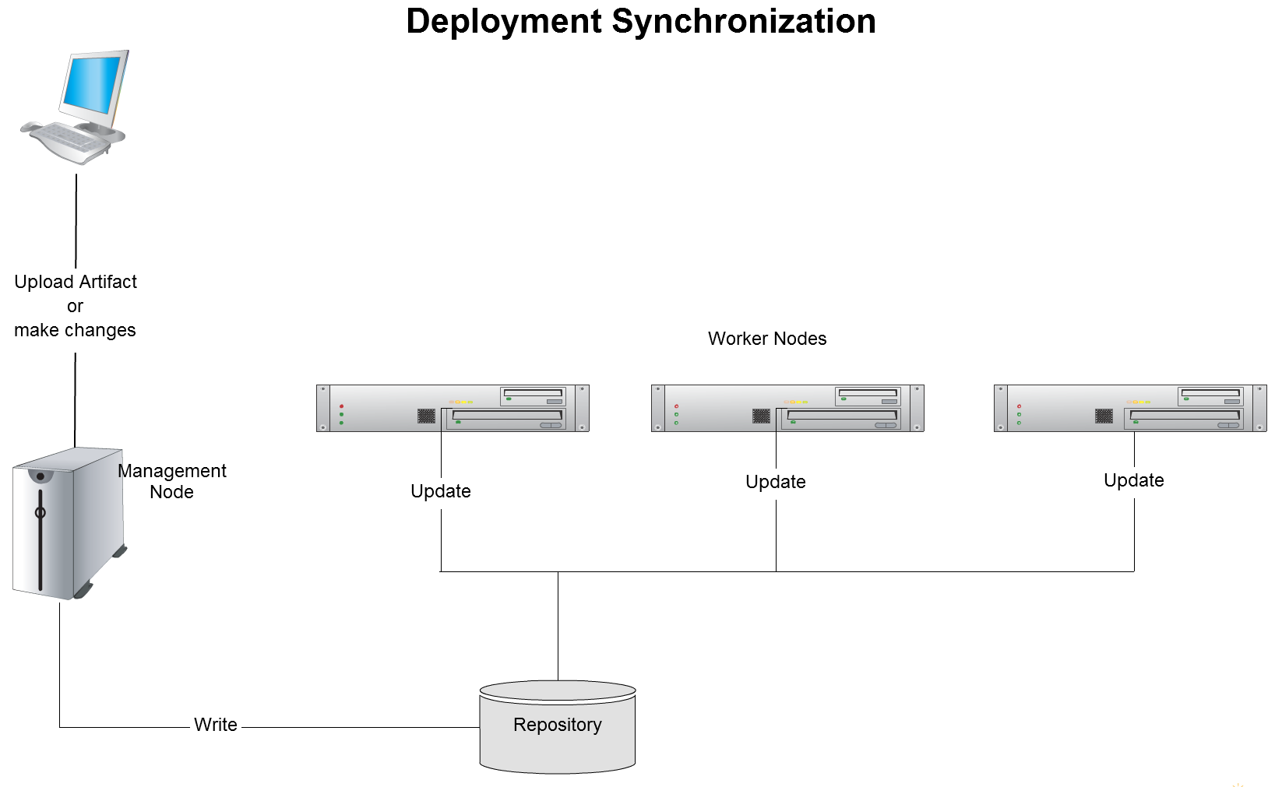
Deployment Synchronizer
19

Slide 20
Deployment Synchronizer
This synchronization functionality is provided by the following feature in the WSO2 feature repository:
Name: WSO2 Carbon - Deployment Synchronizer Feature
Identifier: org.wso2.carbon.deployment.synchronizer.feature.group
Deployment Synchronizer has the following user scenarios:
Maintaining an up-to-date backup of the artifact repository.
Sharing a single artifact repository among multiple servers in a cluster.
Enforcing artifact updates to be deployed on a server at runtime.
20
Notes:
If Deployment Synchronizer is not included in your product by default, you can add it by installing the above feature using the instructions in Installing Features.

Slide 21
Deployment Synchronizer
The WSO2 Deployment Synchronizer (DepSync) uses an SVN-based repository for storing shared deployment artifacts.
The synchronization process is as follows:
When changes to the contents of axis2 repo directory are present, the Read-Write nodes commit those to the Subversion repository.
Then, this node sends a cluster message to all other (slave) nodes specifying the repo is updated.
When the slave nodes receive the message, they update their axis2 repo directory with what's in the svn repository.
21
Notes:
When the number of artifacts in a repo gradually increase, the initial tenant loading time gradually gets higher. To circumvent that, Ghost deployment can be used.
It is the process of loading ghost artifacts instead of checking out the entire SVN repository at the time a tenant loads. This increases the performance of the initial tenant loading time.
To improve the initial tenant loading time and avoid long delays and timeouts, Ghost meta files of the actual artifacts are loaded to the repository. These ghost artifacts are lightweight XML files stored in <PRODUCT_HOME>\repository\deployment\server, with metadata references to the actual artifacts. Loading the ghostified formats of the actual artifacts is faster, more efficient and prevents first-request timeouts and delays. At the time a request is made for an actual artifact, the GhostDisptcher issues a DepSync update of the required artifacts only.

Slide 22
Synchronizing Artifact Deployment
Set up an empty SVN repo
svnadmin create <PathToRepository>/<RepoName>
Enabling DepSync on the manager node:
<DeploymentSynchronizer>
<Enabled>true</Enabled>
<AutoCommit>true</AutoCommit>
<AutoCheckout>true</AutoCheckout>
<RepositoryType>svn</RepositoryType>
<SvnUrl>https://svn.example.com/depsync.repo/</SvnUrl>
<SvnUser>repouser</SvnUser>
<SvnPassword>repopassword</SvnPassword>
<SvnUrlAppendTenantId>true</SvnUrlAppendTenantId>
</DeploymentSynchronizer>
22

Slide 23
Synchronizing Artifact Deployment
Enabling DepSync on the worker nodes:
The same way as on the manager node, with one change: set <AutoCommit>false</AutoCommit>, since worker nodes do not handle server admin requests.
<DeploymentSynchronizer>
<Enabled>true</Enabled>
<AutoCommit>false</AutoCommit>
<AutoCheckout>true</AutoCheckout>
<RepositoryType>svn</RepositoryType>
<SvnUrl>https://svn.example.com/depsync.repo/</SvnUrl>
<SvnUser>repouser</SvnUser>
<SvnPassword>repopassword</SvnPassword>
<SvnUrlAppendTenantId>true</SvnUrlAppendTenantId>
</DeploymentSynchronizer>
23

Slide 24
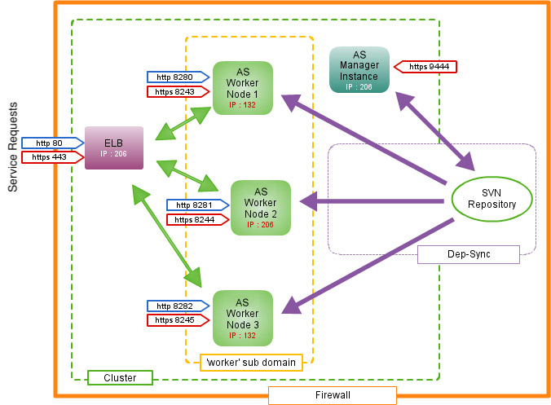
Clustering example
24
Notes:
Only management nodes are authorized to add new artifacts into the system or make configuration changes.

Slide 25
Clustering example
This system will behave
as a single, high-performing AS available at IP address xxx.xxx.xxx.206 via default HTTP or HTTPS ports.
The ELB performs load balancing by handling the incoming requests and routing them to the worker nodes.
The worker nodes process the requests that were routed to them and send responses back to the client through the ELB.
All admin requests are sent to the manager node via HTTPs on port 9444. The manager node synchronizes the same configuration across the clustered worker nodes.
25
Notes:
Details about the example of a clustered deployment:
Two servers (in our example, we use two servers with IP addresses xxx.xxx.xxx.132 and xxx.xxx.xxx.206)
One WSO2 Elastic Load Balancer (ELB) instance
Three WSO2 AS instances as workers to handle service requests
One WSO2 AS instance for managing configuration across the clustered nodes via Deployment Synchronizer
A Subversion (SVN) repository

Slide 26
Creating a cluster (1)
High-level steps for creating a cluster:
Install the load balancer and instances of the product you are clustering.
Configure the load balancer. When using WSO2 ELB as the load balancer, this involves the following steps:
Define the cluster domain in loadbalancer.conf.
Configure clustering and HTTP/S ports in axis2.xml.
Map the cluster host name to the IP address in the /etc/hosts file.
Start the load balancer.
Set up the central database.
26
Notes:
Although those steps are for clustering WSO2 AS, they apply to all WSO2 products.

Slide 27
Creating a cluster (2)
Configure the manager node:
Define the data source(s) for the central database in master-datasources.xml.
Configure clustering in axis2.xml.
Configure the port offset and cluster host name (so that requests to the manager node are redirected to the cluster) in carbon.xml.
Map the database and cluster host name to the IP addresses in the /etc/hosts file.
Start the manager node.
27
Notes:
Although those steps are for clustering WSO2 AS, they apply to all WSO2 products.

Slide 28
Creating a cluster (3)
Configure the worker nodes:
Define the data source(s) for the central database in master-datasources.xml.
Configure clustering in axis2.xml.
Configure the port offset in carbon.xml.
Map the database and cluster host name to the IP addresses in the /etc/hosts file.
Start the worker nodes.
Test the cluster.
28
Notes:
Although those steps are for clustering WSO2 AS, they apply to all WSO2 products.

Slide 29
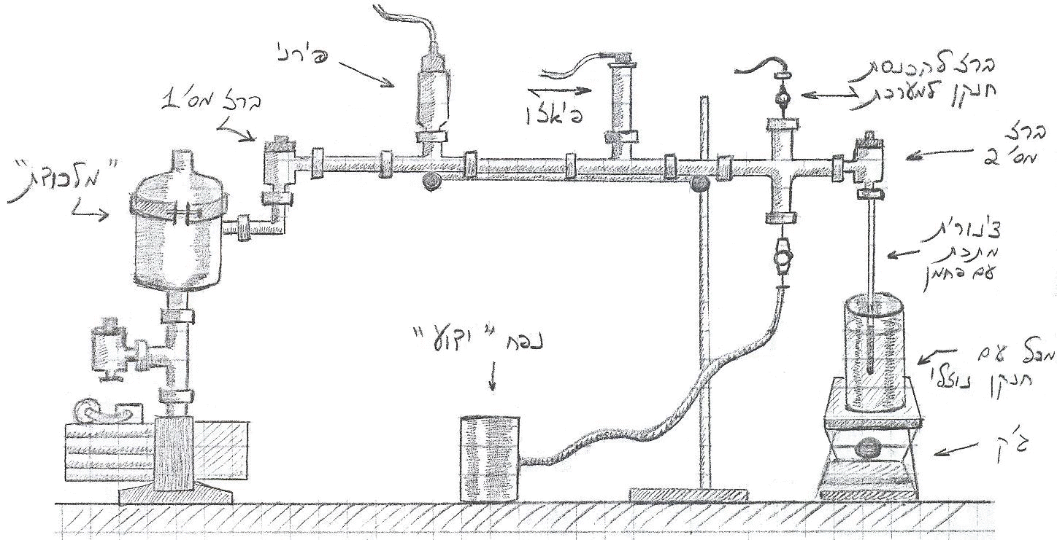
Class Lab: Clustering
Installing and Running a cluster of 2 Application Servers
Following the “Independent Nodes” clustering pattern
29

Slide 30
Resources
WSO2 Products: http://docs.wso2.org/
Clustering WSO2 products
https://docs.wso2.com/display/CLUSTER420/Clustering+WSO2+Products
30
Notes:
You will notice that throughout the training slides, we constantly point you to the documentation.
In addition to examples and scenarios, our docs have every detail of every feature for you to explore.
In training, we will focus on the main use cases, but feel free to review docs to get all options/features.
These links point to main documents – throughout the slides, there will be pointers to specific areas of these main documents.

