Slide 1


Touchdown Insights
A Data-Driven NFL Dashboard
Sara Parveen
Lailah Libay
Gus Mendes
Jacob Evans
WEB PROJECT
Multipurpose Template

Slide 2

WEB PROJECT
Multipurpose Template

Slide 3
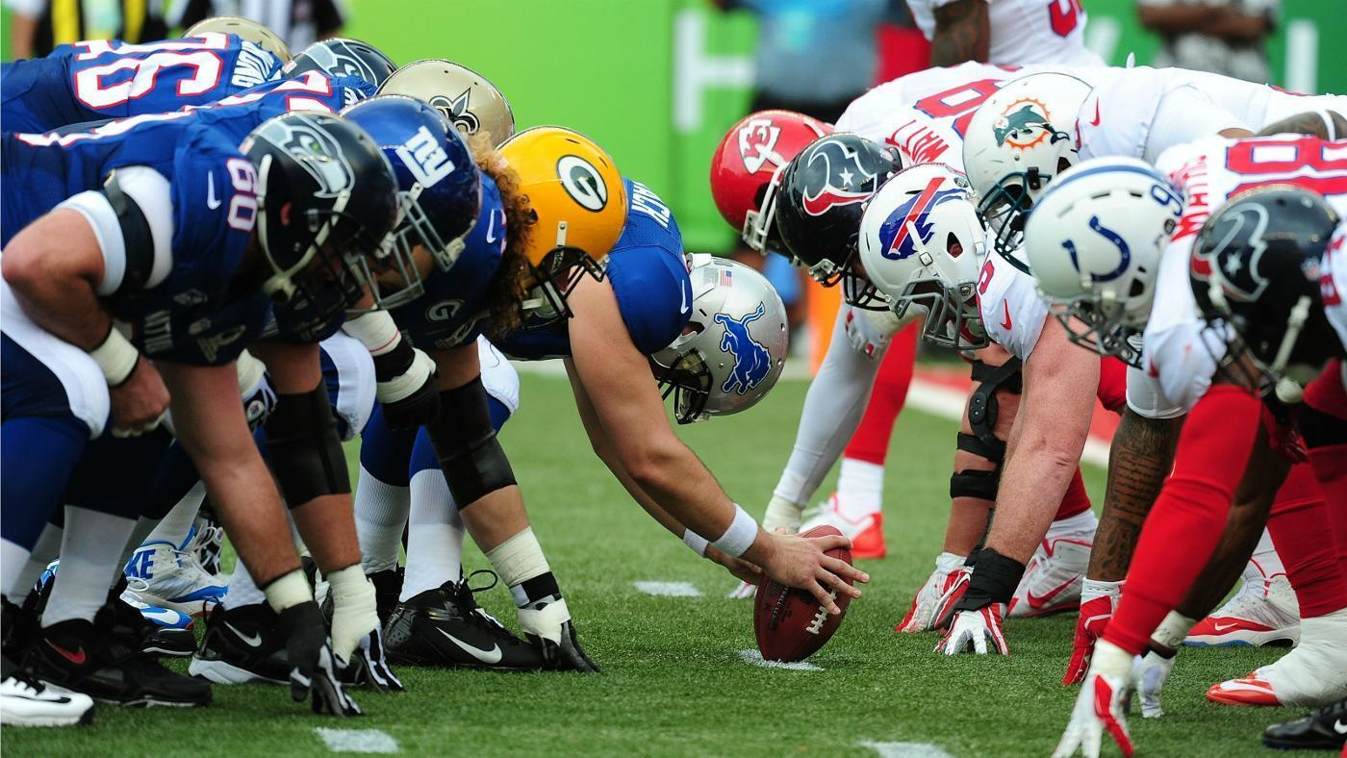
Target Audience
Football enthusiasts
NFL Sports Agents
Sports Analysts
Football coaches

Slide 4
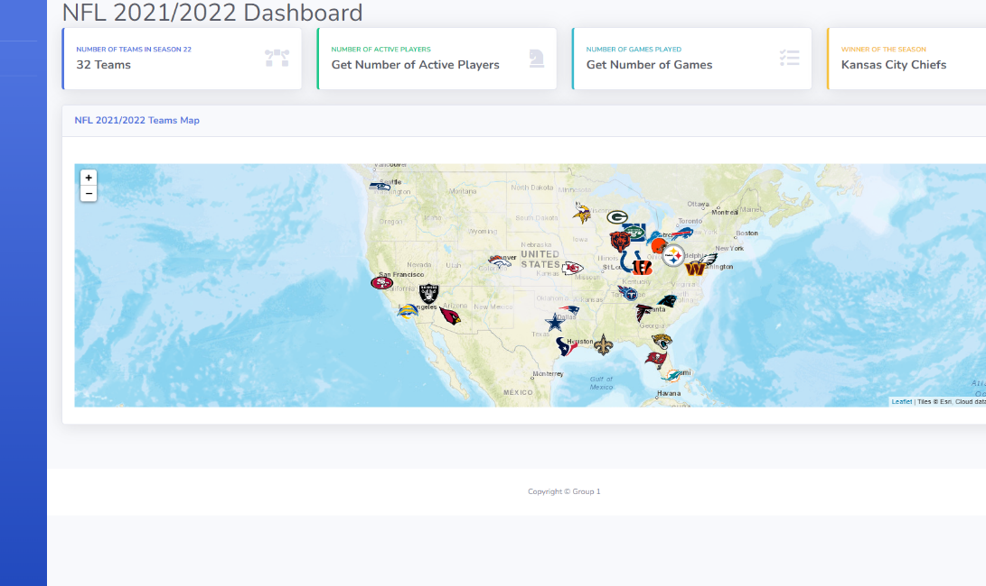
The NFL Dashboard
Main Dashboard
Teams Dashboard
Athletes Dashboard
Overall Statistics
Teams Venue Map
Team Logo
Team Details
Statistic charts
Athlete Headshot
- Athlete Details
- Statistic charts

Slide 5




Data Sources
ESPN API
On GitHub
2021/ 2022 data
Teams and Athletes
Kaggle
Team Statistics
2002 to 2023
GeoPy
- Location coordinates for team venues
Miscellaneous
-ProFootball Reference
- Covers

Slide 6
Our Goals
Type The Subtitle Of Your Great Here
Goal 01
Goal 02
Goal 03
Goal 04
Goal 05
It is a long established fact that a reader
It is a long established fact that a reader
It is a long established fact that a reader
It is a long established fact that a reader
It is a long established fact that a reader

Slide 7
Project Stages
Type The Subtitle Of Your Great Here
ETL
Database
Visualizations
Deployment
It is a long established fact that a reader will be distracted by the readable content
It is a long established fact that a reader will be distracted by the readable content
It is a long established fact that a reader will be distracted by the readable content
It is a long established fact that a reader will be distracted by the readable content

Slide 8
Extract, Transform & Load (ETL)
- Imported Statistics data from CSV
Create Pandas Dataframes
Converted to JSON and CSV outputs
Scraped data from API
Used embedded loops to extract teams and athletes data

Slide 9
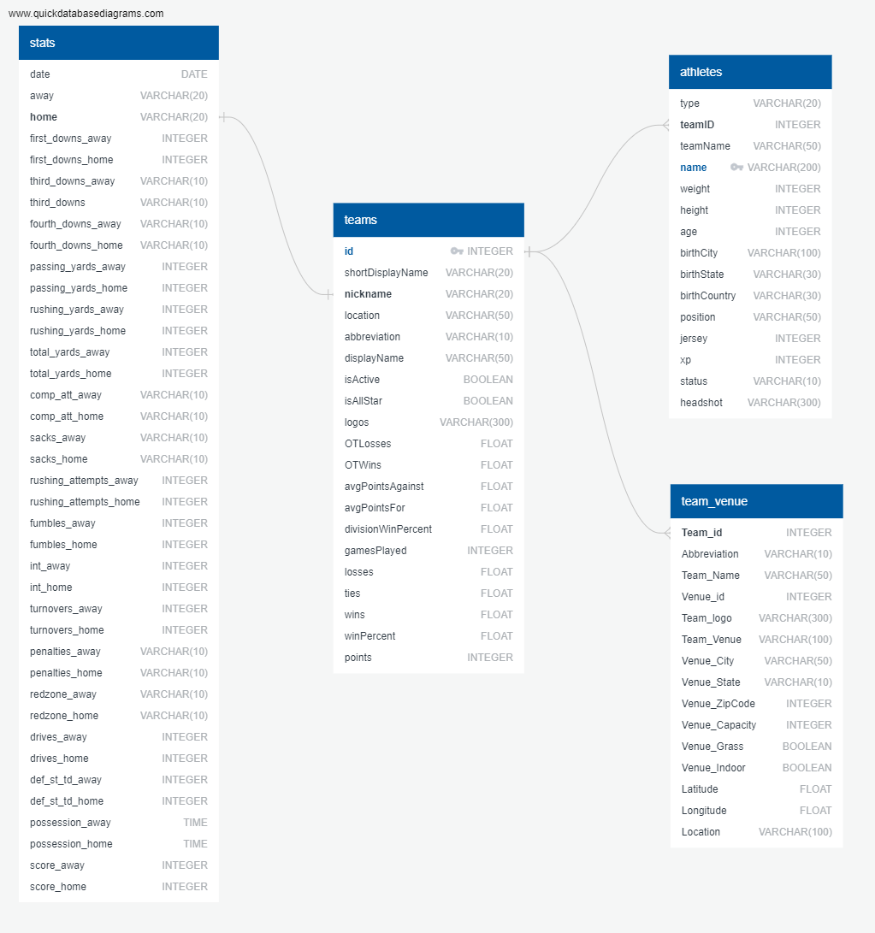
SQL Database
- Imported CSV to tables on PostgreSQL
Developed ERD

Slide 10
Visualizations – HTML/ CSS
Customized HTML to create the three views
Modified to effectively display the visualizations
Personalized CSS
NFL color theme
Template from bootstrap

Slide 11
Visualizations – JavaScript
Libraries used:
D3
Leaflet
Highcharts (new)
Interactive Map
Created dropdowns for Teams and Athletes
Customization by adding labels, legends, tooltips
Three JS files
Teams
Athletes
Teams Venue

Slide 12

Deployment
Deployed to render
Used guincorn for web deployment
https://nfl-dashboard.onrender.com/
Created Python Flask app
Added routes
Included debugger

Slide 13
Data charts
Type The Subtitle Of Your Great Here

Slide 14
75%
Greenland
(Denmark)
90%
ALASKA (U.S.A)
Iceland
SWEDEN
Russia
Canada
NORWAY
FINLAND
UNITED
KINGDOM
ESTONIA
DENMARK
LATVIA
IRELAND
Netherlands
LITHUANIA
BELARUS
BELGIUM
GERMANY
POLAND
UKRAINE
CZECH
Kazakhstan
32%
AUSTRIA
SLOVAKIA
MOLDOVA
FRANCE
Switzerland
HUNGARY
Magnolia
SLOVENIA
ROMANIA
CROATIA
SERBIA
U.S.A
BOSNIA
BULGARIA
Georgia
Uzbekistan
ITALY
MONTENEGRO
Azerbaijan
NORTH
KOREA
SPAIN
ALBANIA
Turkey
Armenia
Turkmenistan
PORTUGAL
Tunisia
GREECE
Syria
China
SOUTH
KOREA
Japan
Lebanon
Afghanistan
Kashmir
Morocco
Israel
Jordan
Iraq
Iran
Algeria
Libya
Egypt
Kuwait
Pakistan
Nepal
Western
Sharah
Qatar
Bhutan
K.S.A
U.A.E
Bangladesh
CUBA
India
MEXICO
Myanmar
(Burma)
TAIWAN
HONDURAS
Mauritania
Mali
Niger
Chad
Eritrea
Oman
HONDURAS
Senegal
Burkina
Faso
Sudan
Yemen
Thailand
Vietnam
PHILIPPINES
NICARAGUA
Guinea-Bissau
Djibouti
Cambodia
VENEZUELA
GUYANA
Guinea
Nigeria
Central
African
Republic
Ethiopia
PANAMA
SURINAME
Sierra Leone
Côte
D’ivoire
Ghana
S-sudan
SRI
LAN KA
COLOMBIA
FRENCH
GUIANA
Liberia
Cameroon
Somalia
Malaysia
Equatorial Guinea
Congo
Uganda
Kenya
ECUADOR
Gabon
Democratic
Republic
Of The Congo
45%
Indonesia
PAPUA
NEW
GUINEA
BRAZIL
Tanzania
PERU
Angola
Zambia
Malawi
BOLIVIA
Zimbabwe
Mozambique
Mauritius
PARAGUAY
Namibia
Botswana
Madagascar
Australia
CHILE
Uruguay
South
Africa
ARGENTINA

