Slide 1
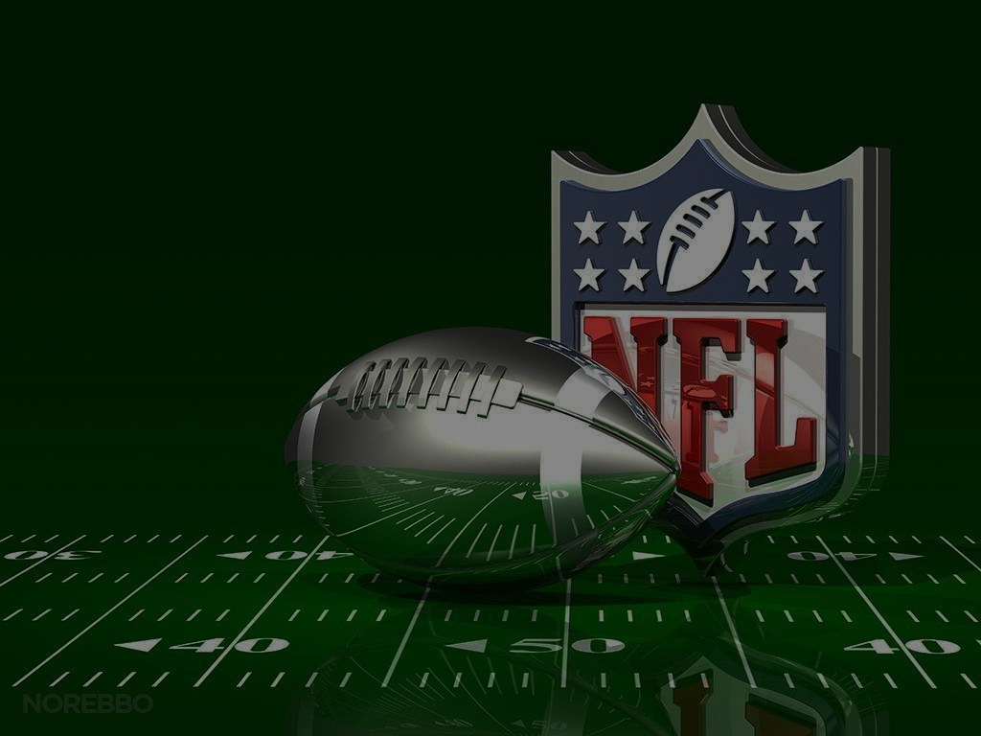
Touchdown Insights: A Data-Driven NFL Dashboard
Prepared by:
Sara Parveen
Lailah Libay
Gus Mendes
Jacob Evans

Slide 2
Table of Contents
pprint (Introduction)
console.log (Work Schematic)
pprint (Design & Features)
console.log (Implementation)
pprint (Conclusion)

Slide 3



Analyzes both team and player’s performance
Track team statistics
ESPN
NFL
Introduction

Slide 4







Visit:
https://nfl-dashboard.onrender.com/
ETL
Database
JavaScripting
CSS
Deployment
HTML
Schematic

Slide 5
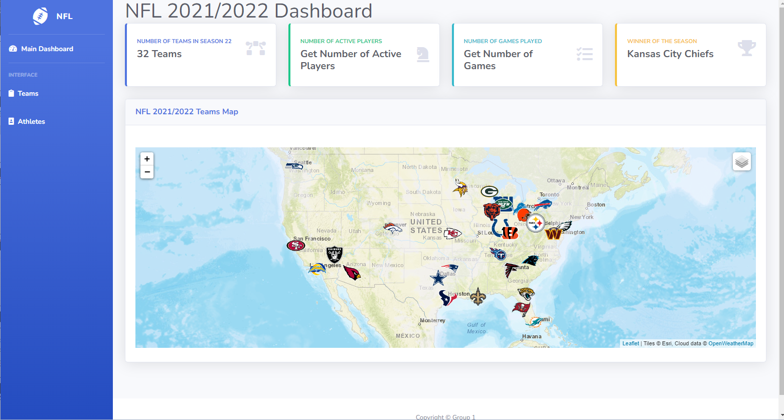

Main Page Overview
Design & Features

Slide 6
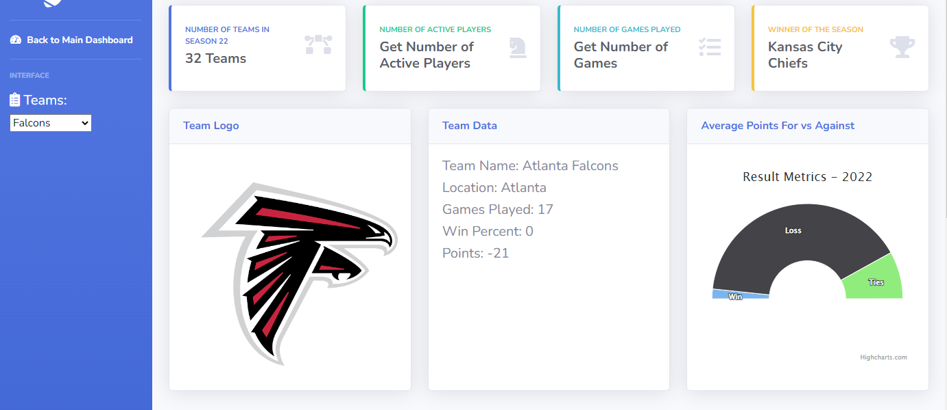
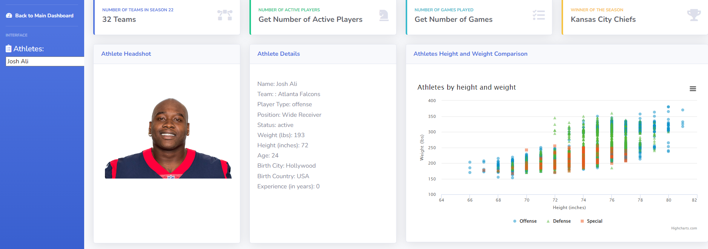

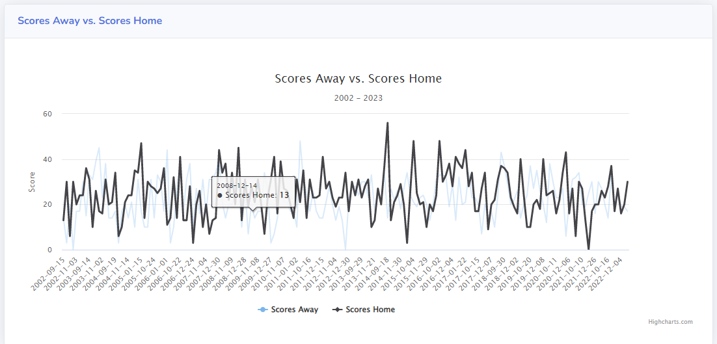
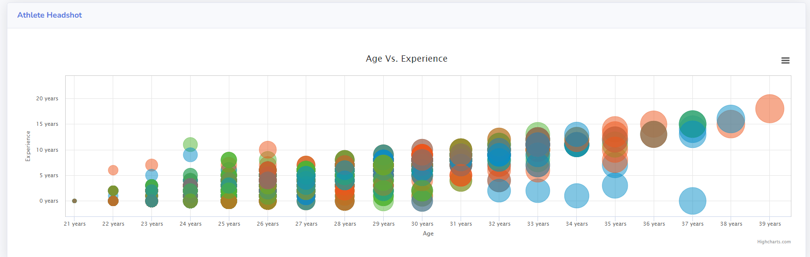
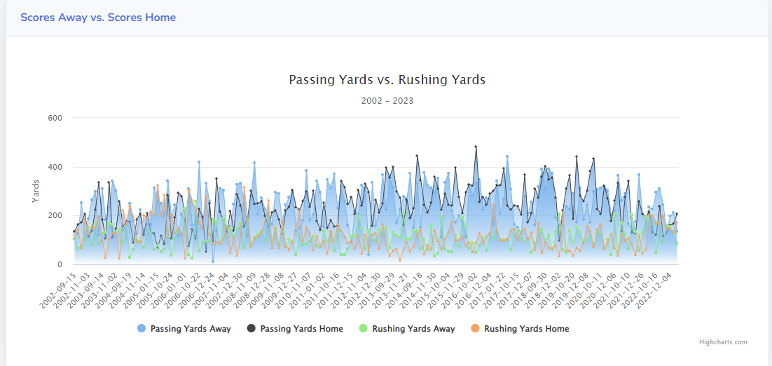
Teams Page Overview
Athletes Page Overview
Design & Features

Slide 7


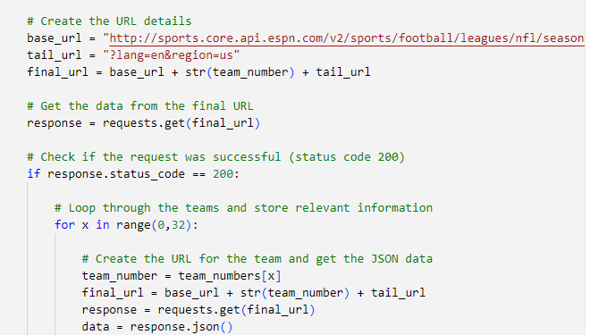
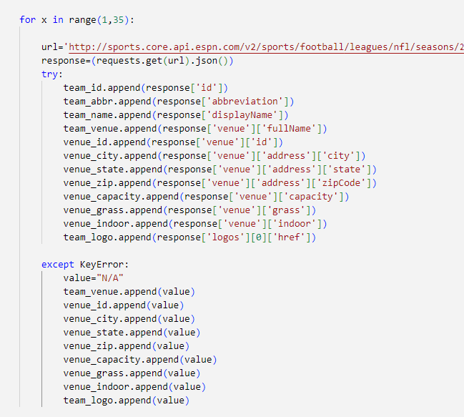
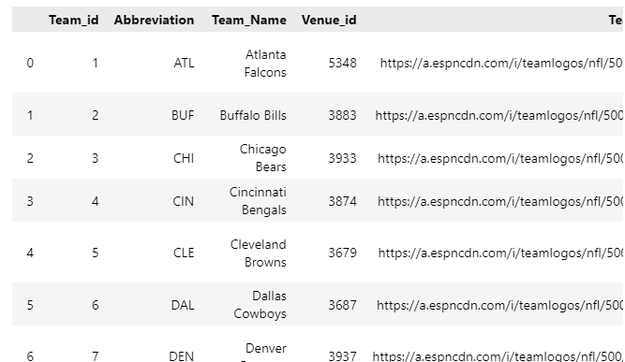
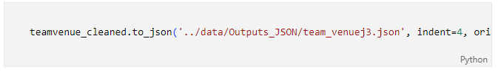
Phase I - Extracting Transforming & Loading
Libraries Used
Process
Sample Script
QUERIED Team & Athletes
Embedded Data…
Performed loops→JSON
Dictionary → Dataframe
Stats Data (Kaggle→Dataframe)
pandas
requests
json
pprint
Implementation

Slide 8
Phase II – Database(ing)
Libraries Used
Process
Sample Script
..
..
..
Implementation

Slide 9
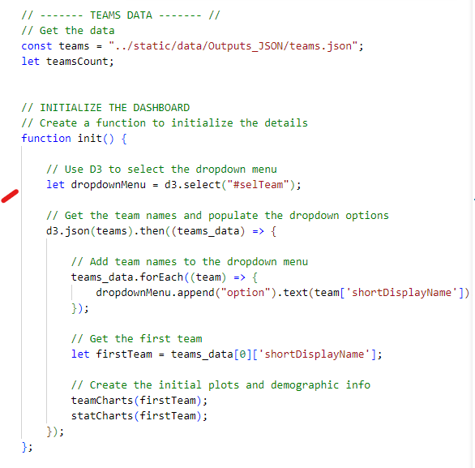
Phase III – Javascripting
Libraries Used
Process
Sample Script
Loaded json files –d3
Drop down list
Functions for charts
Charts updates with dropdown
Filtered
d3
Plotly
Highcharts
Leaflet
Implementation

Slide 10
Phase IV – CSS & HTML
Libraries Used
Process
Sample Script
…
…
…
…
…
..
..
Implementation

Slide 11
Phase V – Mapping
Libraries Used
Process
Sample Script
…
…
…
…
…
..
..
Process
Source-json files (team venue)
-Transferred files to a server -avoided CORS error by loading file from browser
Implementation

Slide 12
Phase VI – Flask & Deployment
Libraries Used
Process
Sample Script
…
…
…
…
…
..
..
Implementation

Slide 13
Thank you for listening

