Slide 1
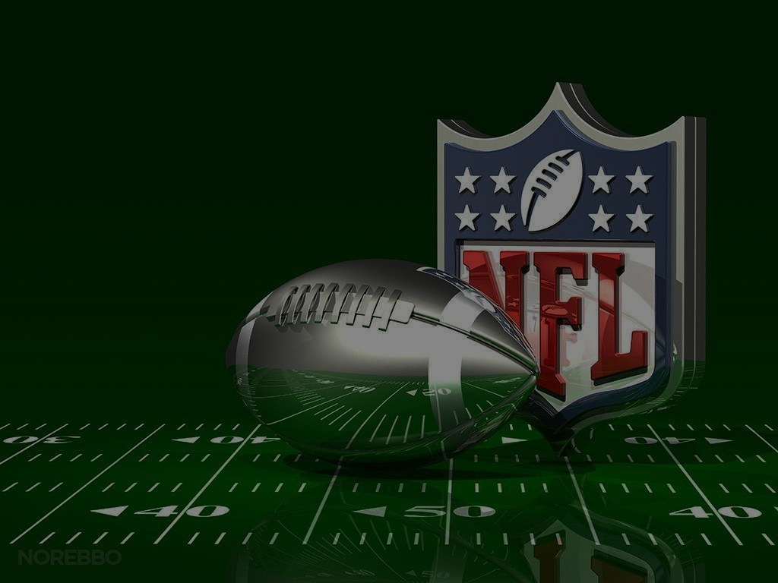
Touchdown Insights: A Data-Driven NFL Dashboard
Prepared by:
Sara Parveen
Lailah Libay
Gus Mendes
Jacob Evans

Slide 2
Table of Contents
pprint (Introduction)
console.log (Work Schematic)
pprint (Design & Features)
console.log (Implementation)
pprint (Conclusion)

Slide 3



Analyzes both team and player’s performance
Track team statistics
ESPN
NFL
Introduction

Slide 4







Visit:
https://nfl-dashboard.onrender.com/
ETL
Database
JavaScripting
CSS
Deployment
HTML
Schematic

Slide 5
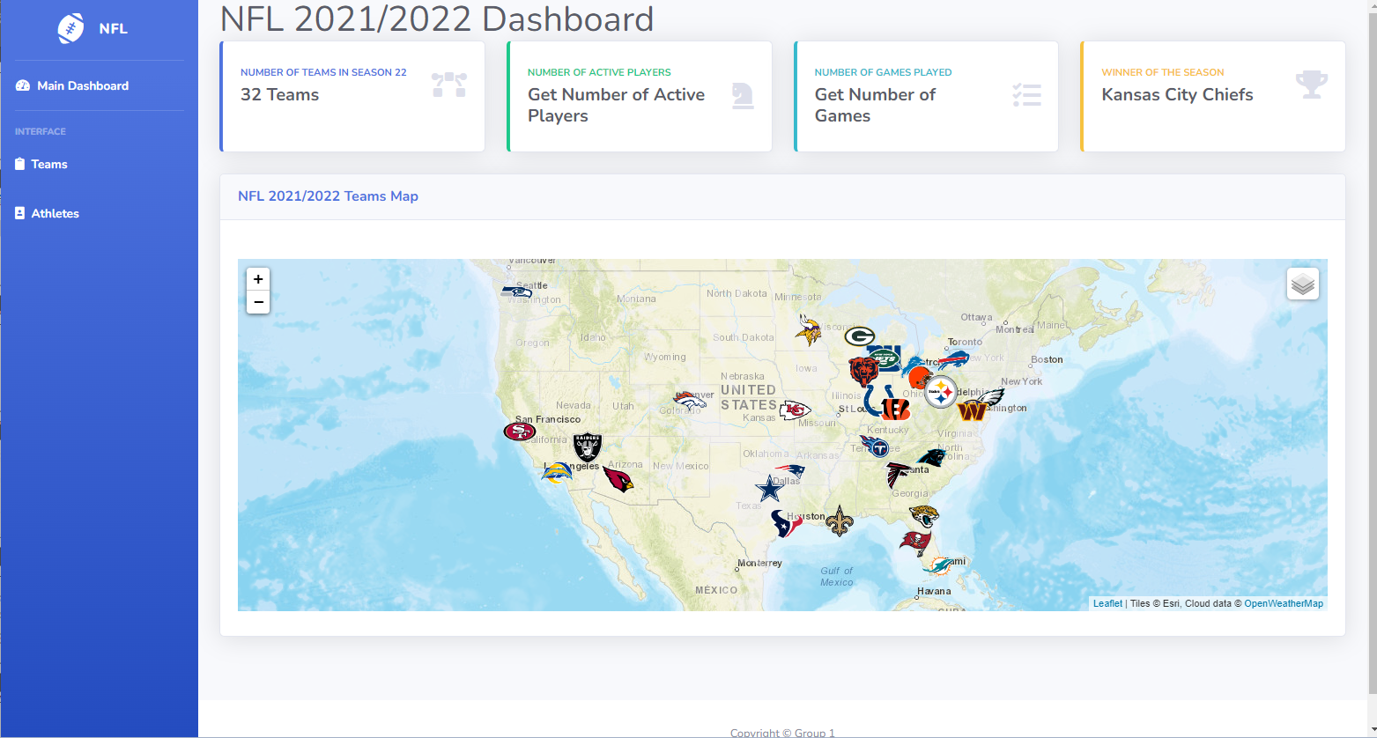

Main Page Overview
Design & Features

Slide 6


Phase I - Extracting Transforming & Loading
Libraries Used
Process
pandas
requests
json
pprint
Scrapped Team & Athletes data
Embedded Data…
Performed loops→JSON
Dictionary → Dataframe
Stats Data (Kaggle→Dataframe)
Implementation

Slide 7
Phase II – Database(ing)
Libraries Used
Process
..
Implementation

Slide 8
Phase III – Visualization
Libraries Used
Process- Add charts
Process-Add Mapps
d3
Plotly
Highcharts
Leaflet
Plotted markers and define variables for tile layers
layers→layer Control→Maps
Created functions for icons used in markers
Fetched data using d3
Loaded json files –d3
Drop down list
Functions for charts
Charts updates with dropdown
Filtered
Implementation

Slide 9
Phase IV –Web Page Creation, Styling & Deploment
Libraries Used-HTML & CSS
Libraries Used
Bootstrap
Flask
render_ template
Process
Process
Customized bootstrap to taste
…
Deployed on render using guinicorn
Included debugger
Added routes for home page, teams and athletes' pages
Implementation

Slide 10
Thank you for listening

