Slide 1
FIT3143 – ASSIGNMENT 3
Accelerating K-Means Clustering with Parallel
Implementations and GPU computing
Janki Bhimani, Miriam Leeser, Ningfang Mi

Slide 2
Accelerating K-Means Clustering with Parallel Implementations and GPU computing
“A K-Means implementation that converges based on dataset and user input.”
“Comparison of different styles of parallelism using different platforms for K-Means implementation.”
“Speed-up the algorithm by parallel initialization.”
Notes:
The three things Bhimani and colleagues seaked to contribute to the literature with this work was

Slide 3
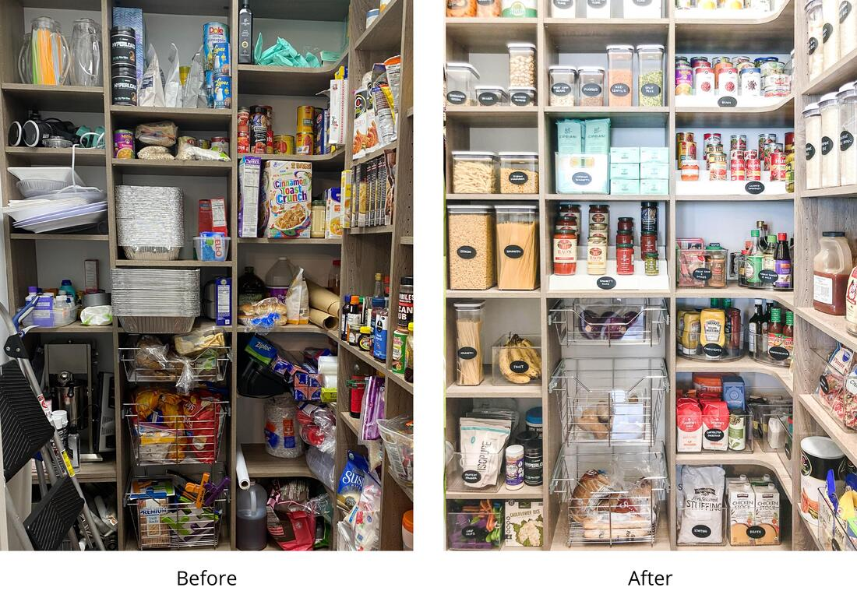
Clustering
“ Clustering is the unsupervised classification of ” patterns
Notes:
Birmani and colleagues classify clustering as the unsupervised classification of patterns. We can further abstract this by saying that machine learning clustering is akin to organizing a messy room. If we have a bunch of items scattered around we might seek to organise them. By doing so we seek to find hidden patterns or structures within the data in order to make better sense of the relationship structures within a data set.

Slide 4
K-means clustering
Step 1:
Randomly assign k-points across the data set
Initial Centroids
Step 2:
Cluster the points based on there distance from the k-chosen points
Step 3:
Take the mean value of the clustered points
Second iteration Centroids
Step 4:
Re-cluster based on distance from the means
Notes:
If we begin with a number line containing points we can break k-means down into steps.
The first step being the random assignment of k clusters to a point
The second involves clustering the points depending on the distance from the centroids
The third step involves calculating new centroids based on the mean value of the cluster points.
The fourth step is just a new iteration of the second step, but with new centroid values
The following steps are repeated until some iteration has been reached or a certain tolerance level set by the user has been reached

Slide 5
K-means Visualized
Visualization by Surayya Shaikh
https://www.linkedin.com/pulse/k-means-clustering-its-real-use-case-surayya-shaikh
Notes:
Though the last example was a simple number line, we can generalize the k-means algorithm to any higher dimensional space. This visualization shows the k-means algorithm being performed on a data set in two dimensions.

Slide 6
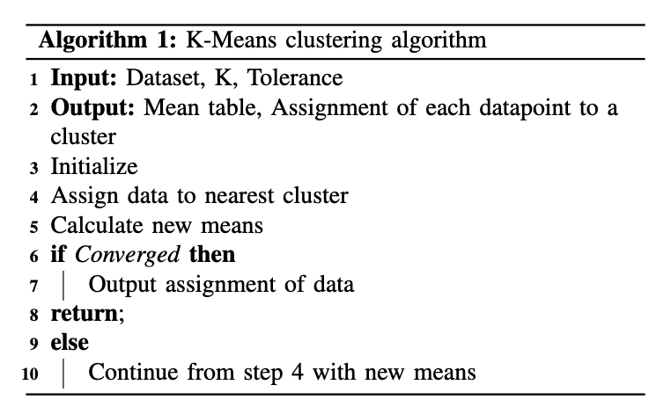
Parallelism Potential
85—90% of algorithm spent within step 4 execution time, and as k-means is an iterative approach, this is an excellent point for parallel implementations
Notes:
By examining the pseudocode supplied by the paper, the places for parallelism within the algorithm can be identified. Bhirami and coleagues identified that step 4 within the given pseudocode was an optimum point for parellization, not only due to it’s iterative nature but also the fact that up to 90% of the algorithm was spent within this step.

Slide 7
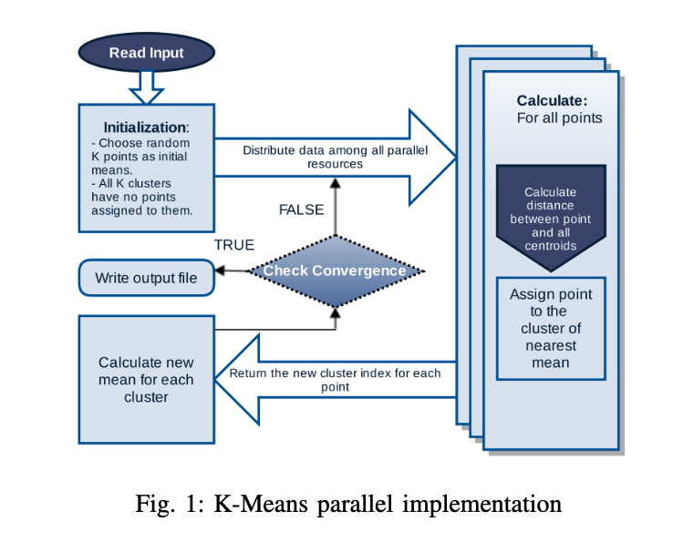
Parallelism Potential
Notes:
Figure 1 from the paper further generalizes a parallel approach to solving the k-means clustering problem. The sequential steps within the algorithm is the initialization and convergence check that hold dependencies from each thread. Parallel implementations of the code exist at calculations of distance from data points to centroids and the cluster assignment for a given point.

Slide 8
Parallel Implementations
Three methods were used to achieve parallelism:
Shared memory with OpenMP
Distributed memory with OpenMPI
CUDA GPCGPU implementation
Notes:
From the paper 3 means for implementing parelization were identified those being shared memory with OpenMP, distributed memory via use of openMPI and general purpose computing using CUDA.

Slide 9
OpenMP Implementation.
Entering Parallel Region
OMP Critical
If converged
Random points picked as initial centroids
Calculate cluster mean
Else:
Finish
Points assigned to nearest cluster by individual threads
Notes:
OpenMP implements a shared memory model and a multiple thread program to spawn parallel computation. Random points are picked as
initial means to start the algorithm, then the parallel region is entered. Each point is assigned to its nearest cluster by a group of threads operating in parallel,
followed by a sequential step to compute new means. If the
algorithm has not converged then the parallel threads are
spawned again with the new means.

Slide 10
OpenMPI implementation
Master
Perform sequential instructions
MPISend()
Data distributed by Master to slave nodes
MPIRecv()
…
}
s₀
s₁
s_{n}
Slave Nodes
Slaves perform the parallel work
Notes:
MPI is the implementation for a distributed memory platform. The deployment is a Master-Slave model where sequential steps are performed by the master
process and the slaves do the parallel work. The major difference in the distributed memory implementation from the shared memory implementation is that
the master needs to perform explicit send and receive calls to distribute the data among available processes and to collect resulting assignments from the processes. In
every iteration, the slaves send the index array containing the cluster assignment for each point and the master broadcasts new means to all slaves after updating means and checking for convergence. The master decides to terminate when the desired convergence is reached.

Slide 11
CUDA Implementation
Initialization is done on the host.
Host copies all data points to GPU memory
GPU performs calculation, finding clusters
Cluster array copied back to host memory
Host calculates new centroids
Repeat until convergences is reached

Slide 12
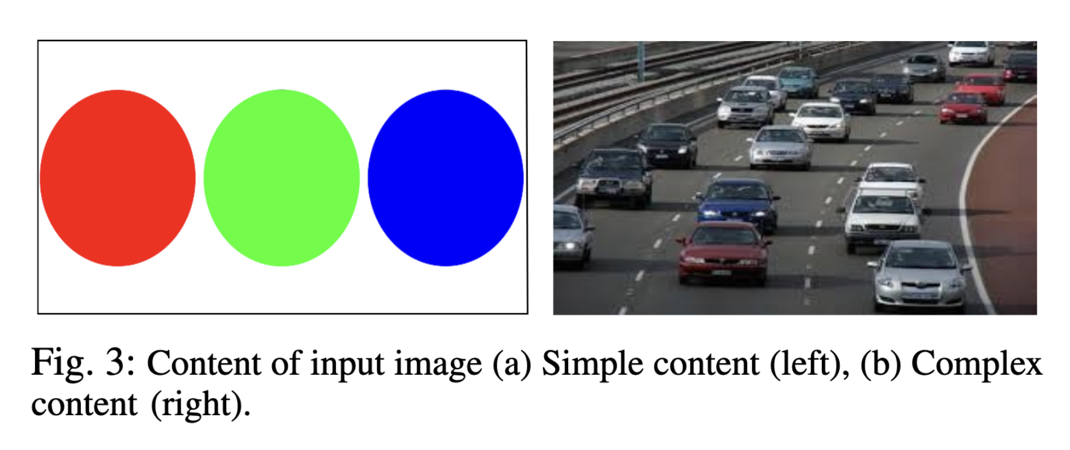
Setup
Notes:
The algorithm implemented by Bhimani and colleagues saw the k-means algorithm cluster both simple and complex images. These inputs dictate the rate of convergence of the k-means algorithm.

Slide 13
Tolerance
=
Number of points changing cluster between iterations
Total number of data points
Notes:
Tolerance was used as a means of convergence within the algorithm, for which the tolerance allowed is set by the user at initialization and the tolerance value is calculated at each iteration by the taking the change in data points between clusters divided by the total amount of data points.

Slide 14
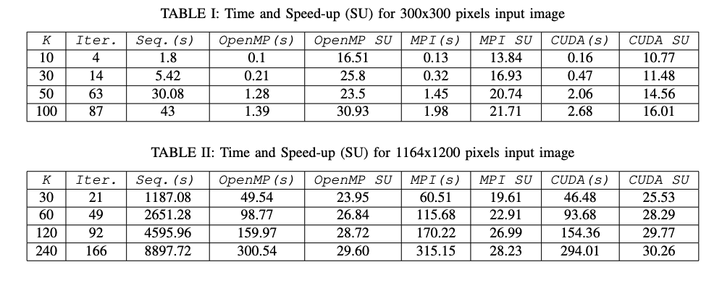
Results
Notes:
The two tables show the difference in convergence rates for different values of K and two different input images, one being relatively simply and the other being more complex. For both tables the tolerance is set to 0 and therefore there must be no change in any data point to a different cluster between the penultimate and final iteration of the algorithm. As hypothesized all parallel algorithms outperformed the sequential implementation of the algorithm and Birmani and coleagues were also able to identify that for simple images a 16 thread OpenMP implementation outperformed all other competition for the 300x300 simple image. However for the complex image a 32x32 block implementation of CUDA was the best performing implementation.

Slide 15
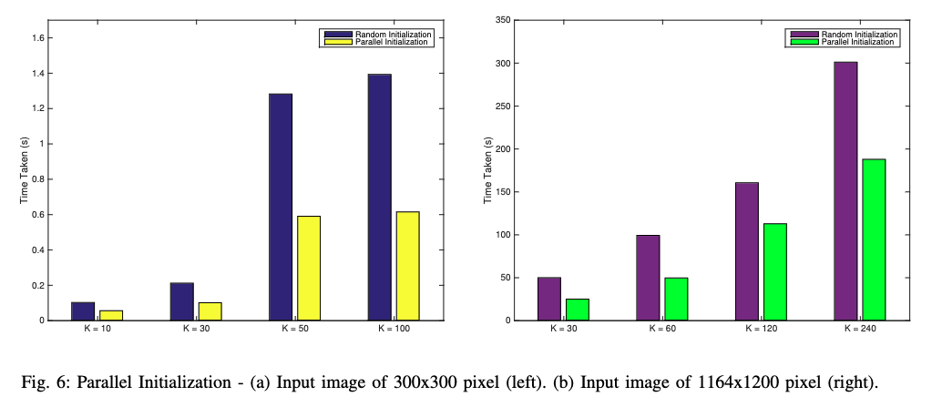
Results continued
Notes:
Further analysis of the results show the dramatic influence that picking suitable initial centroids for a parallel k-means algorithm can make. Additional speedups of up to 2.5 times the amount can be seen if properly selected for instead of randomly selecting initial centroids.

Slide 16
Conclusions
Notes:
So from the results the authors were able further identify the iterative nature of machine learning algorithms and put in place parallel implementations in order to reduce computational bottlenecks in the sequential algorithms. The main conclusions from the results with regard to parallism of the k-means algorithm was that for computationally simple examples an OpenMP implantation was best suited, but for complex imagery CUDA should be used as an implementation of the k-means algorithm.

