Slide 1
大家好 這是最後一次project 主要分三個部分: SOCKS server + connect mode
SOCKS server + bind mode: 可透過 FTP Client上傳/下載檔案
CGI可以連線到SOCKS server
請參考 NP_project4.pptx Part2, Part3 demo流程請參考 *.mp4檔 有問題歡迎在討論區發問 需要繳交的檔案為： socks4 proxy server 程式碼
可透過 proxy 連線的 cgi 程式碼
socks.conf (防火牆設定檔)
僅需繳交程式碼，請勿上傳 git 相關檔案，最後的程式碼請打包成 .zip，否則根據情況扣分。 作業繳交時間為 12/31(日) 23:59，DEMO 日期為 1/2(二)。

Slide 2
Project IV: SOCKS4 Server
Prof. I-Chen Wu
Network Programming

Slide 3
Abstract
SOCKS 4 Protocol
SOCKS 4a Protocol (extension)
In this project, you are asked to implement the SOCKS 4 firewall protocol in the application layer of the OSI model.
SOCKS is similar to a proxy (i.e. intermediary-program) that acts as both server and client for the purpose of making request on behalf of other clients. Because the SOCKS protocol is independent of application protocols, it can be used for many different services: telnet, ftp, www, etc.
There are two types of the SOCKS operations (i.e. CONNECT and BIND). You have to implement both of them.

Slide 4
Requirements
Code
Part I: Socks4 Server Connect Mode
Part II: Socks4 Server Bind Mode
Part III: CGI Proxy
Others
Name your cgi as hw4.cgi
Wrap your code into .zip (Do not upload test cases and git files)
Use the concurrent, connection-oriented paradigm.

Slide 5
Schedule
Deadline:
2017/12/31 23:59 (Sunday)
Demo:
2018/01/02 10:00~17:00 (Tuesday)

Slide 6
Part I: Socks4 Server Connect Mode

Slide 7
Web Browser(Connect mode)
Browser
SOCKS
SERVER
Dest
Host
SOCKS4_REQUEST
SOCKS4_REPLY
HTTP REQUEST
HTTP REQUEST
REPLY
HTML
REPLY
HTML
Notes:
Connect mode: with browser
Socks server 把從 client 接收到訊息送給 host，反之亦然
寫好 socks server + connect mode

Slide 8
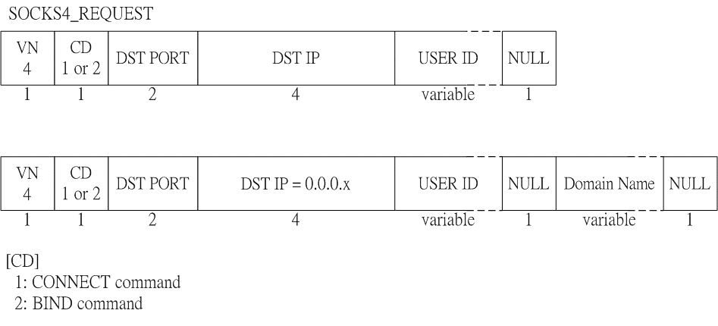
SOCKS4_REQUEST
[DST IP]
Connect mode: is the DST IP in SOCKS4_REQUEST
Bind mode: 0

Slide 9
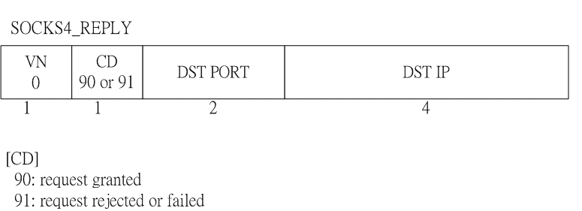
SOCKS_REPLY

Slide 10
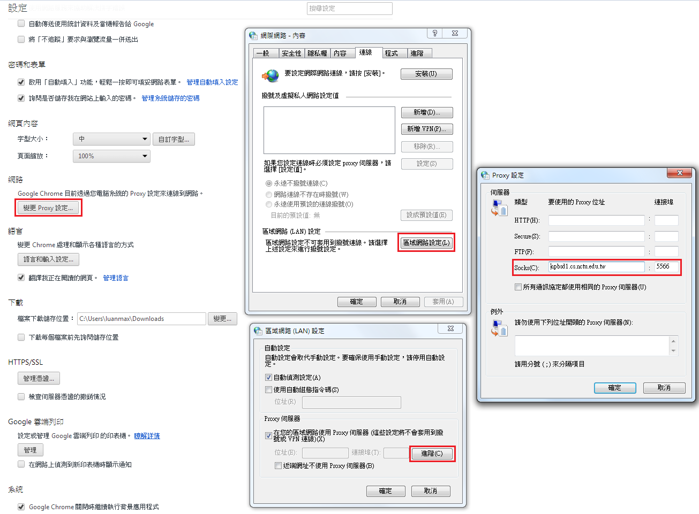
Browser Setting

Slide 11
Part I points
[SOCKS Server : CONNECT] (15 points)
1. Open your browser and connect to any webpage
2. Turn on and set your socks server, then
(1)5%: able to connect any webpages on google search
(2)5%: turn off your socks server, connection to the same page will be failed.
(3)5%: turn on your socks server again, the connection should be built successfully.

Slide 12
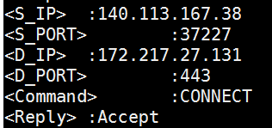
Part I points
[SOCKS Server : Messages] (5 points)
Your socks server need to show messages below：
<S_IP> : source ip
<S_PORT> : source port
<D_IP> : destination ip
<D_PORT> : destination port
<Command> : CONNECT or BIND
<Reply> : Accept or Reject
<Content> : Redirect partial socket data

Slide 13
Part II: Socks4 Server Bind Mode

Slide 14
FTP Transfer(Bind mode)
FTP
CLIENT
SOCKS
SERVER
FTP
SERVER
SOCKS4_REQUEST
SOCKS4_REPLY
DATA
DATA
DATA
DATA
Notes:
寫好 socks server + bind mode => for FTP transfer

Slide 15
FTP server/client
FTP Server
You can apply free 5GB space on http://5gbfree.com/
Server: ftp.[Username].5gbfree.com:21
Account: [Username]
Or build a FTP server on your own computer
Refernce: http://goo.gl/UjrFwy
FTP client
Use FlashFXP (http://www.flashfxp.com/)
FileZilla is not recommended
Steps
Download and set FlashFXP
Connect to FTP server
Upload/Download files

Slide 16
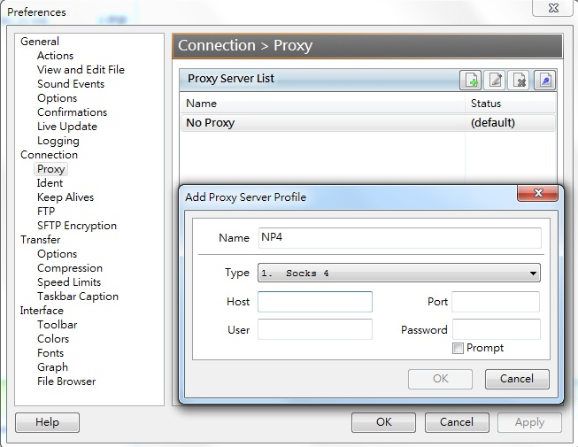
FlashFXP
Options → Preferences→Connection→Proxy
Add entry
Socks4
Host/Port

Slide 17
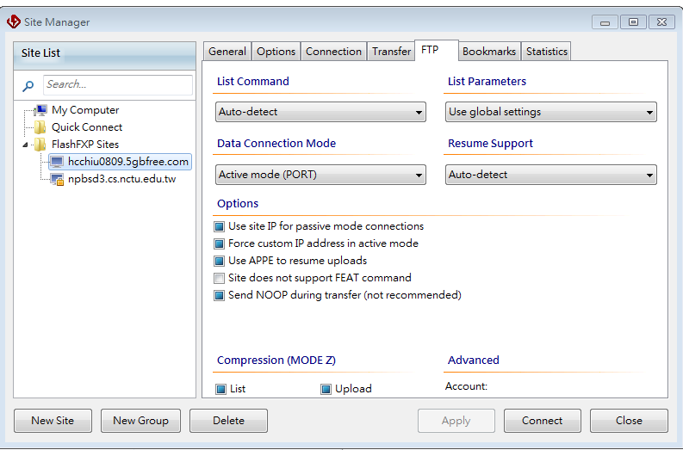
FlashFXP – set FTP server
Sites → Site Manager→ New Site → FTP→ Data Connection Mode
Change to Active Mode(PORT)

Slide 18
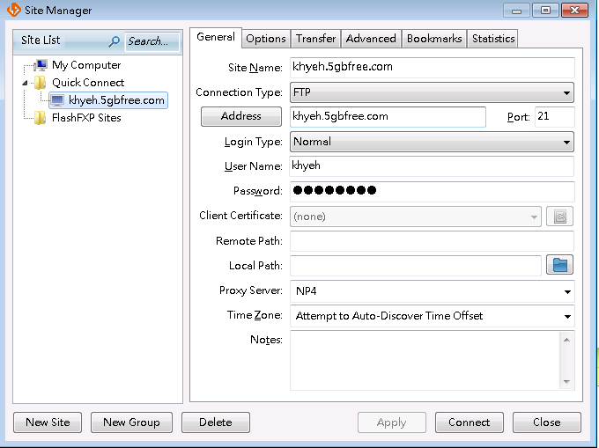
FlashFXP – set FTP server
Sites → Site Manager→General → Apply
Connect

Slide 19
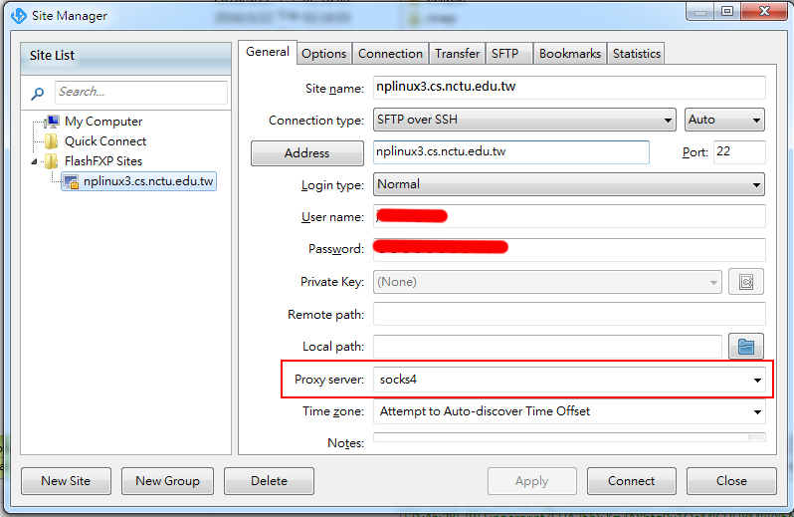
FlashFXP
Sites → Site Manager →General → Proxy Server

Slide 20
Part II points
[SOCKS Server : BIND] (15 points)
Open FlashFXP and set your socks server
Connect to ftp server, and upload/download file > 1GB.
E.g. Ubuntu 16.04 iso (download link)
Upload/Download file and check whether the size remains the same and be able to open (5 points each)
Check whether SOSKS server’s output has used BIND protocol (5 points)

Slide 21
Part III: CGI Proxy

Slide 22
CGI Connection
COMMAND
COMMAND
Browser
HTTP
SERVER
CGI
SOCKS
SERVER
RAS/
RWG
RESULT
RESULT
COMMAND
RESULT

Slide 23
CGI Connection(Connect mode)
COMMAND
COMMAND
Browser
HTTP
SERVER
CGI
SOCKS
SERVER
RAS/
RWG
RESULT
RESULT
COMMAND
RESULT
Notes:
Connect mode: Last project
改好CGI 去讀 form_get2.htm Remind:
Given form_get2.htm
送出 -> 教起你們cgi給參數
Cgi 要改成去 connect socks server
Non-blocking connect with socks server
送request
CGI 改完記得命名為 hw4.cgi
SOCKS server 和 RAS 也是 nonblocking

Slide 24
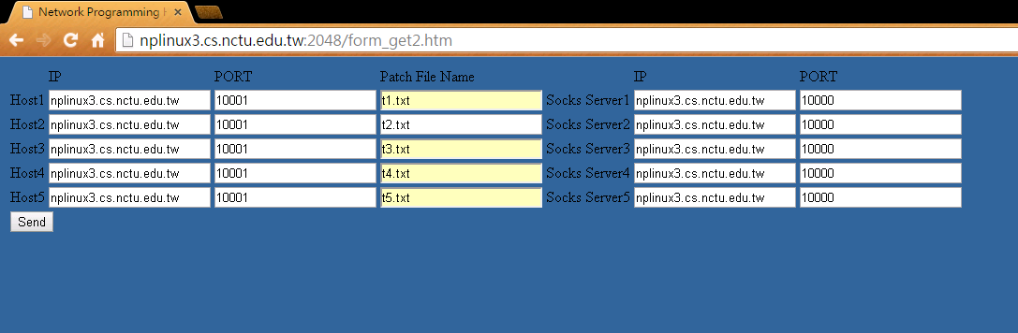
Demo

Slide 25
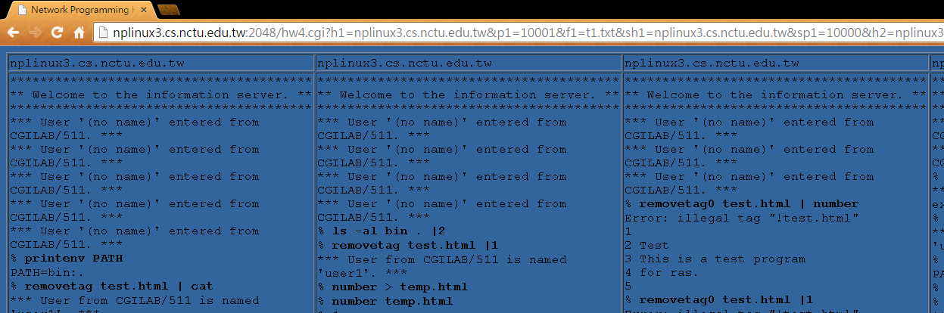
Demo

Slide 26
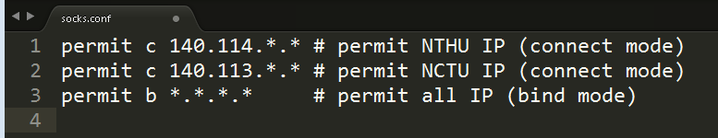
Firewall
When socks server accept a SOCKS4_REQUEST, it will analysis whether DEST_IP is a permitted IP. If the DEST_IP is not allowed, send a SOCKS_REPLY with CD is 91 (rejected).
You only need to implement a simple firewall. Write permitted IPs into socks.conf
Your socks server will read socks.conf to make judgement.

Slide 27
Part III points
[CGI SOCKS Client] (25 points)
Close browser’s proxy setting
Open your http server, connect to form_get2.html
Key in IP, port, filename, SocksIP, SocksPort
Connect to 5 ras/rwg server through socks sever and check the output
Test Case (as same as Project III, no hidden test case)
t1.txt~t5.txt (5 points each)

Slide 28
Firewall
[Firewall] (10 points)
Allow any DEST_IPs. “*.*.*.*”in socks.conf
Only allow connections to NCTU (5 points)
“140.113.*.*”in socks.conf
Only allow connections to NTHU (5 points)
“140.114.*.*”in socks.conf

Slide 29
END

Slide 30
Implementation Details

Slide 31
SOCKS4_REQUEST

Slide 32
SOCKS4_REQUEST
Request
read(sock, buffer, size);
unsigned char VN = buffer[0] ;
unsigned char CD = buffer[1] ;
unsigned int DST_PORT = buffer[2] << 8 |
buffer[3] ;
unsigned int DST_IP = buffer[4] << 24 |
buffer[5] << 16 |
buffer[6] << 8 |
buffer[7] ;
char* USER_ID = buffer + 8 ;

Slide 33
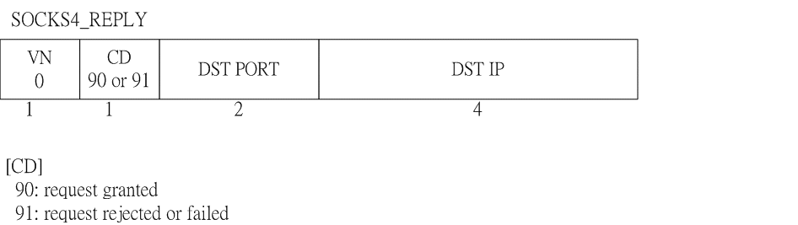
SOCKS4_REPLY

Slide 34
SOCKS4_REPLY
Reply
package[0] = 0;
package[1] = (unsigned char) CD ; // 90 or 91
package[2] = port / 256;
package[3] = port % 256;
package[4] = ip >> 24;
// ip = ip in SOCKS4_REQUEST for connect mode
// ip = 0 for bind mode
package[5] = (ip >> 16) & 0xFF;
package[6] = (ip >> 8) & 0xFF;
package[7] = ip & 0xFF;
write(sock, package, 8);

Slide 35
Port
[Port]
Connect mode: is the DST PORT in SOCKS4_REQUEST
IE
SOCKS
server
WEB
server
Port 1080
Port 80
CONNECT

Slide 36
Port
[Port]
Bind mode: newly binded port in SOCKS server
FTP
client
SOCKS
server
FTP
server
Port 1080
Port 21
CONNECT
BIND
Port X

Slide 37
Implementation Details
Process：
master socket(listener)不斷地listen，有連線(SRC)來就fork一個process(SOCKS) 去處理，然後繼續listen
SOCKS 與SRC 連線溝通
1.收SOCKS4_REQUEST格式封包
2.check 是否可以過防火牆(socks.conf)，並回傳SRC
SOCKS4_REPLY
CONNECT mode
1.從REQUEST裡取出dest的IP與PORT
2.SOCKS連線到DEST
3.SOCKS幫SRC與DEST做資料傳導的動作
－SRC傳來的資料－＞傳給DEST
－DEST傳來的資料－＞傳給SRC

Slide 38
Implementation Details
BIND mode：
1. SOCKS 先去BIND一個port(BIND_PORT)
2. SOCKS listen該port，回傳給SRC監聽Port， DEST就會自己連過來
3. SOCKS accept DEST之後，要再丟一個 SOCKS4_REPLY給SRC <-- 重要!!!!!!!!!
4.SOCKS幫SRC與DEST做資料傳導的動作
－SRC傳來的資料－＞傳給DEST
－DEST傳來的資料－＞傳給SRC

Slide 39
Notes
SOCKS_REQUEST , SOCKS_REPLY
1 byte : unsigned char
2 byte : unsigned char[2]
4 byte : unsigned char[4]
Port formulation e.g. port = 1234
unsigned char port[2]
port[0] = 4
port[1] = 210
(hint : (int)port = port[0]*256 + port[1] ==> 1234 = 4*256 + 210)

Slide 40
Notes
IP formulations e.g. IP = 140.113.1.2
unsigned char IP[4]
IP[0] = 140
IP[1] = 113
IP[2] = 1
IP[3] = 2
In BIND mode, you need to ensure the connection between client and server is built before transfer data.

