Slide 1

Predicting land usage from historical data https://github.com/gusriobr/IACapstone
Datascience team presentation

Slide 2
Use Case
Objective: Predict the next year land usage based on historical data.
There area common usage land patterns: cyclical usage crops, static crops, etc.
Integrate the model in a decision support tool to propose the configuration of farm for the next year.
Create a deep learning model based on LSTM networks

Slide 3
Dataset
2 million points scattered across a region of Spain tagged with last 9 years land usage.
Extreamly umbalanced.
Crop distribution is stable through years
The mean variation in each point along the years is around 63%.
Private data set originated from claims for payment of CAP subsidies.

Slide 4
Data Treatment
2M data points scattered over the region.
Review crop codes and year variation.
Create sample dataset with 30.000 to reduce iteration time:
  Keep crop distribution (structured split)
  Each crop has a mininum presence: oversampling.

Slide 5
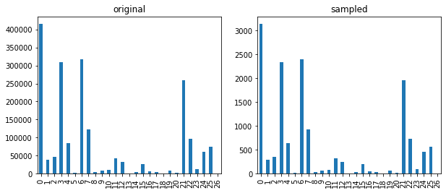
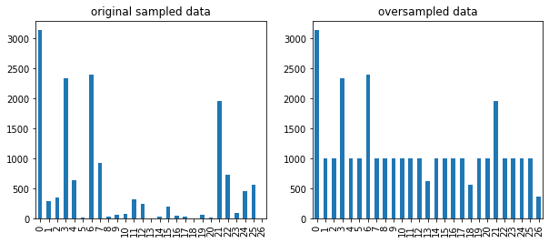

Slide 6
Arquitectural choice
LSTM model that can take advange of the historical data and learn patterns from context.
Keras as machine learning library and sklearn, pandas, etc. for tools and utils.
TPOT to create base classifier.
Performance metric: f1-score on the test dataset to keep balance between precission and recall.

Slide 7
Base model
Prior knowledge based
  Use the last year crop: f1-score: 0.34
  Using the main category and static crop codes: 0.15
Use TPOT to train different classifiers outputs
ExtraTreesClassifier(input_matrix, bootstrap=False, criterion=entropy, max_features=0.8, min_samples_leaf=2, min_samples_split=12, n_estimators=100)
Final score: 0.498
https://github.com/gusriobr/IACapstone/blob/master/course/modeling_base_tpot.ipynb

Slide 8
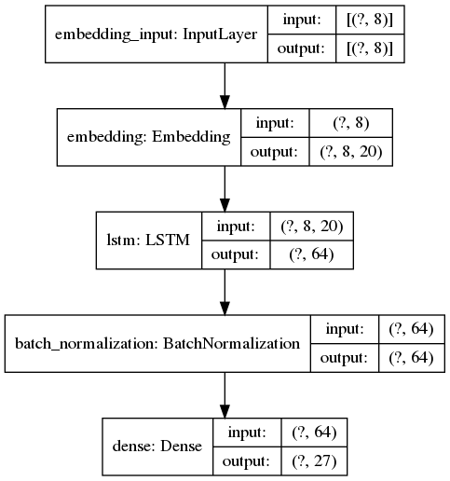
LSTM Architecture
Embedding layer endoces crop codes to 20-depth space.
LSTM learns patters from sencences.
BatchNorm avoids overfitting.
Dense: maps LSTM output to categories

Slide 9
Training / Evaluation
Train / test split 80 / 20%
Different iterations exploring different architecture elements:
  Embedding depth: 20
  Number of units in LSTM cells: 256
  Number of layers: one or two
  Regularization parameters: recurrent_regularizer l2(0.001)
  Sequence length
  https://github.com/gusriobr/IACapstone/blob/master/course/modeling_lstm_keras

Slide 10
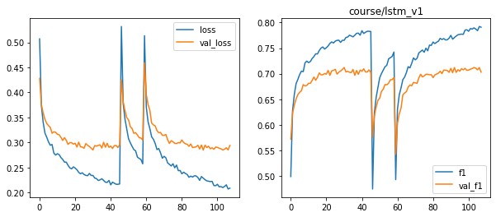
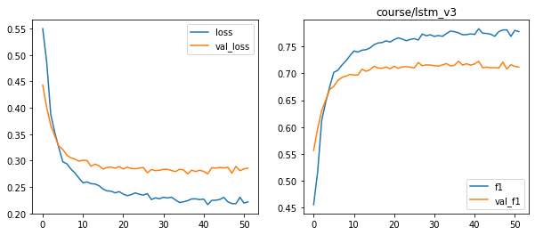

Slide 11
Parameter tunning
Model: bayesian optimization
  Get the mos importan features and get the optimun values
  Training: titch the learning rate to get out of the plateau: keras callbacks LRScheduller, ReduceLROnPlateau.

Slide 12
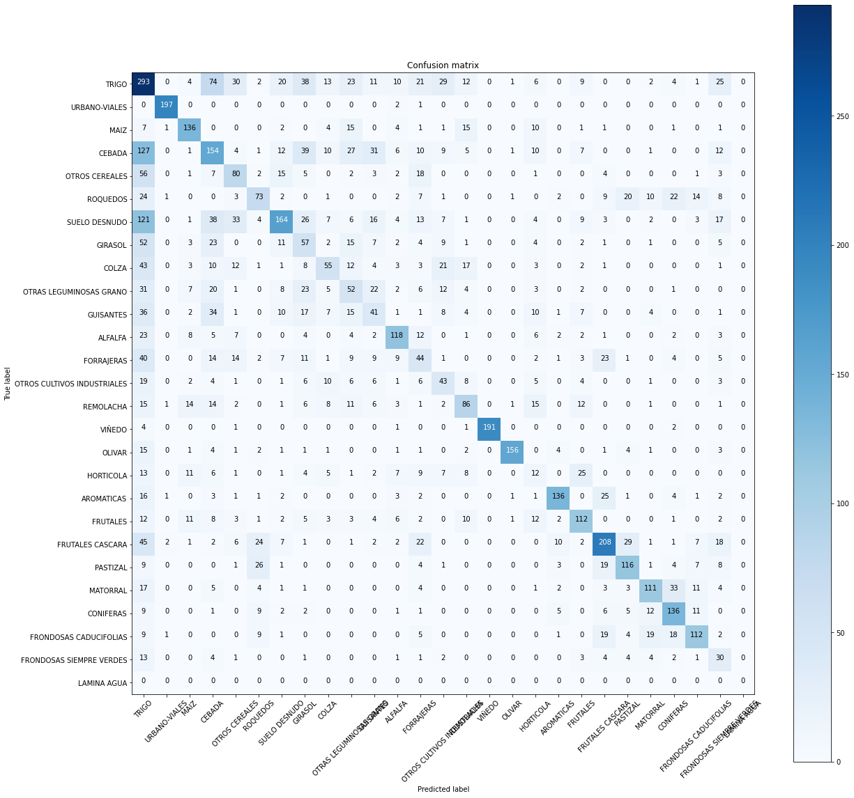

Slide 13
Next steps
Add new categorical variables as new embeddings as seen here.
Use a preclustering to create automatic index for each crop to create a new feature.
Flatten the timeseries to leghten the context so LSTM can have more steps to learn from context.
Experiment with 1DConv networks as an alternative to LSTM models or combine them.

Slide 14
Disclaimer
This document is only a draft, a pet project developed during a training course and should not be taken as finished work or extract conclusions from it.

