Slide 1
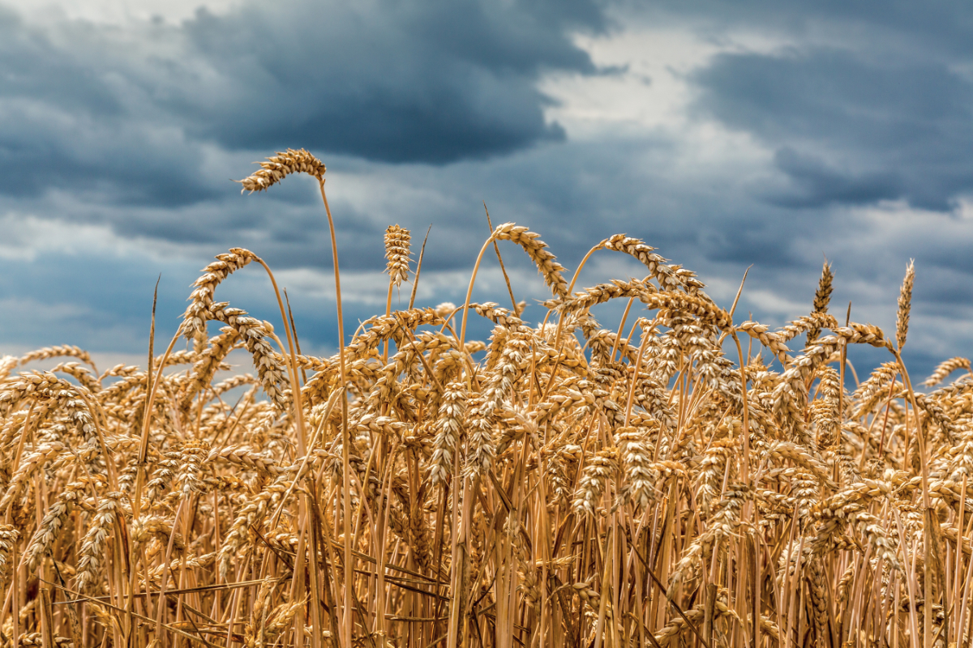
Predicting land usage from historical data
stake holders press

Slide 2
Use Case
Objective: Predict the next year land usage based on historical data.
There area common usage land patterns: cyclical usage crops, static crops, etc.
Integrate the model in a decision support tool to propose the configuration of farm for the next year.

Slide 3
Dataset
2 million points scattered across the region tagged this last 9 years land usage.
Extreamly umbalanced.
Crop distribution is stable through years
The mean variation in each point along the years is around 63%.
Private data set originated from claims for payment of CAP subsidies.

Slide 4
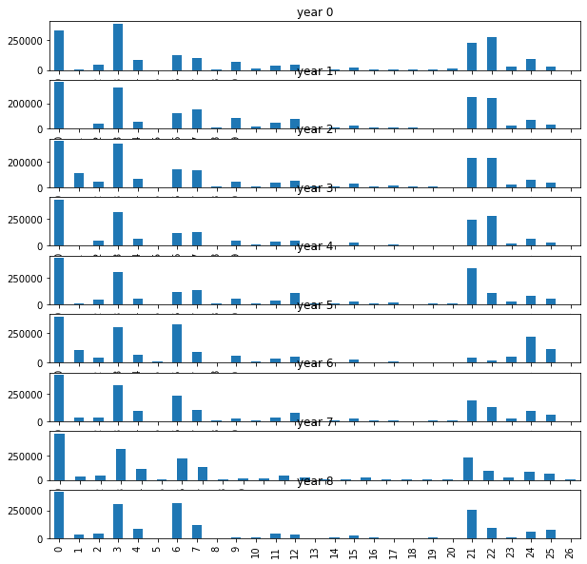

Slide 5
Solution
Deep learning model LSTM learns patterns from historical data and predicts next year crop.
Works similar to text prediction, each crops is encoded and each sample represents a “sentence”, the model gives you the most probable next word (crop code).
Model performance is is 72%, with many open work lines to improve it.

Slide 6
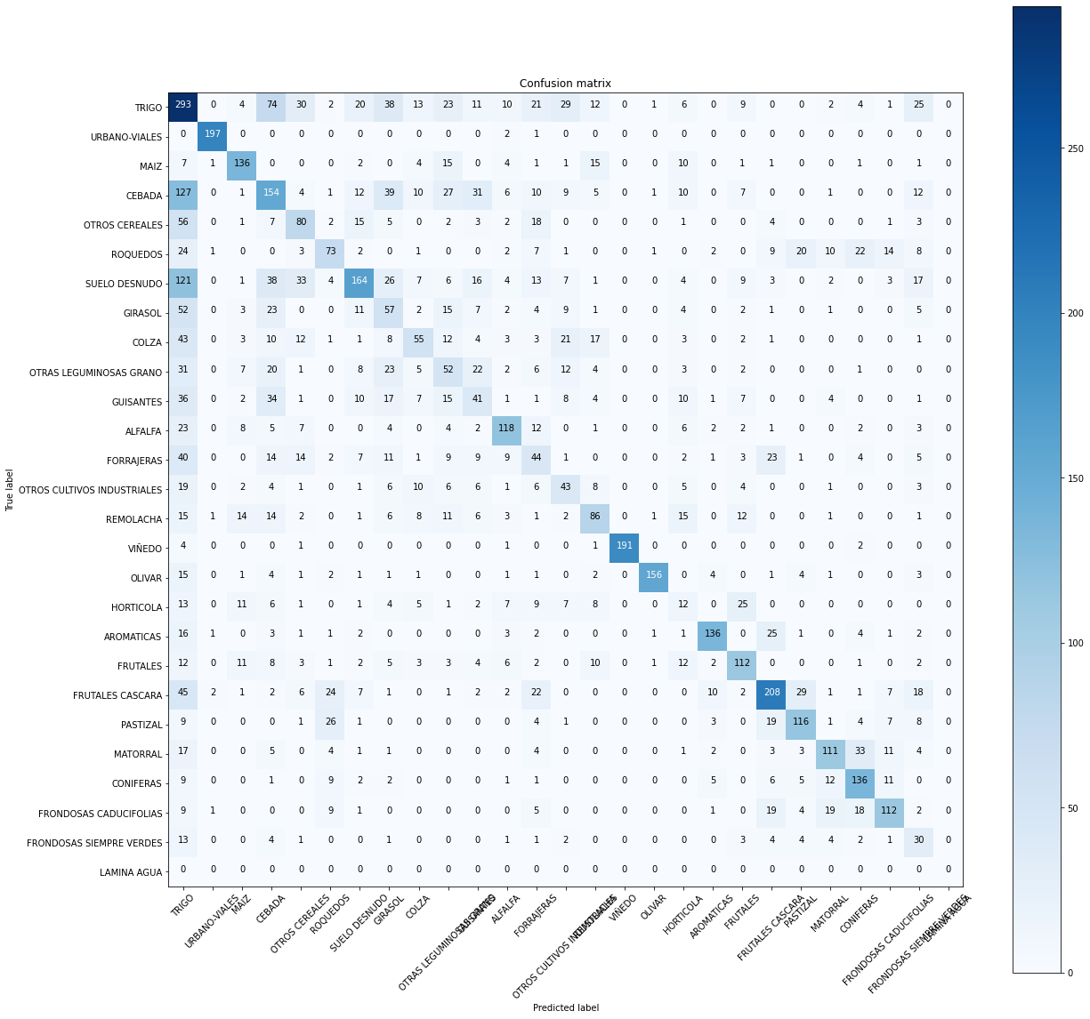

Slide 7
Limitations
De model is performing well specially in static crops (vineyard, olive, fruit trees, etc..) and mayority crops.

