Slide 1

Presentation
Methodology
SCRUM
4 SPRINTS
Agile Methodology
Technologies
Python
MySql
NodeJS

Slide 2
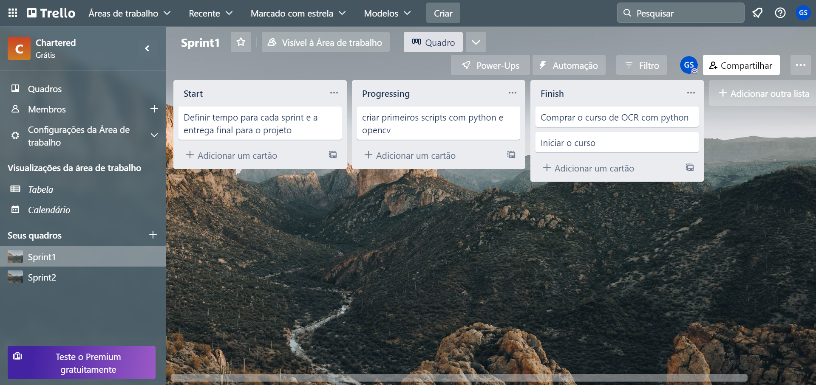
Management Tool
TRELLO

Slide 3
