Slide 1

Presentation
Methodology
SCRUM
4 SPRINTS
Technologies
Python
MySql
NodeJS
Angular

Slide 2
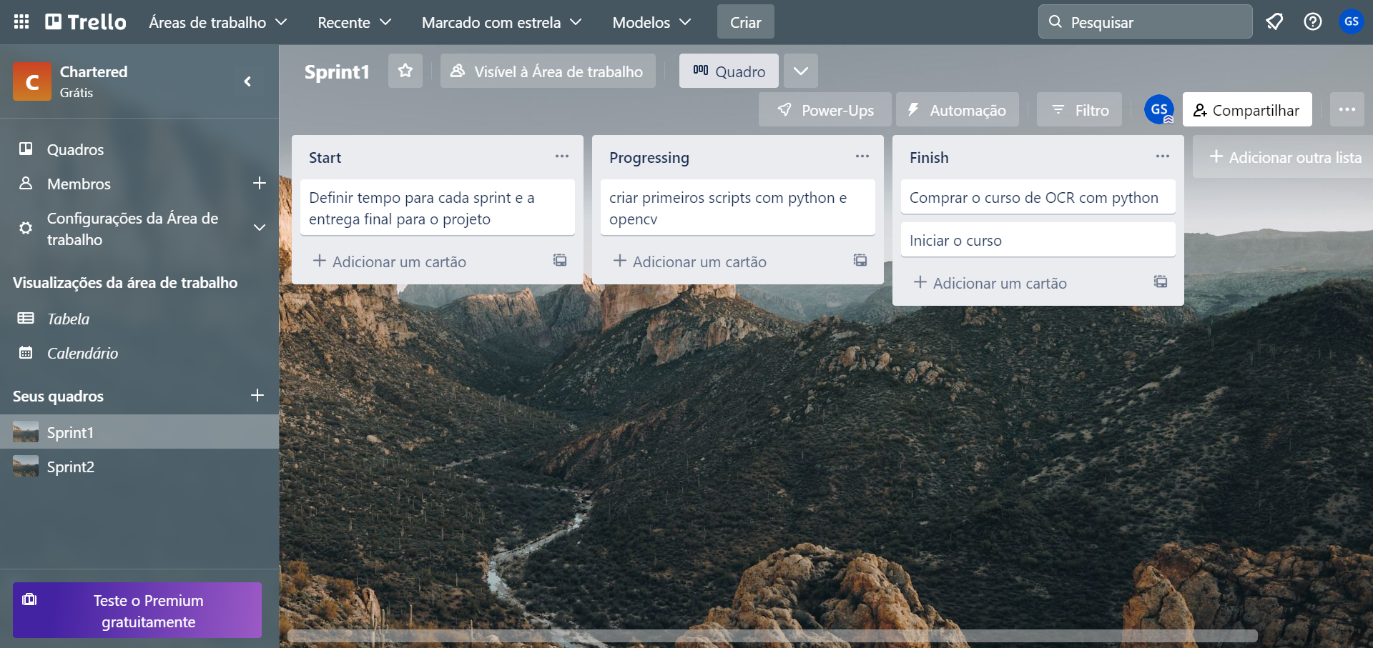
Management Tool
TRELLO

Slide 3


