Slide 1
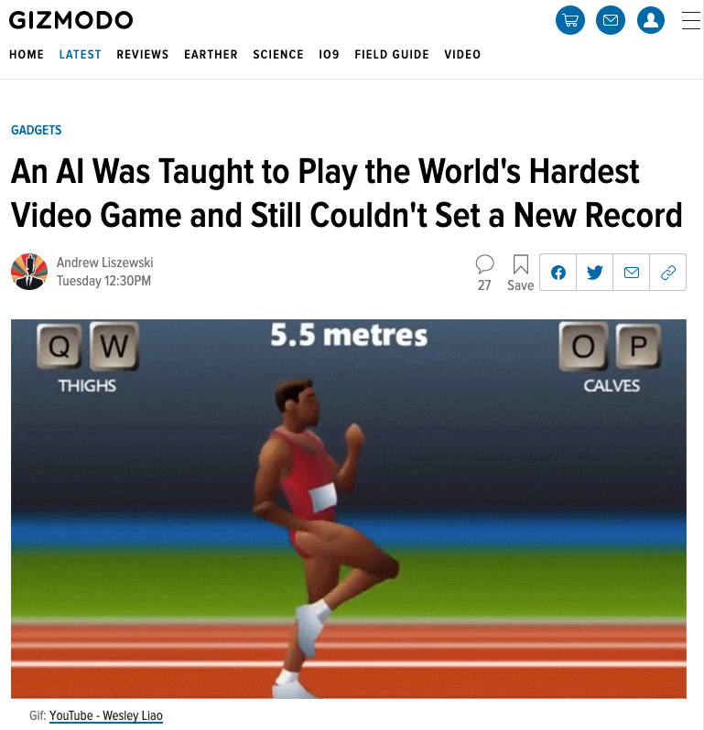
Notes:
Hi everyone, I’m back with another QWOP video. Since my last upload, a lot of people have been asking me why the bot wasn’t able to set a new record. why the student wasn’t able to surpass the teacher.
Well the answer is quite simple..

Slide 2
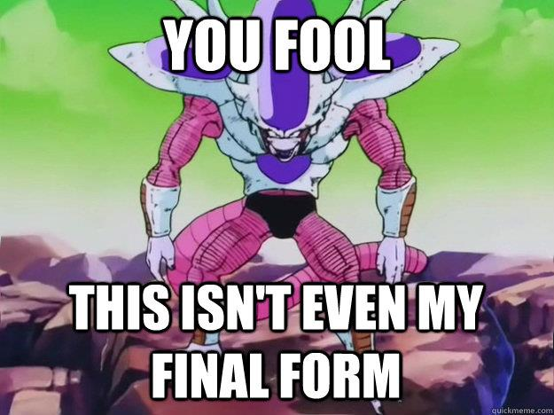
Notes:
It’s because the agent was merely an infant. It was designed mostly for experimentation and learning new behaviors. But now that you guys asked for speed, I created a new agent that takes ACER’s behaviors and optimizes them for pure speed. Here it is in action and setting a new world record…

Slide 3
Speedrun

Slide 4
 | Old Agent | New Agent
Algorithm | ACER | Prioritized DDQN
Notes:
Now I’ll go through some of the tweaks I made to improve the agent’s speed.
The first thing I did was to swap out the ACER algorithm for Prioritized DDQN. This is because DQN is much more sample efficient so it can quickly optimize the techniques already learned by ACER.

Slide 5

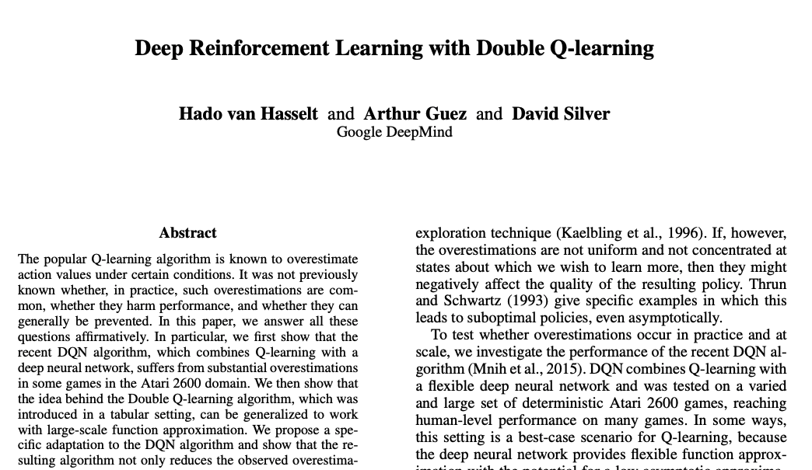
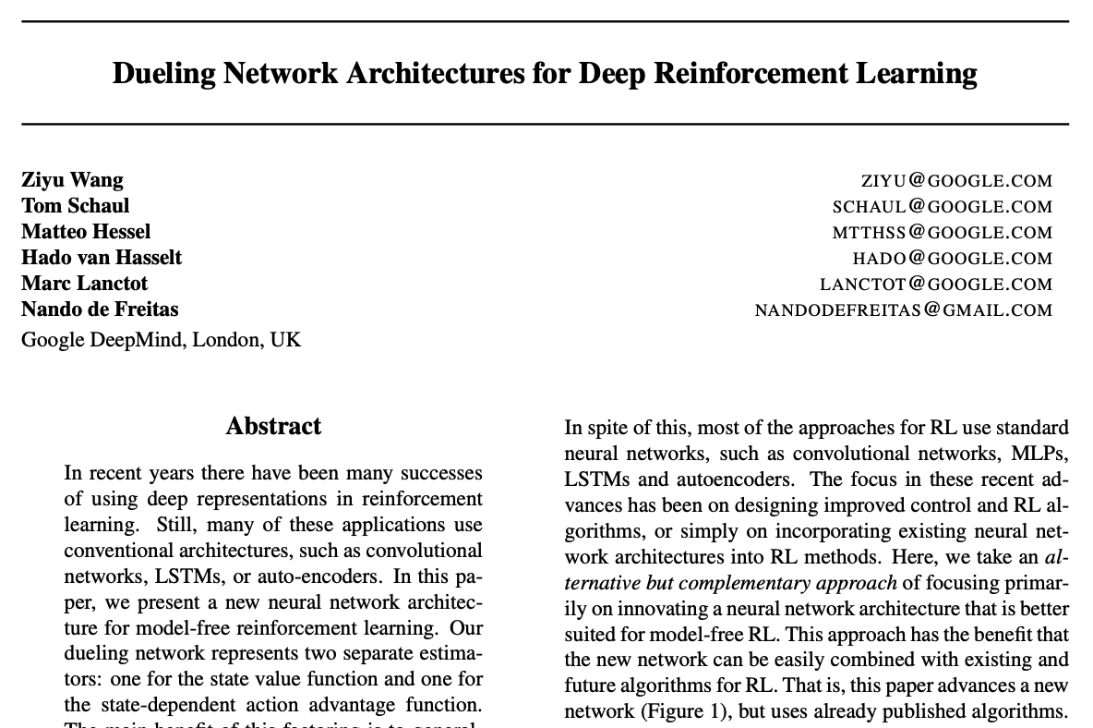
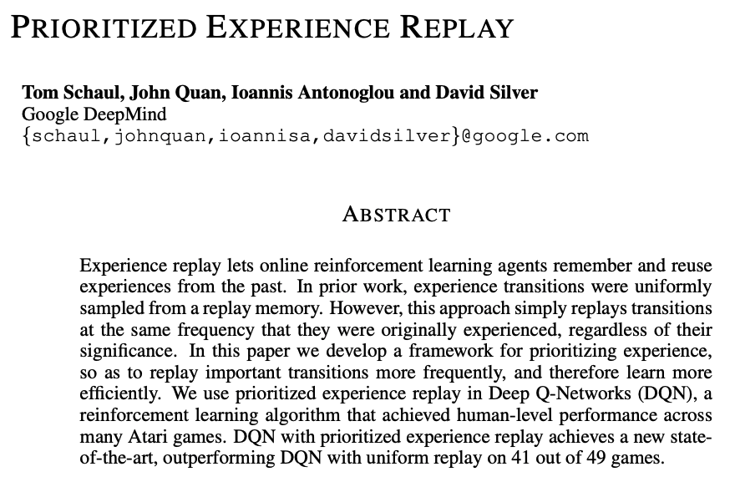
Notes:
Here are some papers that go through the key features of the algorithm, including Double Q-learning, Dueling Networks, and Prioritized Experience Replay.
I’ll link these in the description below. I highly recommend checking them out, they’re much easier to read than the ACER paper.

Slide 6
 | Old Agent | New Agent
Algorithm | ACER | Prioritized DDQN
Reward | Forward velocity Torso height penalty Torso bouncing penalty Knee angle penalty | Forward velocity
Notes:
Next, the reward function was modified. Previously it had a number of penalties including penalties for low torso height, vertical torso movement, and excessive knee bending. when the agent was just learning to stride, these helped stabilize its running technique. But now that it knows how to stride, I took the training wheels off and let it optimize purely for forward velocity.

Slide 7
 | Old Agent | New Agent
Algorithm | ACER | Prioritized DDQN
Reward | Forward velocity Torso height penalty Torso bouncing penalty Knee angle penalty | Forward velocity
Actions per second | ~9 | Training: ~18 Testing: ~25
Notes:
The effective framerate for both training and testing were also increased so that the agent could make more precise actions.

Slide 8
 | Old Agent | New Agent
Algorithm | ACER | Prioritized DDQN
Reward | Forward velocity Torso height penalty Torso bouncing penalty Knee angle penalty | Forward velocity
Actions per second | ~9 | Training: ~18 Testing: ~25
Learning | Kurodo’s runs Self-learning | ACER’s runs Self-learning
Notes:
The new agent was first pre-trained with ACER’s runs and then improved through self-learning. It did not do mixed memory training with Kurodo’s data like ACER did.

Slide 9
 | Old Agent | New Agent
Algorithm | ACER | Prioritized DDQN
Reward | Forward velocity Torso height penalty Torso bouncing penalty Knee angle penalty | Forward velocity
Actions per second | ~9 | Training: ~18 Testing: ~25
Learning | Kurodo’s runs Self-learning | ACER’s runs Self-learning
Training time | ~65 hours | ~40 hours
Notes:
It was trained for a total of 40 hours, of which all of it was self-learning except for a couple of minutes of pre-training.

Slide 10
Extra footage
Notes:
And there you have it, yet another game where AI has surpassed humans. I hope you enjoyed this video. Leave any thoughts or questions in the comments below. I’ll leave you guys with some extra footage of the agent training.. cheers!

