Slide 1
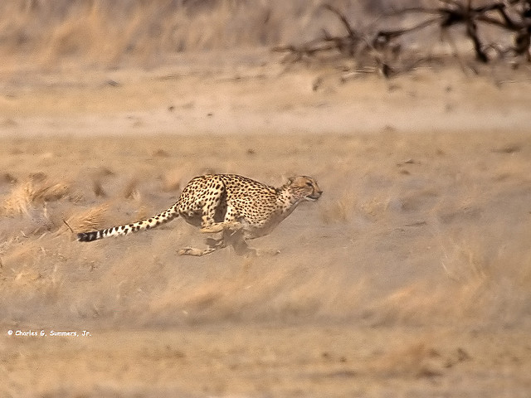
High Performance Websites
http://www.flickr.com/photos/wild_images/1147361271

Slide 2
Please wait.
Loading...

Slide 3
80% of the end-user response time is spent on the front-end.
Most of this time is downloading images, stylesheets, scripts, Flash, etc.
Reducing the number and size of HTTP requests is key to faster pages.

Slide 4
Why bother?
Slow website
Lower user experience
Higher drop-off rate
Lower conversion rate
Less $
Google +500ms → -20% revenue
Amazon +100 ms → -1% sales
Yahoo +400 ms → -5-9% page traffic
Notes:
http://www.svennerberg.com/2008/12/page-load-times-vs-conversion-rates/
http://home.blarg.net/~glinden/StanfordDataMining.2006-11-29.ppt
² http://www.slideshare.net/stoyan/yslow-20-presentation

Slide 5

Why slow?
Connection bandwith
Connection lag
Client side computation
Page size
Number of requests
JS Code/CSS/# of reflows

Slide 6
What can be done?
Make fewer HTTP requests
Use a CDN
Add an Expires header
Gzip components
Put stylesheets at the top
Put scripts at the bottom
Avoid CSS expressions
Make JS and CSS external
Reduce DNS lookups
Minify JS
Avoid redirects
Remove duplicate scripts
Configure ETags
Make AJAX cacheable
Split the initial payload
Load scripts without blocking
Don’t scatter inline scripts
Split dominant content domains
Make static content cookie-free
Reduce cookie weight
Flushing the document early
Using iframes sparingly
Simplifying CSS Selectors

Slide 7

What can be done. Diagnosis.
Yslow

Slide 8

What can be done. Diagnosis.
PageSpeed

Slide 9

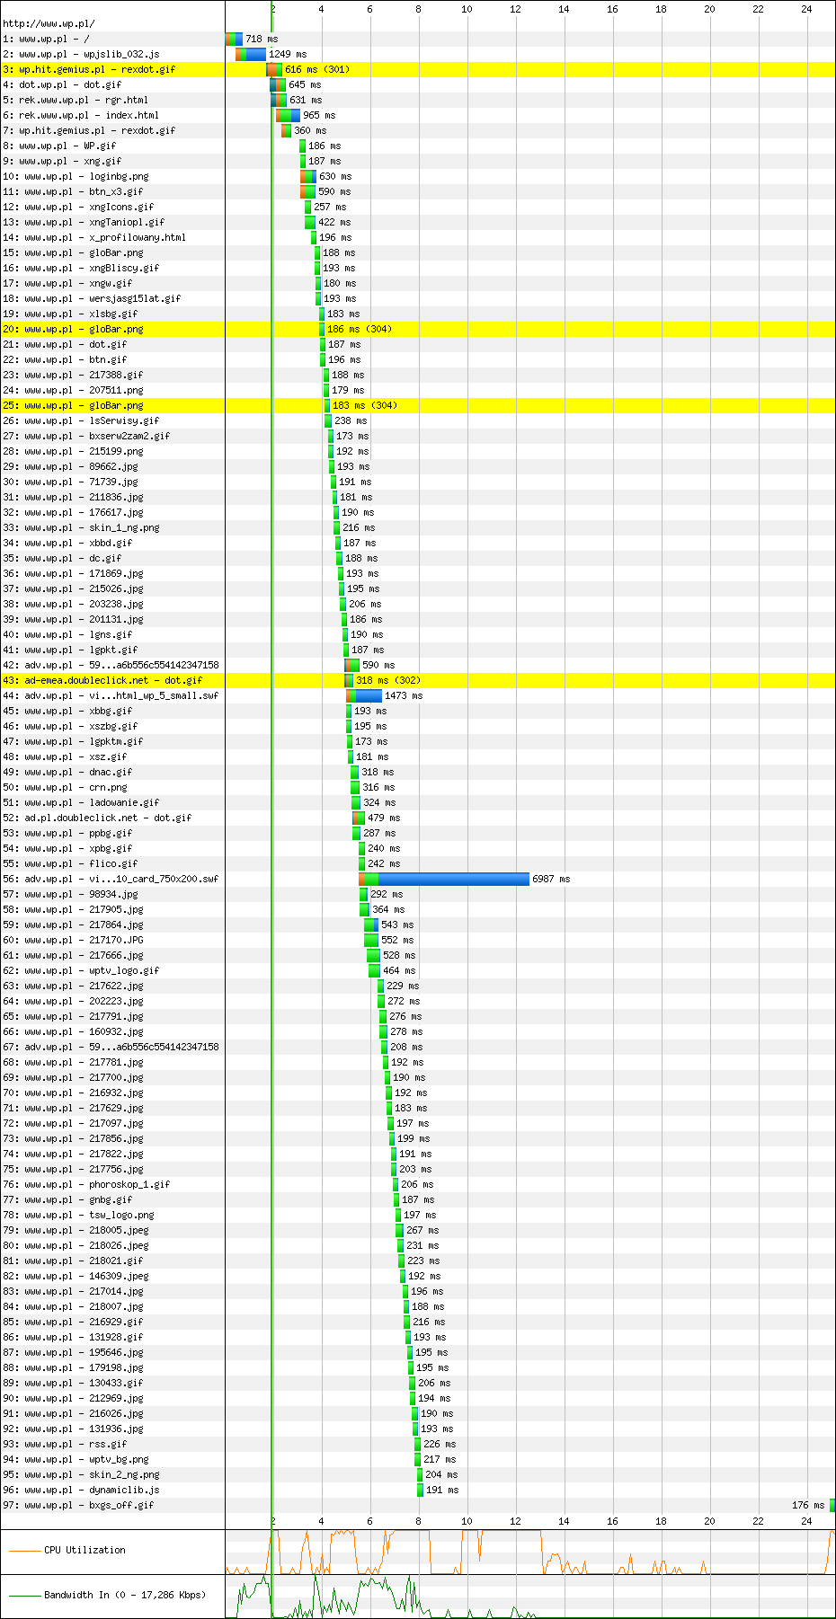
Meet waterfall
http://www.wp.pl
First View (Error: Timed Out)
http://www.webpagetest.org/result/101117_CTH4/1/details/
http://www.flickr.com/photos/thesussman/4030969285

Slide 10
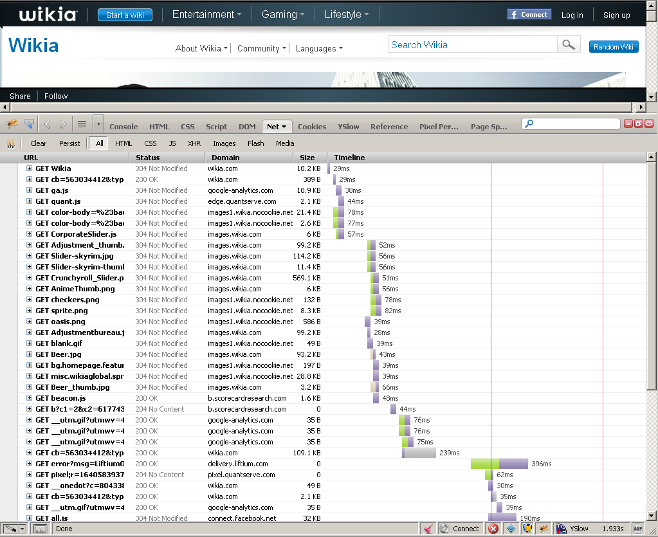
Meet waterfall

Slide 11
Browser connection limits
Simultaneous number of connections per domain varies with browser:
FF2, IE6, IE7:
2 connections
IE8, FF3, Safari,Chrome:
6 connections
But not all of them are used if JS is downloaded
http://stevesouders.com/hpws/js-blocking.php
http://www.flickr.com/photos/thesussman/4030969285

Slide 12
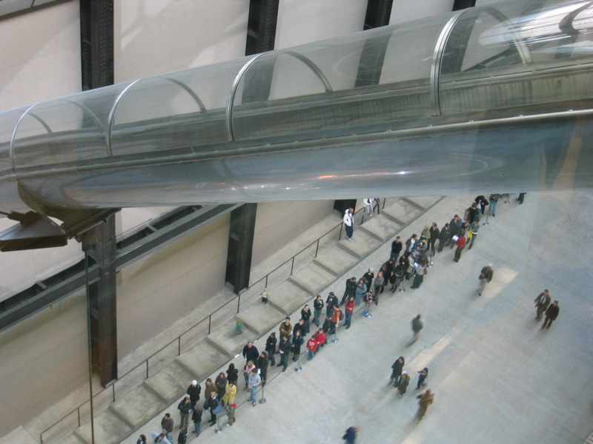
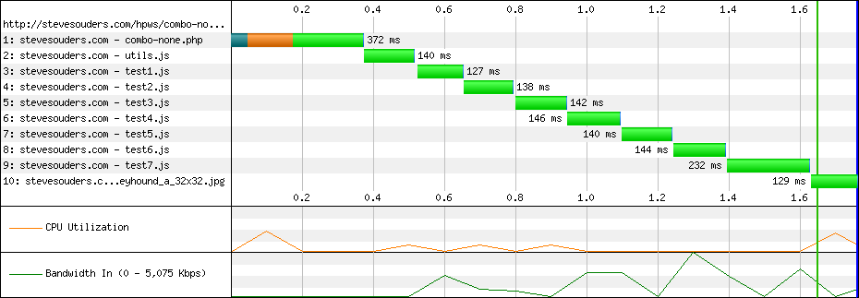
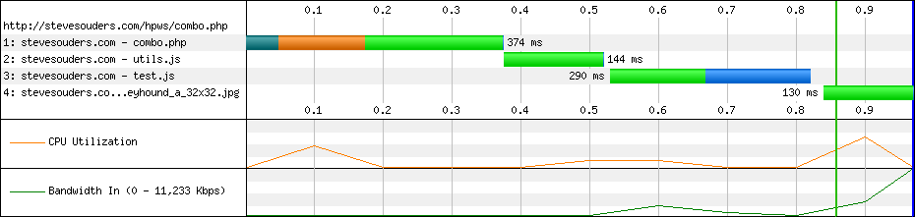
Reduce number of requests
Combine JS and CSS files
Use sprites (http://www.google.com/images/srpr/nav_logo37.png)
Avoid redirects.
http://www.flickr.com/photos/andrewpaulcarr/288909779/

Slide 13
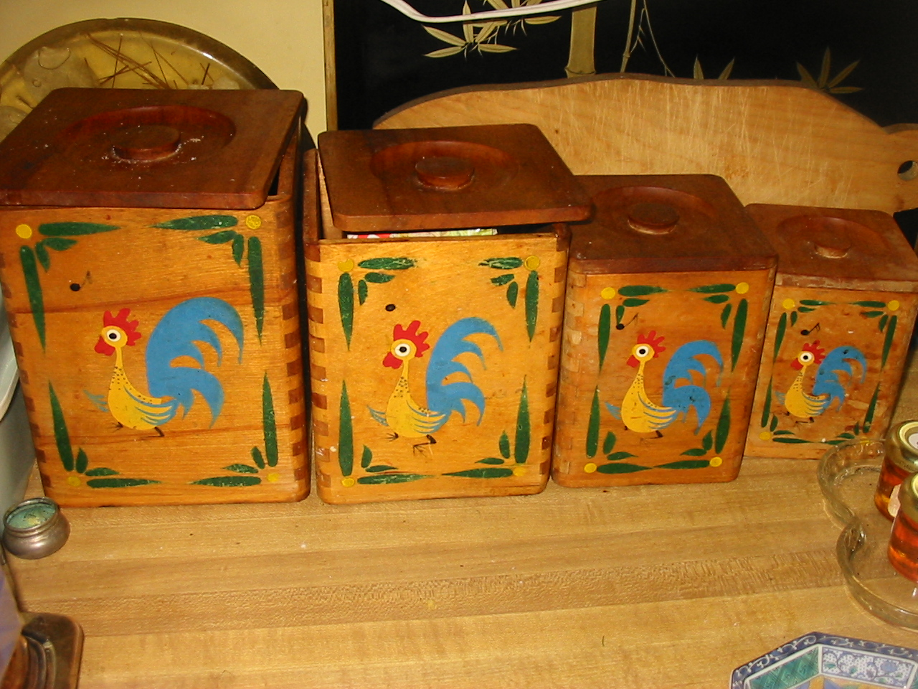
Size matters.
Minify JS/CSS
Minify HTML
Gzip JS/CSS/HTML
http://www.flickr.com/photos/mia3mom/2704693800

Slide 14
Size matters.
Minify JS
Google Closure Compiler
http://code.google.com/closure/compiler/
YUI Compressor
http://developer.yahoo.com/yui/compressor/
Optimize CSS
YUI Compressor
Dust Me Selectors FF plugin http://www.sitepoint.com/dustmeselectors/
CSSCompressor
http://www.csscompressor.com/
mod_pagespeed
http://code.google.com/speed/page-speed/docs/module.html

Slide 15
Size matters.
Minify HTML
HTMLCompressor for Java, mod_pagespeed
view-source:http://www.google.com/
Gzip JS/CSS/HTML
Typical size savings range from 60-85%
http://www.websiteoptimization.com/speed/tweak/compress/
GET / HTTP/1.1
Accept-Encoding: gzip,deflate
Home page | HTML (plain) | HTML (compressed) | savings
Google.com | 3,873 | 1,412 | 63.5%
Google search | 26,321 | 5,505 | 79.1%
Orbitz.com | 44,183 | 9,046 | 79.5%
HTTP/1.1 200 OK
Date: Thu, 04 Dec 2003 16:15:12 GMT
Server: Apache/2.0
Vary: Accept-Encoding
Content-Encoding: gzip
Cache-Control: max-age=300
Expires: Thu, 04 Dec 2003 16:20:12 GMT
Content-Length: 1533
Content-Type: text/html; charset=ISO-8859-1

Slide 16
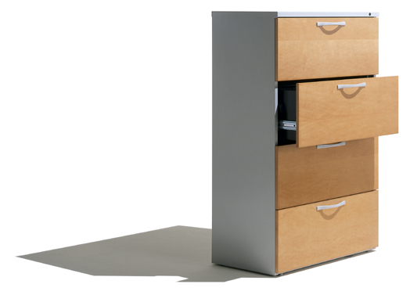
Use browser cache.
40% to 60% of Yahoo!'s users have an empty cache
About 20% of all page views are done with an empty cache
http://www.flickr.com/photos/bfionline/2380398365/

Slide 17
Use browser cache.
Add far future Expires (static conent) or Cache-Control (dynamic conent) header.
Configure ETags.
Use CDN.
Make JavaScript and CSS External
Serve images from a separate cookie-less domain.
http://www.flickr.com/photos/bfionline/2380398365/

Slide 18
Etags (Entity Tags)
GET /i/yahoo.gif HTTP/1.1
HTTP/1.1 200 OK
Last-Modified: Tue, 12 Dec 2006 03:03:59 GMT
ETag: "10c24bc-4ab-457e1c1f"
Content-Length: 12195
GET /i/yahoo.gif HTTP/1.1
If-Modified-Since: Tue, 12 Dec 2006 03:03:59 GMT
If-None-Match: "10c24bc-4ab-457e1c1f"
HTTP/1.1 304 Not Modified
Entity tags can reduce performance if configured incorrectly
http://www.flickr.com/photos/bfionline/2380398365/
Notes:
Used to validate.
Based on inode/server id, turn off in multiserver environments.

Slide 19
Browser connection limits
Simultaneous number of connections per domain varies by browser:
FF2, IE6, IE7:
2 connections
FF3, Safari,Chrome:
6 connections
http://www.flickr.com/photos/thesussman/4030969285

Slide 20
Split resources across domains
Split resources across domains
2 domains is enough to improve parallelization
Images (i.domain.com) – no cokies, safer (domainimg.com)
js + css (www.domain.com)
Downgrade connections to HTTP 1.0
 | HTTP 1.1 | HTTP 1.0
FF2, IE6, IE7 | 2 | 4
IE8,FF3 | 6 | 6
Chrome | 6 | 6

Slide 21
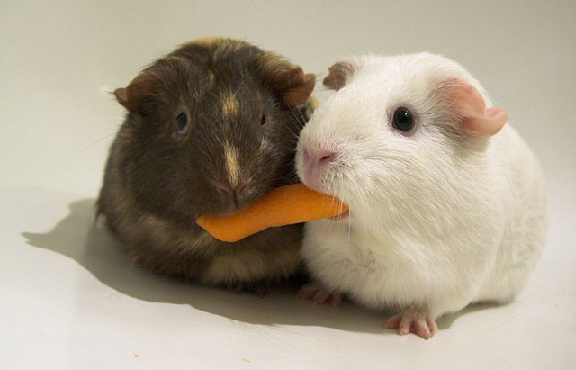
A story of one cookie, err thread.
http://www.flickr.com/photos/ryanr/142455033

Slide 22
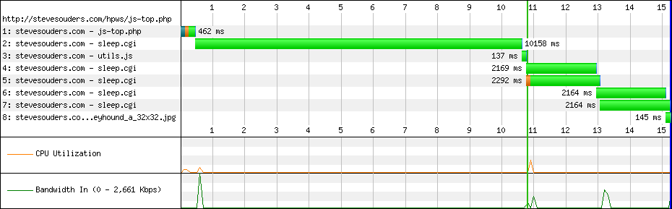
JS blocks rendering
<html>
<head>
<script src="/bin/sleep.cgi?&sleep=10"></script>
<title>Scripts at the Top</title>
http://stevesouders.com/hpws/js-top.php?t1290026279466
Notes:
http://stevesouders.com/efws/links.php?ex#Chapter4

Slide 23
Render first. JS second.
<html>
<head>
<title>Scripts at the bottom</title>
<link rel="stylesheet" href="/bin/sleep.cgi">
</head>
<body>
...
<script src="/sleep.cgi?&sleep=10"></script>
</body>
</html>

Slide 24
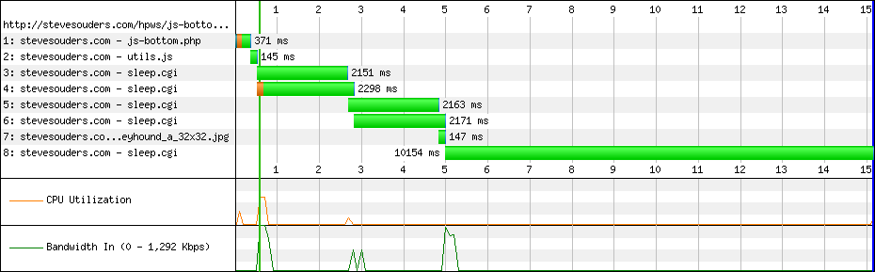
Render first. JS second.
JS at the Top
JS at the Bottom
http://stevesouders.com/hpws/move-scripts.php
Notes:
Linki do stronek testow soudersa – top/bottom
http://www.webpagetest.org/

Slide 25
Load scripts asynchronously
XHR eval
XHR injection
Script in iframe
Script DOM element
document.write
defer attribute
Split initial content (load what necessary, rest later)

Slide 26
XHR Eval
var xhrObj = getXHRObject();
xhrObj.onreadystatechange =
function() {
if ( xhrObj.readyState != 4 ) return;
eval(xhrObj.responseText);
};
xhrObj.open('GET', 'A.js', true);
xhrObj.send('');
Same domain constraint
Douglas Crockford does no eval
http://stevesouders.com/efws/links.php?ex#Chapter4

Slide 27
XHR Injection
var xhrObj = getXHRObject();
xhrObj.onreadystatechange =
function() {
if ( xhrObj.readyState != 4 ) return;
var se=document.createElement('script');
document.getElementsByTagName('head')
[0].appendChild(se);
se.text = xhrObj.responseText;
};
xhrObj.open('GET', 'A.js', true);
xhrObj.send('');
Same domain constraint
Faster than eval

Slide 28
Script in Iframe
<iframe src='A.html' width=0 height=0 frameborder=0 id=frame1></iframe>
iframe must have same domain as main page
must refactor script to access script in iframe and access parent document from script
// access iframe from main page
window.frames[0].someMethodInScript();
// access main page from iframe
parent.document.createElement('div');

Slide 29
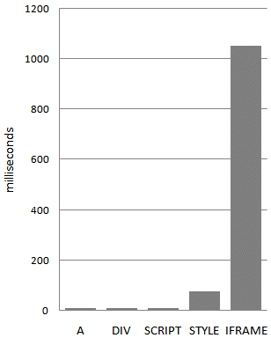
Avoid iframes
Iframes are most expensive DOM elements
Iframes block window.load
Iframes share connections with parent document
load 100 empty elements of each type

Slide 30
DOM Script element
var script = document.createElement('script');
script.src = 'http://anydomain.com/A.js';
document.getElementsByTagName('head’)[0].appendChild(se);
Different domains allowed
No refactoring needed
Sounds like a good choice? Yeah, but IE does not ensure order

Slide 31
document.write Script Tag
document.write("<scri" + "ipt type='text/javascript' src='A.js'>"
+ "</scri" + "ipt>");
Parallel downloads only for scripts and only in IE

Slide 32
Script defer
<script defer src='A.js'></script>
Only IE
Cannot be used for scripts with document.write (ads...)

Slide 33
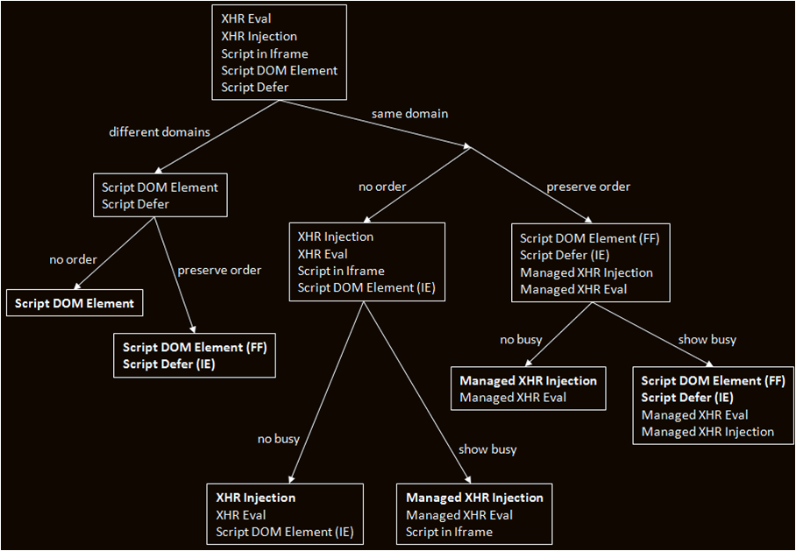
Which technique

Slide 34
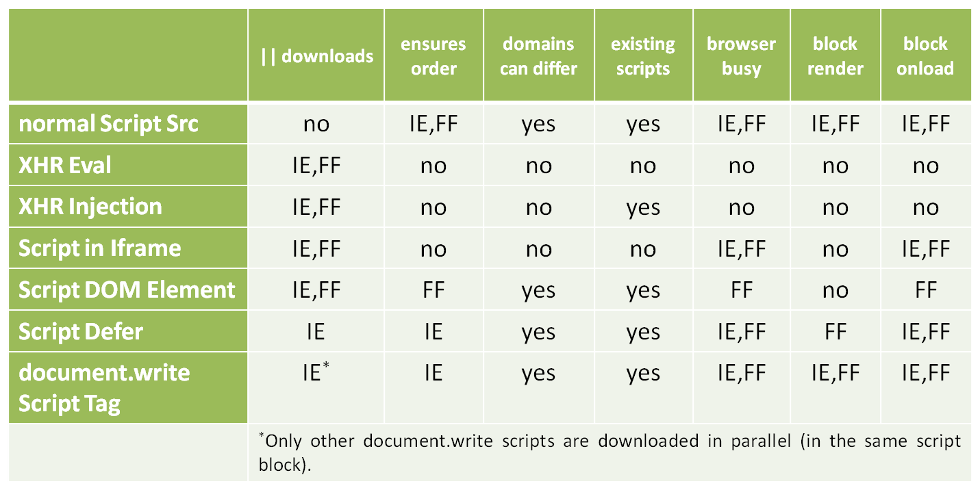
Load scripts asynchronously
Various techniques:
No single technique warranties order execution in all browsers
Use script loaders

Slide 35
Script loaders
Many loaders (LabJS, RequireJS, ControlJS, head.js, yepnope, YUI)
https://spreadsheets.google.com/lv?key=0Aqln2akPWiMIdERkY3J2OXdOUVJDTkNSQ2ZsV3hoWVE
Typical code
<script src="framework.js"></script>
<script src="plugin.framework.js"></script>
<script src="myplugin.framework.js"></script>
<script>
myplugin.init();
framework.init();
framework.doSomething();
</script>
LABjs example
<script>
$LAB.script("framework.js").wait()
.script("plugin.framework.js")
.script("myplugin.framework.js")
.wait(function(){
myplugin.init();
framework.init();
framework.doSomething();
});
</script>

Slide 36
Take aways
Javascript blocks downloads
Reduce number of HTTP requests
Load JS asynchronously

Slide 37
TO BE CONTINUED

Slide 38
Javascript performance
Reduce time spent in JS
One thread JS and UI
Avoid actions longer than 100ms
Split/delegate work:
Web workers (FF3.5, Safari 4, Chrome 7 , Opera 10.6. No IE)
Yelding (setTimeout)

Slide 39
Worker example
Main program code
worker.js
var worker = new Worker("worker.js");
// Watch for messages from the worker worker.onmessage = function(e){ // The message from the client: e.data };
worker.postMessage("start");
onmessage = function(e){ if ( e.data === "start" ) { // Do some computation done() } };
function done(){ // Send back the results to the parent page postMessage("done"); }

Slide 40
Scroll event handlers
requestAnimationFrame
CSS transitions

Slide 41
Yelding example
Split long running task into chunks.
function chunk(array, process, context) {
setTimeout(function() {
var item = array.shift();
process.call(context, item);
if (array.length > 0) {
setTimeout(arguments.callee, 100);
}
}, 100);
}
Example use
function printUppercase(item) {
console.log(item.toUppercase());
}
var items[] = „wpadla”, „gruszka”, „do”, fartuszka”;
chunk(items, printUppercase, window);

Slide 42
Javascript performance
Minimize operations on DOM
Use local variables scope
Avoid with/catch
If else > switch 1, 2
If else if else if < switch 1, 2, 3
Array[no] > switch > if
Optimize loops Var len = arr.len;
Reversed loop for(i--)
String concatenation < array.join

Slide 43
Don’t touch DOM... Too often
reflow – time to apply CSS, re-layout elements, and repaint
elem.className = "newclass";
elem.style.cssText = "color: red";
elem.style.padding = "8px";
elem.style.display = "";
reflow can happen multiple times for long-lasting Web apps

Slide 44
Don’t touch DOM... too often
var $ul = $("<ul/>").appendTo("body");
for (var i = 0; i < 100; i++) {
$("<li/>").appendTo($ul);
}
var $ul = $("<ul/>")
for (var i = 0; i < 100; i++) {
$("<li/>").appendTo($ul);
}
$ul.appendTo("body");
29ms (FF3.6) – plain page
159ms (FF3.6) – jquery.com
268ms (IE8) – jquery.com
9ms (FF3.6) – plain page
88ms (FF3.6) – jquery.com
262ms (IE8) – jquery.com

Slide 45
Don’t touch DOM... too often
iframes are the most expensive DOM element to create
http://stevesouders.com/efws/costofelements.php
watch out for event handlers
$sitemap.find("a")
.click(expandChildren);
$sitemap
.delegate("a", "click", expandChildren);

Slide 46
Image optimization
Compression
GIF and PNG favour horizontal patterns (eg. repeating colors)
JPEG can look good in 70%
Progressive JPEG (baseline < 10kB, progressive > 10kb)
Yahoo test on 10 000 images
Image format choice
Graphics (logos, graphs, cartoons, icons) - GIF, PNG8
Photos (JPEG – lossy , PNG24, PNG32 – non lossy)
JPEG usually compresses better for true color photos but introduces artifacts around sharp color transitions
Pallette reduction
Full pallete vs indexed color

Slide 47
Image transparency done wroong
AlphaImageLoader
freezes browser (IE waits for images to load before rendering page)
increased memory usage
invoked for every instance of the image on page (in UI thread)
Yahoo: 8ms per call * number of processed images
.shadow {
background-image: url(shadow.png);
_background-image: none;
_filter:progid:DXImageTransform.Microsoft.AlphaImageLoader(
src='corner.png',
sizingMethod='scale'
);
}

Slide 48
Image transparency done right
Transparency
GIF < PNG8
PNG8 -> alpha -> full transparency IE6
Photoshop can’t save proper alpha PNG8 for IE6
pngquant
pngquant 256 image.png
http://www.libpng.org/pub/png/apps/pngquant.html
pngng (claims better results)
pngnq -n 256 image.png
http://pngnq.sourceforge.net/
Adobe Fireworks

Slide 49
Image optimization
Crushing PNGs
removing unnecessary chunks
pngcrush –rem alla –brute -reduce src.png dest.png
http://pmt.sourceforge.net/pngcrush/
remove all but alpha, try different optimizations, try to reduce pallette
(other: pngout, OptiPNG, PngOptimizer)
Stripping JPEG metadata
comments
application info (PS puts some garbage in there)
EXIF (geo, camera, exposure,date, copyright, etc.)
jpegtran –copy –none –optimize src.jpg > dest.jpg
http://jpegclub.org/
ExifTool – meta information management
http://www.sno.phy.queensu.ca/~phil/exiftool/

Slide 50
Image optimization
Smush.it
Optimizes images using aformentioned tools
Available from Yslow results panel
http://www.smushit.com/ysmush.it/
Do not resize images in HTML
<img width="100" height="100" src="500x500.jpg" alt="my badly resized image" />
Provide favicons
Avoid 404 pages
cache favicon.ico or control location with link rel=„shortcut icon” and use CDN
Limit ico to one size 16x16 (less than 1KB)
Provide Apple touch
57x57 apple-touch –icon.png in root
<link rel="apple-touch-icon" href="/customIcon.png"/>

Slide 51
Optimize CSS selectors
"The style system matches a rule by starting with the rightmost selector and moving to the left through the rule's selectors. As long as your little subtree continues to check out, the style system will continue moving to the left until it either matches the rule or bails out because of a mismatch.„
https://developer.mozilla.org/en/Writing_Efficient_CSS
#toc > LI { font-weight: bold; }
find every LI whose parent is id="toc"
#toc A { color: #444; }
find every A and climb its ancestors until id="toc" or DOM root (!) is found
P.class0007 SPAN { border: red }
find every span and climb its ancestors until finds matching P

Slide 52
Optimize CSS selectors
avoid universal selectors
bad: A.class0007 * { ... }
don't qualify ID selectors
bad: DIV #navbar {}
good: #navbar {}
don't qualify class selectors
bad: LI .tight {}
good: .li-tight {}
make rules as specific as possible
bad: #navbar A {}
good: .a-navbar {}
avoid descendant selectors
bad: UL LI A {}
better: UL > LI > A {}

Slide 53
Optimize CSS selectors
avoid tag-child selectors
bad: UL > LI > A {}
best: .li-anchor {}
be wary of child selectors
DIV:first-child {}
Avoid attribute selectors
bad: .class0007 [href]
CSS3 selectors are really slow compared to .class/id selectors
rely on inheritance
http://www.w3.org/TR/CSS21/propidx.html

Slide 54
Tools.
Firebug Net Panel
http://www.webpagetest.org
Yslow (http://developer.yahoo.com/yslow/)
Google Page Speed (http://code.google.com/speed/page-speed/)
Fiddler
mod_pagespeed
DynaTrace Ajax edition

Slide 55


Slide 56

More reading
http://developer.yahoo.com/performance/rules.html
http://stevesouders.com/hpws/
http://stevesouders.com/efws/
http://code.google.com/speed/
http://www.websiteoptimization.com/speed/
Copyrights and attribution
Based on books and presentations of Steve Souders, a web preformance guru.

