Slide 1
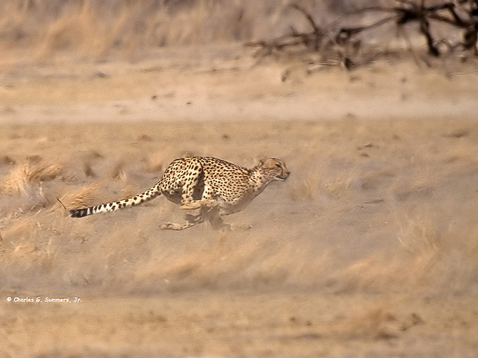
High Performance Websites
http://www.flickr.com/photos/wild_images/1147361271

Slide 2

Please wait.
Loading...

Slide 3
Faster websites?
80% of the end-user response time is spent on the front-end.
Most of this time is downloading images, stylesheets, scripts, Flash, etc.
Reducing the number HTTP requests is the key to faster pages.

Slide 4

Why slow?
Connection bandwith
Connection lag
Page size
Number of requests

Slide 5

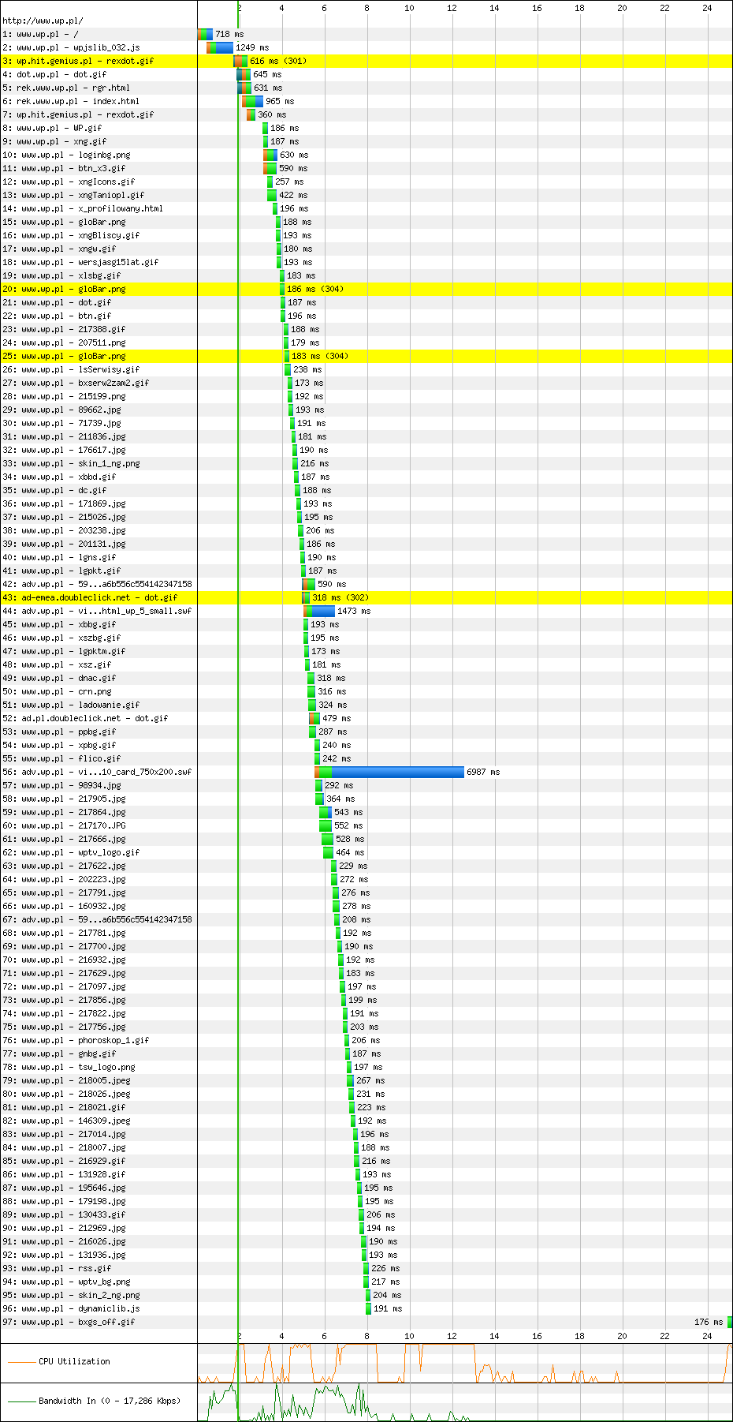
Meet waterfall.
http://www.wp.pl
First View (Error: Timed Out)
http://www.webpagetest.org/result/101117_CTH4/1/details/
http://www.flickr.com/photos/thesussman/4030969285

Slide 6
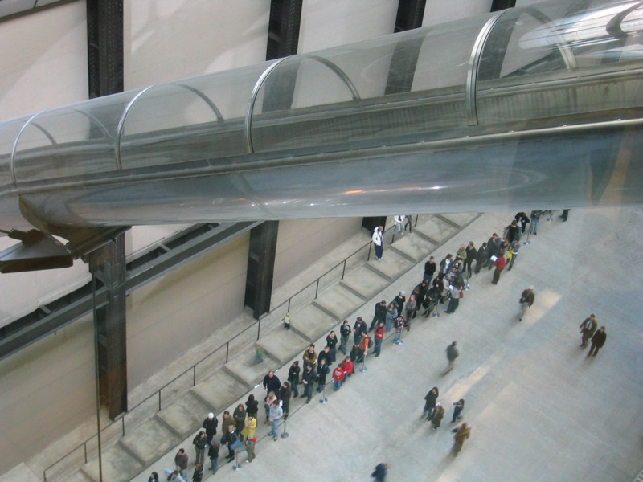
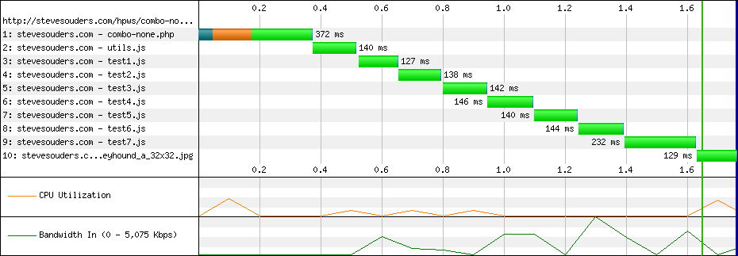
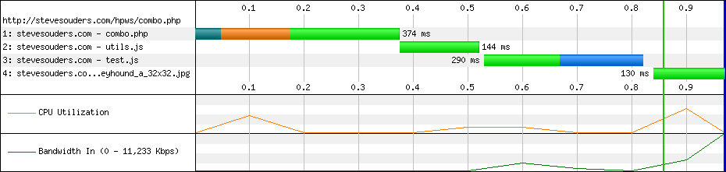
Less is more.
Combine JS and CSS files
Avoid redirects.
http://www.flickr.com/photos/andrewpaulcarr/288909779/

Slide 7
Less is more.
JAWR.
Combines and minifies JS/CSS
Asset servlet(s)
Config file
Tag
http://www.flickr.com/photos/andrewpaulcarr/288909779/

Slide 8
Less is more.
JAWR.
Config
# Define minification processors
jawr.js.bundle.factory.bundlepostprocessors=YUI
jawr.css.bundle.factory.bundlepostprocessors=YUI
#Javascript properties and mappings
jawr.js.bundle.scripts.id=/bundles/scripts.js
jawr.js.bundle.scripts.mappings=cq:/apps/investec/docroot/js/jquery-1.4.2.js, cq:/apps/investec/docroot/js/jquery-ui.js
JSP
<cqjwr:cqInit />
<cqjwr:script src="cq:/apps/investec/docroot/js/jquery-1.4.2.js" />
<cqjwr:script src="cq:/apps/investec/docroot/js/jquery-ui-personalized-1.5.2.packed.js" />
http://www.flickr.com/photos/andrewpaulcarr/288909779/

Slide 9
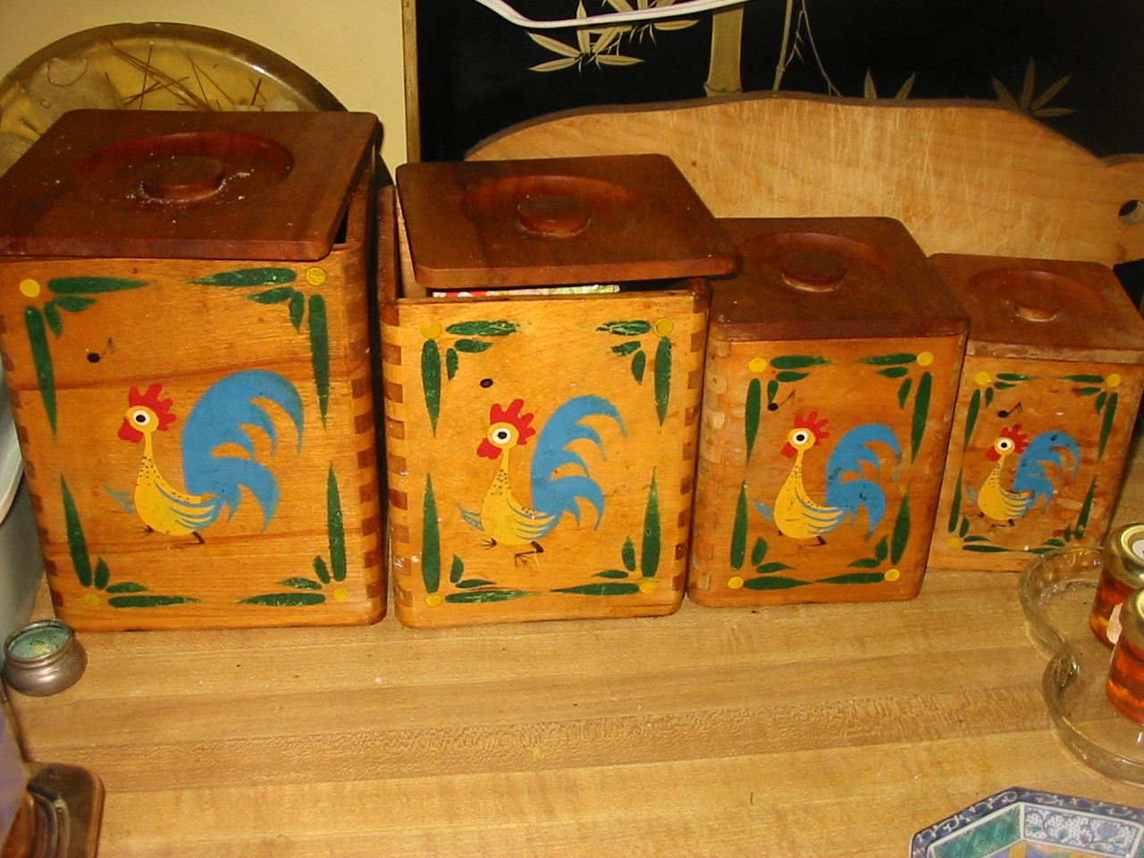
Size matters.
Minify JS/CSS
Minify HTML
Gzip JS/CSS/HTML
http://www.flickr.com/photos/mia3mom/2704693800

Slide 10
Size matters.
JAWR/HTMLCompressor.
JAWR minifies JS and CSS
HTML Compressor Wrapper Tag
Minifies HTML on the fly.
<%@page pageEncoding="UTF-8" contentType="text/html; charset=UTF-8"
%><%@taglib uri="/apps/investec/taglib/htmlcompressor.tld" prefix="compress"
%><compress:html>
.... JSP/HTML code goes here ...
</compress:html>
http://www.flickr.com/photos/mia3mom/2704693800

Slide 11
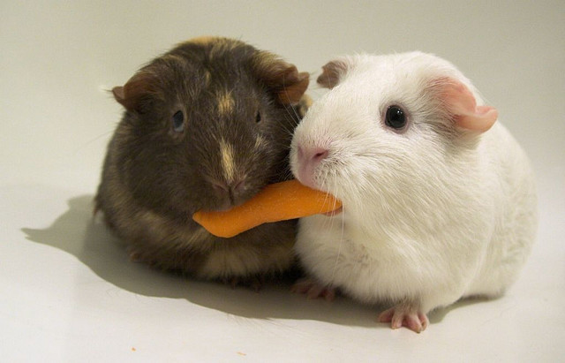
A story of one cookie, err thread.
http://www.flickr.com/photos/ryanr/142455033

Slide 12
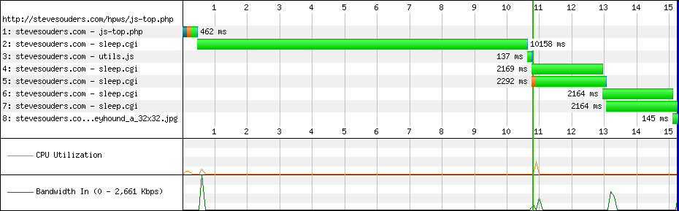
Busy with JS === no rendering
<html>
<head>
<script src="/bin/sleep.cgi?&sleep=10"></script>
<title>Scripts at the Top</title>
http://stevesouders.com/hpws/js-top.php?t=1290026279466

Slide 13
Render first. JS second.
<html>
<head>
<title>Scripts at the bottom</title>
<link rel="stylesheet" href="/bin/sleep.cgi">
</head>
<body>
...
<script src="/sleep.cgi?&sleep=10"></script>
</body>
</html>

Slide 14
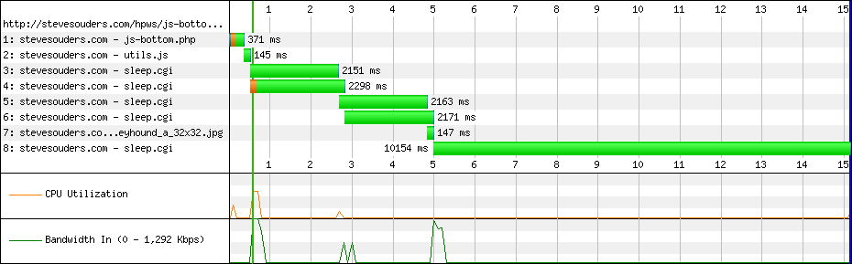
Render first. JS second.
JS at the Top
JS at the Bottom

Slide 15
Move JS down.
Capture and Render Tags.
<skype:captureBody id="js" >
<script type="text/javascript" src="/js/jquery.js"></script>
</skype:captureBody>
.... Some other HTML ...
<skype:captureBody id="js”>
<script type="text/javascript">
//<![CDATA[
$(document).ready(function(){
$("#fullName").rules("add", {
required: true,
messages: {
required: "Please enter full name."
}
});
...
    //]]>
    </script>
    </skype:captureBody>
    .... Some other HTML ...
<skype:renderCapture id="js" />

Slide 16
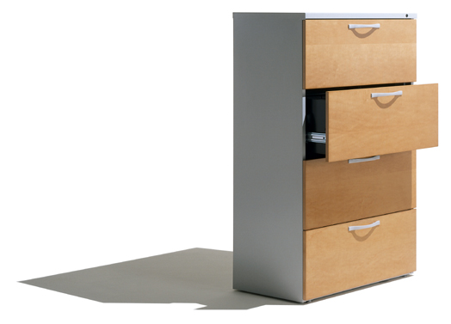
Use browser cache.
Add Expires or Cache-Control header.
Configure Etags.
Use CDN.
Make JavaScript and CSS External
http://www.flickr.com/photos/bfionline/2380398365/

Slide 17
Tools.
Firebug Net Panel
http://www.webpagetest.org
Yslow (http://developer.yahoo.com/yslow/)
Google Page Speed (http://code.google.com/speed/page-speed/)
Fiddler
mod_pagespeed

Slide 18


Slide 19

More reading
http://developer.yahoo.com/performance/rules.html
http://stevesouders.com/hpws/
http://stevesouders.com/efws/
http://code.google.com/speed/

