Slide 1
Introduction to Google Stock
52-week range: $140.53 - $340.49
Current price: $336.01, 52-week high: $340.49
Next earnings date: February 4, 2026
P/E ratio: 33.13, forward P/E: 31.41
Revenue: $385.477 billion, net margin: 32.23%
Notes:
Welcome to our Google stock analysis. We'll begin with an overview of its market performance. Over the past year, the stock has fluctuated significantly, between $140.53 and a high of $340.49. As of now, it stands at $336.01, which is close to its peak. We're expecting the next earnings report on February 4, 2026. Currently, Google is trading with a P/E ratio of 33.13, indicating how much investors are willing to pay for its earnings. These figures reflect its position within the tech industry. Let's also note Google's substantial revenue, emphasizing its financial prowess.
Moving forward, we'll discuss Alphabet Inc., the parent company behind Google.
Source: [CNBC GOOGL](https://www.cnbc.com/quotes/GOOGL)
Sources:
- https://www.cnbc.com/quotes/GOOGL

Slide 2
Company Overview
Alphabet Inc. as Google's parent company
Flexible and innovative structure
Suite of interconnected products
1 billion users on Google Drive
1.8 billion users on Gmail
Notes:
Alphabet Inc. serves as Google's parent company, offering a diversified approach to management across various sectors. Google's organizational structure is designed to foster flexibility and innovation, crucial for its success in the dynamic tech landscape. Its product suite, such as Google Drive and Gmail, boasts enormous user bases, reinforcing its stature in digital communication and collaboration. For example, Gmail's robust spam filtering greatly enhances user experience and marketing efficacy. As we delve deeper, consider how these aspects influence Google's market position and stock performance.
Next, we'll examine specific stock price trends for detailed insights.
Source: [Panmore Analysis](https://panmore.com/google-organizational-structure-characteristics-analysis), [WPSEO](https://wpseoai.com/blog/what-are-some-of-googles-most-popular-products-and-services/)
Sources:
- https://panmore.com/google-organizational-structure-characteristics-analysis
- https://wpseoai.com/blog/what-are-some-of-googles-most-popular-products-and-services/

Slide 3
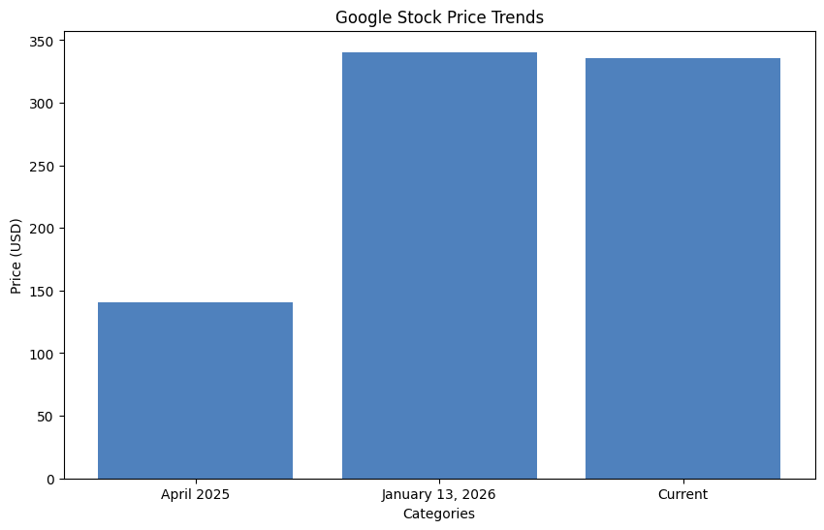
Stock Price Trends
52-week low: $140.53, high: $340.49
Recent closing price: $336.01
Highest price reached on Jan 13, 2026
P/E ratio: 33.13
Net margin: 32.23%
Notes:
Let's delve into Google's stock price trends over the past year. It hit an all-time high of $340.49 on January 13, 2026, while its lowest point was $140.53 in April 2025. The price volatility highlights significant market interest and response to Google's positioning against industry changes. Its P/E ratio at 33.13 suggests investor confidence, though it requires careful analysis. Tracking these trends provides predictive insights into future price movements.
In the next section, we'll discuss Google's financial performance metrics in more detail.
Source: [CNBC GOOGL](https://www.cnbc.com/quotes/GOOGL)
Sources:
- https://www.cnbc.com/quotes/GOOGL

Slide 4
Financial Performance Metrics
Revenue: $385.477 billion
EBITDA: $149.653 billion
ROE: 35.45%
Gross margin: 59.17%
Debt-to-equity ratio: 6.72%
Notes:
This slide focuses on Google's key financial metrics. The company's revenue stands at a staggering $385.477 billion, with an EBITDA of $149.653 billion. These metrics demonstrate substantial growth and operational efficiency. Google's ROE of 35.45% indicates effective use of equity funding to generate profits, while a gross margin of 59.17% highlights its profitable operations. It's financing operations with a debt-to-equity ratio of 6.72%, showcasing conservative financial leverage. These figures establish a foundation for evaluating Google's financial health.
Next, we'll compare its performance against main competitors and the broader market.
Source: [CNBC GOOGL](https://www.cnbc.com/quotes/GOOGL)
Sources:
- https://www.cnbc.com/quotes/GOOGL

Slide 5
Market Comparison
Market cap: $4.1 trillion
P/E ratio lower than S&P 500
Stock increase: 62% in 2025
Global search dominance: 90%
Revenue TTM: $385.5 billion
Notes:
In comparing Google with its market peers, we note its impressive market cap of about $4.1 trillion. Despite its lower P/E ratio compared to S&P 500, it may be undervalued. Remarkably, Google's stock surged by 62% in 2025, a testament to its strong market presence. Its dominance in global search, capturing over 90% of searches, reinforces its leadership in digital advertising. These comparisons are vital for understanding Google's competitive positioning and future potential.
Next, we turn our attention to recent news stories impacting Google's stock.
Source: [The Motley Fool](https://www.fool.com/research/largest-companies-by-market-cap/)
Sources:
- https://www.fool.com/research/largest-companies-by-market-cap/

Slide 6
Recent News Impacting Stock
Stock surge: 77% in six months
P/E ratio at 33, over S&P average
Net margin over 30%
Regulatory concerns impacting valuation
Second most valuable company after Nvidia
Notes:
Google's stock has experienced a dramatic 77% surge over the past six months. This rise has been fueled by increasing P/E multiples and modest revenue growth. Its current P/E ratio is higher than the S&P 500 average, signaling a possible overvaluation, yet it reflects investor confidence in Google's profitability, as shown by a net margin exceeding 30%. However, regulatory challenges continue to affect its valuation. Being the second-most valuable company globally speaks volumes about its market influence.
We'll now review analysts' ratings on Google stock performance.
Source: [Forbes](https://www.forbes.com/sites/greatspeculations/2026/01/29/decoding-google-stocks-recent-volatility/)
Sources:
- https://www.forbes.com/sites/greatspeculations/2026/01/29/decoding-google-stocks-recent-volatility/

Slide 7
Analyst Ratings
Consensus price target: $192.38
Analyst ratings: Buy to Strong Buy
Potential rise to $500 by 2030
Increased 60% YTD by December 2025
High volatility, past declines: 31% during Covid
Notes:
Analysts have shown broad confidence in Google's stock, with a consensus target of $192.38, while some foresee a rise to $500 by 2030. Currently, ratings range from Buy to Strong Buy, reflecting optimistic future valuations. Despite a 60% increase year-to-date as of December 2025, Google's stock has a history of volatility. It experienced significant declines during major market events like the COVID-19 pandemic. Understanding these insights helps investors assess fundamental risks and potential benefits.
Let's proceed to analyze the risks and challenges facing Google.
Source: [Benzinga](https://www.benzinga.com/quote/GOOG/analyst-ratings)
Sources:
- https://www.benzinga.com/quote/GOOG/analyst-ratings

Slide 8
Risks and Challenges
Stock volatility: past declines 23% to 45%
27% below all-time highs due to regulation
$75 billion in AI and cloud investments
Increased regulatory scrutiny
Antitrust proposals by DOJ
Notes:
Investors should be aware of the risks associated with Google stock. Historically, it has shown volatility with declines between 23% and 45% during economic downturns. Currently, it's 27% below its all-time highs due to intensified regulatory scrutiny and competition. Google has committed $75 billion in investments to enhance its AI and cloud sectors, addressing competitive threats. However, regulatory pressure, notably from DOJ antitrust proposals, presents ongoing challenges to its business model.
We'll now look ahead to Google's future outlook and growth forecasts.
Source: [Forbes](https://www.forbes.com/sites/jackkelly/2025/04/21/big-tech-in-turmoil-the-challenges-confronting-meta-and-google/)
Sources:
- https://www.forbes.com/sites/jackkelly/2025/04/21/big-tech-in-turmoil-the-challenges-confronting-meta-and-google/

Slide 9
Future Outlook
Quarterly revenue exceeded $100 billion
Mid-teens revenue CAGR predicted
Strong Cloud revenue growth: 34% YoY
Potential share price: $341.58 to $600 by 2030
AI and cloud expansion driving growth
Notes:
Looking forward, Google has impressive growth prospects. It surpassed $100 billion in quarterly revenue for the first time, signaling strong business momentum. Analysts foresee a mid-teens consolidated revenue CAGR, backed by innovations in AI and cloud services. Google's Cloud segment, a major growth driver, saw a 34% YoY increase in Q3 2025. The average projected share price indicates a rise to $341.58, with the potential to exceed $600 by 2030, supported by AI capabilities. The future looks promising if these growth vectors are sustained.
Let's conclude with some investment recommendations for potential investors.
Source: [Forbes](https://www.forbes.com/sites/greatspeculations/2025/12/26/what-to-expect-from-google-stock-in-2026/)
Sources:
- https://www.forbes.com/sites/greatspeculations/2025/12/26/what-to-expect-from-google-stock-in-2026/

Slide 10
Conclusion and Recommendations
GOOGL (Class A) and GOOG (Class C) differences
Current price: ~$327.93, strong 2025 growth
Potential rise to $500 by 2030
Beta 1.03 indicates stable volatility
Considered lower cost than some tech peers
Notes:
In conclusion, Google trades under two tickers, GOOGL and GOOG, impacting investor choices due to voting rights differences. Its current price of around $327.93 reflects strong growth throughout 2025. Projections suggest a rise to $500 by 2030, underscoring its long-term growth potential. With a beta of 1.03, Google offers relatively stable volatility in a competitive tech landscape. Compared to other tech giants, it is a lower-cost investment option, making it attractive for diversifying portfolios. These insights should guide your investment decisions.
Thank you for your attention. I'd be happy to address any questions.
Source: [Investopedia](https://www.investopedia.com/investing/google-good-investment/)
Sources:
- https://www.investopedia.com/investing/google-good-investment/

