Slide 1
Introduction to Microsoft Stock
Founded by Bill Gates and Paul Allen in 1975.
Initial product was Altair BASIC for personal computers.
Year-end sales in 1975 totaled $16,005.
Notes:
Microsoft was founded by Bill Gates and Paul Allen in 1975. Since then, it has grown to be a major player in the technology sector and a key stock on the market. The company's first major milestone was the development and sale of Altair BASIC, a revolutionary computer language for personal computers. By the end of 1975, Microsoft reported year-end sales amounting to $16,005, laying the groundwork for its future success. These early beginnings highlight Microsoft's growth story from a two-man venture to a multinational corporation. As we transition to our next slide, we'll explore the various factors that currently influence Microsoft's stock performance.
Sources:
- https://learn.microsoft.com/en-us/shows/history/history-of-microsoft-1975

Slide 2
Factors Influencing Microsoft Stock Performance
Company performance and news impact stock prices.
Industry trends and investor confidence play a role.
Economic and political factors influence stock valuations.
Notes:
Several elements can influence Microsoft's stock price. Crucially, company-specific news such as earnings reports and new product launches significantly affect stock valuation. Moreover, the overall performance of the tech industry can push investors to buy or sell. Investor confidence, which often sways due to market sentiment rather than fundamentals, also plays a pivotal role. Additionally, broad economic indicators like interest rates, inflation, and political events shape the business environment and subsequently affect stock prices. Moving forward, let's delve into what the future holds for Microsoft's stock based on market analyses and forecasts.
Sources:
- https://www.getsmarteraboutmoney.ca/learning-path/stocks/factors-that-can-affect-stock-prices/

Slide 3
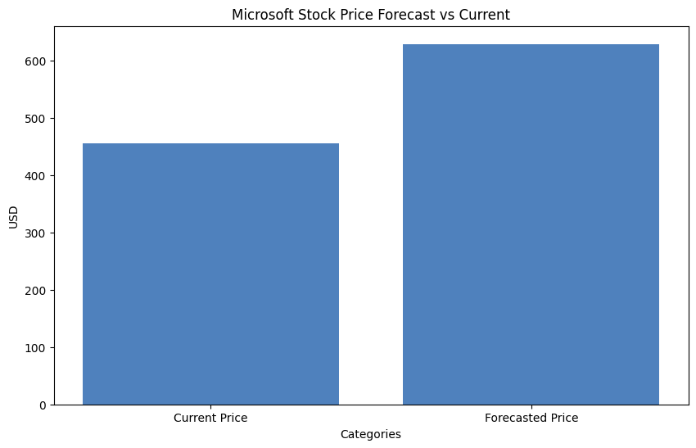
Future Outlook for Microsoft Stock
Analysts predict up to 37.85% upside.
Sales forecasted to grow by 16% in fiscal 2026.
Azure's growth significantly boosts revenue.
Notes:
The future for Microsoft's stock looks promising based on expert forecasts. Analysts have set an average price target that indicates a 37.85% potential upside, showing strong confidence in Microsoft's continued growth. Sales are anticipated to grow by 16% in fiscal year 2026, while Microsoft's Azure cloud service has already shown impressive growth with a 33% increase in fiscal 2024. Despite occasional setbacks, such as recent stock price lows, the company maintains a robust growth trajectory through strategic focus on AI and cloud services. This positions it well for sustained earnings growth in the coming years.
Sources:
- https://www.zacks.com/stock/research/MSFT/price-target-stock-forecast
- https://www.fool.com/investing/2026/01/05/prediction-this-will-be-microsofts-stock-price-at/
- https://www.cnbc.com/2026/01/28/microsofts-quarter-shows-once-again-that-it-must-get-its-growth-to-spending-ratio-right.html

