Slide 1
Introduction to Amazon Stock
Amazon (AMZN) on NASDAQ – $1T market cap
Stock up 60% in past year
Rapid growth in e-commerce and AWS
Founded by Jeff Bezos in 1994
Over 200M Prime subscribers globally
Notes:
Introduce Amazon as a key market player with a $1 trillion market cap. Highlight its growth in e-commerce and AWS. Mention its origin and Prime's contribution.
Sources:
- https://www.nasdaq.com/market-activity/stocks/amzn
- https://www.forbes.com/companies/amazon/
- https://www.investopedia.com/amazon-stock-analysis-4689755
- https://www.amazon.com/gp/help/customer/display.html?nodeId=201365360
- https://www.statista.com/statistics/791122/amazon-prime-membership-worldwide/

Slide 2
Factors Influencing Amazon's Stock Price
Company performance and market trends affect price
No dividends; reinvestment in growth areas like AWS
Regulatory changes can influence prices
Multi-billion investments in AI, data centers
Recent layoffs to streamline amidst AI expansion
Notes:
Discuss factors like company performance and market trends influencing Amazon's stock. Highlight the focus on growth areas and investments. Note regulatory impacts and restructuring efforts.
Sources:
- https://myamazonguy.com/amazon-stock-price/
- https://www.barchart.com/story/news/37254765/dear-amazon-stock-fans-more-layoffs-are-coming-this-week
- https://www.bnnbloomberg.ca/business/company-news/2026/01/28/amazon-cuts-16000-jobs-in-its-latest-round-of-layoffs/

Slide 3
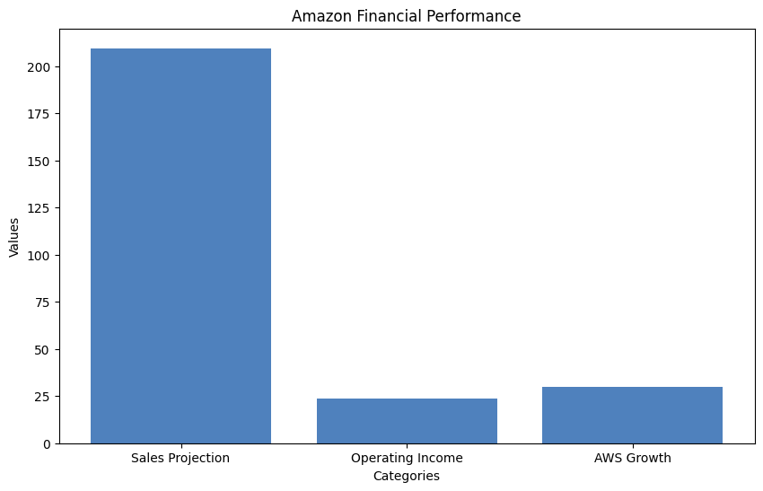
Amazon's Financial Performance
Sales projections: $209.5B surpassing estimates
Operating income above expectations: $21B–$26B
EPS increase by 42%; AWS grows at 20.2%
Advertising revenue on the rise: $17.7B in Q3
AWS projected to exceed $172B revenue by 2026
Notes:
Highlight Amazon's solid financial projections and earnings performance. Mention AWS's significant contributions and growth potential. Note the rising advertising revenues.
Sources:
- https://www.cnbc.com/2025/10/30/amazon-amzn-q3-earnings-report-2025.html
- https://www.fool.com/investing/2026/01/27/why-feb-5-could-be-big-day-amazon-investors-ai/
- https://www.forbes.com/sites/greatspeculations/2026/01/02/amazon-stock-in-2026-show-me-the-growth/

Slide 4
Market Trends and Future Outlook
Online sales to reach $6.9T–$8.1T by 2026
CAGR for revenue and EPS: 12% and 20%
AWS maintains strong position despite AI competition
Analysts' optimism: Target price $302 vs $282
Potential for $2T market cap by 2024
Notes:
Discuss future projections for Amazon, focusing on growth in online sales and earnings. Highlight AWS's resilience and analyst optimism regarding stock performance.
Sources:
- https://qubit.capital/blog/high-growth-startup-sectors
- https://www.fool.com/investing/2026/01/03/where-will-amazon-amzn-stock-be-in-3-years/
- https://www.benzinga.com/insights/analyst-ratings/26/01/50140007/breaking-down-amazon-com-38-analysts-share-their-views

Slide 5
Investing in Amazon Stock: Pros and Cons
AWS leads with 29% market share
$125B invested in AI development
AWS 65% of total operating income
Strong cash flow supports reinvestments
Risks: AWS slowdown, market fluctuations
Notes:
Summarize the strengths of investing in Amazon, emphasizing AWS's market lead and financial strategy. Balance with risks like AWS growth potential and market uncertainties.
Sources:
- https://www.aol.com/articles/3-reasons-buy-amazon-stock-172000557.html
- https://www.fool.com/investing/2025/12/03/2-reasons-ill-never-sell-amazon-stock/
- https://www.forbes.com/sites/greatspeculations/2025/12/26/amazon-stock-faces-dangershere-are-some-warning-signs/

