Slide 1
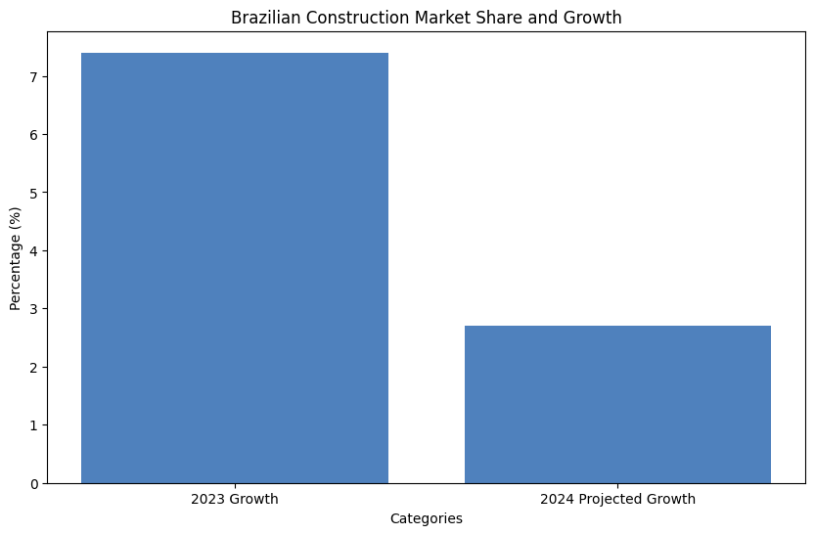
Notes:
Brazil holds a commanding position in the Latin American construction market, capturing 34.3% of the regional share in 2024. This leadership is fueled by robust public and private ventures. Recently, the Brazilian government committed BRL 1.5 trillion through its PAC 2023-2026 program to enhance infrastructure projects, with 87 projects already underway. Looking at growth trends, the construction sector recorded a significant 7.4% growth in 2023, and is projected to expand by 2.7% in 2024, largely driven by infrastructure development. However, the labor market poses challenges as the workforce has shrunk, causing wage inflation as firms offer up to 30% higher salaries to attract skilled workers.
Moving on, we will explore the key drivers and the challenges faced by the Brazilian construction market.
Sources:
- [Market Data Forecast](https://www.marketdataforecast.com/market-reports/latin-america-construction-market)
- [World Construction Network](https://www.worldconstructionnetwork.com/data-insights/five-largest-construction-projects-brazil/)
Sources:
- https://www.marketdataforecast.com/market-reports/latin-america-construction-market
- https://www.worldconstructionnetwork.com/data-insights/five-largest-construction-projects-brazil/

Slide 2
Key Drivers and Challenges
Infrastructure market to grow USD 106.58M to USD 182.32M by 2035
Growth driven by urbanization, advanced technologies, sustainability
Housing programs like 'Minha Casa, Minha Vida' boost demand
Challenges: rising household debt, economic conditions, funding issues
Notes:
The Brazilian infrastructure market is set to reach USD 182.32 million by 2035, growing from USD 106.58 million in 2024. This upward trend is largely driven by ongoing urbanization, adoption of advanced construction technologies, and a focus on sustainable practices. Government-backed housing initiatives like 'Minha Casa, Minha Vida', which have mobilized approximately $140 billion since their inception, are pivotal in maintaining construction sector demand. Despite these positive drivers, the sector is faces substantial challenges including rising household indebtedness and economic restraints affecting investment and hiring. Public-private partnerships are emerging as crucial alternatives to traditional funding, especially in light of past economic setbacks and corruption issues. As we pivot to insights, let's delve into future projections and opportunities in the Brazilian construction market.
Sources:
- [Market Research Future](https://www.marketresearchfuture.com/reports/brazil-infrastructure-construction-market-48044)
- [Fastmarkets](https://www.fastmarkets.com/insights/brazils-construction-sector-2026-housing-programs-support-rates-high-risks-persist/)
Sources:
- https://www.marketresearchfuture.com/reports/brazil-infrastructure-construction-market-48044
- https://www.fastmarkets.com/insights/brazils-construction-sector-2026-housing-programs-support-rates-high-risks-persist/

Slide 3
Future Outlook and Opportunities
Market to grow from BRL 673.07B in 2024 to BRL 878.72B by 2029
CAGR of 4.3% from 2025 to 2029 driven by infrastructure and housing
Government focus on public infrastructure to fuel growth
Potential risks: fiscal policies, economic uncertainties delaying growth
Notes:
Looking ahead, Brazil's construction market is projected to expand from BRL 673.07 billion in 2024 to reach approximately BRL 878.72 billion by 2029, boasting a notable CAGR of 4.3% from 2025 onward. This growth is primarily driven by investments in both infrastructure and housing, supported by government initiatives focusing on public and energy facilities, urban development, and sustainability improvements. Programs like 'Reforma Casa Brasil', with its $39.8 billion investment in 2026, underline the government's commitment to improving housing conditions. Nevertheless, potential risks remain, including fiscal constraints and economic uncertainties that could hinder growth. This concludes our overview, opening the floor for questions, such as about the specific impacts of technology and digital construction advances.
Sources:
- [GlobeNewswire](https://www.globenewswire.com/news-release/2025/11/13/3187188/28124/en/Brazil-Construction-Industry-Report-2025-A-BRL-878-72-Billion-Market-by-2029-Opportunities-in-Affordable-Housing-Modern-Commercial-Spaces-Industrial-Facilities-in-Logistics-and-Ren.html)
- [Market Research Future](https://www.marketresearchfuture.com/reports/brazil-infrastructure-construction-market-48044)
Sources:
- https://www.globenewswire.com/news-release/2025/11/13/3187188/28124/en/Brazil-Construction-Industry-Report-2025-A-BRL-878-72-Billion-Market-by-2029-Opportunities-in-Affordable-Housing-Modern-Commercial-Spaces-Industrial-Facilities-in-Logistics-and-Ren.html
- https://www.marketresearchfuture.com/reports/brazil-infrastructure-construction-market-48044

