Slide 1
Introduction to General Motors
Founded in 1908 by William C. Durant
First listed on NYSE in 1911
Reported $1 billion earnings in 1955
Filed for Chapter 11 bankruptcy in 2009
$35 billion commitment to EVs by 2021
Notes:
General Motors was established on September 16, 1908, by William C. Durant in Flint, Michigan. It started by acquiring Buick Motor Company. Just three years later, GM became the pioneer automotive company to be listed on the New York Stock Exchange in 1911. This financial move was crucial for expansion.
In 1955, GM marked history as the first American corporation to surpass annual earnings of $1 billion, showcasing its financial might. However, by 2009, GM faced financial difficulties, leading to a Chapter 11 bankruptcy filing. This resulted in a government bailout and reorganization.
Looking forward, GM announced a significant commitment to electric vehicles in 2021, allocating $35 billion to develop electric and autonomous vehicles focusing on its Ultium platform.
Source credibility can boost your claims, so it's vital to refer to resourceful links provided for authenticity.
Transitioning to recent developments, GM's focus shifts towards sustainability and innovation.
Sources:
- https://automotivehistory.org/september-16-1908-the-birth-of-general-motors/
- https://www.motorcities.org/story-of-the-week/2019/a-history-of-the-general-motors-building
- https://portersfiveforce.com/blogs/brief-history/gm
- https://appraisalengine.com/appraiser-blog/the-rise-of-gm-a-century-of-automotive-innovation/

Slide 2
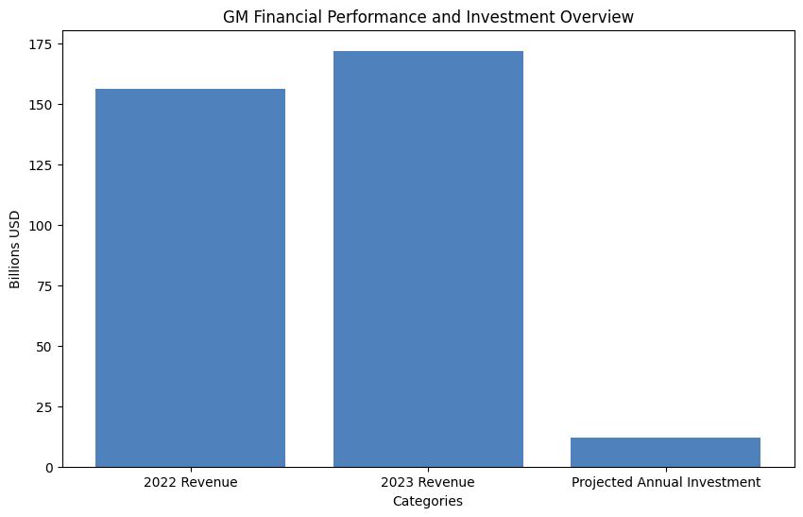
Notes:
GM continues to demonstrate strong financial performance with its 2023 revenue growing by 10% to reach $171.84 billion, alongside a net income of $10.13 billion. These figures show that GM exceeded market expectations and maintain a strong financial standing. Furthermore, they're expected to invest between $10 to $12 billion annually until 2027, emphasizing their dedication to infrastructure and innovation.
An important aspect of GM’s modern strategy is their commitment to sustainability, seen in the participation of 88% of their direct suppliers in EcoVadis with an average score of 52. This initiative underlines GM’s dedication to reducing environmental impact across its supply chain.
The target to electrify 50% of their fleet by 2030 shows GM's progressive approach towards a sustainable and electric future.
Consider audience questions regarding the competitive landscape for EVs, which can be answered by GM's commitment to technological innovations and investments.
Now, let's explore the financial implications of these strategic developments further.
Sources:
- https://www.cnbc.com/2024/01/30/general-motors-gm-earnings-q4-2023.html
- https://www.cnbc.com/2026/01/29/gm-earnings-trump.html
- https://sustainabilitymag.com/articles/general-motors-drives-sustainability-across-supply-chain
- https://www.hbs.edu/bigs/how-gm-is-shaping-an-all-electric-future

