Slide 1
Introduction to the Tech Industry
Tech sector drives economic growth
Investment in tech averages 10% of bank revenues
Remote work revolution in tech
AI and automation changing business models
Notes:
The technology sector is a cornerstone of modern economic growth, largely due to its broad impact across virtually all industry sectors. It's composed of companies engaged in the development of software, electronics, and other digital products and services like Apple, Google, and Microsoft. Banks, for example, allocate approximately 10% of their revenues to tech investments, showcasing the sector's importance and integration within financial services [source: Integrate.io]. The tech industry is also revolutionizing traditional business models through rapid advancements in AI and automation, allowing businesses to operate on unprecedented scales. The shift to remote work, widely embraced by the tech sector, further amplifies its transformative role by allowing companies to leverage global talent without geographical constraints [source: UChicago].
Sources:
- https://www.investopedia.com/terms/t/technology_sector.asp
- https://www.integrate.io/blog/data-transformation-challenge-statistics/
- https://esnaad.com/the-role-of-technology-in-driving-economic-growth/
- https://grad.uchicago.edu/wp-content/uploads/2021/03/IT-Industry-Guide-.pdf

Slide 2
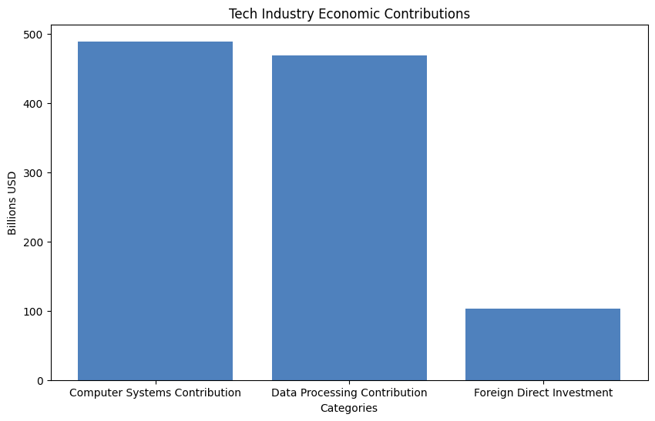
Notes:
The historical growth of the tech industry is marked by significant economic contributions and expansion. In 2023, the computer systems and related services boosted the U.S. economy by nearly $489.2 billion [source: U.S. Trade Department]. There are roughly 585,000 software and IT services companies in the U.S., showcasing the vast scale and presence of the sector. International interest is also evident with foreign direct investment reaching $102.8 billion in the same period. Employment within the industry is on an upward trajectory, anticipated to reach 6.6 million by 2024, signaling ongoing robust job creation. As we explore these data points, consider the pivotal role that technological advancements like AI and IoT play in sustaining this growth.
Sources:
- https://www.trade.gov/selectusa-software-and-information-technology-industry
- https://www.pwc.com/us/en/industries/tmt/library/tmt-trends.html

Slide 3
Current Market Trends
AI projected 37.3% annual growth rate
55% of companies prioritize AI
Integration of AI and IoT increases efficiency
Quantum and neuromorphic computing emerging
Notes:
Current market trends in the tech industry are largely influenced by emerging technologies. Artificial Intelligence, for instance, is forecasted to grow by 37.3% annually through 2030 [source: F12.net], with more than half of companies ranking it among their top investment priorities [source: PwC]. The amalgamation of AI with IoT has led to enhanced operational efficiencies across sectors by enabling predictive maintenance and better customer engagement. Meanwhile, quantum computing and neuromorphic computing are on the horizon, promising extraordinary advancements in computational power. As we dive deeper, let's consider how these technological advancements are shaping the competitive landscape and what that means for future growth.
Sources:
- https://f12.net/blog/the-emerging-technology-trends-you-cant-afford-to-ignore/
- https://www.pwc.com/us/en/tech-effect/emerging-tech/emtech-survey.html
- https://technologymagazine.com/top10/top-10-biggest-innovations-of-2023

Slide 4
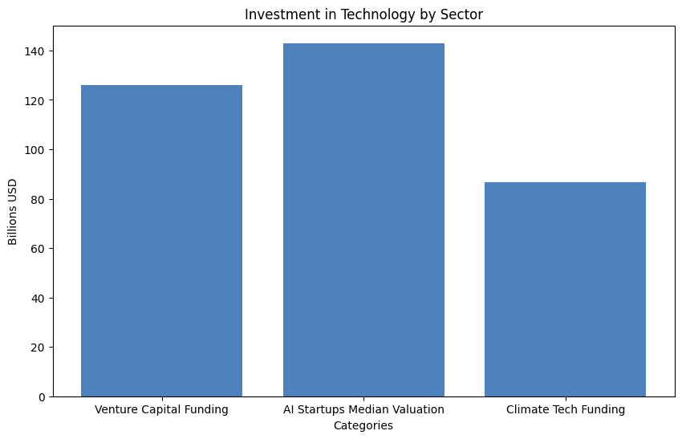
Notes:
Investments in the tech industry reveal a dynamic landscape. Global venture capital funding hit $126 billion in Q3 2025, underscoring continued investor interest, especially in AI sectors where startups command median valuations of $143 million for Series B funding [source: Bain]. Climate tech has also seen substantial investment, with $86.6 billion allocated, highlighting the focus on sustainable technology solutions. Tech mega-caps are further directing over $300 billion into AI initiatives, spanning infrastructure and custom development projects [source: Qubit Capital]. As we discuss these figures, consider how this financial commitment is shaping tech innovation and the competitive edge of companies within this space.
Sources:
- https://www.bain.com/insights/global-venture-capital-outlook-latest-trends-snap-chart/
- https://qubit.capital/blog/ai-startup-fundraising-trends
- https://qubit.capital/blog/startup-industry-trends

Slide 5
Impact of COVID-19 on Tech Growth
Digital transformation accelerated in pandemic
Increased reliance on tech firms
Surge in telehealth and e-commerce
Entrepreneurial response with new tech applications
Notes:
COVID-19 has dramatically accelerated tech industry growth, spotlighting the strategic importance of digital transformation. Technology's pivotal role became apparent as firms adapted to operate with minimal disruption, fostering a digital-first approach. Telehealth exemplified this change, with institutions like Cleveland Clinic increasing telehealth consultations from 2% to 75% [source: PMC]. Additionally, e-commerce witnessed a 19% revenue boost globally in 2020, as consumer behavior shifted online [source: Trade.gov]. The tech sector also saw a surge in entrepreneurship, evident in high-propensity business applications amid the pandemic. Let's explore how these shifts have not only changed company operations but also permanently transformed consumer expectations.
Sources:
- https://bernardmarr.com/impact-of-covid-19-on-technology/
- https://pmc.ncbi.nlm.nih.gov/articles/PMC7324321/
- https://www.trade.gov/impact-covid-pandemic-ecommerce

Slide 6
Major Players in the Tech Industry
Amazon leads in e-commerce and cloud computing
Apple's innovation in consumer electronics
Alphabet's vast influence via Google
Nvidia's market cap reaches $4 trillion
Notes:
Today's tech landscape is dominated by several key players whose innovations and strategies shape industry dynamics. Amazon has been a pioneer in e-commerce and cloud technology, constantly pushing the envelope in logistics and supply chain management [source: Technology Magazine]. Apple, with its iconic products like the iPhone, continues to drive consumer electronics and digital transformation. Alphabet, the parent company of Google, plays a significant role in digital advertising and cloud technology, while Nvidia, now the largest tech company by market cap at over $4 trillion, leads in graphics and AI computing power [source: CNBC]. These companies set benchmarks for success; how they navigate challenges influences the broader tech ecosystem.
Sources:
- https://technologymagazine.com/top10/the-top-10-technology-companies-2023
- https://joinhandshake.com/blog/students/top-tech-companies/
- https://www.cnbc.com/2025/09/05/tech-megacaps-worth-market-cap.html

Slide 7
Technological Innovations Driving Growth
Cloud usage is extensive with 3 private, 2 public clouds
5G rollout accelerates with Nokia, T-Mobile
AI and blockchain redefining industries
Generative AI boosts efficiencies in sectors
Notes:
Technological innovation continues to drive substantial growth in the tech sector. We see extensive cloud usage among organizations, with many utilizing private and multiple public cloud environments for critical operations [source: Technology Magazine]. The rollout of 5G by Nokia and T-Mobile is significantly boosting connectivity and enabling new services. AI and blockchain technologies are transforming traditional industries by enhancing productivity and data security. For instance, generative AI is poised to contribute $310 billion in additional annual profits to the retail sector by improving efficiencies [source: Strategy&]. As we analyze these innovations, consider how they are not just trends but foundational shifts in how industries operate.
Sources:
- https://technologymagazine.com/top10/top-10-biggest-innovations-of-2023
- https://www.pwc.com/us/en/tech-effect/emerging-tech/essential-eight-technologies.html
- https://extrimian.io/exploring-the-impact-of-ai-and-blockchain-in-the-digital-world/

Slide 8
Challenges Facing the Tech Industry
Inadequate technological capabilities among firms
Economic pressures like inflation and recession
Shortage of software developers
Complex AI regulations impacting innovation
Notes:
Despite the rapid growth and impact of technology, significant challenges persist. A substantial share of CEOs feel their firms lack the technological capabilities necessary for future success, prompting reinvestment in their infrastructures [source: Cambridge Intelligence]. Economic pressures, such as inflation and impending recession, are external disruptors affecting decision-making and strategy. Moreover, a notable shortage of skilled software developers exacerbates collaboration challenges, especially in remote environments [source: Reveal BI]. Finally, a complex landscape of AI regulations across states presents compliance challenges and is seen as a barrier to innovation. As we discuss these hurdles, consider potential strategies for overcoming them.
Sources:
- https://cambridge-intelligence.com/a-ceos-greatest-fears/
- https://www.revealbi.io/whitepapers/reveal-survey-report-top-software-development-challenges-for-2023
- https://www.uschamber.com/technology/the-hidden-cost-of-50-state-ai-laws-a-data-driven-breakdown

Slide 9
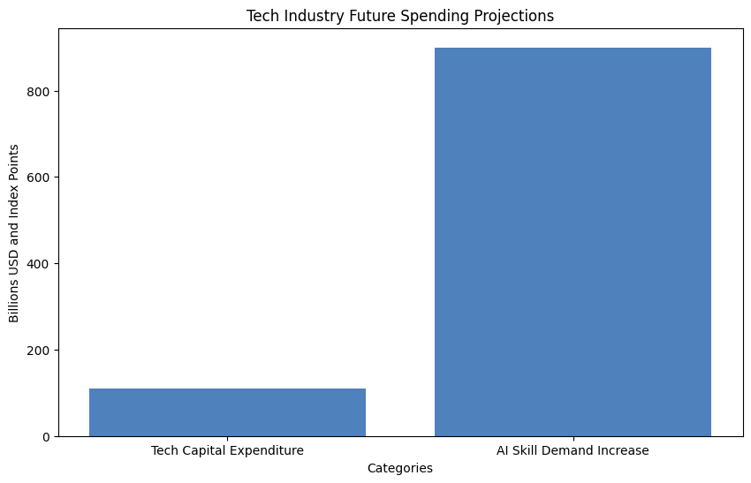
Notes:
Looking ahead, the tech industry's trajectory showcases a dominant trend towards AI becoming an indispensable infrastructure component across sectors. The industry is set to increase its capital expenditure significantly, with predictions exceeding $110 billion by 2026 [source: CNBC]. The demand for specialized AI skills continues to surge, with job postings reflecting a ninefold increase since 2021 [source: I'd Rather Be Writing]. The integration of AI into everyday services, like Microsoft 365 and Google Workspace, further indicates the widespread, transformative potential of these technologies. These insights set the stage for robust industry growth, setting new benchmarks in innovation and efficiency.
Sources:
- https://idratherbewriting.com/blog/tech-comm-predictions-for-2026
- https://www.elsner.com/the-future-of-ai/
- https://www.cnbc.com/2026/01/27/big-tech-earnings-2026-ai-spend.html

Slide 10
Conclusion and Key Takeaways
Role of AI and tech in global growth
Growing investment and innovation in tech
Ongoing regulatory and workforce challenges
Pivotal future of the tech sector in global economy
Notes:
In conclusion, the tech industry stands as a crucial pillar for global economic development, with AI leading significant transformations across sectors. Investment trends highlight a growing focus on technological innovation, promising new opportunities for both established firms and startups. However, we must address persistent regulatory and workforce challenges to ensure sustainable growth. Ultimately, the tech sector's future will shape the global economy, supporting innovation and efficiency across various industries. As we wrap up, consider how your organization could capitalize on these potential opportunities while navigating the inherent challenges.
Sources:
- https://www.pwc.com/gx/en/services/ai/ai-jobs-barometer.html
- https://hai.stanford.edu/ai-index/2025-ai-index-report

