Slide 1
Technology and Planetary Pressures
Workshop 2024-03-12

Slide 2
Recap of the idea
Efficiency gains through technological change affects the economic equilibrium and the planetary pressures caused by the economic system
General-equilibrium adjustments propagate the effects between sectors and the net effects are unclear
Here we will use model from Engström et al. (2020):
Change in efficiencies => change in economic activity => change in planetary pressures
Effects are derived using comparative statics (i.e., how changes in policy or efficiencies change the equilibrium)

Slide 3
Drivers of planetary pressures
Boundary | Problem | Main drivers
Climate change | CO2 and GHG:s | Energy prod. (67%); Agriculture (14%), land-use change (12%)
Biochemical flows | Phosphorus and Nitrogen | Fertilizer in agriculture (90%)
Ocean acidification | H+ concentration←CO2 in atmosphere (nutrients) | See above
Freshwater use | Overconsumption | Agriculture (92%)
Land-use change | Forest-land loss | Deforest. due to agric. expansion (92%)
Biodiversity loss | Extinction of species | Agric. (62%) log. (46%), clim.ch. (19%) fishing (13%) (share of red-listed species threatened by activity)
Ozone | NO2 emissions | “Resolved”, agric., fossil fuel, biof. manuf.
Aerosol loading | black and organic carbon, sulfates, nitrates | Fossil and biof. (95%), biomass burn (5%)
Chemical pollution | Non-natural chemicals and organisms | Manuf., fossil fuels, agric. and fertilizers
Model contains >90% of sources for these pressures

Slide 4
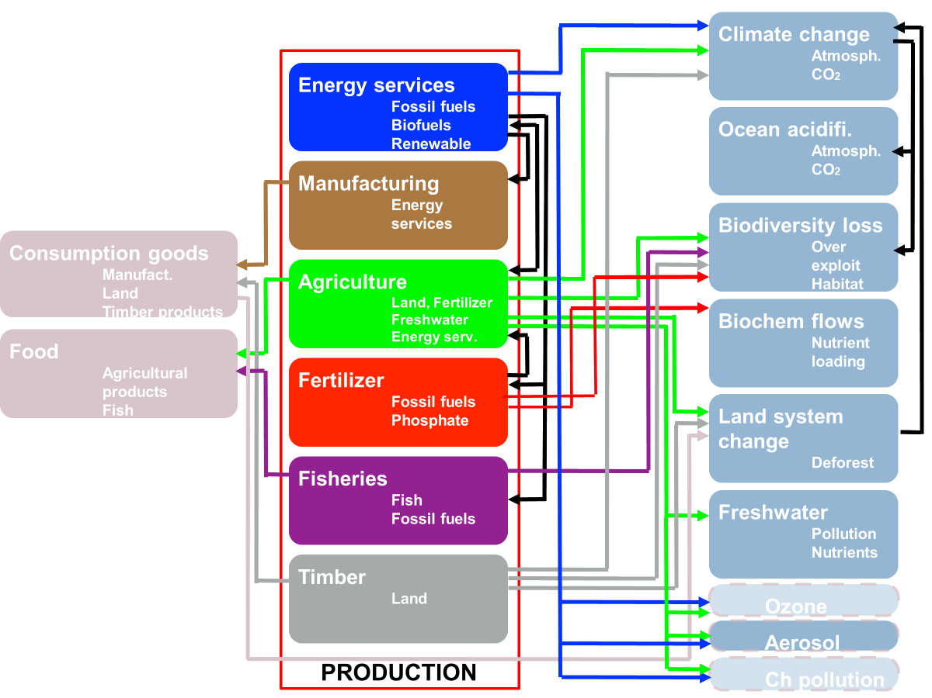

Slide 5
Consumption
Food
Agriculture
Fish
Non-food
Manufacturing
Timber
Land (e.g., for recreation)
Low substitutability between food and non-food
Higher substitutability within categories

Slide 6
Extraction sectors
Sectors modeled as “extraction” with a cost function:
Renewables
Fossil fuels
Water
Phosphate
“Other inputs”

Slide 7
Production sectors, their uses and their inputs
Agriculture: used for food and biofuels
Land
Non-land: Energy services, Fertilizers, Water, Other inputs
Energy services: used in agriculture and manufacturing
Fossil energy
Renewables
Biofuels
Fertilizers: used in agriculture
Fossil energy (for Nitrogen)
Phosphate
Other inputs
Manufacturing: used for consumption
Energy services
Other inputs
Fisheries: used for consumption
Fossil energy
Other inputs
Forestry: used for consumption
Land
Other inputs
All production functions are nested CES and efficiency of all inputs in all sectors can be changed

Slide 8
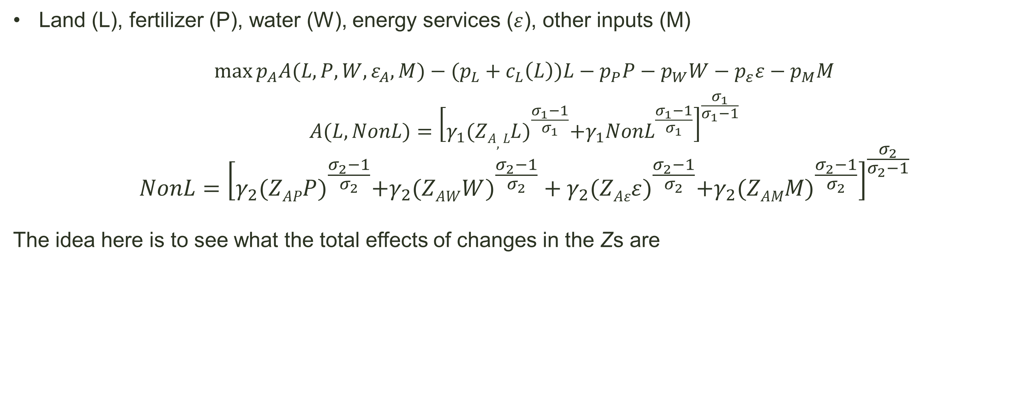
Example of production sector: agriculture
Land (L), fertilizer (P), water (W), energy services ($ε$), other inputs (M)
$$\max_{}{p_{A}A(L,P,W,ε_{A},M)}−(p_{L}+c_{L}\left(L\right))L−p_{P}P−p_{W}W−p_{ε}ε−p_{M}M$$
$$A(L,NonL)={\left[γ_{1}{(ZA,LL)}^{\frac{σ_{1}−1}{σ_{1}}}+γ_{1}{NonL}^{\frac{σ_{1}−1}{σ_{1}}}\right]}^{\frac{σ_{1}}{σ_{1}−1}}$$
$$NonL={\left[γ_{2}{(ZAPP)}^{\frac{σ_{2}−1}{σ_{2}}}+γ_{2}(ZAW{W)}^{\frac{σ_{2}−1}{σ_{2}}}+γ_{2}{(ZAεε)}^{\frac{σ_{2}−1}{σ_{2}}}+γ_{2}({ZAMM)}^{\frac{σ_{2}−1}{σ_{2}}}\right]}^{\frac{σ_{2}}{σ_{2}−1}}$$
The idea here is to see what the total effects of changes in the Zs are

Slide 9
Tasks
Update model
parameter values
Mappings from activities to planetary pressures
Determine what experiments to run and how to present them

