Slide 1

BiGR Formation:
Introduction to
R and RStudio
Bioinformatics Core Facility
bigr@gustaveroussy.fr
B2M+1, Gustave-Roussy

Slide 2
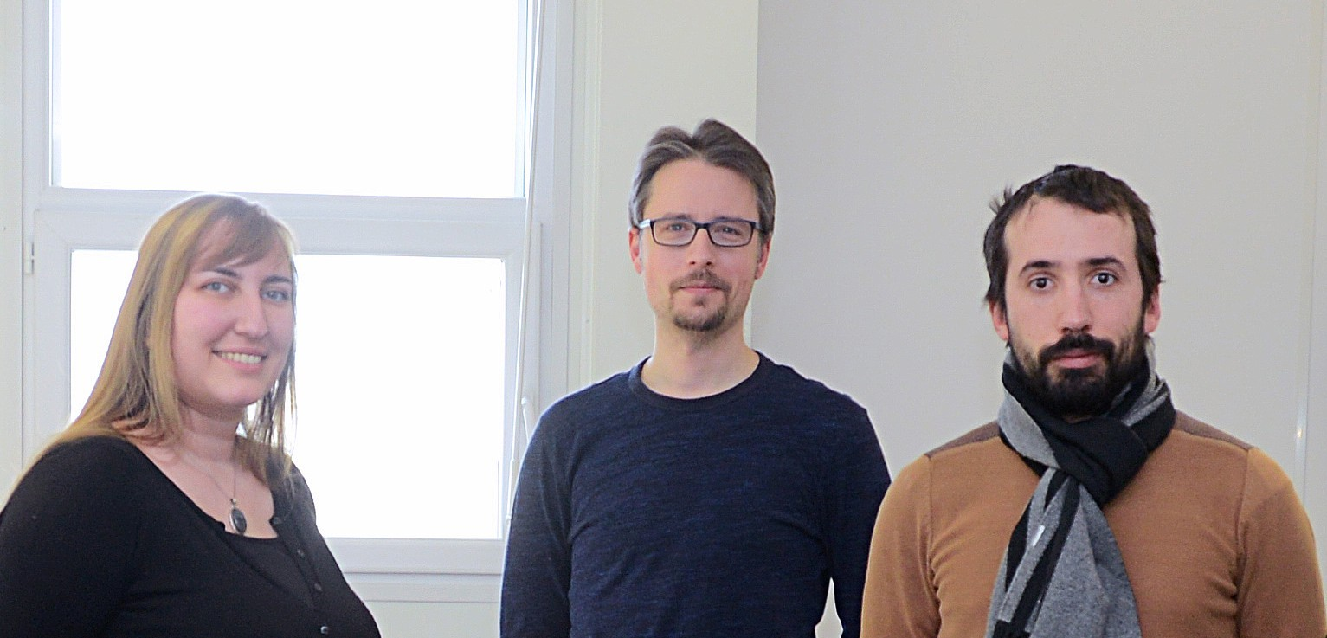
Main teachers
Marine
Bastien
Thibault

Slide 3
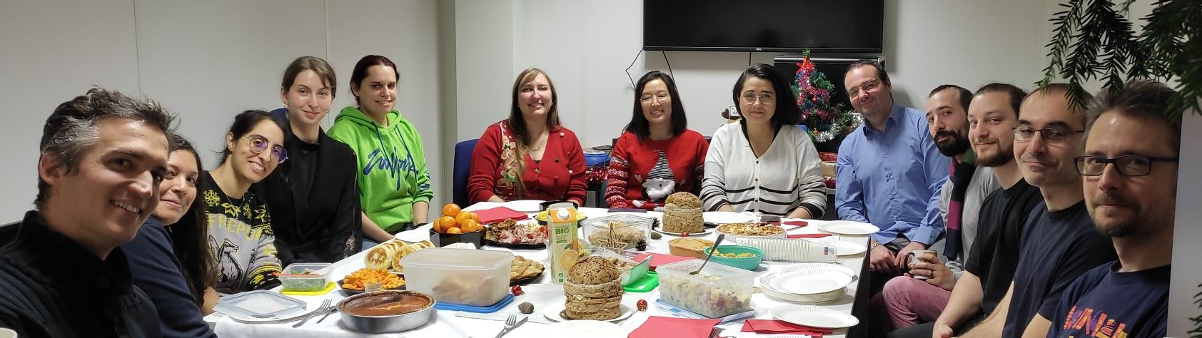
BiGR Teams

Slide 4
Plan of sessions
Step 1 (optional): Pre-sessions:
Help to install R and RStudio on your computer
Step 2 : Session:
Introduction to R and RStudio
Step 3 : Post-session:
Continue to learn by yourself with Swirl
Step 4 : Session:
In-Depth Course in R
Step 5 : Session:
Other Courses
Today

Slide 5
Plan of this course
Introduction
1) RStudio
2) R - Basics
3) R - Packages
4) Tips for your project
5) The Swirl package
Conclusion

Slide 6
Download this course
Go here :
https://github.com/gustaveroussy/training_bigr

