Slide 1
Comic Universe Connections
Sentiment Connectivity of Marvel and DC Characters

Slide 2
01
Introduction to the problem (2 min)
02
The raw data – What? (2 min)
Agenda
03
The modelling – Why? (2 min)
04
The infrastructure – How? (6 min)
~15 minutes presentation then Q&A
05
Data Visualization (3 min)

Slide 3
Introduction
Idea for the project
01
02
03
Disney acquisition of entertainment studios under Robert Iger
The avengers has been hugely profitable
What about DC comics?
Endgame is one of highest grossing film of all time. Connectivity across universes is key
Are the characters and stories also highly intertwined? And could they be incorporated into the marvel universe?
Marvel - US $4 billion
Lucasfilms – US $4 billion

Slide 4
The Raw Data
What data sources does the analysis build upon
Character Lists
Wikipedia pages
Azure Cognitive Services
List of names and Wikipedia links
Example:
27|Al Pratt|Atom (Al Pratt)
Wikipedia API
Example:
https://en.wikipedia.org/w/api.php?
AI/ML API for Text analysis
Example:
“We went to Contoso Steakhouse located at midtown NYC last week for a dinner party, and we adore the spot!”
{ "sentiment": "positive", "confidenceScores": { "positive": 0.99, "neutral": 0.01, "negative": 0.0 }, "offset": 0, "length": 105 },

Slide 5
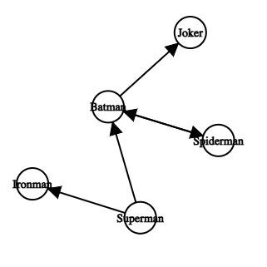
Model as a Graph
All characters are represented as nodes and the hyperlinks to other Wikipedia pages represent edges.
How is it modeled? And the relation to our question?
Highly connected components
Parts of this graph that are strongly connected could be candidates for the next “Avengers”
What does a link mean?
A link means that two characters stories in the universes have some connection to each other, most likely through the comic books. The raw outline for a story is already there.
Links between Marvel and DC and their Characteristics

Slide 6
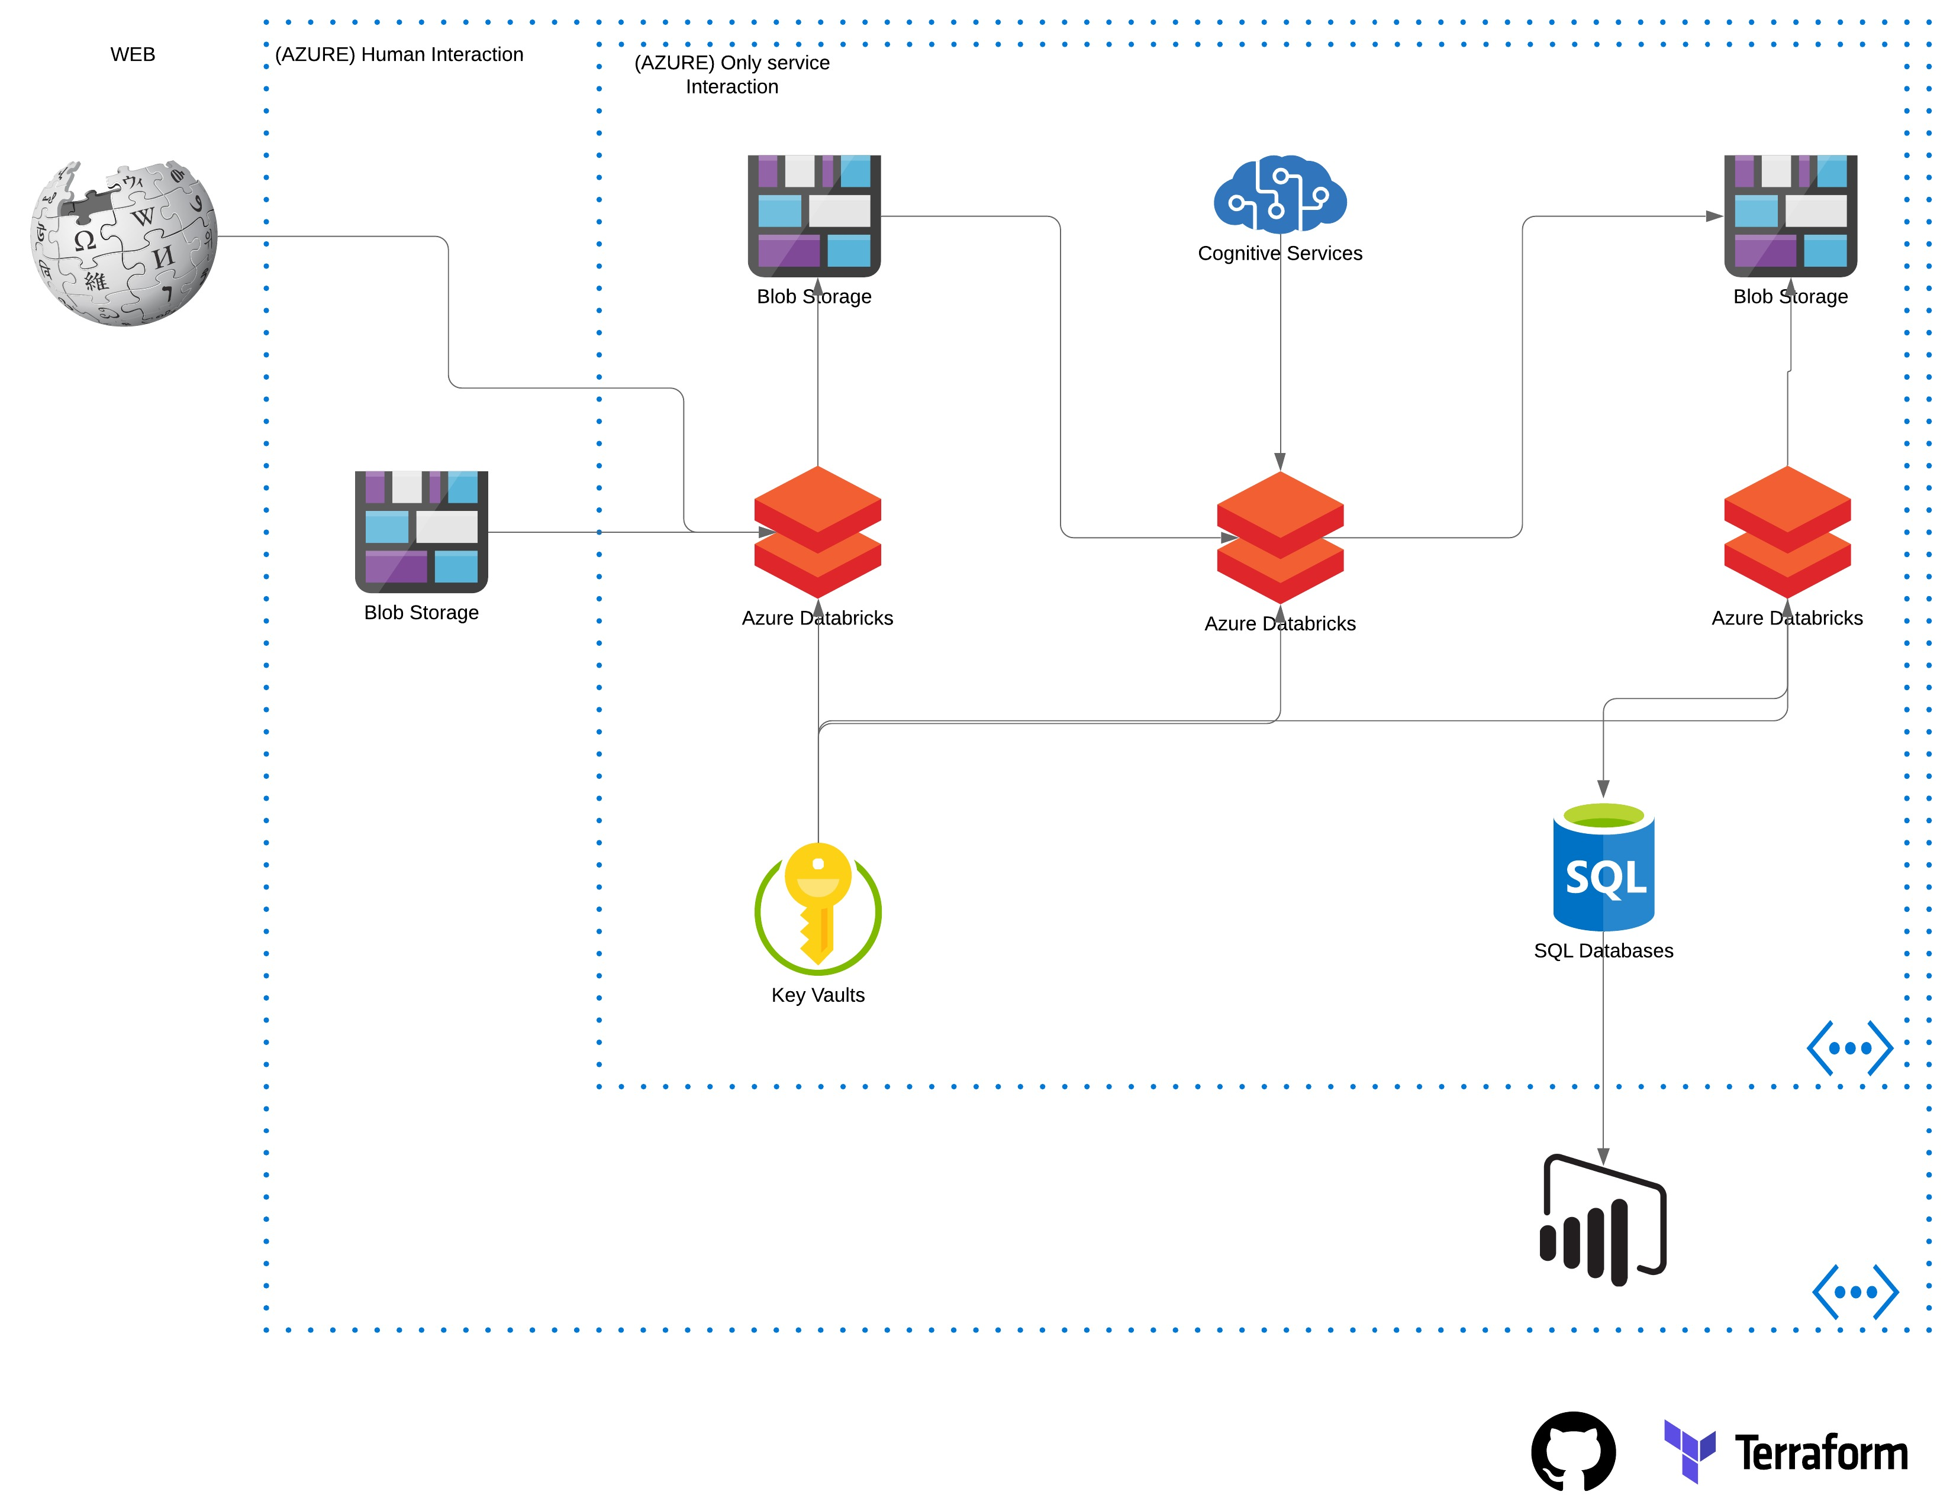
How?
Azure Databricks
Python code for all data processing
Spark for Database interaction
SQL Database
Data store in a small T-SQL instance for easy interaction and storage”
Power BI
PowerBi is used for the visualization of the data. Limitations in the modelling due to size of dataset

Slide 7

Data Visualization

Slide 8





















Questions
&
Answers

