Slide 1

Northwestern IT - Research Computing and Data Services (RCDS)
Emilio Lehoucq
Data Scientist

Slide 2



Slide 3
Support Provided by RCDS
Data science, statistics, and visualization.
Data management and sharing.
Research computing and software.
https://www.it.northwestern.edu/departments/it-services-support/research/

Slide 4
Data Science, Statistics, and Visualization
Free consultations on statistics, data, machine learning/AI, programming, or visualization: https://bit.ly/rcdsconsult
Workshops on R and Python, machine learning/AI, visualization, Git and GitHub, command line, and more: https://www.it.northwestern.edu/departments/it-services-support/research/research-events.html
Working groups that meet 1 hour weekly during the quarter to provide stress-free accountability and support in your data projects (including with a social sciences focus!): https://bit.ly/byod_groups
Much more: https://www.it.northwestern.edu/departments/it-services-support/research/data-science-statistics-visualization/

Slide 5
Data Management and Sharing
Support across every stage of the process:
Writing a data management plan (e.g., for grants).
Protecting sensitive information.
Choosing appropriate storage.
Documenting your research.
Making your data reusable and sharing it.
Free consultations: researchdata@northwestern.edu
Much more (including workshops): https://www.it.northwestern.edu/departments/it-services-support/research/data-storage/

Slide 6
Research Computing and Software
Remote desktop environments (NUWorkspace – e.g., to access Stata, Atlas.ti, Nvivo, ArcGISPro).
High-performance computing (Quest – e.g., if you have big data or computationally intensive analyses).
Free consultations: https://services.northwestern.edu/TDClient/30/Portal/Requests/ServiceDet?ID=83
Much more (including workshops): https://www.it.northwestern.edu/departments/it-services-support/research/computing/

Slide 7

We have a LISTSERV if you want to stay updated on workshops and other resources:
https://bit.ly/rcds_listserv

Slide 8
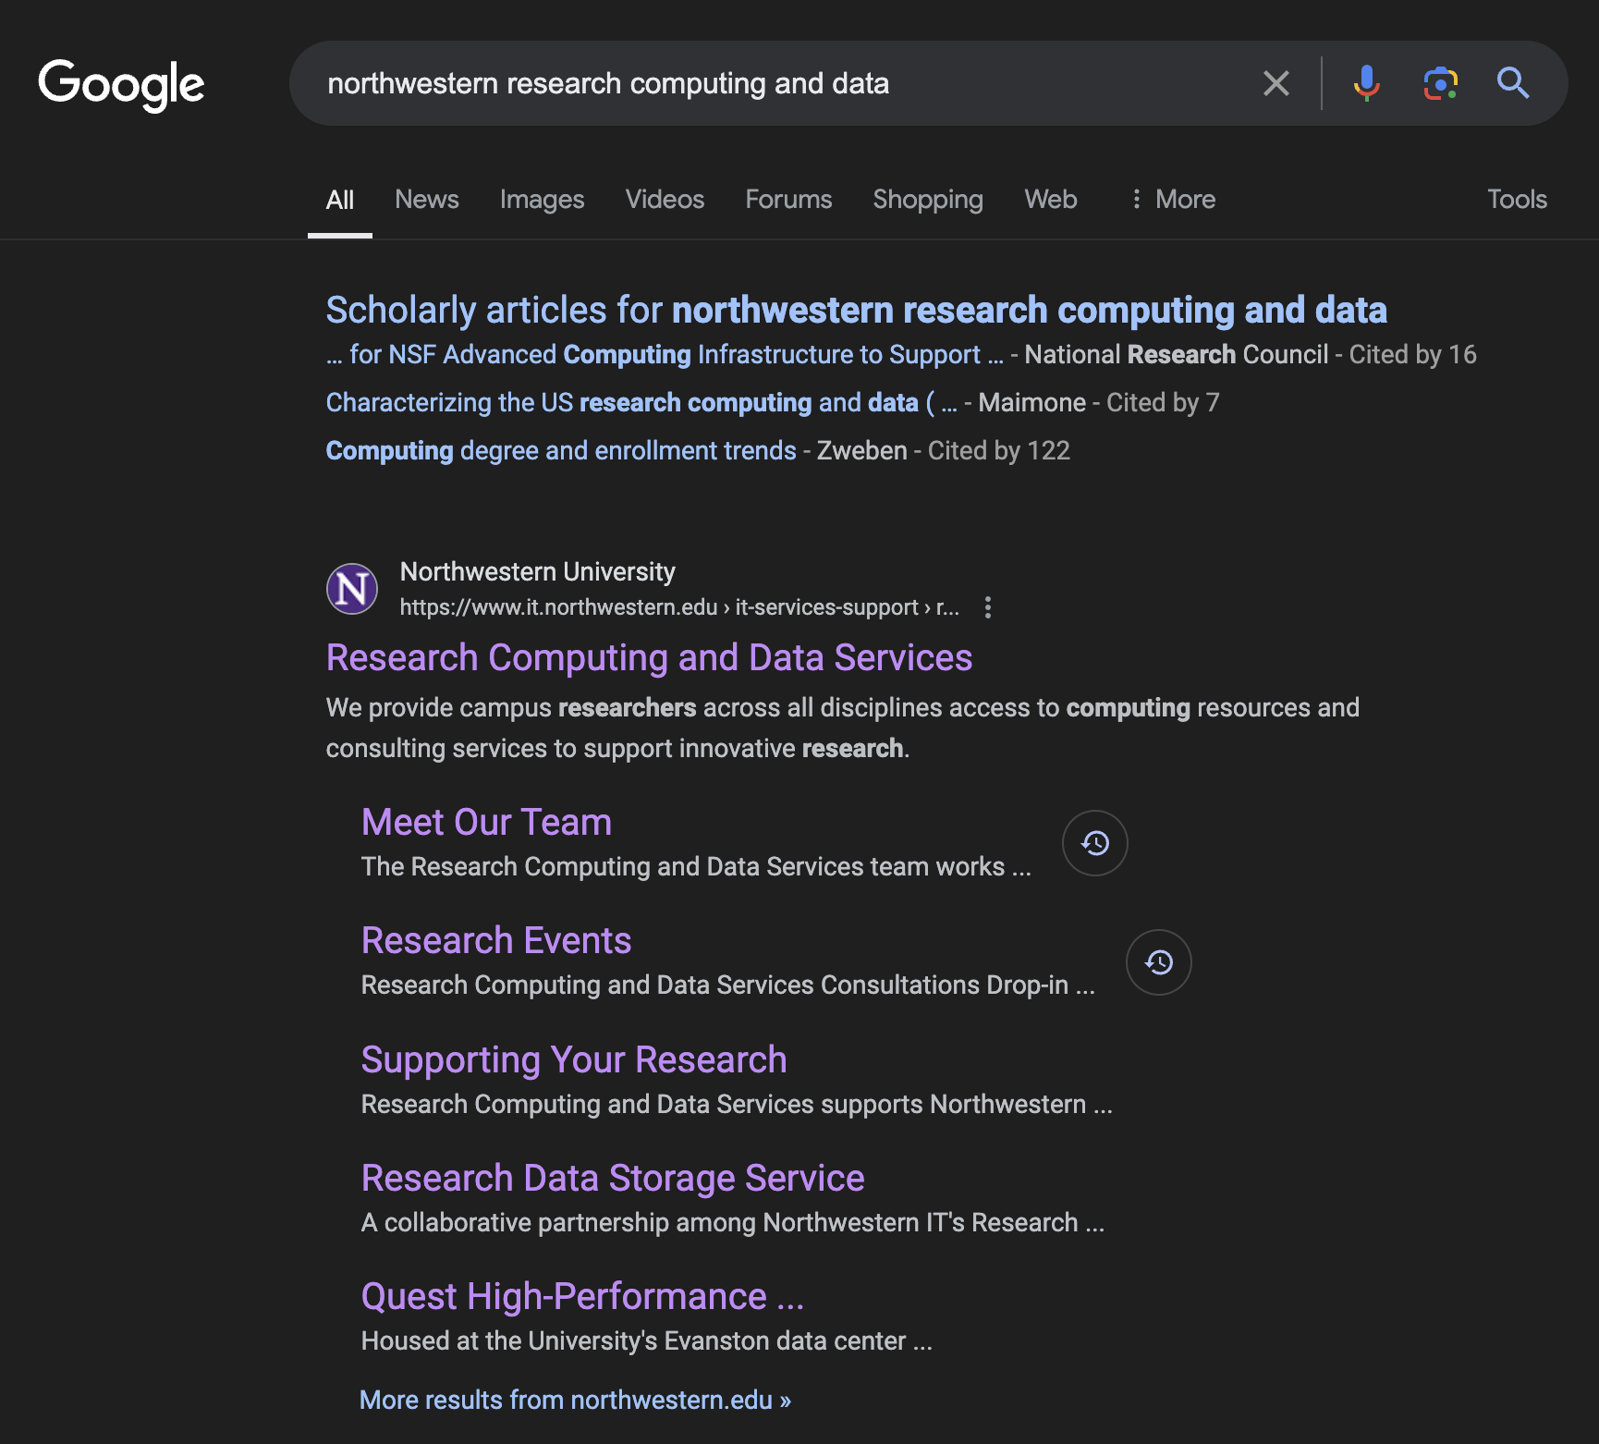
Already forgot everything?

Slide 9
Thank you! emilio@northwestern.edu

