Slide 1
WhatTo.eat
Making dealing with food better for everyone!

Slide 2
What is WhatTo.eat?
An app to help people make shopping lists, and find recipes based on what they have in their kitchen.
The user can search for recipes, add their ingredients to their shopping list, and then it will automatically update your “inventory” once you’ve done your shopping.
Helps you find new recipes and expand on what you might make with your usual ingredients.

Slide 3
What WhatTo.eat needs to do
Allow users to add new recipes to its database.
Rate/review recipes.
Let users search through recipes.
Be able to query recipes based on their ingredients, ratings, and categories.
Create shopping lists, or add ingredients to a shopping list from a recipe you’ve looked up.

Slide 4
So WhatTo.eat needs:
A database of recipes, each of which has:
Ingredients
Ratings
Instructions
Authors
Descriptions

Slide 5
So WhatTo.eat needs:
A database of users which has:
Their username
Passwords
Favourite recipes
Recipes they’ve added
Their inventory
Shopping list

Slide 6
So WhatTo.eat needs:
A search algorithm which returns recipes based on their:
Ingredients when compared with the user’s inventory
Ratings
Difficulty and time, if needed.

Slide 7
So WhatTo.eat needs:
Functionality to add to and take away from the user’s inventory.
Create shopping lists based on recipes’ ingredients
Make searches based on different criteria.

Slide 8
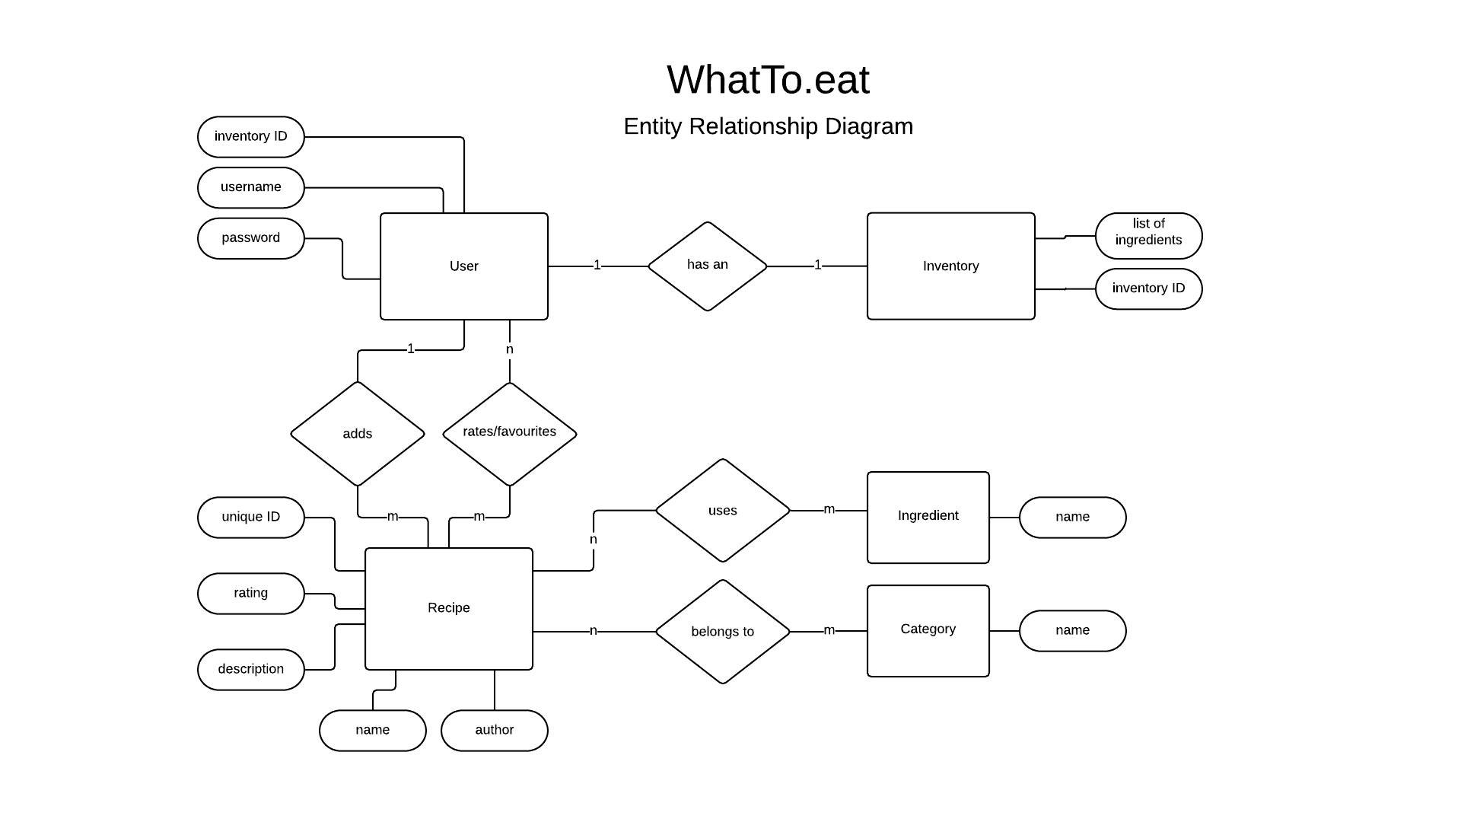

Slide 9
WhatTo.eat’s architecture
Django-based middleware for:
User profiles and adding/rating functionality as we did in creating “Rango.”
SQLite3 Database:
To hold all of our users, their inventories, and recipes.

Slide 10

Who‘s it for?
Username: skint_student_steve
Age: 20
Gender: Male
Occupation: Student
Background
Steve’s time is divided in going to to the university and watching netflix. He has recently moved from his parents house to a private accommodation. He’s not keen on cooking, therefore he usually cooks a simple recipe and he does not maintain a diversity of ingredients in his fridge. He is tired of eating mushroom omelettes and he spends a significant amount searching websites for easy recipes.
User goals
Search for easy recipes quickly
Set up an inventory with all the items in his fridge
Receive recipe suggestions that closely match to his inventory

Slide 11

Who’s it for?
Username: carry_rosemary
Age: 40
Gender: Female
Occupation: Financial manager
Background
She has a successful career in a big company. On weekends she wants to show another ability: cooking. She has a big book of recipes that she received from her mother and she would like to share those delicious recipes with as many people possible. Also, she is keen on trying new recipes, combining new ingredients and the complexity of a recipe is not a problem to her.
User goals
Share her recipes
Search for recipes that combine different types of ingredients
Sort the recipes by complexity

Slide 12
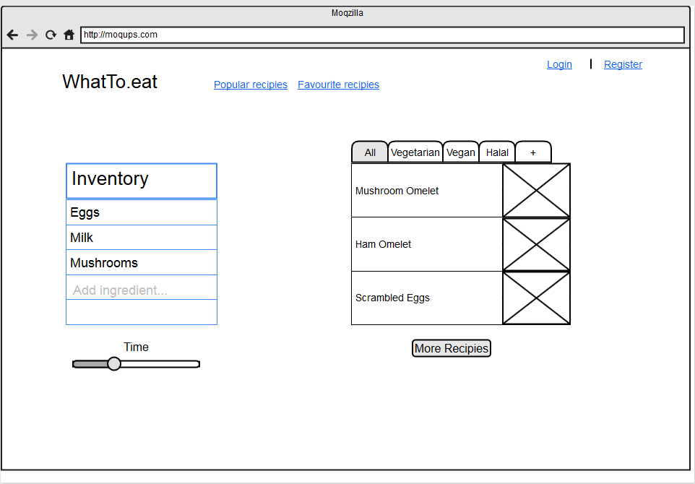
How’s it look?

Slide 13
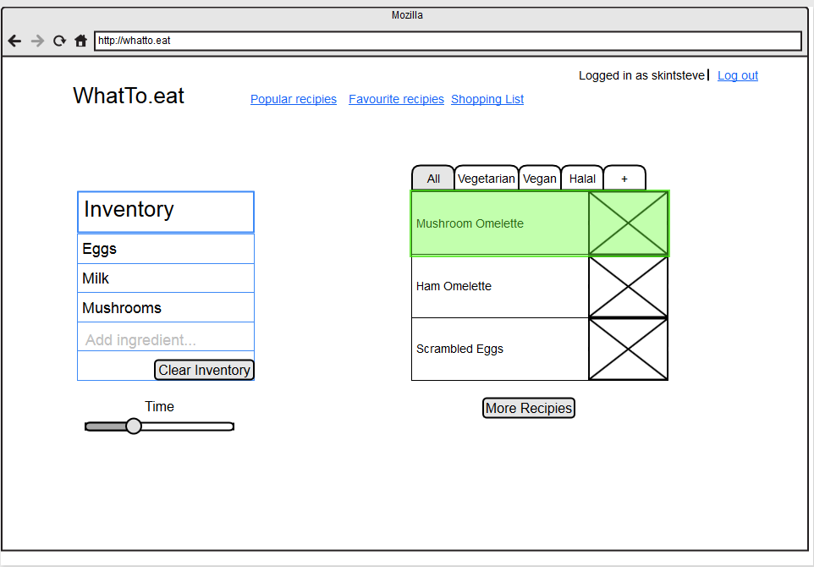
How’s it look?

Slide 14
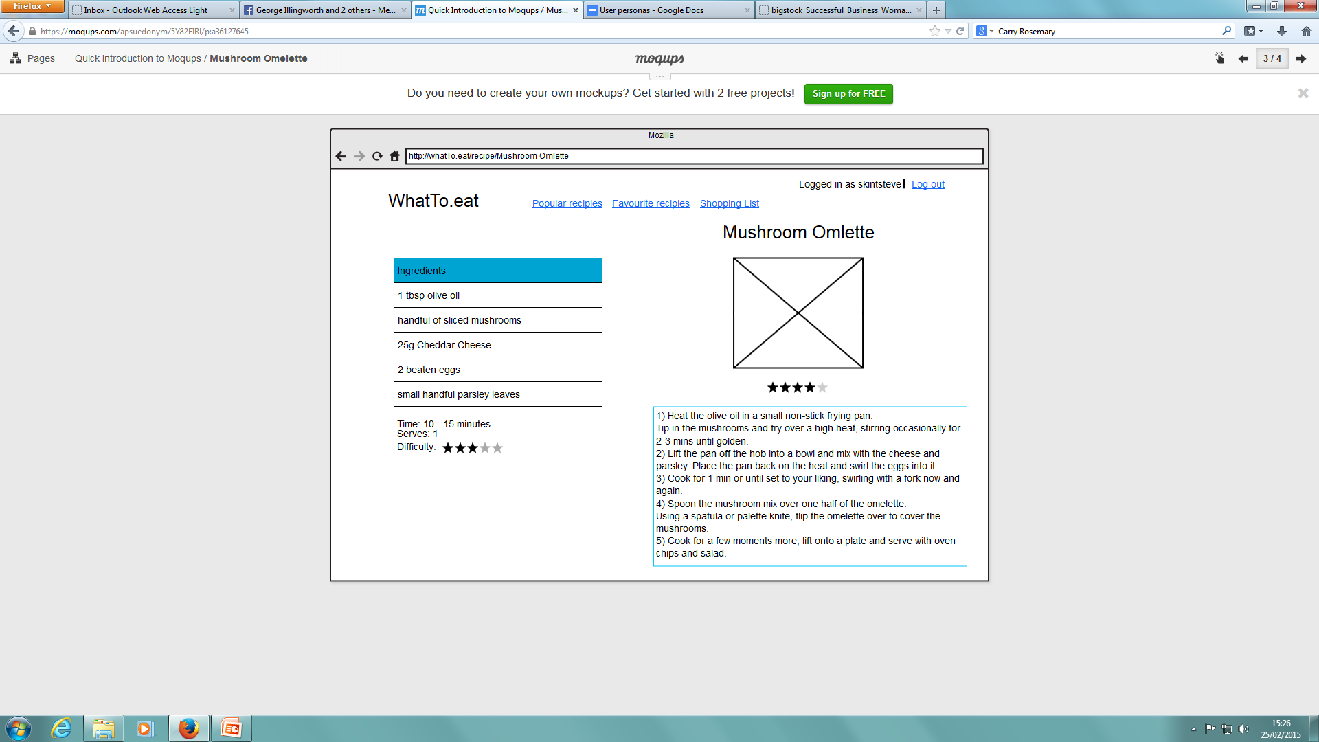
How’s it look?

Slide 15
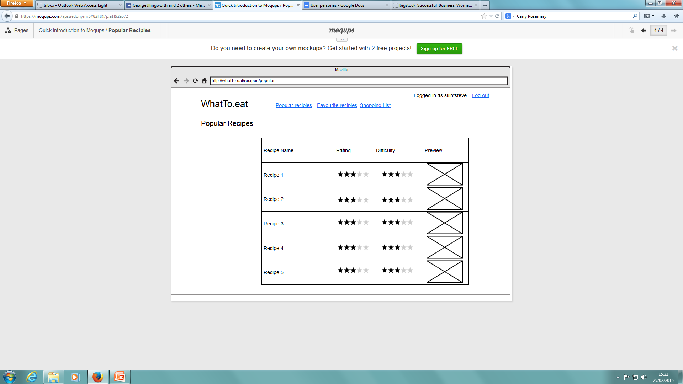
How’s it Look?

Slide 16



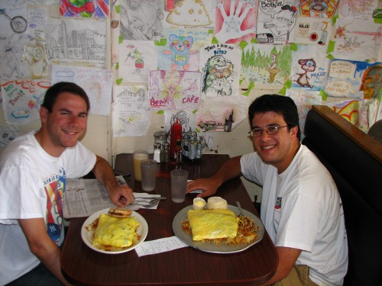
The End!

