Slide 1

UNICAMP Projeto INF574
Gustavo Celani

Slide 2
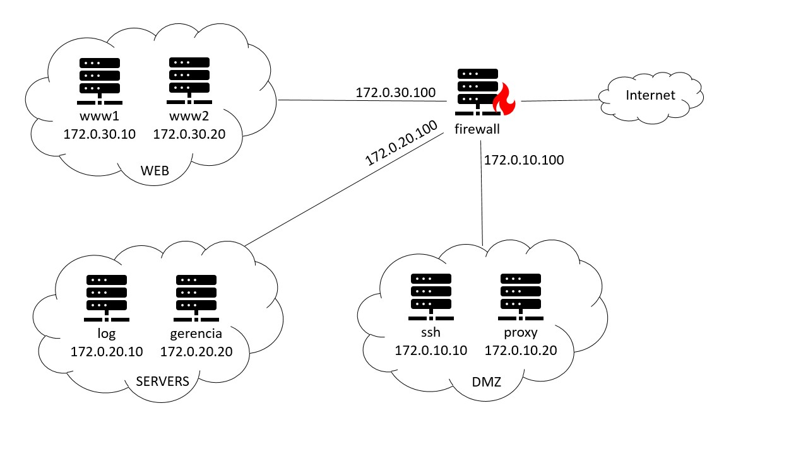
TOPOLOGIA

Slide 3
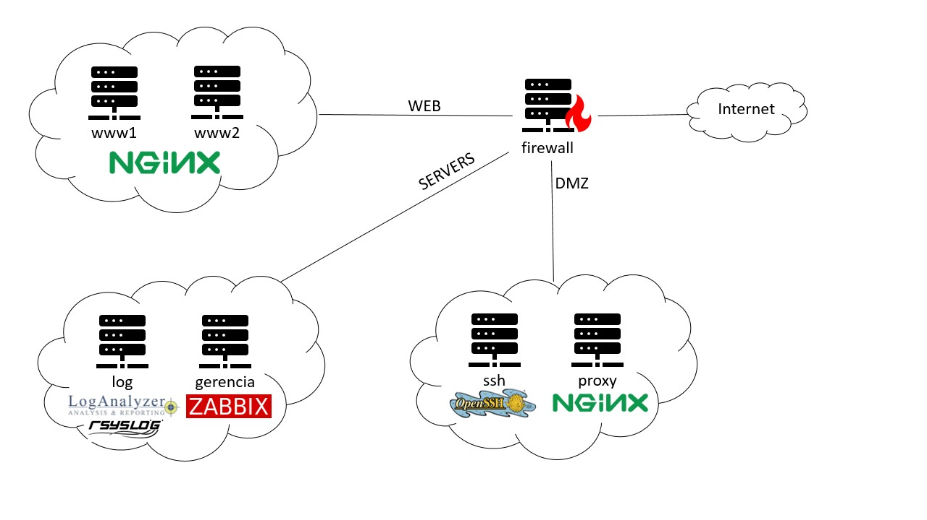

TOPOLOGIA

Slide 4
Ação | Container | IP | Porta
Permitir | SSH | 172.0.10.10 | 4578
Permitir | Proxy | 172.0.10.20 | 443
FIREWALL

Slide 5

SSH Protocol 2
Disabling root login
Client sessions
Client Alive Interval: 300
Client Alive Count Max: 3
Avoiding default port (22 -> 4578)
Disabling X11 forwarding
Only 'ssh_user' allowed
3-Factor Authentication
Password
RSA Key
Challenge PAM with Google-Authenticator
Fail2ban
Selected ban time: 10s (demonstration)
3 Max retries
Alias to watch logs: $ log-fail2ban
Firewall rules
SSH

Slide 6

TLS over HTTP (HTTPS)
Load Balancer for WWW1 and WWW2
Reverse Proxy
DDoS Prevention
Firewall rules
Load Balancer of web servers
https://172.0.10.20
https://172.0.10.20/www
WWW1 Web Server
https://172.0.10.20/www1
WWW2 Web Server
https://172.0.10.20/www2
LogAnalyzer
https://172.0.10.20/log
Zabbix
https://172.0.10.20/gerencia
PROXY

Slide 7


Avoiding Rsyslog default port (514 -> 5689)
Allowed networks whitelist
Log rotation weekly
Firewall rules
LOG

Slide 8

Avoiding default passwords (Admin/zabbix)
Removing guest users
Firewall rules
GERENCIA

Slide 9

Obrigado!
Projeto disponível em
https://github.com/gustavocelani

