Slide 1

UNICAMP Projeto INF574
Gustavo Celani
Sandra Carrillo

Slide 2
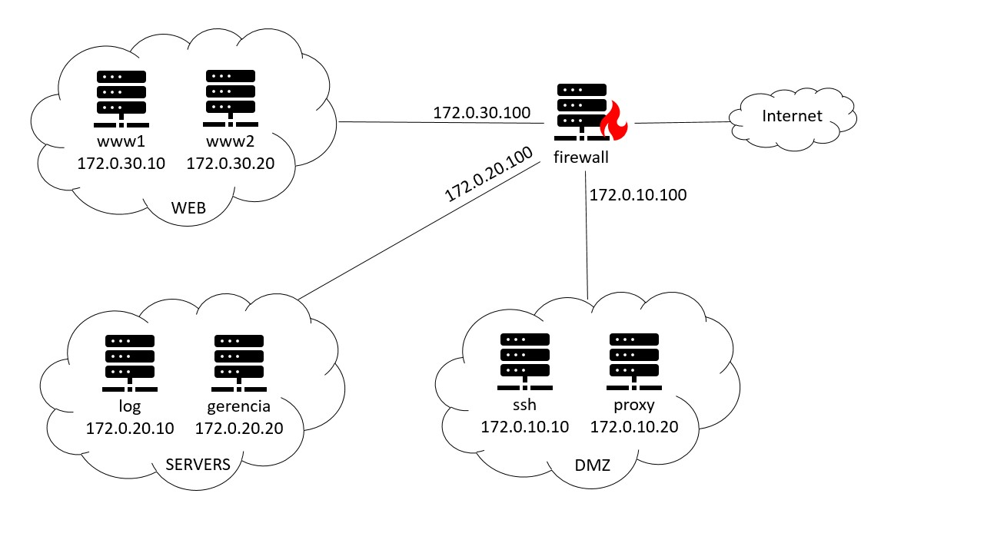
TOPOLOGIA

Slide 3
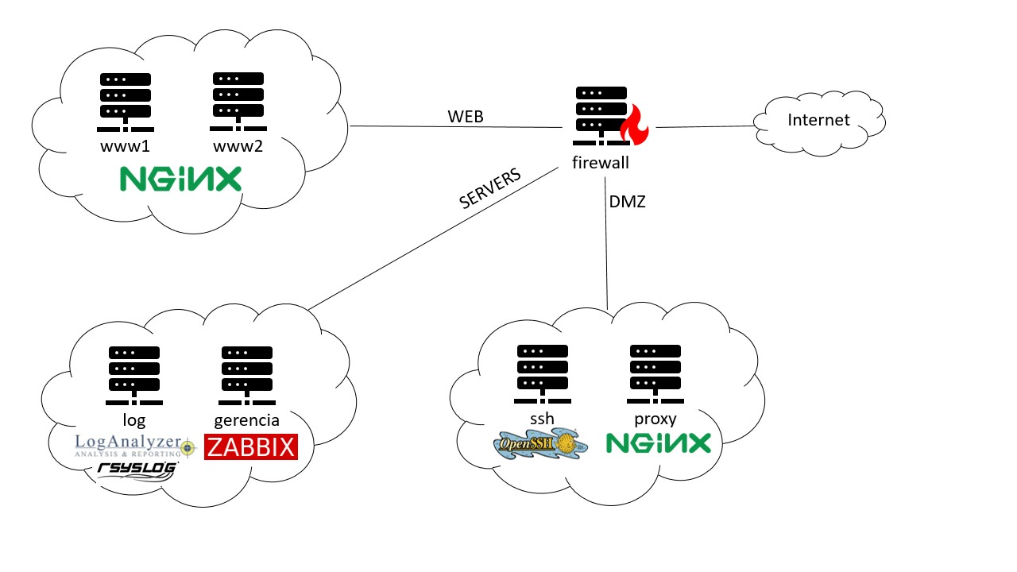

TOPOLOGIA

Slide 4
Ação | Container | IP | Porta
Permitir | SSH | 172.0.10.10 | 4578
Permitir | Proxy | 172.0.10.20 | 443
FIREWALL

Slide 5

SSH Protocol 2
Disabling root login
Client sessions
Client Alive Interval: 300
Client Alive Count Max: 3
Avoiding default port (22 -> 4578)
Disabling X11 forwarding
Only 'ssh_user' allowed
3-Factor Authentication
Password
RSA Key
Challenge PAM with Google-Authenticator
Fail2ban
Selected ban time: 10s (demonstration)
3 Max retries
Alias to watch logs: $ log-fail2ban
Firewall rules
SSH

Slide 6

TLS over HTTP (HTTPS)
Load Balancer for WWW1 and WWW2
Reverse Proxy
DDoS Prevention
Firewall rules
Load Balancer of web servers
https://172.0.10.20
https://172.0.10.20/www
WWW1 Web Server
https://172.0.10.20/www1
WWW2 Web Server
https://172.0.10.20/www2
LogAnalyzer
https://172.0.10.20/log
Zabbix
https://172.0.10.20/gerencia
PROXY

Slide 7


Avoiding Rsyslog default port (514 -> 5689)
Allowed networks whitelist
Log rotation weekly
Firewall rules
LOG

Slide 8

Avoiding default passwords (Admin/zabbix)
Removing guest users
Firewall rules
GERENCIA

Slide 9

Obrigado!
Projeto disponível em
https://github.com/gustavocelani

Slide 10


172.0.30.100
Internet
www1
172.0.30.10
www2
172.0.30.20
firewall
172.0.20.100
172.0.10.100
WEB
log
172.0.20.10
gerencia
172.0.20.20
ssh
172.0.10.10
proxy
172.0.10.20
SERVERS
DMZ

Slide 11
WEB
Internet
www1
www2
firewall
SERVERS
DMZ
log
gerencia
ssh
proxy

