Slide 1

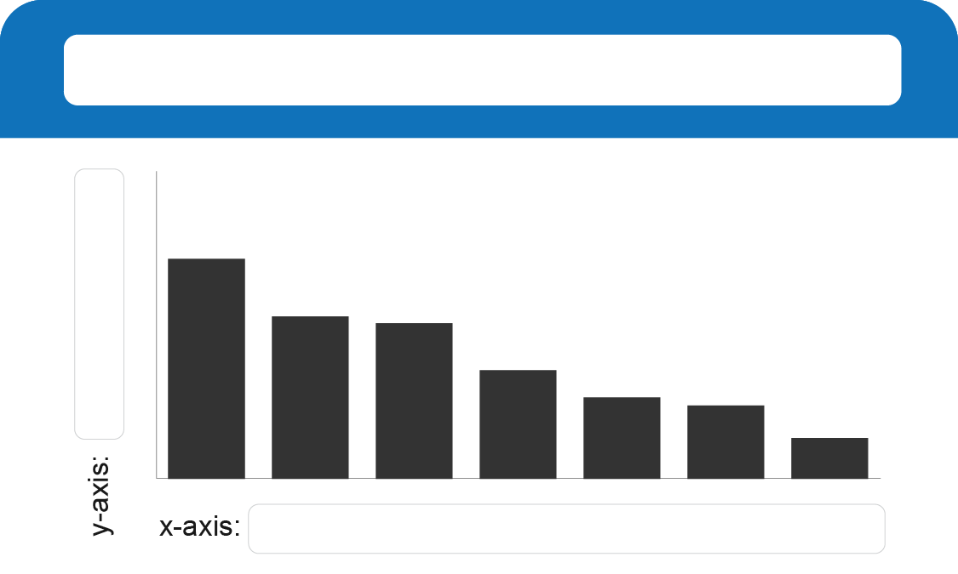

Enter the title of the tab here
E.g. Weekly
Enter KPI title here
Enter the target persona here and document their goals and outcomes.
$XX
Enter KPI title here
List the questions that this tabs is answering:
First question
Second question
Third question
Etc.
List the actions that this tab is driving:
Action one
Action two
Action three
Etc.
Enter chart title here
Enter filter title here
Category A
Category B
Category C
Category D
Category E
Y-axis title
X-axis title

Slide 2
Enter the title of the tab here
E.g. Weekly
Enter the target persona here and document their goals and outcomes.
Enter KPI title here
$XX
List the questions that this tabs is answering:
First question
Second question
Third question
Etc.
Enter KPI title here
List the actions that this tab is driving:
Action one
Action two
Action three
Etc.
Enter filter title here
Category A
Category B
Category C
Category D
Category E

Slide 3
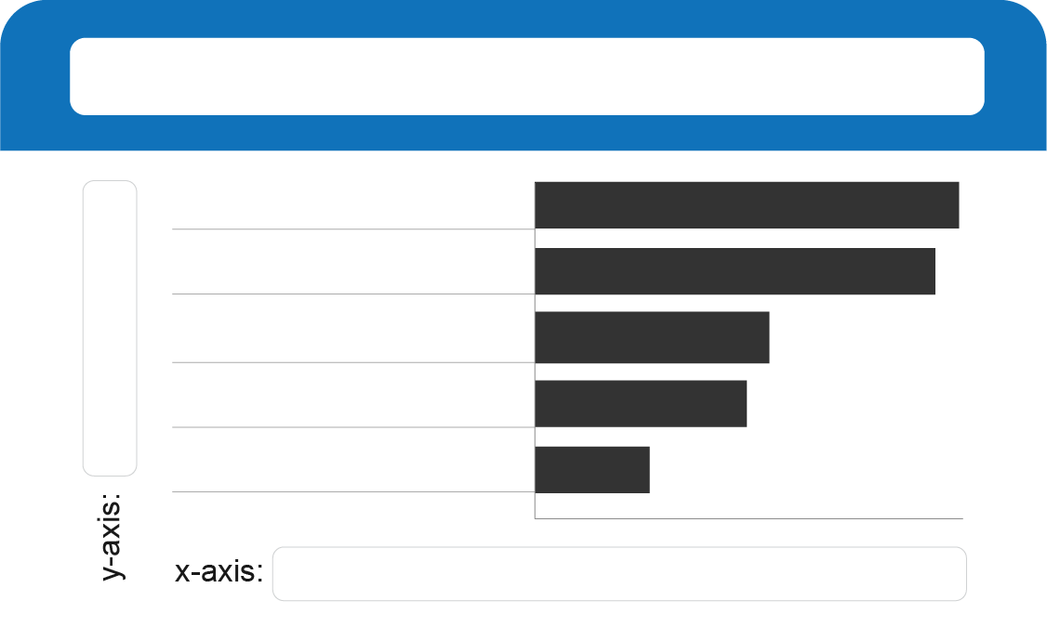
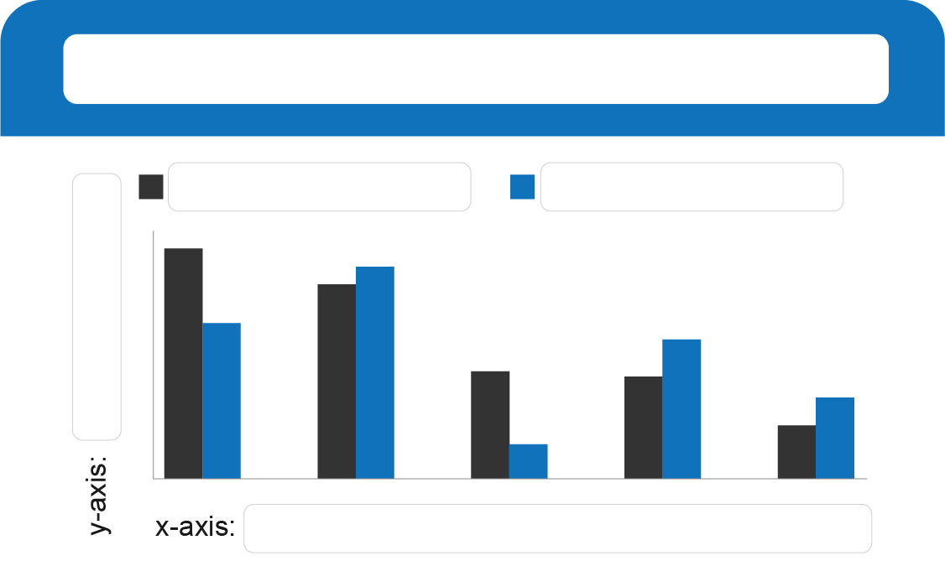
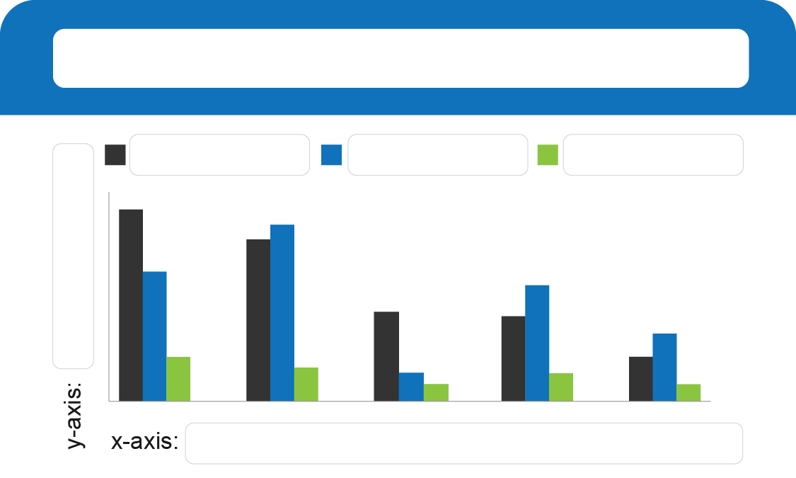
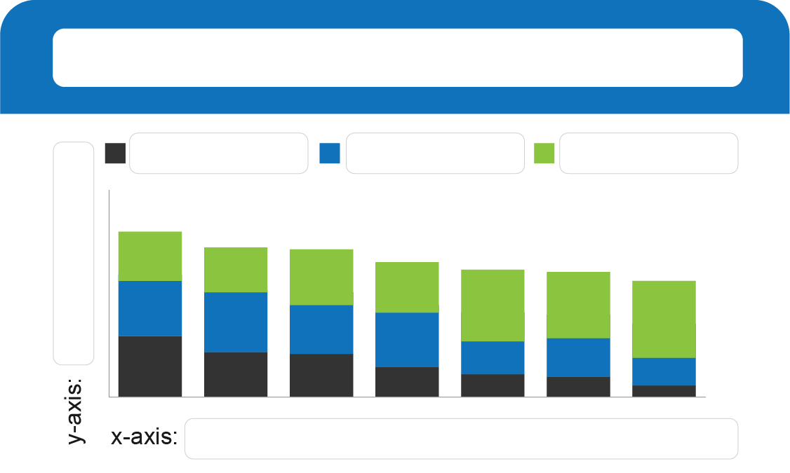
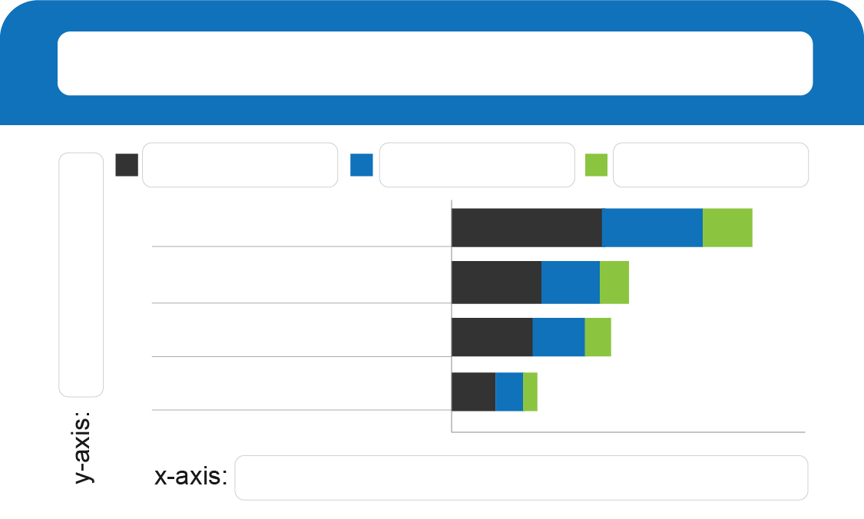
Enter chart title here
Enter chart title here
Enter chart title here
Category A
Category B
Y-axis title
Y-axis title
Y-axis title
X-axis title
X-axis title
X-axis title
Enter chart title here
Enter chart title here
Enter chart title here
Category A
Category B
Category C
Category A
Category B
Category C
Category A
Category B
Category C
Y-axis title
Y-axis title
Y-axis title
X-axis title
X-axis title
X-axis title

Slide 4
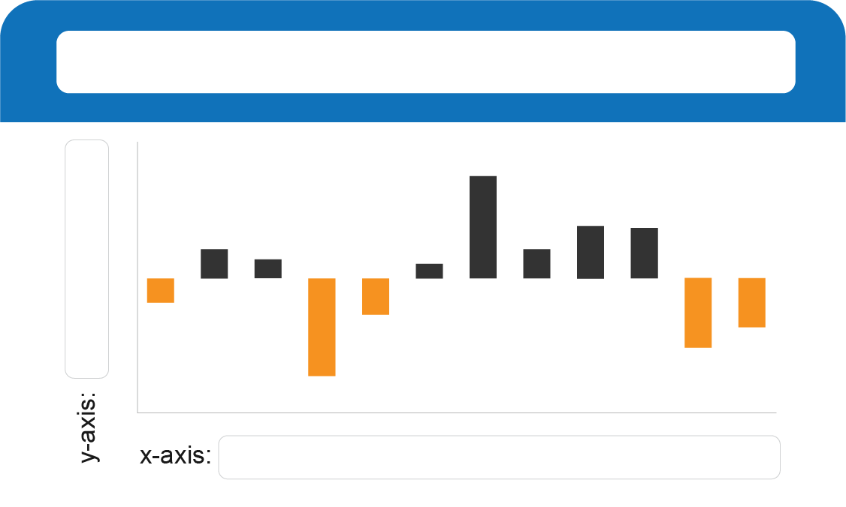
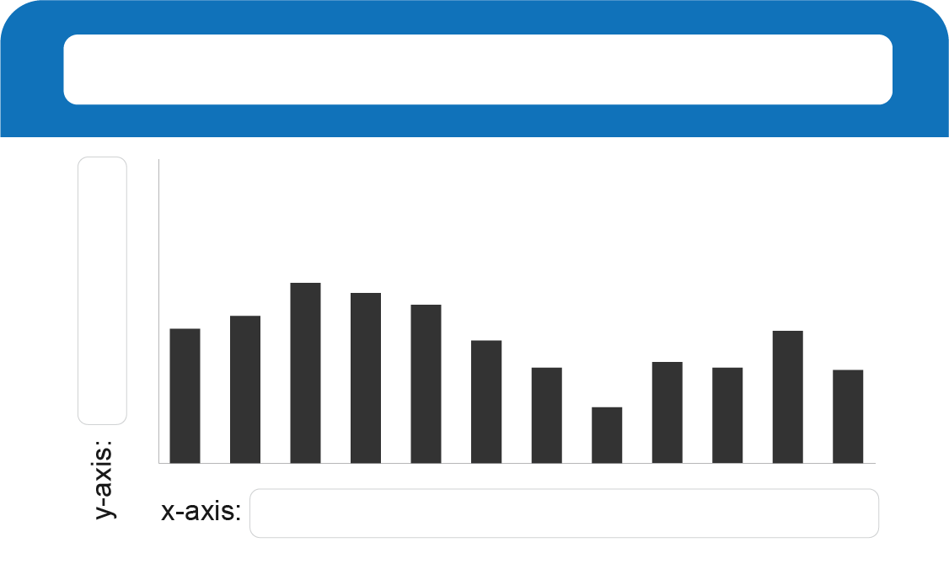
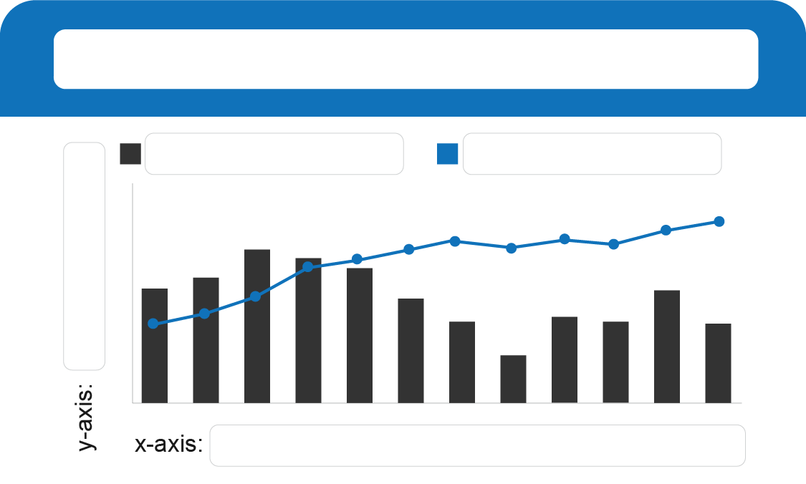
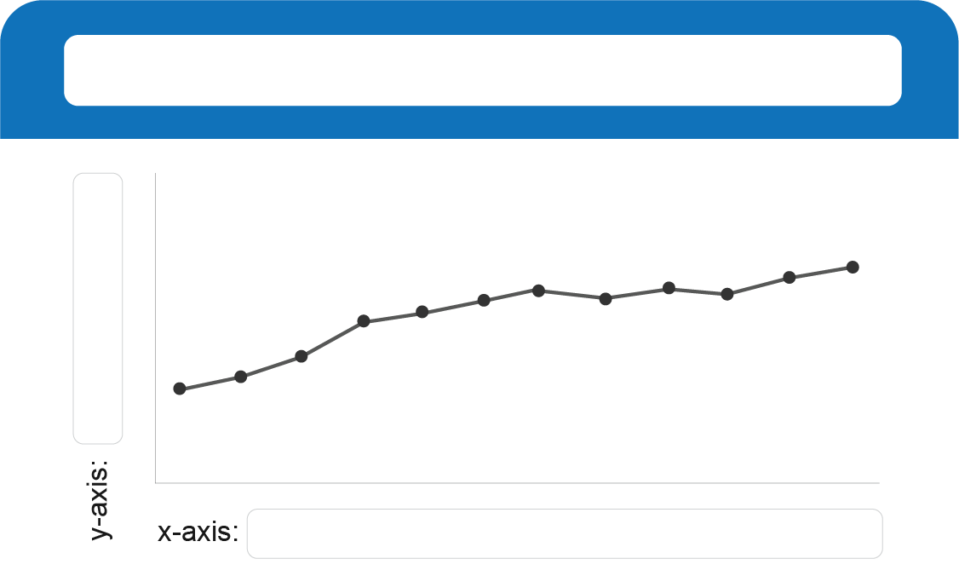
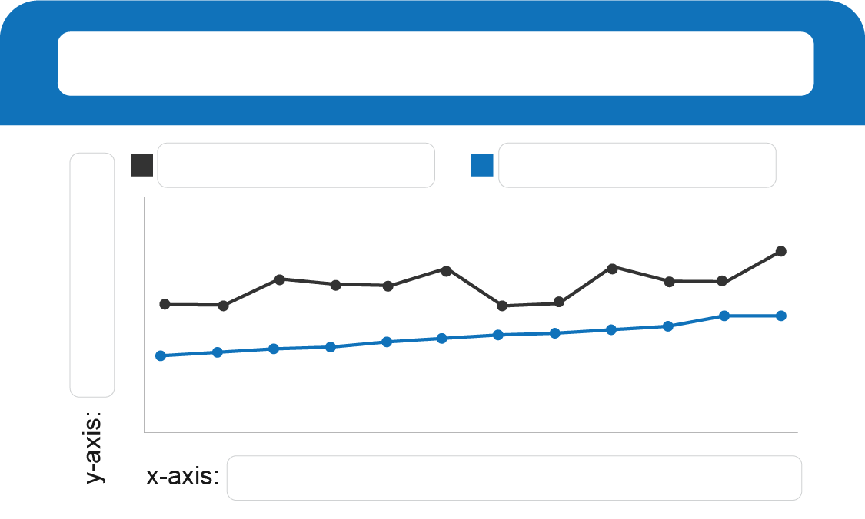
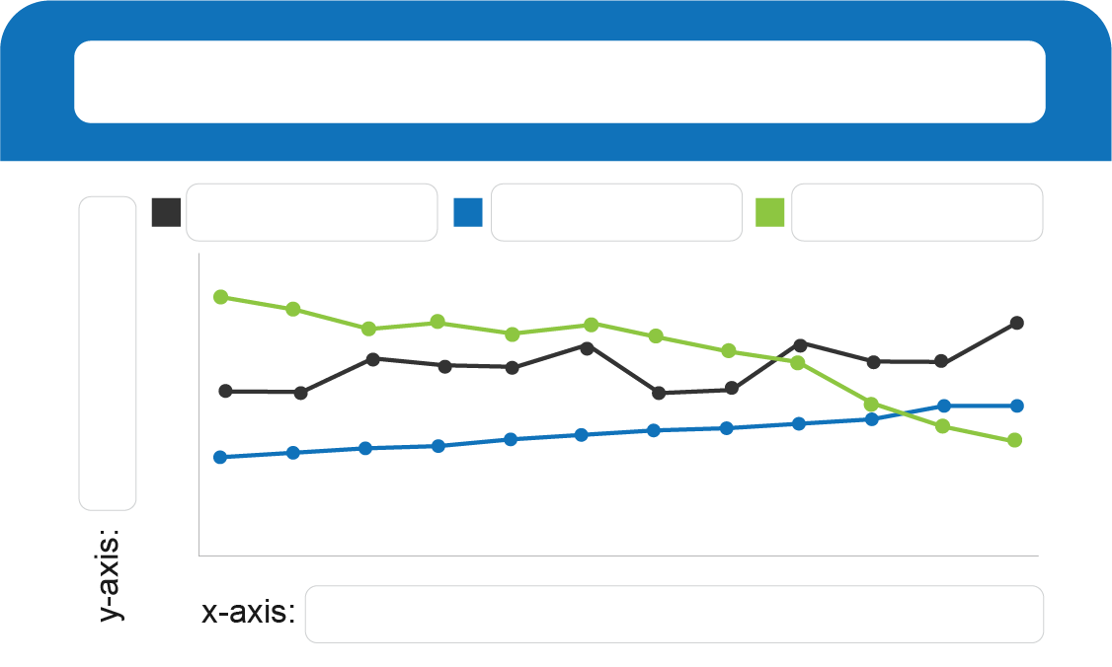
Enter chart title here
Enter chart title here
Enter chart title here
Category A
Category B
Y-axis title
Y-axis title
Y-axis title
X-axis title
X-axis title
X-axis title
Enter chart title here
Enter chart title here
Enter chart title here
Category A
Category B
Category A
Category B
Category C
Y-axis title
Y-axis title
Y-axis title
X-axis title
X-axis title
X-axis title

Slide 5
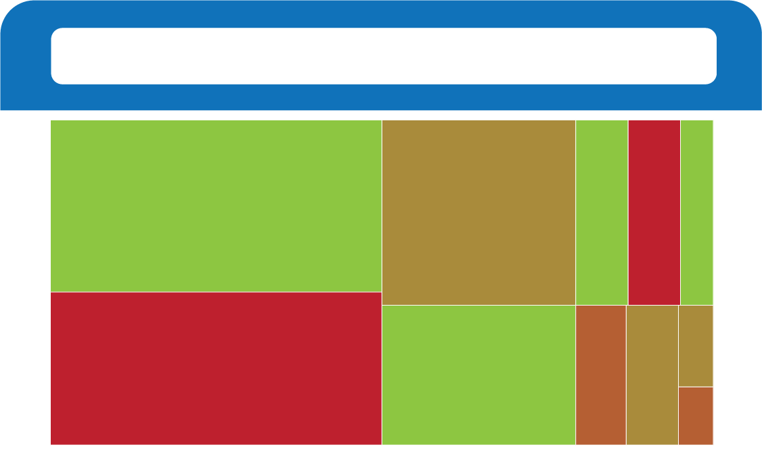
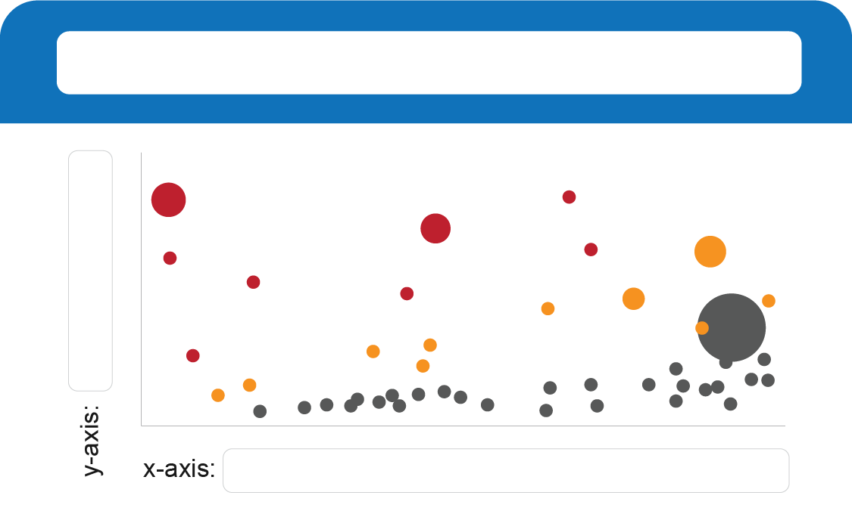
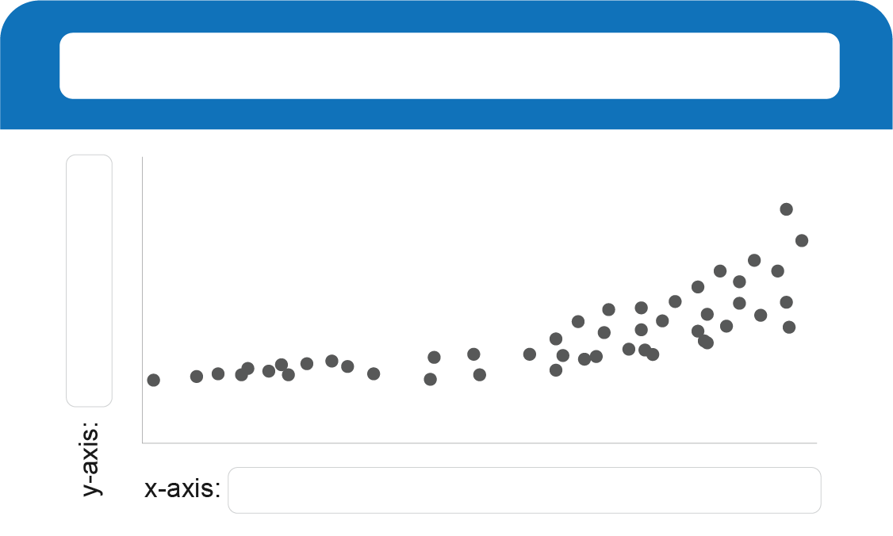
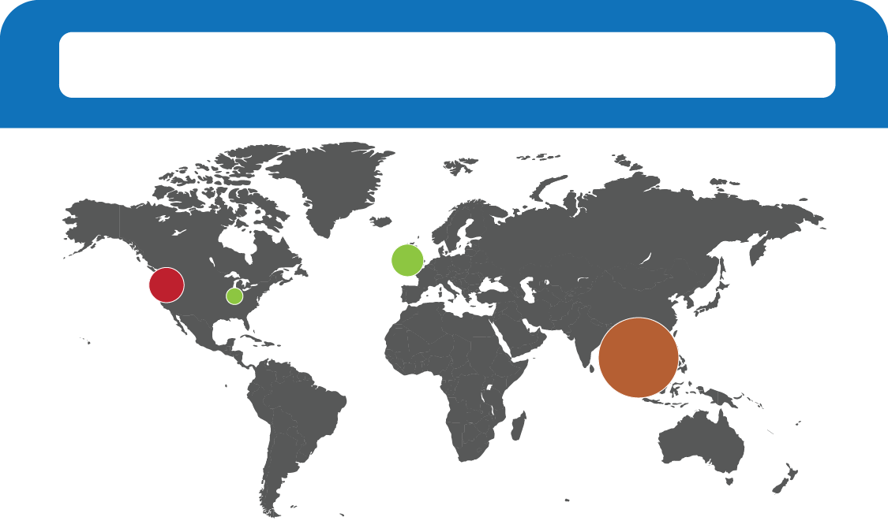
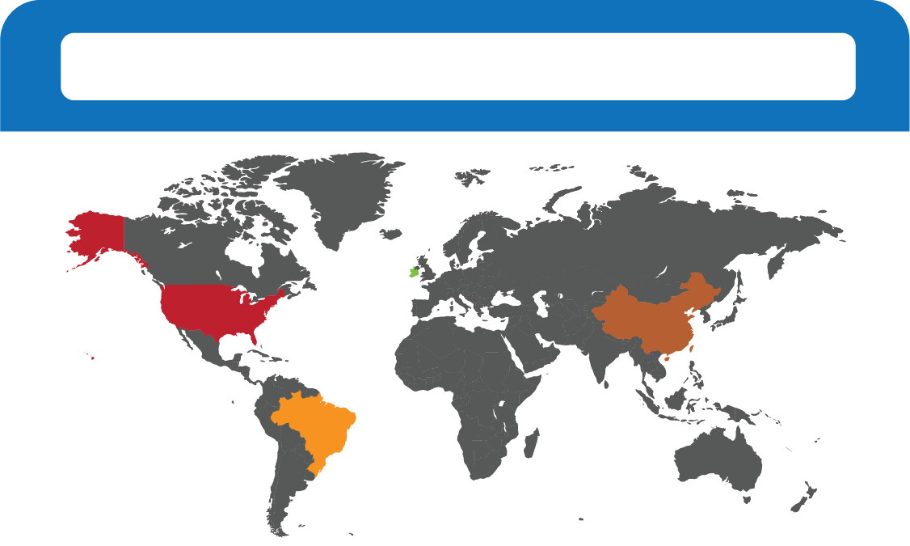
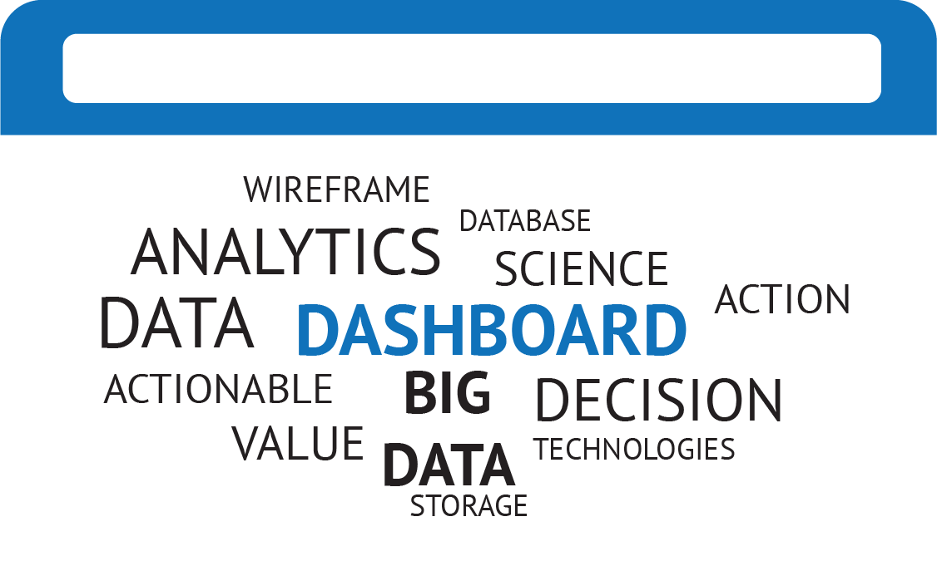
Enter chart title here
Enter chart title here
Enter chart title here
Y-axis title
Y-axis title
X-axis title
X-axis title
Enter chart title here
Enter chart title here
Enter chart title here

Slide 6
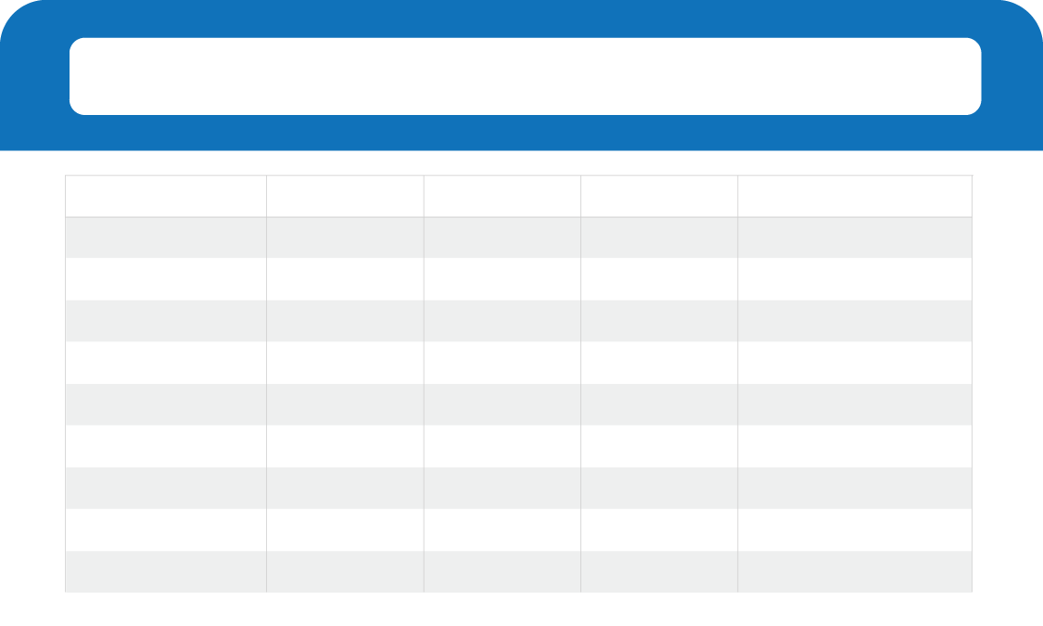
Enter chart title here
Enter KPI title here
Enter KPI title here
Enter KPI title here
Enter filter title here
$XX
$XX
$XX
Category A
Category B
Category C
Category D
Category E
+ Y% YTD
+ $ZZ YTD
Plan $XY
Enter chart title here

