Slide 1


Physiological response of marine organisms to environmental change from a genomic perspective
Gustavo Núñez-Acuña
http://www.incar.cl

Slide 2
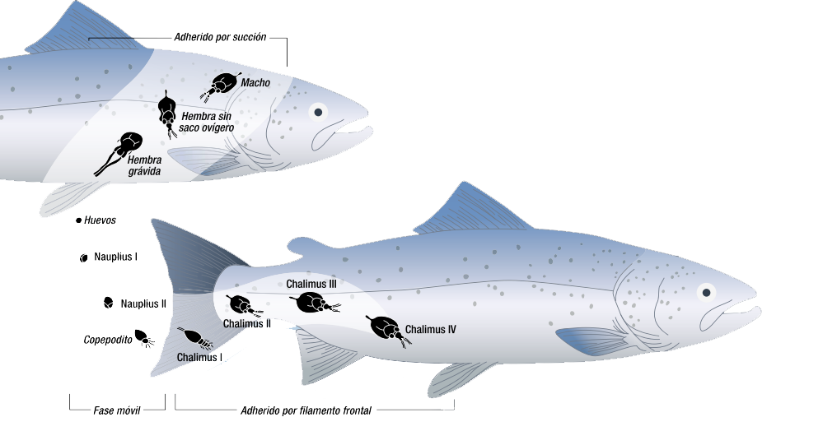
Overview from Caligus rogercresseyi lifecycle
Adhered by suction
Host recognition
mechanisms
Semiochemicals
Adhered by frontal filament
INVOLVEMENT OF HOST-PARASITE INTERACTIONS
http://www.incar.cl

Slide 3
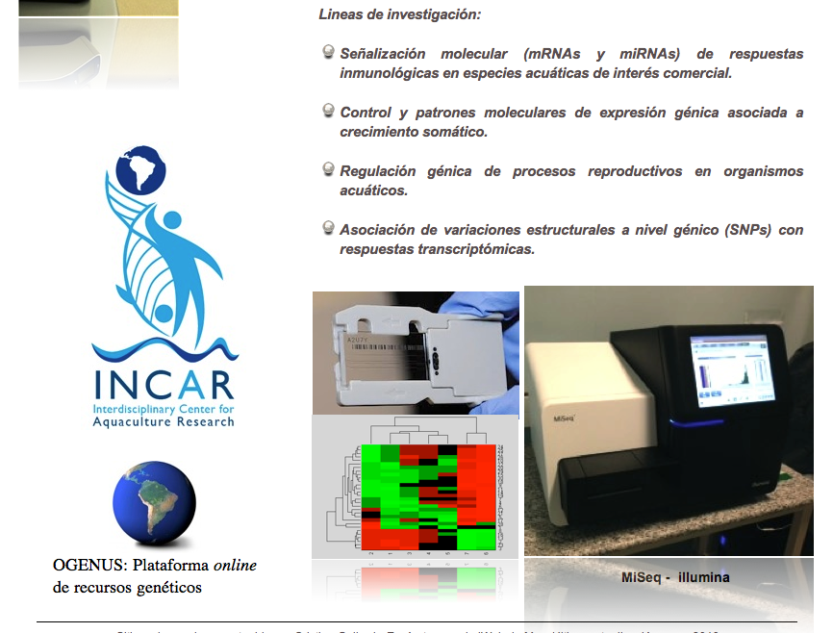
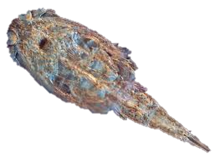
Transcriptome sequencing of C. rogercresseyi
How sea lice can identify host fishes?
http://www.incar.cl

Slide 4
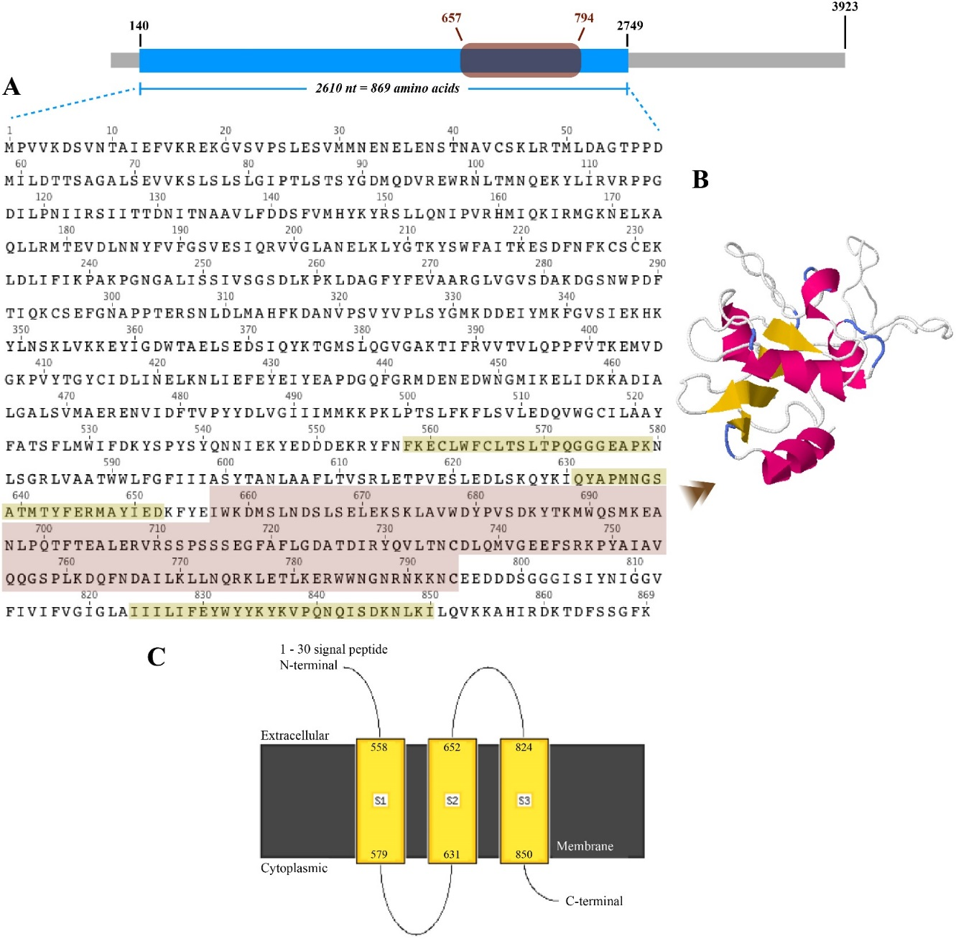
Ionotropic receptors mRNA characterization
Conserved domain and
transmembrane regions
http://www.incar.cl

Slide 5
Exposure of parasites to masking compounds
**
**
Control
LD
MD
HD
+ IS
Control
LD
MD
HD
+ IS
mRNA relative levels
**
**
*
*
Control
LD
MD
HD
+ IS
Control
LD
MD
HD
+ IS
In-feed additives
http://www.incar.cl

Slide 6

From the ASI course: Some results
The Oyster DESeq experiment
(https://github.com/gustavonunez/Project/blob/master/notes/Oyster%20DESeq.md)

